Slide 1

Research Infrastructure Policy and Priorities in Australia
David de Carvalho
Head of Higher Education Group
5 November 2013

Slide 2
Research funding snapshot
GERD = 2.2% of GDP in 2008
$9.1 b (€6.1 b) in 2011-12
R&D Tax concessions = 22%
University research = 20%
ARC and NHMRC = 20%
Other agencies = 20%

Slide 3
Other agencies = 20%
Commonwealth Scientific and Industrial Research Organisation (CSIRO) - $734m
Defence Science and Technology Organisation (DSTO) - $427m
Australian Nuclear Science and Technology Organisation (ANSTO) - $229m
Geoscience Australia - $113m
Australian Institute of Marine Science (AIMS) - $32m
Australian Bureau of Meteorology - $28m

Slide 4
  Australian Research Committee
  (ARCom)
    Chaired by Chief Scientist for Australia
    Provide integrated and strategic advice on investment across the science, research and innovation system

Slide 5
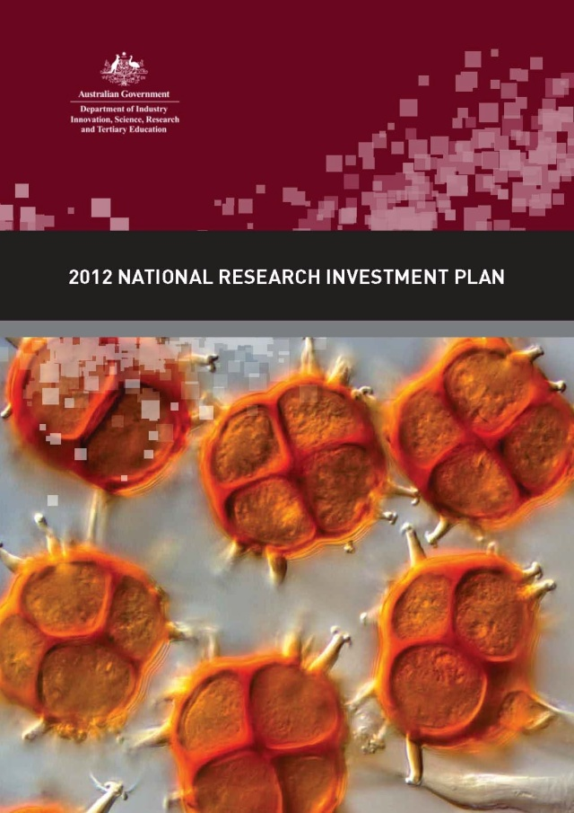
National Research Investment Plan (2012)
    NRIP comprises:
    a framework that enables the development of Australia’s research capacity and capability for all sectors
    a set of research investment principles that ensures government investments are objective and efficient
    a statement of strategic research priorities

Slide 6
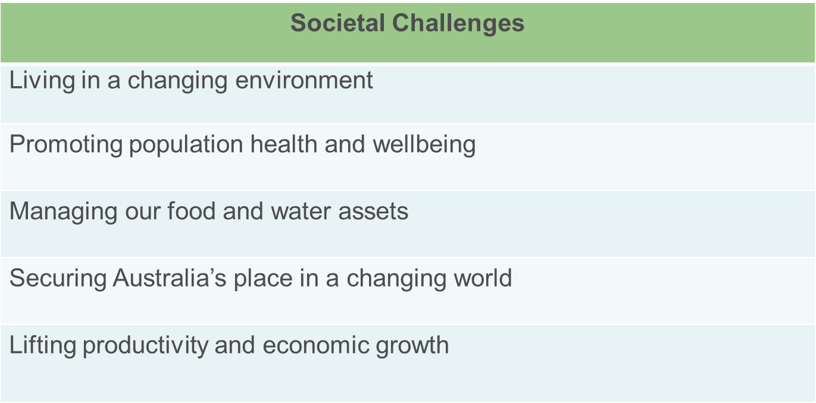
Strategic Research Priorities

Slide 7
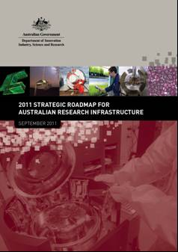
  Prioritisation of research infrastructure
2011 Strategic Roadmap for Australian Research Infrastructure
Identified priority research infrastructure areas for next 5-10 years;
national scale
12 research outcome targeted priority areas
7 enabling capability areas
Strategic and collaborative

Slide 8
  Investment in Australian Research Infrastructure
    National Collaborative Research Infrastructure Strategy ($542m, 2006-11)
    Super Science Initiative ($901m, 2009-13)
    Education Investment Fund ($746m to date)
    Collaborative Research Infrastructure Scheme ($60m, 2013-14)
    The renewed National Collaborative Research Infrastructure Strategy ($186m, 2013-15)

Slide 9
  Internationalisation of research infrastructure
    The National Research Investment Plan recognises that things don’t stand still.
    “Research infrastructure is evolving into global networks that underpin multidisciplinary research.
    The increasing complexity and cost of construction and operation of major research infrastructure will continue to be more than a single nation can manage.
    The ability to share research infrastructure development and to access international facilities will be critical.”

Slide 10
  Workshop themes
    The Australia-European Union Workshop on Research Infrastructure will focus on;
    Healthy Ageing
    Clean Energy
    Sustainable Cities
    Industry Links

Slide 11
  Outcomes from earlier workshops
  AMMRF and EuroBioimaging
    Strategic partnership
    Visits, workshops
  BioPlatforms Australia and European Bioinformatics Institute
    Collaborative letter of intent
    Training workshops
  CSIRO and ECCSEL
    Knowledge sharing on establishment, operation and governance of infrastructure
    Follow up workshop in Perth 2012

Slide 12
DEPARTMENT OF EDUCATION
Industry House
10 Binara Street
Canberra City, ACT 2601, Australia
Telephone +61 2 6213 6000

