Slide 1

Nova Institute of Technology
International Students Information Session
7 September 2026
Tanya Benton-Hall
Case Management Team
www.tps.gov.au

Slide 2
Purpose of this meeting
How the Tuition Protection Service (TPS) can assist you
Student visa information
Getting a copy of your student record
Other assistance available
How to use the TPS Online case management system
www.tps.gov.au

Slide 3
Nova Institute of Technology
(Nova International Education Pty Ltd)
Nova Institute of Technology closed on Tuesday 1 September 2026
Nova Institute of Technology did not meet its obligations to all students
The Tuition Protection Service (TPS) began assisting students on Monday 7 September 2026
www.tps.gov.au

Slide 4

Tuition Protection Service (TPS)
Australian Government initiative supported by the Department of Education
Student tuition fee protection scheme
Supports students following an education provider default to:
  find an alternative provider to continue studying
and
  receive a refund of unspent tuition fees
www.tps.gov.au

Slide 5
TPS Online system
TPS Online is the system you will use to request and receive TPS assistance
You can request a refund of your unspent tuition fees in TPS Online
We will show you how to use TPS Online later in this presentation
TPS Online step-by-step instructions are on the TPS website
Access TPS Online via the TPS website
www.tps.gov.au

Slide 6
Continuing your studies with an alternative provider
Our priority: To help you to continue your studies with a new education provider
You will be emailed links to find alternative courses at different providers
You will need to contact the new provider to enrol with them
Alternative courses may cost more or less than your current course. If costs are higher, you will need to meet those costs.
www.tps.gov.au

Slide 7
Unspent tuition fees
Unspent tuition fees: The tuition fees you paid to Nova Institute of Technology for education or training you did not receive due to the closure
For example, if you paid for 10 weeks of tuition and only attended classes for 7 weeks when Nova Institute of Technology closed, the remaining 3 weeks are your unspent tuition fees
The TPS can provide you with a refund of any unspent tuition fees that were paid to Nova Institute of Technology
www.tps.gov.au

Slide 8
Unspent tuition fees
Your refund can be paid to:
  your personal bank account
  another nominated bank account (e.g. a family member)
  your new education provider
  your education agent
If you would like your agent to receive your refund, you must request and
return an Authority to Act form by emailing support@tps.gov.au
www.tps.gov.au

Slide 9
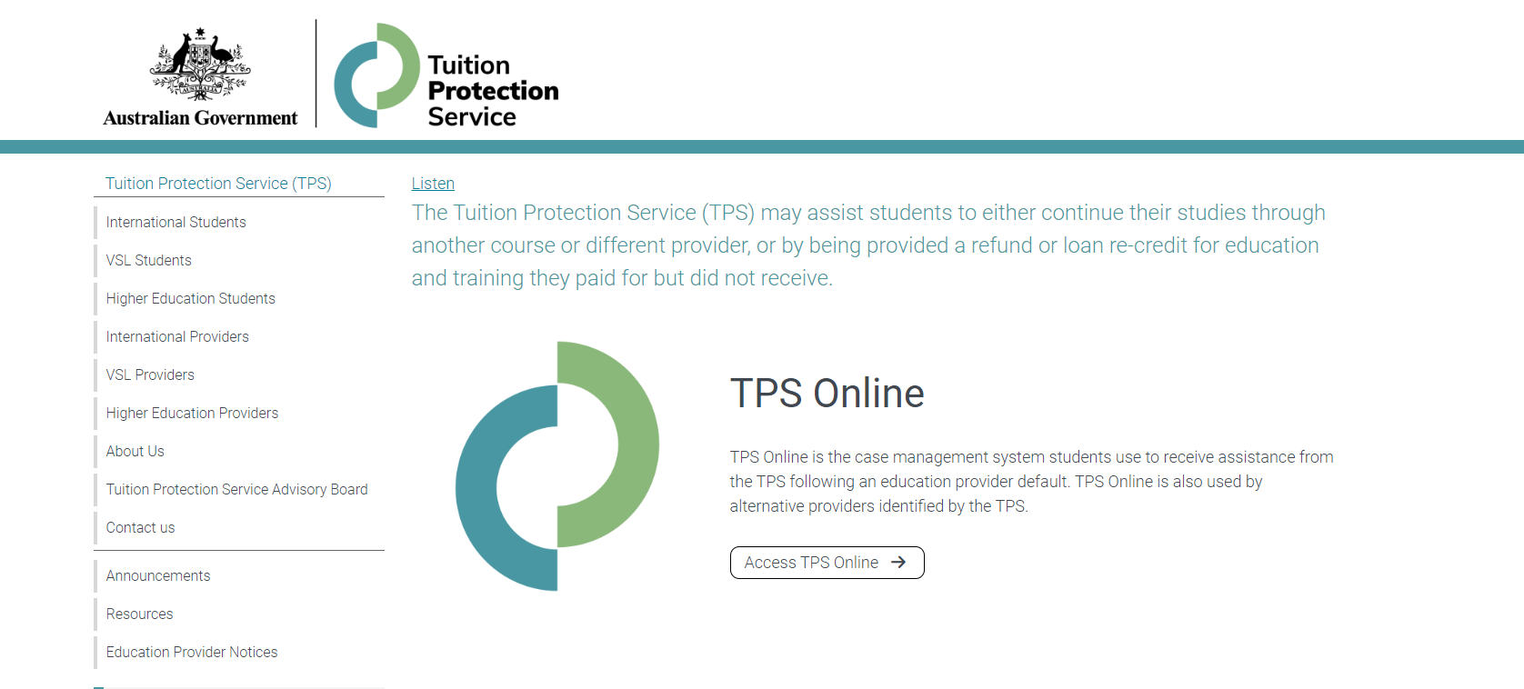
TPS website
For TPS Online, click Access TPS Online.
For information about your provider default, click Education Provider Notices.
www.tps.gov.au

Slide 10

Student visa information
Information about your student visa
Applying for a new student visa
Students under 18
Work conditions
Travelling home

Slide 11
Subclass 500 Student Visa
The TPS can only assist students on a subclass 500 student visa
If you are not on a subclass 500 student visa, you will need to contact the appointed liquidator, Mackay Goodwin, by emailing bcolomban@mackaygoodwin.com.au
You are eligible for TPS assistance if you applied for a subclass 500 student visa and:
your visa was granted
your visa was refused
you are still awaiting a decision on your visa application, including if you
are on a Bridging Visa
www.tps.gov.au

Slide 12
Information about your student visa
Student visa holders must remain enrolled in a registered course
You must finalise a new enrolment within 3 months of your provider defaulting
If you cannot finalise a new enrolment within 3 months, the Department of Home Affairs may offer you an extension. You must provide relevant information for consideration.
If your student visa has not yet been granted, you must finalise a new enrolment and send information about your new enrolment to the Department of Home Affairs. Your visa application will be assessed based on your new enrolment.

Slide 13
Do I need a new student visa?
You will need to apply for a new student visa if you enrol in a new course which:
  is at a lower Australian Qualification Framework (AQF) level than your previous course, or
  will finish after your current visa expires
You will not need to apply for a new student visa if you enrol in a new course which:
  is at the same or a higher AQF level than your previous course, and
  will finish before your current visa expires
Check the expiry date of your student visa by viewing your visa grant notice or by using the Visa Entitlement Verification Online (VEVO) service at online.immi.gov.au/evo/firstParty?actionType=query

Slide 14
Visa Application Charge exemption
If you need to apply for a new student visa because your provider defaulted, you will be eligible for a Visa Application Charge (VAC) exemption if:
  you currently hold a student visa, or your last substantive visa was a student visa, and
  you apply for the new visa within 12 months of the default
When you apply, tell the Department of Home Affairs that you were affected by a provider default and attach evidence of your enrolment with a new education provider, such as your CoE

Slide 15
Students under 18 years of age
You must maintain welfare arrangements at all times as a condition of your student visa if you are under 18 years of age
If your education provider issued a Confirmation of Appropriate Accommodation and Welfare (CAAW) to take responsibility for your welfare in Australia, you must seek alternative enrolment immediately and make alternative welfare arrangements

Slide 16
Work conditions
You cannot work more than 48 hours per fortnight while your course is in session
You can work more than 48 hours per fortnight when your enrolment has been cancelled due to a provider default
Use the email you received from Nova Institute of Technology advising that it had ceased operating as evidence for your employer that you can work longer hours
If you are on a Bridging Visa (BV), refer to the conditions attached to your BV regarding work and other conditions

Slide 17
Travelling home
You can travel home while you arrange your enrolment in another course. You must have a valid student visa to enter Australia on your return.
If you have applied for a student visa and you are awaiting a decision, you must have a valid Bridging Visa B (BVB) to travel outside Australia

Slide 18
Further information and contacts
Information about your student visa:
immi.homeaffairs.gov.au/visas/getting-a-visa/visa-listing/student-500
Information about how an education provider default may affect your student visa:
immi.homeaffairs.gov.au/visas/getting-a-visa/visa-listing/student-500/education-provider-default
Call the Global Service Centre:
  In Australia: 131 881
  Outside Australia: +61 2 6196 0196

Slide 19

Getting a copy of your student record
Australian Skills Quality Authority (ASQA)

Slide 20

ASQA: Getting a copy of your student record
When closing, a provider is expected to issue:
  a testamur and record of results to a student who has completed the requirements of a qualification, or
  a statement of attainment to a student who has not completed a qualification, but has completed one or more units of competency
You will need evidence of the units of competency you have achieved to continue your training at another provider
If you are unable to obtain an up-to-date copy of your student record, ASQA may be able to assist you

Slide 21
ASQA: Further information and contacts
Information about how ASQA can help students:
www.asqa.gov.au/students/how-asqa-can-help-students
Information about student records:
www.asqa.gov.au/students/student-record
Call ASQA:
  In Australia: 1300 701 801
  Outside Australia: +61 3 8613 3910

Slide 22

Study Adelaide
Support for international students

Slide 23
Study Adelaide
Study Adelaide provides information and assistance to international students before and after they arrive in South Australia
The Study Adelaide website contains information and resources about:
  Studying in Adelaide
  Living in Adelaide
  Working in Adelaide
  Student support services, news and events

Slide 24
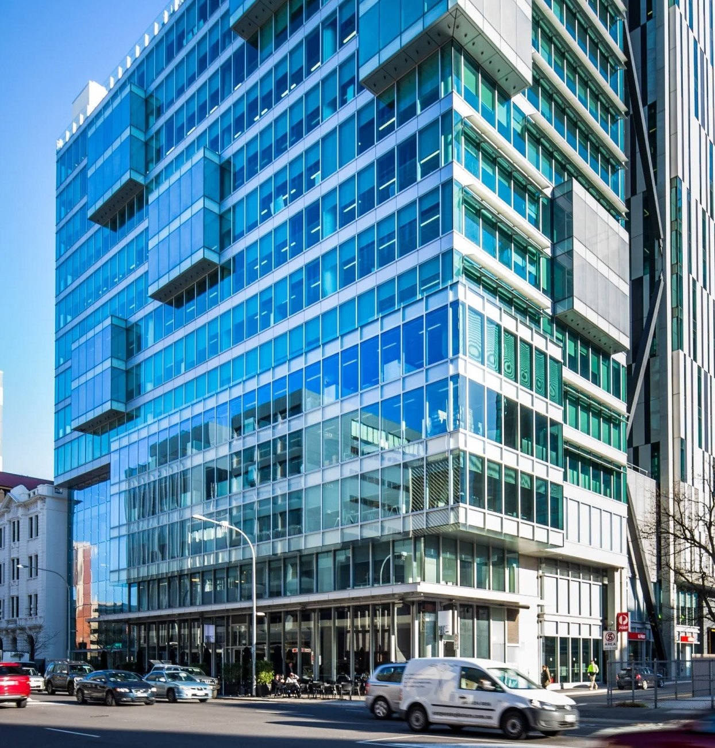
Contact Study Adelaide
Website: studyadelaide.com
Visit: Level 1, 26 Franklin Street, Adelaide
Phone: +61 8 8226 0022
Email: enquiries@studyadelaide.com

Slide 25

Study Melbourne
Support for international students

Slide 26
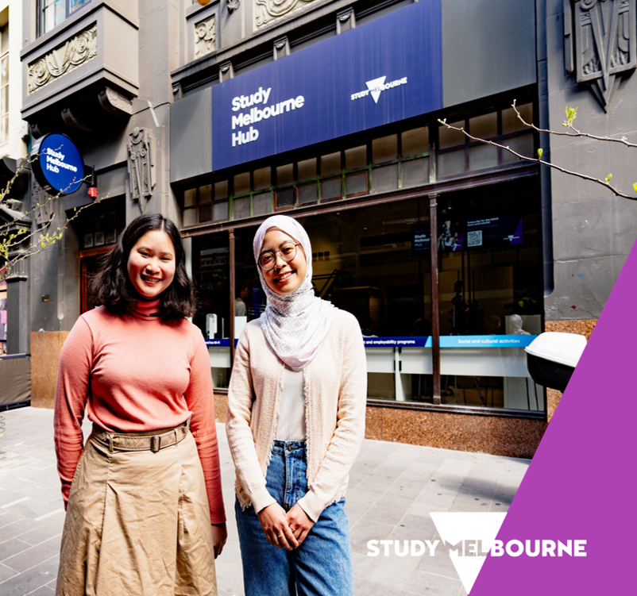
Study Melbourne Hub
The Study Melbourne Hub provides free help and advice to all international students in Victoria
Student support services include:
Accommodation advice
Wellbeing and mental health support
Financial hardship
Employability programs
Legal information
Education provider problems

Slide 27

Contact the Study Melbourne Hub
Contact the Study Melbourne Hub to speak with a caseworker.
All services are confidential.
Visit: 17 Hardware Lane, Melbourne
(Open Monday to Friday 9am – 5pm)
Phone: 1800 056 449
Email: info@studymelbourne.vic.gov.au

Slide 28

Study New South Wales
Support for international students

Slide 29

Study NSW
The Study NSW website contains information and resources for international students in New South Wales about:
  Studying in NSW
  Living in NSW
  Working in NSW
  Student support services, news and events
Website: www.study.nsw.gov.au/current-students

Slide 30
How to use TPS Online
Using TPS Online to receive assistance from the TPS
Summary of tasks you must complete in TPS Online
www.tps.gov.au

Slide 31
Accessing TPS Online
Visit tps.gov.au and click Access TPS Online.
www.tps.gov.au

Slide 32
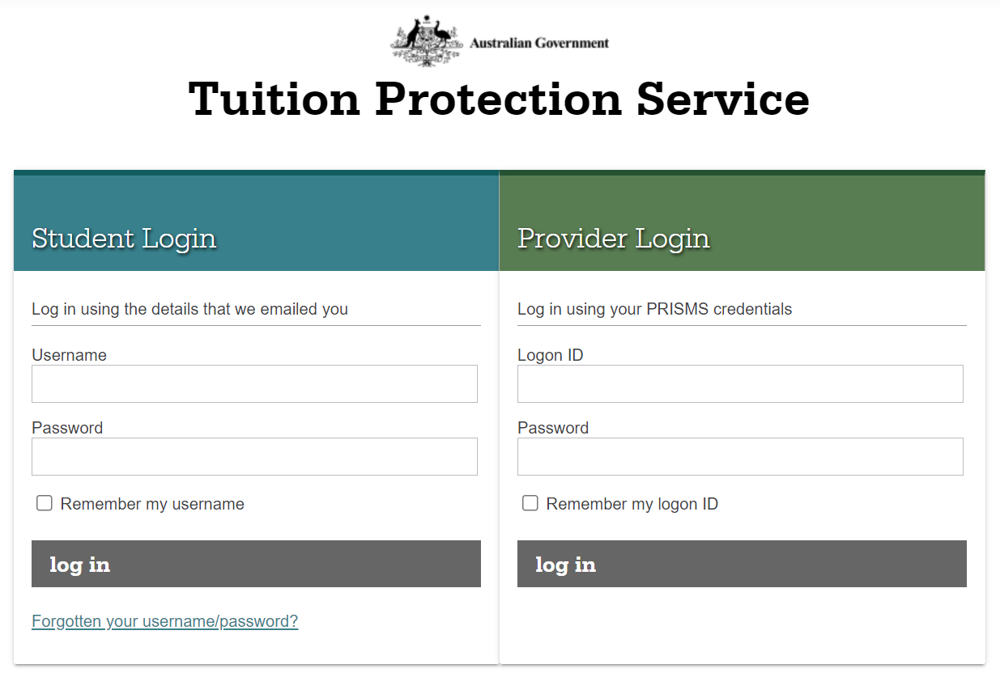
TPS Online: Logging in
Log in.
If you are logging in for the first time, use the username and password emailed to you.
www.tps.gov.au

Slide 33
TPS Online: Summary of tasks
Log in to TPS Online
Change your password
Indicate whether your provider owes you a refund of unspent tuition fees
Provide proof of your identity
Update your contact details
If your provider owes you a refund of unspent tuition fees, upload proof of payment documents
If you are eligible to receive a refund of unspent tuition fees, apply for a refund
Check your emails and TPS Online regularly for notifications and tasks to complete
www.tps.gov.au

Slide 34
TPS Online: Proof of payment document checklist
You must upload the following documents for the TPS to calculate your refund amount:
  Receipts and bank statements for all payments made to your provider for your course
  Letter of Offer outlining all payments due to your provider for your course
  Visa Grant Letter from the Department of Home Affairs
If you have an education agent, you must upload the following additional documents:
Receipts and bank statements for all payments made to your agent
Receipts for all payments your agent made to your provider on your behalf
Agent commission statement or invoice
www.tps.gov.au

Slide 35
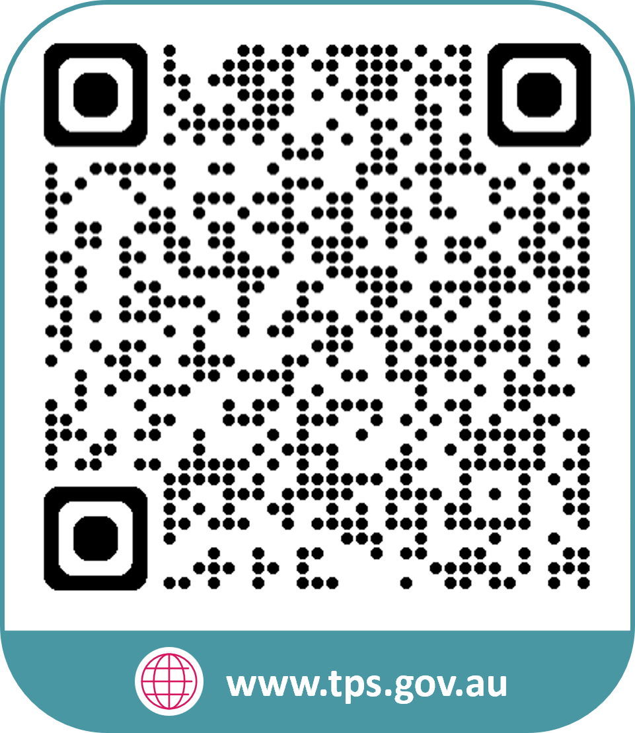
www.tps.gov.au
support@tps.gov.au
1300 131 798

