Slide 1

2027 International TPS Levy
Sector Consultation on Draft Levy Settings
Sept-Oct 2026
Kate Tagg
TPS Director (a/g)
www.tps.gov.au

Slide 2
Outline
Tuition Protection Service (TPS)
International TPS Levy setting process, Fund and collection overview
Levy components and draft 2027 settings
Request for Information, late payments and
levy notices
2027 levy timeline and takeaways
www.tps.gov.au

Slide 3
Tuition Protection Service (TPS)
TPS Director, team and Advisory Board
www.tps.gov.au

Slide 4
Purpose of the Tuition Protection Service (TPS)
What the TPS does
Supports students with tuition fee refunds, loan re‑credits and course placements
Helps providers meet their obligations
Manages tuition protection levies
Who the TPS supports
International students
VET Student Loans (VSL) students
HELP and higher education up‑front fee‑paying students
Australian Government initiative, supported by the Department of Education
Safeguards Australia’s reputation as a trusted education destination
www.tps.gov.au

Slide 5
Tuition Protection Service Director
Kate Tagg, TPS Director (a/g)
  Statutory office holder appointed by the federal Minister for Education
  Operational oversight of the daily activities of the TPS
Responsible for:
  annual collection of tuition protection levies from eligible education providers
  managing the levy funds
Supported by small team of 13 staff
www.tps.gov.au

Slide 6
TPS Advisory Board
View Board member profiles at tps.gov.au
Ms Sharon Robertson (Chair)
The Hon. Phil Honeywood (Deputy Chair)
Ms Joanna Kwai (General Board member)
Mr Trevor Schwenke (General Board member)
Dr Damian Oliver (a/g), Department of Education
Ms Renae Houston, Department of Employment and Workplace Relations
Mr Guy Thorburn, Australian Government Actuary
Mr Anthony Leong, Australian Prudential Regulation Authority
Ms Gemma Cooper, Department of Finance
Ms Maria Amory, Department of Home Affairs
www.tps.gov.au

Slide 7
International TPS Levy
Levy setting process, guiding principles and legislation
www.tps.gov.au

Slide 8
International TPS Levy
An annual tuition protection levy collected from international education providers
Paid into the Overseas Students Tuition Fund (OSTF) – a quarantined account managed by the TPS Director
Funds the student placement and refund activities of the TPS following an international education provider closure and TPS operational costs
Levy calculation based on an education provider’s size and risk of closure
Legislative Authority: Education Services for Overseas Students (TPS Levies) Act 2012
www.legislation.gov.au/C2012A00011/latest/text
www.tps.gov.au

Slide 9
International TPS Levy Setting Process
26 Aug 2026 | TPS Advisory Board provided draft advice to the TPS Director on the 2027 International Levy settings
Sept-Oct 2026 | TPS consults with the sector on the draft settings
18 Nov 2026 | TPS Advisory Board considers the sector’s feedback on the draft settings then provides final advice to the TPS Director
By 1 Jan 2027 | 2027 levy settings finalised in legislative instruments
www.tps.gov.au

Slide 10
TPS Advisory Board’s Advice on Levy Settings
Factors considered by the Board
Overall risk environment
Advice from the Australian Government Actuary (AGA)
Feedback from regulators, peak bodies and providers
Current Fund balance and the funds required for long-term sustainability
Principles that guide the Board’s advice
Reflect the current risk environment
Make changes gradually to support business planning
Keep levy model simple and transparent
Reflect risk to the fund and encourage positive provider behaviour
Minimise extra data and reporting requirements for providers
www.tps.gov.au

Slide 11
Overseas Students Tuition Fund and
Levy Collection Overview
www.tps.gov.au

Slide 12
Overseas Students Tuition Fund (OSTF)
International TPS Levy paid into OSTF
AGA recommends target range for OSTF to ensure sufficient funds are available for a large provider closure or multiple provider closures
AGA recommends maintaining the 2026 target range for 2027
OSTF Balance: $53.15 million (30 June 2026)
Target range | Mid-point of target range
Current: $50-70 million | Current: $60 million
2027 recommendation: $50-70 million | 2026 recommendation: $60 million
www.tps.gov.au

Slide 13
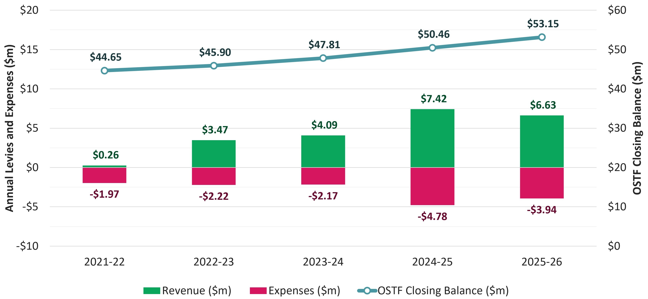
OSTF Revenue, Expenses and Balance: Last 5 Financial Years
www.tps.gov.au

Slide 14
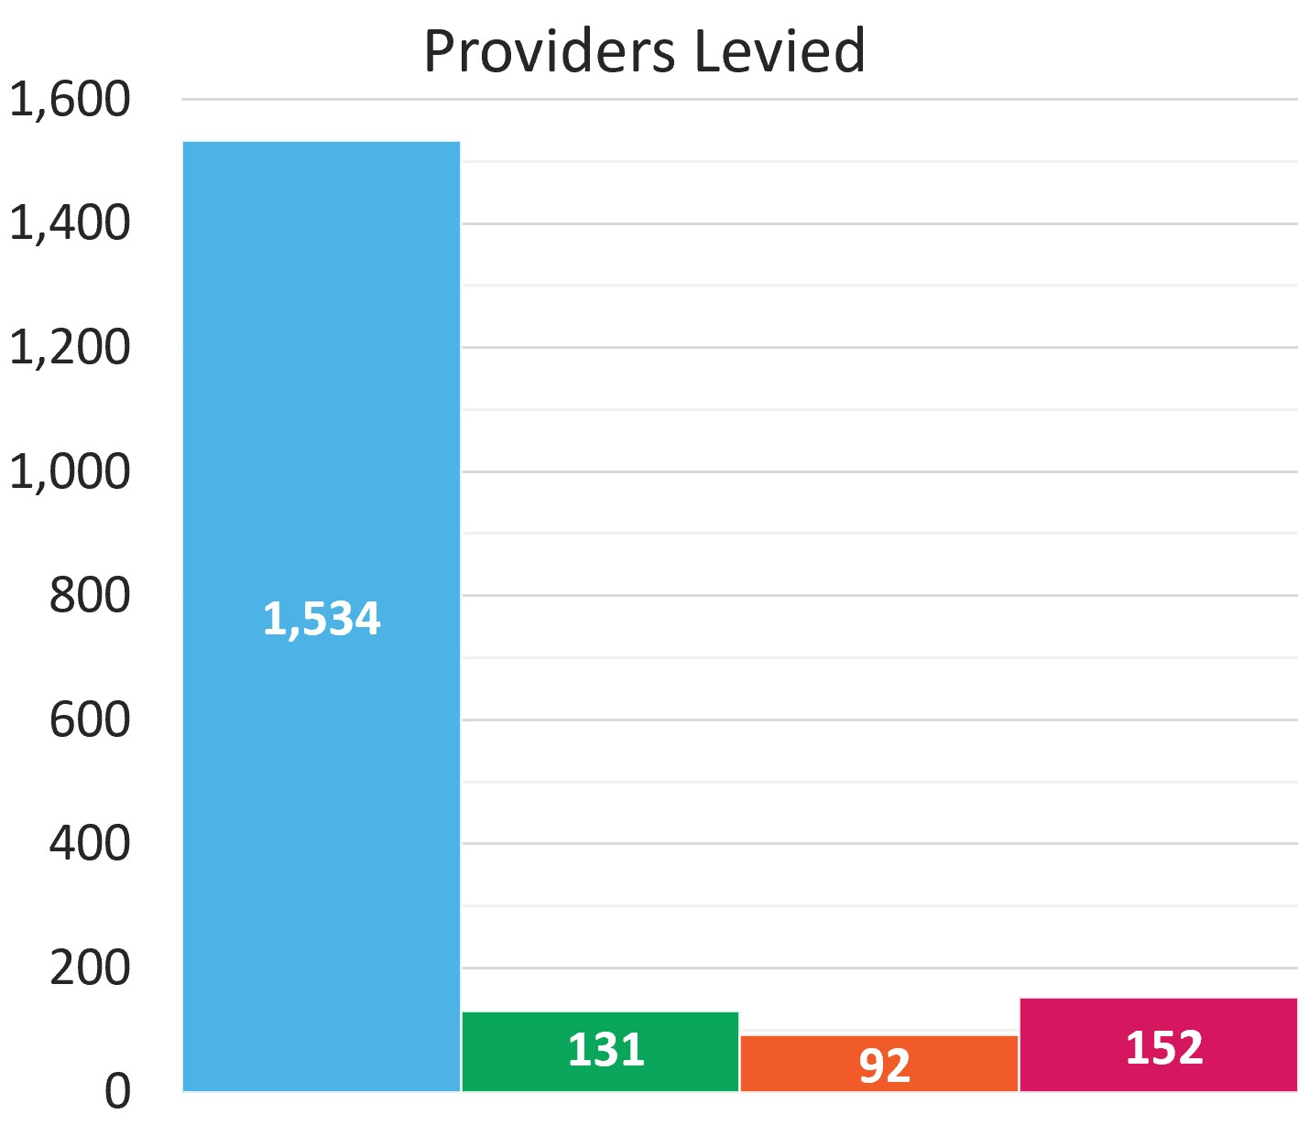
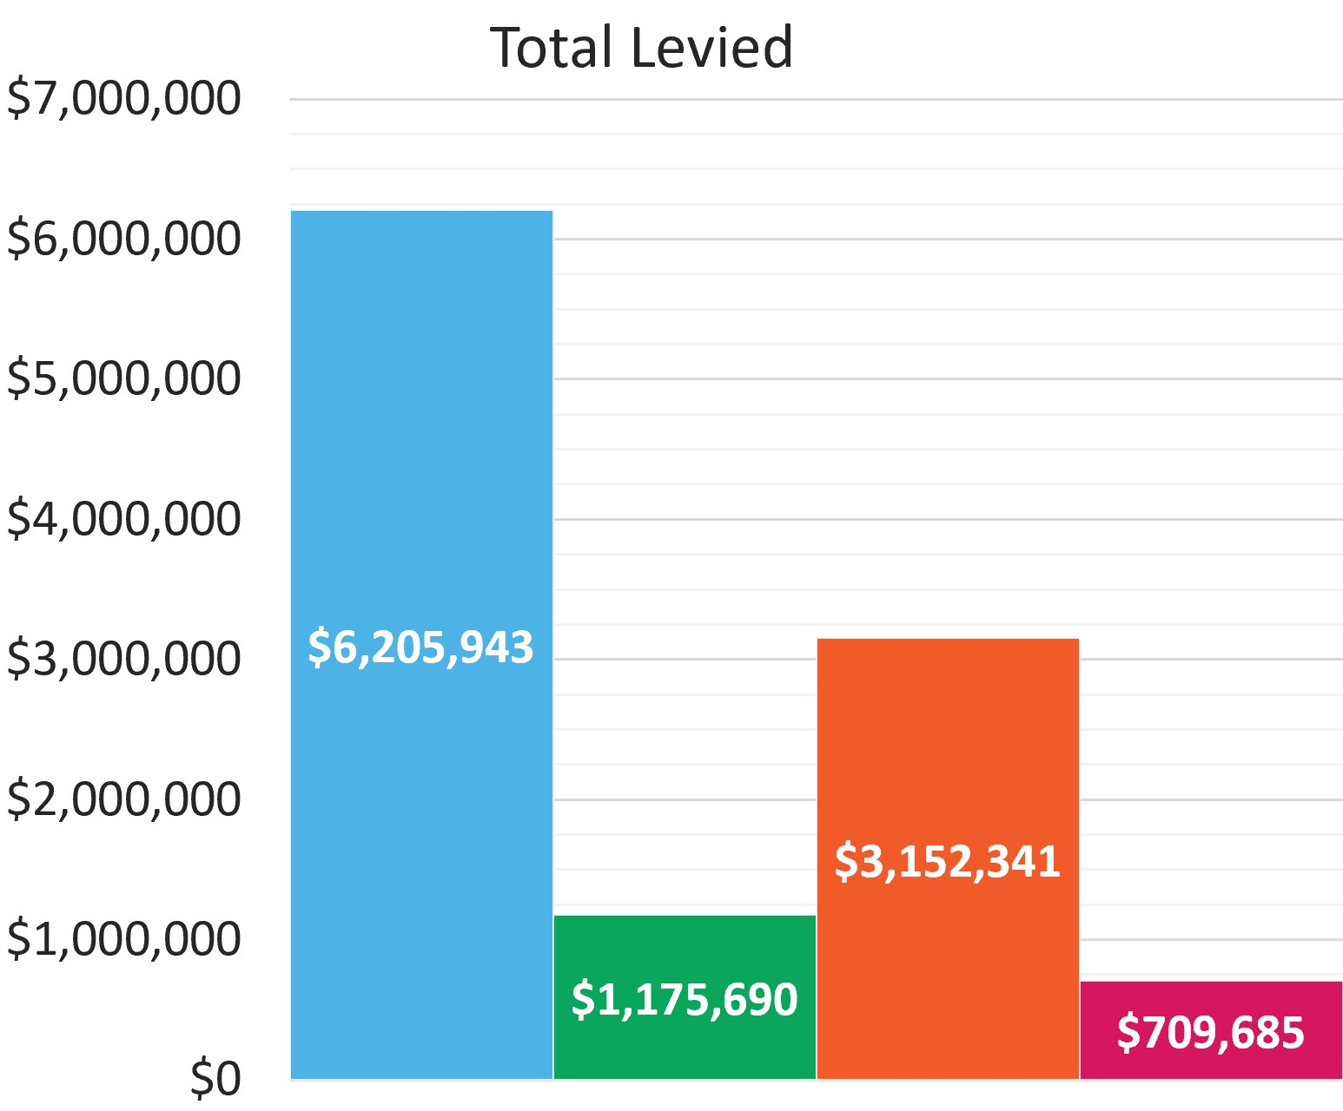
TPS Levy Collection Overview 2025-26
www.tps.gov.au

Slide 15
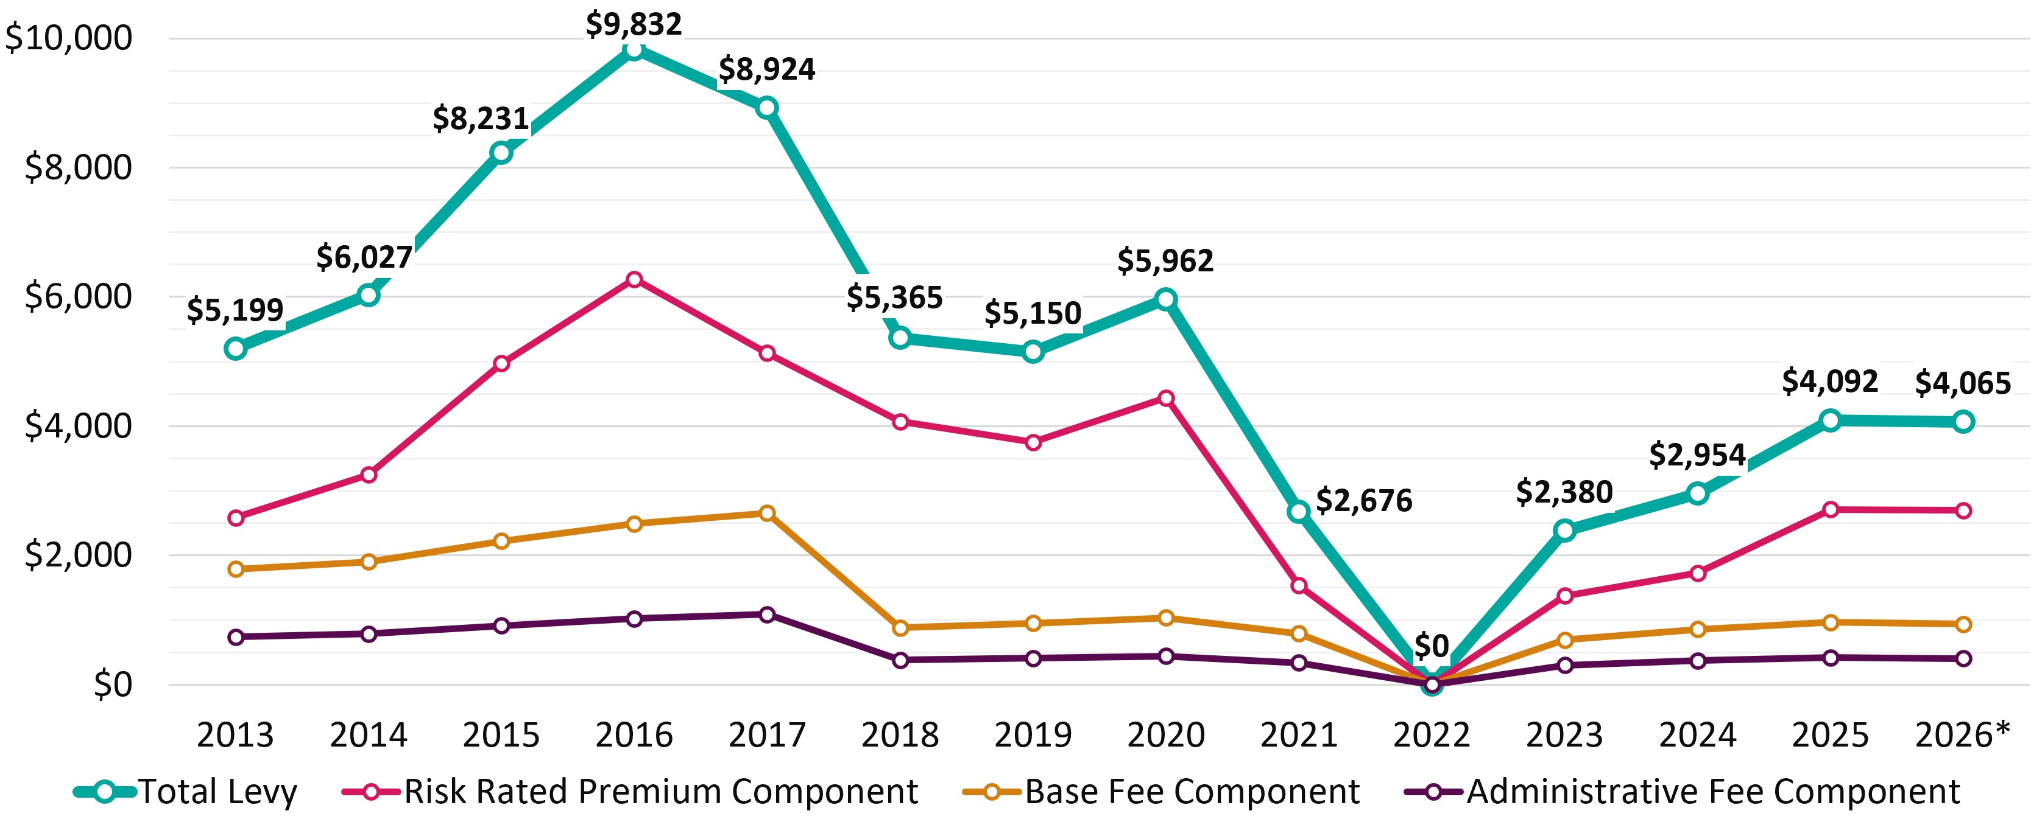
Average International Levy Amount per Provider 2013-26
*2026 figures are approximate
www.tps.gov.au

Slide 16
International TPS Levy Components and
Draft 2027 Settings
www.tps.gov.au

Slide 17
International TPS Levy Components
Component | Key elements | Purpose and authority
Administrative Fee | Sum of a ‘per provider’ and ‘per student’ charge | Designed to cover administrative costs Set by Minister for Education
Base Fee | Sum of a ‘per provider’ and ‘per student’ charge | Maintains OSTF balance at a sustainable level Set by Minister for Education
Risk Rated Premium | Considers 5 risk factors and overseas student tuition fees for previous year | Intended to reflect risk of provider closure Set by TPS Director with Board advice
Special Tuition Protection | Percentage multiplied by overseas student tuition fees for previous year | Charged when OSTF is below target range Set by TPS Director with Board advice
www.tps.gov.au

Slide 18
Draft 2027 International TPS Levy Settings
Component | Draft 2027 Settings
Administrative Fee* | $110.00 per provider + $0.58 per 2026 overseas student enrolment
Base Fee* | $223.00 per provider + $1.41 per 2026 overseas student enrolment
Risk Rated Premium | [0.05% x total risk factor value] x total 2026 overseas student tuition fees
Special Tuition Protection | 0% x total 2026 overseas student tuition fees
*Administrative and Base Fee figures reflect 2026 values and may be indexed to CPI for 2027
Note: 2027 levy calculated using student enrolment numbers and revenue for 2026 calendar year
www.tps.gov.au

Slide 19
Risk Rated Premium Component
Considers 5 risk factors designed to reflect the risk of provider closure
Providers receive a risk factor value for each risk factor
Higher risk factor values indicate higher risk of closure
www.tps.gov.au

Slide 20
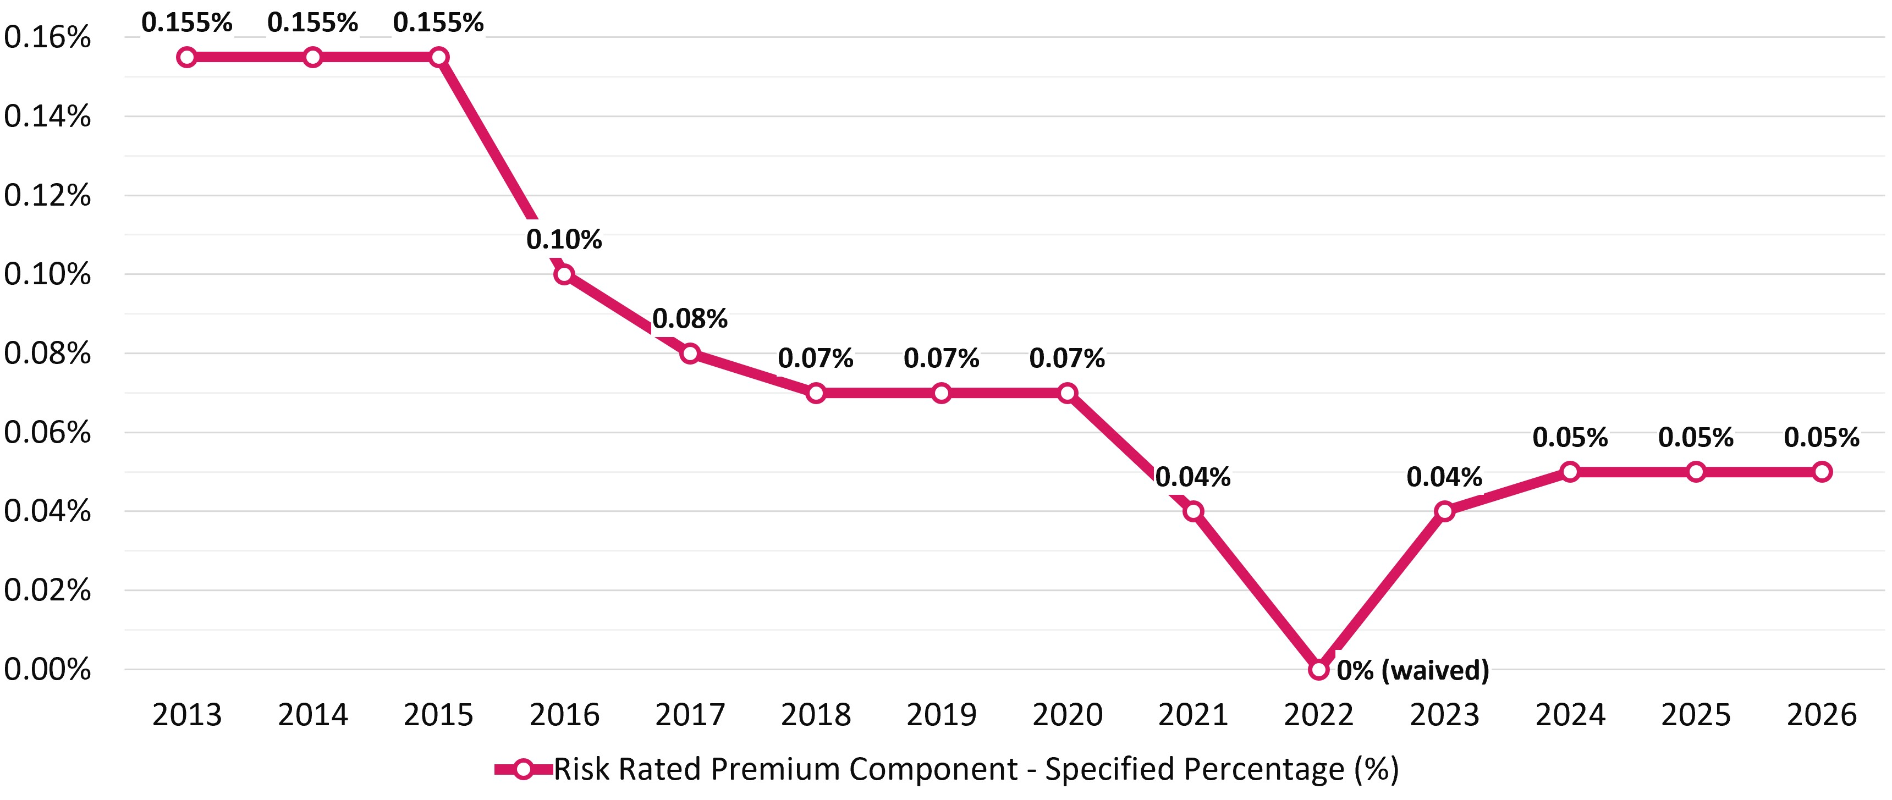
Risk Rated Premium Component Specified Percentage 2013-26
www.tps.gov.au

Slide 21
Risk Rated Premium Component: Risk Factors
Base Risk Factor | Risk factor value of 1.0 applied for all providers
Length of Operation | Higher risk of closure associated with shorter length of operation
Volatility in Overseas Student Enrolments | Higher risk of closure associated with extreme volatility in overseas student enrolments
Maximum Overseas Source Country Concentration | Higher risk of closure associated with heavy reliance on a single source country of overseas students
Non-Compliance and Registration Renewal | Penalties for late payment of the levy or CARC, having sanctions imposed for non-compliance, shorter registration periods due to risk management concerns, and/or having at least one student default where the refund was paid by the TPS
www.tps.gov.au

Slide 22
Risk Rated Premium Component: Risk Factor Values
Total risk factor value for the year
=
Base risk factor | + | Length of operation | + | Volatility in overseas student enrolments | + | Maximum overseas source country concentration | + | Non-compliance history and registration renewal
www.tps.gov.au

Slide 23
Risk Rated Premium Component Formula
specified percentage for 2027
provider’s overseas student tuition fees for 2026
X
total risk factor value
X
Proposed specified percentage for 2027: 0.05%
www.tps.gov.au

Slide 24
Risk Rated Premium Component: High risk example
0.05%
4.5
$2,000,000
specified percentage for 2027
provider’s overseas student tuition fees for 2026
X
total risk factor value
X
= 0.00225 x $2,000,000
= $4,500
www.tps.gov.au

Slide 25
Risk Rated Premium Component: Low risk example
0.05%
1.0
$2,000,000
specified percentage for 2027
provider’s overseas student tuition fees for 2026
X
total risk factor value
X
= 0.0005 x $2,000,000
= $1,000
www.tps.gov.au

Slide 26
Special Tuition Protection Component
Charged when the OSTF is below its target size
Formula:
specified percentage for 2027
provider’s overseas student tuition fees for 2026
X
Proposed specified percentage for 2027: 0%
www.tps.gov.au

Slide 27
Request for Information, Late Payments and
Levy Notices
www.tps.gov.au

Slide 28
Request For Information (RFI)
Non-exempt providers will receive an RFI in early 2027 to declare their 2026:
overseas student tuition fee income, and
domestic student enrolment numbers
This information is required for levy amounts to be calculated. Providers have 2 weeks to respond to the RFI.
Failure to comply with a request under subsection 26(3) of the ESOS Act is considered a breach
www.tps.gov.au

Slide 29
2026 RFI Non-compliance
57 providers failed to respond to the RFI by the due date in 2026
The TPS referred these providers to the relevant regulator for compliance action
To avoid levy invoicing delays, the following methodology was applied to RFI
non-respondents in 2026 (and will be applied again for the 2027 levy):
overseas student tuition fee income: average tuition fee income received per overseas student (derived from RFI respondents) multiplied by non-respondents’ overseas student enrolments, and
domestic student enrolments: zero
www.tps.gov.au

Slide 30
2026 International TPS Levy: Late Payments
Invoices issued 10 March 2026, with payments to be received 10 April 2026
1,534 providers invoiced
120 providers did not pay by the due date and received a late payment penalty
36 providers did not pay by the reminder notice due date and were suspended
As of 25 August 2026, 32 providers still had outstanding payments, totalling $39,387.02
www.tps.gov.au

Slide 31
Late or Non-Payment of International TPS Levy
The TPS is obligated to send one reminder notice to providers who have not paid their levy by the due date. Providers have 7 days to pay after the reminder notice is given.
Providers whose payment is received after the due date will receive a late payment penalty of 20% of their unpaid levy amount. They may also receive a weighted late payment penalty in the non-compliance risk factor calculation of the next three years' levies.
A provider’s registration will be automatically suspended if they fail to comply with the reminder notice (s90 ESOS Act). The provider reinstatement fee in 2026 was $694.
Levy invoices are sent to PEO contacts in PRISMS. Keep your contact information in PRISMS up to date. To update your PEO details, please contact your regulator.
www.tps.gov.au

Slide 32
2027 International TPS Levy Notices
You will receive the following notices about your 2027 levy:
Early advice
Request for Information (RFI) (with 2 weeks to respond)
Invoice (with 28 days to pay)
Reminder notice (if your payment has not been received by the due date)
Late payment penalty invoice (if applicable)
Suspension notification (if applicable)
Provider reinstatement fee invoice (if applicable)
www.tps.gov.au

Slide 33
2027 International Levy Timeline and Takeaways
www.tps.gov.au

Slide 34
2027 International TPS Levy Timeline
August 2026
Sept – Oct 2026
November 2026
December 2026
Feb – May 2027
26 August
Draft advice on 2027 International TPS Levy confirmed at TPS Advisory Board meeting
Late August
Draft advice letter published on TPS website
8 September
Online session for all providers
Mid September
9 Sep: In-person sessions, Melbourne
16 Sep: In-person session, Brisbane
23 Sep: In-person sessions, Sydney
Mid October
13-14 Oct: Online, interactive sessions for all providers
September-October
Meetings with stakeholders
18 November
TPS Advisory Board considers sector feedback
Final advice on 2027 International TPS Levy settings confirmed at Board meeting
Mid-November
Legislative instrument drafted and sent to Treasurer
Department of Education briefing for Administrative and Base Fee components sent to Minister for Education
31 December
Legislative instrument must be approved by Treasurer and signed off by TPS Director
February
Non-exempt providers receive a Request for Information to declare their 2026 overseas students tuition fee income and domestic student enrolment figures
March
2027 levy invoices sent to providers
April-May
International levy collected
www.tps.gov.au

Slide 35
Takeaways
Board’s draft advice on 2027 levy settings: No changes proposed from 2026 settings
Risk Rated Premium component specified percentage to be maintained at 0.05%
Special Tuition Protection component specified percentage to be maintained at 0%
All risk factors and settings to be maintained at 2026 levels
Target range of OSTF to be maintained at $50-70 million
Timeline estimates levy will be collected in April-May 2027
www.tps.gov.au

Slide 36
Key messages
Ensure all contact information and student enrolment data in PRISMS is up to date
  Submit your RFI on time to ensure your levy can be calculated
  Pay the full and correct levy amount on time to avoid receiving a late payment penalty and a non-compliance loading for the next three levies
  Check account details and reference number are correct before making a payment
www.tps.gov.au

Slide 37
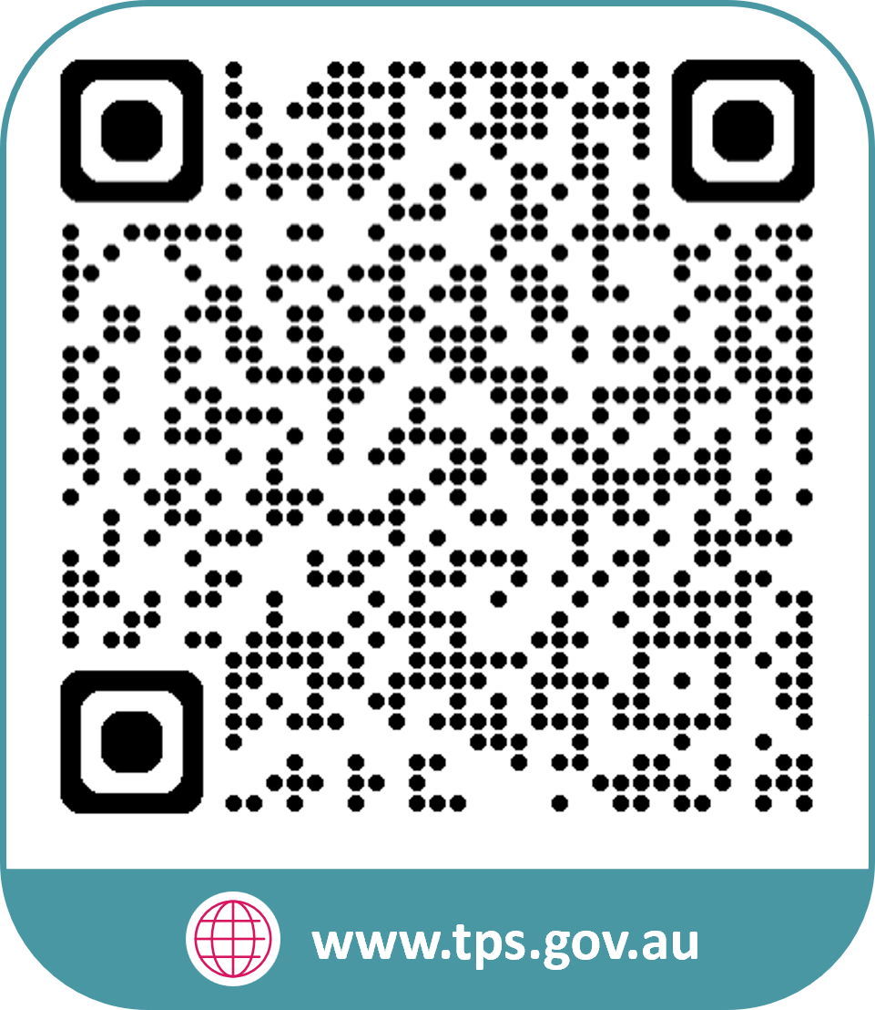
www.tps.gov.au
operations@tps.gov.au

