Slide 1
Needs-based Funding and Outreach Funding reporting
Information session – 5 May 2026

Slide 2
We acknowledge the Traditional Owners and Custodians of Country throughout Australia and their continuing connection to land, waters and community.
We pay our respects to them and their cultures, and to their Elders past and present.

Slide 3
Today’s outline
Introduction on reporting
NBF (equity component) & Outreach reporting
NBF (regional component) reporting
Questions

Slide 4
Why is reporting required and why is it important?
Reporting is required as a condition of funding under the NBF and Outreach Funding Other Grants Guidelines.
Its purpose includes:
  Acquitting NBF and Outreach Funding expenditure for each year, including that it is spent on eligible activities.
  Reporting of activities to build an evidence base where outcomes can be tracked over time.
  Enhancing transparency by sharing information.
    This also includes with the Indigenous Governance Mechanism (IGM).
This will support providers in the development of their mission-based compacts in future years.

Slide 5
Questions from 23 March NBF and Outreach information session
Question: What role will the Student Equity in Higher Education Evaluation Framework (SEHEEF) have in NBF and Outreach reporting?
The reporting of 2026 NBF and Outreach Funding, and its assessment, will be closely guided by the SEHEEF. The Reporting Handbook provides guidance on how providers may use the SEHEEF to assist with completing the template.
Question: How does the current template ensure alignment with NBF requirements?
The 2026 NBF and Outreach Funding reporting package has been streamlined to support providers in completing their reporting. This includes through the use of drop-down menus to ensure providers are reporting appropriately. The reporting templates meet the reporting requirements as outlined in the Other Grants Guidelines for both NBF and Outreach Funding.

Slide 6
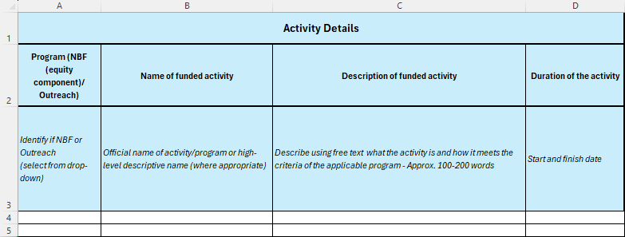
1. Expenditure & Activity Data – Activity Details
For activities with both NBF (equity component) and Outreach funding, report the activity twice, with funding amounts in column I or J.
For activities with multiple funding sources, the description can be the same across rows.
If the duration of the activity is not known, write TBC.

Slide 7
Question from 23 March NBF and Outreach information session
Question: Is reporting of expenditure by program required?
Yes, reporting of expenditure by program will still be required, as outlined in the Other Grants Guidelines for both NBF and Outreach Funding.

Slide 8
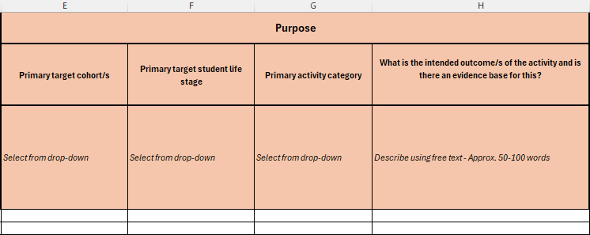
1. Expenditure & Activity Data – Purpose
Select the primary target cohort, primary target student life stage, and primary activity category from the drop-down menus that best fits the activity.
Use the free text in column H to describe where an activity does not clearly fit the menu options.

Slide 9
Question from 23 March NBF and Outreach information session
Question: Why is First Nations reported under the broader equity cohort?
The NBF Equity Component is a grant based partially on the number of First Nations student enrolments. Where First Nations supports are delivered, it is recommended that providers collaborate or share reporting with the Indigenous Governance Mechanism or Indigenous support unit.

Slide 10
1. Expenditure & Activity Data – Purpose
Primary target cohort/s (column E):
Select the primary target cohort, with further cohorts provided in column H.
Primary target student life stage (column F):
Pre-access: refers to activities delivered under Outreach funding.
Access: provide supports to enable pathways into higher education and admission processes.
Participation: offer supports for transition, engagement and progression, to keep students enrolled at university and complete a qualification.
Completion and transition: referred to as attainment and transition out in the NBF Guidance and means the successful completion of study, with smooth transition out.
Primary activity category (column G):
Select the primary activity category. Eligible activity categories will remain consistent with the SEHEEF.

Slide 11
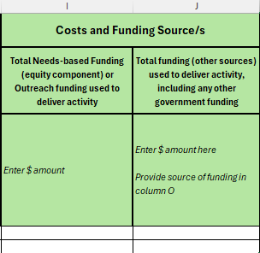
1. Expenditure & Activity Data – Costs and Funding Source/s
Enter the NBF (equity component) or Outreach funding amount used to deliver the activity.
If relevant, enter the total amount of additional funding (other sources) used to deliver the activity, and include further information in column O.
Other sources can include other government programs, the university, partners or industry, and reflects that activities may not be solely funded through NBF or Outreach.

Slide 12
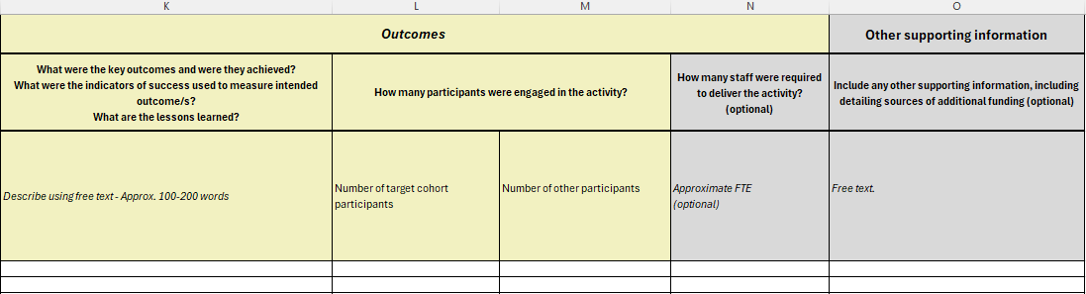
1. Expenditure & Activity Data –
Outcomes & Other supporting information
Key outcomes should refer to the intended outcomes outlined in column H.
Numbers provided may be exact or approximate.
Column O is free text to expand on any information already provided.
For the 2026 transition year, if using NBF (equity component) for Outreach activities, provide further information in column O.

Slide 13
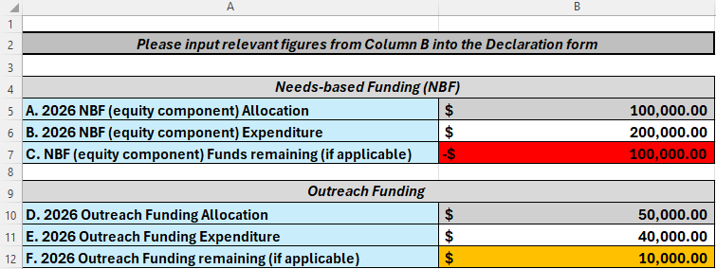
2. Expenditure Summary
Cells B5 and B10 have been pre-populated for each provider.
Cells B6 and B11 will pre-populate based on figures provided in worksheet 1.
Cells B7 and B12 have been conditionally formatted to highlight underspends and overspends.
This worksheet has been locked to prevent any accidental changes.

Slide 14
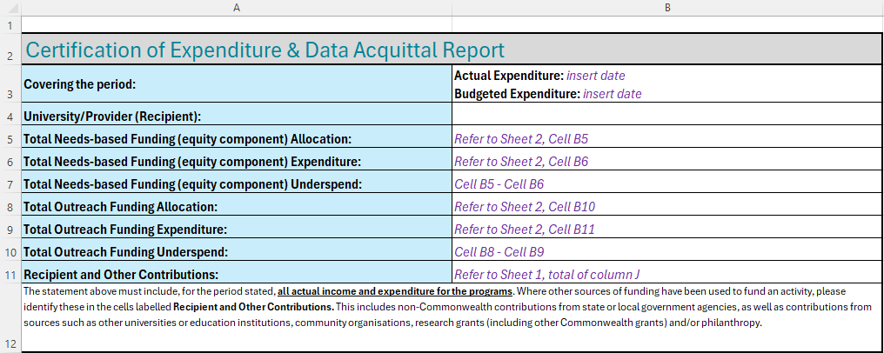
3. Certification
Complete all sections with relevant financial information.
Purple italicised text is included to guide where information can be found in the template.

Slide 15
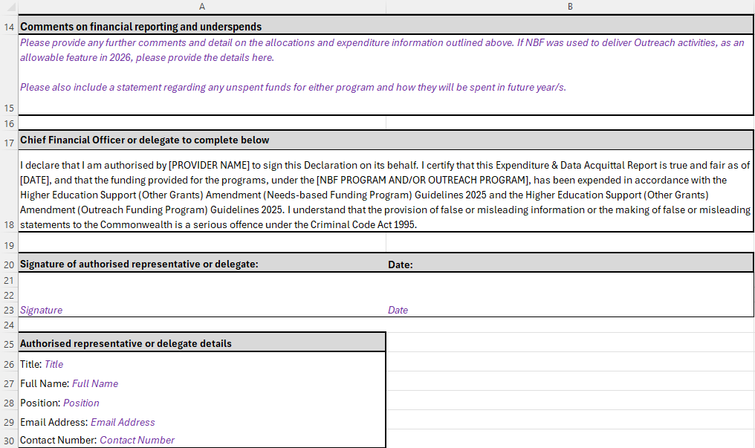
3. Certification
In row 15, providers should include information on any underspends and/or if NBF (equity component) was used to deliver Outreach activities.
To be approved and cleared in full by the CFO or delegate.
Return file as .xlsx (Excel document) and retain all worksheets.

Slide 16
Question from 23 March NBF and Outreach information session
Question: Is the CFO expected to be the submitting officer, or is their primary role to certify the accuracy of figures?
Under the 2026 NBF and Outreach Reporting Handbook, the CFO or delegate is required to approve and clear the Expenditure Data & Acquittal Report. The CFO or delegate is not expected to submit the report to the department. As providers receive funding for First Nations enrolments, we recommend additional consultation with the Indigenous Governance Mechanism to ensure activities are not duplicated across other government programs.

Slide 17
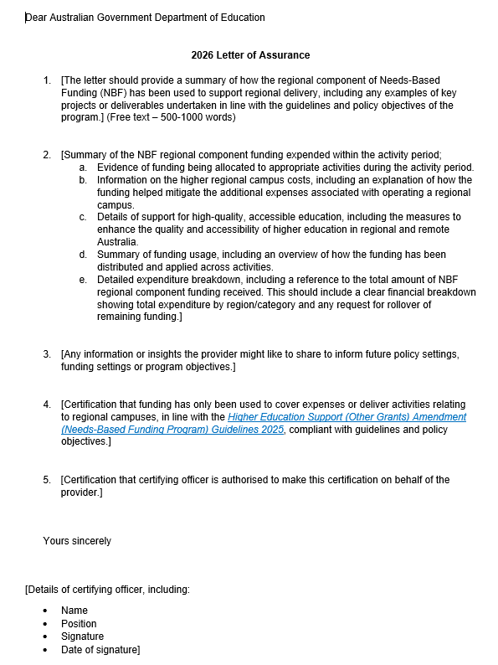
NBF (regional component)
Letter of Assurance
Provides assurances to the department that NBF (regional component) has been spent on appropriate activities, in line with the NBF Other Grants Guidelines.
Any request to rollover funds must be expressly written.
Include details of certifying officer.

Slide 18
Wrap-up and questions
Reporting due by 5pm, 27 March 2027 (AEDT)
Email: equityprograms@education.gov.au
Q&As from the 23 March NBF and Outreach information session can be found here.
Upcoming session/s (TBC)
Second session of NBF/Outreach and/or reporting for those who missed the first one
Please send an email if your provider has interest in a second session and we will gauge interest
NBF and Outreach: policy discussion and early feedback

