Slide 1

2026 VSL, HELP and Up-front Payments Tuition Protection Levies
Sector Consultation Feedback on Draft Levy Settings
22 April 2026
Kate Tagg
TPS Director (a/g)
www.tps.gov.au

Slide 2
Outline
Tuition Protection Service (TPS) and levies
Levy components and draft 2026 settings
Summary of 2026 domestic levies consultation
2026 levies timeline and takeaways
www.tps.gov.au

Slide 3
Purpose of the Tuition Protection Service (TPS)
What the TPS does:
Supports students with tuition fee refunds, loan re‑credits and course placements
Helps providers meet their obligations
Manages tuition protection levies
Who it supports:
International students
VET Student Loans (VSL) students
HELP and higher education up‑front fee‑paying students
Australian Government initiative, supported by the Department of Education
Safeguards Australia’s reputation as a trusted education destination
www.tps.gov.au

Slide 4
Tuition Protection Service Director
Kate Tagg, TPS Director (a/g)
  Statutory office holder appointed by the federal Minister for Education
  Operational oversight of the daily activities of the TPS
Responsible for:
  annual collection of TPS levies from eligible education providers
  managing the levy funds
  determining the settings of two components of the TPS levies based on advice from the TPS Advisory Board
Supported by small team – the Tuition Protection Service – 13 staff
www.tps.gov.au

Slide 5
TPS Advisory Board
View Board member profiles at tps.gov.au
Ms Sharon Robertson (Chair)
The Hon. Phil Honeywood (Deputy Chair)
Ms Joanna Kwai (General Board member)
TBC, Australian Government Department of Education
Ms Renae Houston, Australian Government Department of Employment and Workplace Relations
Mr Guy Thorburn, Australian Government Actuary
Mr Anthony Leong, Australian Prudential Regulation Authority
Ms Gemma Cooper, Australian Government Department of Finance
Ms Libby McDonald, Australian Government Department of Home Affairs
www.tps.gov.au

Slide 6
Domestic Tuition Protection Levies – at a glance
Levy | VSL Levy | HELP Levy | Up-front Payments Levy
Paid by | VSL providers | HELP providers | Higher education up-front fee-paying providers
Account | VSL Tuition Protection Fund | Higher Education Tuition Protection Fund | Higher Education Tuition Protection Fund
Funds | Loan re-credits Placements | Loan re-credits Placements | Student refunds Placements
Supports | TPS operational costs | TPS operational costs | TPS operational costs
Calculated | Based on provider’s size and risk of closure | Based on provider’s size and risk of closure | Based on provider’s size and risk of closure
www.tps.gov.au

Slide 7
Domestic Tuition Protection Levy Setting Process
4 March 2026 | TPS Advisory Board provided draft advice to the TPS Director on the 2026 domestic tuition protection levies settings
Mar-Apr 2026 | TPS consults the sector on the draft settings
20 May 2026 | TPS Advisory Board considers the sector’s feedback on the draft settings then provides final advice to the TPS Director
By 1 August 2026 | 2026 domestic levies settings finalised in legislative instruments
www.tps.gov.au

Slide 8
VSL and Higher Education Tuition Protection Funds
Fund | Target range | Balance | Seed funding to be repaid
VSL | $6.92-9.74 million | $9.12 million (as at 31 Dec 2025) | $3.58 million (as at 31 Dec 2025)
Higher Education | $21.53-25.63 million | $22.35 million (as at 31 Dec 2025) | $8.62 million (as at 31 Dec 2025)
www.tps.gov.au

Slide 9
Late or Non-Payment of Domestic Levies
Providers that pay their levies after the due date may receive a late payment penalty for the next three years’ levy risk rating calculation
In 2025, across the three levies, we saw approximately 17% of levies not paid by the due date
Levy invoices are sent to contacts identified in HITS with the contact type 'CEO/VC' and are copied to those listed as 'CFO', 'Senior Authorised Officer' and 'Primary Contact – HE/VET'. Keep your contact information in HITS up to date.
www.tps.gov.au

Slide 10
Domestic Levy Components and
Draft 2026 Settings
www.tps.gov.au

Slide 11
Domestic Tuition Protection Levy Components
Component | Key elements | Purpose and authority
Administrative Fee | Sum of a ‘per provider’ and ‘per student’ charge | Designed to cover administrative costs Set by relevant Minister. Therefore, we are not consulting on the settings of this component.
Risk Rated Premium | Considers 3 risk factors: Financial strength Completion rate Non-compliance history and registration renewal | Intended to reflect risk of provider default Set by TPS Director with Board advice
Special Tuition Protection | Percentage multiplied by total loan amounts or up-front payments received | Builds Fund balances when below target range and facilitates repayment of seed funding Set by TPS Director with Board advice
www.tps.gov.au

Slide 12
Draft 2026 Domestic Tuition Protection Levy Settings
Component | VSL Levy | HELP Levy | Up-front Levy
Administrative Fee | $129 per provider + $10.85 per VSL student | $129 per provider + $10.85 per HELP student | $129 per provider + $10.85 per up-front student
Risk Rated Premium | $6 per VSL student + 0.13% x total 2025 loan amounts | $6 per HELP student + 0.06% x total 2025 loan amounts | $2 per up-front fee-paying student + 0.04% x total 2025 up-front payments
Special Tuition Protection | 0% x total 2025 VSL loan amounts | 0.10% x total 2025 HELP loan amounts | 0.10% x total 2025 up-front payments
*Administrative Fee figures quoted are 2025 rates. These are yet to be set by relevant Ministers for 2026.
Note: 2026 levies will be calculated using 2025 calendar year student enrolment numbers and revenue
www.tps.gov.au

Slide 13
Risk Rated Premium component
Considers 3 risk factors designed to reflect the risk of provider closure
Providers receive a risk value against each risk factor
The sum of a provider’s risk values give a total risk factor value
Providers with a high total risk factor value present a higher risk of closure and will pay a higher levy amount
www.tps.gov.au

Slide 14
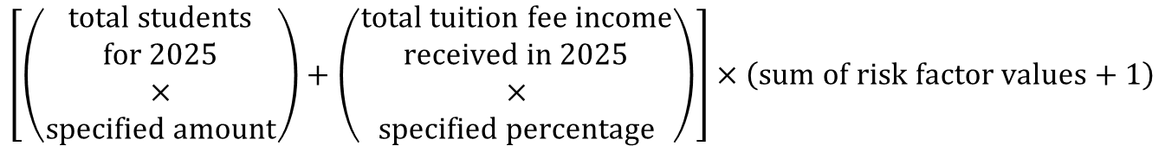
Risk Rated Premium Component Formula
$$\left[\left(\begin{aligned}total students \\ for 2025 \\ × \\ specified amount\end{aligned}\right)+\left(\begin{aligned}total tuition fee income \\ received in 2025 \\ × \\ specified percentage\end{aligned}\right)\right]×\left(sum of risk factor values+1\right)$$
The sum of a provider’s risk factor values is a multiplier for the Risk Rated Premium component calculation
www.tps.gov.au

Slide 15
Risk Rated Premium Component: Risk Factors
Risk Factor 1 Financial Strength
Based on 2 ratios: return on assets and debt to equity
Calculations use provider’s most recent financial data
Risk Factor 2 Unit Completion Rate
Based on the unit completion rate of students
Risk Factor 3 Non-Compliance History and Registration Renewal
Late payment history of the relevant tuition protection levy and annual registration provider charges; and
If a provider’s registration was renewed for a period less than the maximum allowable for risk management reasons
www.tps.gov.au

Slide 16
Financial Strength
Proposed 2026 risk factor values unchanged from 2025 (and since 2022)
Financial strength score | Risk factor value (2022-25) | Proposed risk factor value (2026)
9 | 0.0 | 0.0
6 or 7.5 | 1.0 | 1.0
3 or 4.5 | 2.0 | 2.0
Provider does not submit financial statements | 2.5 | 2.5
Providers receive a score of 1.5, 3.0 or 4.5 for each ratio, which are summed together to give an overall financial strength score
Financial strength scores determine providers’ financial strength risk factor values
www.tps.gov.au

Slide 17
Unit Completion Rate
Proposed 2026 risk factor values unchanged from 2025 (and since 2023)
Completion rate percentage | Risk factor value (2023-25) | Proposed risk factor value (2026)
85% or higher | 0.0 | 0.0
60% to <85% | 1.0 | 1.0
35% to <60% | 2.5 | 2.5
0% to <35% | 3.5 | 3.5
www.tps.gov.au

Slide 18
Non-Compliance History and Registration Renewal
Proposed 2026 risk factor values unchanged from 2025 (and since 2022)
Non-compliance history and registration renewal | Risk factor value (2022-25) | Proposed risk factor value (2026)
Weighted late payment measure of 30 days or more | 2.0 | 2.0
Weighted late payment measure of 15 to <30 days | 0.9 | 0.9
Weighted late payment measure of 1 to <15 days | 0.7 | 0.7
Weighted late payment measure of <1 day | 0.0 | 0.0
PLUS
Applied to have its registration renewed and, for risk management reasons, had its registration renewed for a period less than the maximum allowable | 1.0 | 1.0
www.tps.gov.au

Slide 19
Special Tuition Protection component (STPC)
Helps build the balance of the Funds when below their target range and facilitates seed funding repayments
One proposed change for 2026 VSL Levy: STPC percentage to be reduced from 0.10% to 0%
Proposed 2026 STPC percentages for HELP and Up-front Levies unchanged from 2025 (and since 2022)
Levy | STPC percentage (2022-25) | Proposed STPC percentage (2026)
VSL | 0.10% | 0%
HELP | 0.10% | 0.10%
Up-front | 0.10% | 0.10%
www.tps.gov.au

Slide 20
2026 Domestic Levies Consultation Feedback
www.tps.gov.au

Slide 21
2026 Domestic Levies Consultation Activities (March 2026)
National webinar
In-person sessions in NSW, QLD and VIC
Online session for SA, WA, ACT, NT and TAS
Consultations with peak bodies
www.tps.gov.au

Slide 22
Q: In the levy calculations, does ‘student count’ refer to ‘EFTSL’ or a student ‘headcount’?
The levy calculations use a combination of equivalent full-time student load (EFTSL) and a headcount of students
The components of the levies that are calculated using a student count and the type of student count used are:
Administrative Fee component: Headcount of students for previous calendar year
Risk Rated Premium component: Headcount of students for previous calendar year
Completion Rate risk factor: EFTSL for previous calendar year
www.tps.gov.au

Slide 23
Q: How is the Completion Rate risk factor calculated if the practical component is deferred into 2026?
Unit completion rate percentage calculation:
Passed EFTSL
X 100
(Passed + Failed + Ongoing + Data missing EFTSL)
EFTSL: Equivalent full-time student load for a year
If a student remains enrolled in a unit of study and does not pass or fail in the 2025 calendar year, they will be counted as ‘ongoing EFTSL’ in the calculation denominator for the 2026 levies
www.tps.gov.au

Slide 24
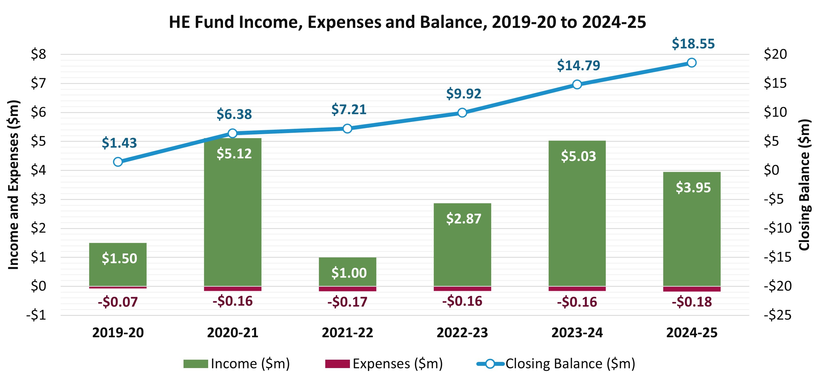
Q: How much is spent against the levy funds?
www.tps.gov.au

Slide 25
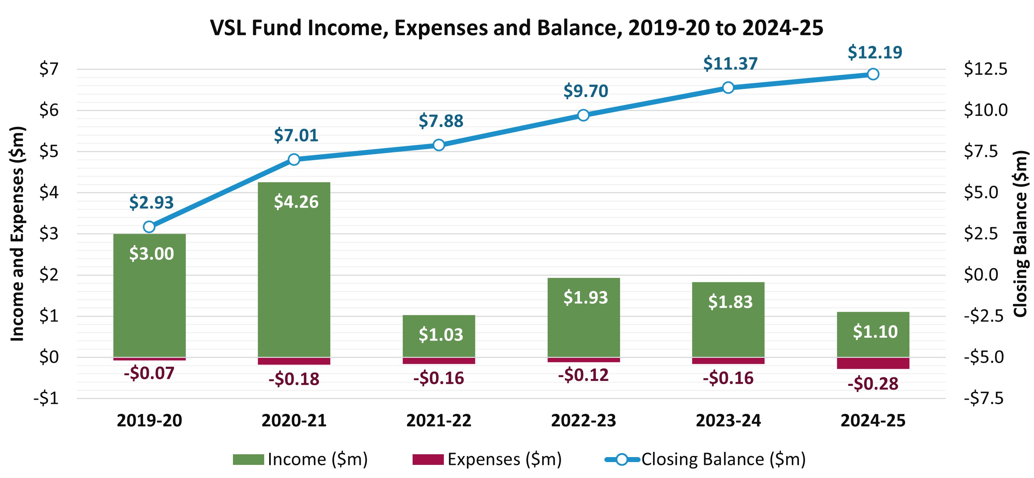
Q: How much is spent against the levy funds?
www.tps.gov.au

Slide 26
2026 Domestic Levies Timeline and Takeaways
www.tps.gov.au

Slide 27
2026 Domestic Tuition Protection Levies Timeline
March 26
April 26
May 26
August 26
Oct-Dec 26
4 March
Draft advice on 2026 Levy settings confirmed at TPS Advisory Board meeting
March
Online consultation session for all providers
State-based
in-person and online consultation sessions
Meetings with stakeholders
22 April
Online feedback session for all providers
April
Legislative instruments prepared
20 May
TPS Advisory Board considers sector feedback
Final advice on 2026 Levy settings confirmed at TPS Advisory Board meeting
1 August
Legislative Instruments must be made by 1 August and published online
October
Early advice notices sent
Levy estimate notice with link to estimator tool sent to providers
November
Domestic levy invoices issued
December
Domestic levy payments due
www.tps.gov.au

Slide 28
Takeaways
One proposed change for 2026: VSL Special Tuition Protection component
percentage to be reduced from 0.10% to 0%
No proposed changes for 2026 to:
Risk Rated Premium component settings (all levies)
Special Tuition Protection component settings for HELP and Up-front levies
2026 domestic levies collected in November-December 2026
If you have any further questions or feedback, email operations@tps.gov.au by
30 April so this can be shared with the TPS Advisory Board
www.tps.gov.au

Slide 29
Key messages
Ensure contact details in HITS and enrolment data in TCSI are current
Providers liable for more than one levy will receive a separate invoice for each levy
Check account details before making a payment
  Pay the right amount, on time to avoid being penalised for non-compliance for the following three years
  Ensure all financial statements are signed by an auditor; contain financial information from the previous year (2025), previous financial year or the previous applicable financial reporting period; and display the ABN of the entity the TPS is levying
  Do not use parent company’s financial statements
www.tps.gov.au

Slide 30

www.tps.gov.au
operations@tps.gov.au

