Slide 1


2026 VSL, HELP and Up-front Payments Tuition Protection Levies
Sector Consultation on Draft Levy Settings
Mar-Apr 2026
Kate Tagg
TPS Director (a/g)
www.tps.gov.au

Slide 2
Outline
Tuition Protection Service (TPS)
Levy setting process, guiding principles and legislation
2025 levy collection snapshot
Levy components and draft 2026 settings
2026 levies timeline and takeaways
www.tps.gov.au

Slide 3
Tuition Protection Service (TPS)
TPS Director, team and Advisory Board
www.tps.gov.au

Slide 4
Purpose of the Tuition Protection Service (TPS)
What the TPS does:
Supports students with tuition fee refunds, loan re‑credits and course placements
Helps providers meet their obligations
Manages tuition protection levies
Who it supports:
International students
VET Student Loans (VSL) students
HELP and higher education up‑front fee‑paying students
Australian Government initiative, supported by the Department of Education
Safeguards Australia’s reputation as a trusted education destination
www.tps.gov.au

Slide 5
Tuition Protection Service Director
Kate Tagg, TPS Director (a/g)
Statutory office holder appointed by the federal Minister for Education
Operational oversight of the daily activities of the TPS
Responsible for:
annual collection of TPS levies from eligible education providers
managing the levy funds
Supported by small team – the Tuition Protection Service - 13 staff
www.tps.gov.au

Slide 6
TPS Advisory Board
View Board member profiles at tps.gov.au
Ms Sharon Robertson (Chair)
The Hon. Phil Honeywood (Deputy Chair)
Ms Joanna Kwai (General Board member)
Ms Karen Sandercock, Australian Government Department of Education
Ms Renae Houston, Australian Government Department of Employment and Workplace Relations
Mr Guy Thorburn, Australian Government Actuary
[Vacant, pending appointment] Australian Prudential Regulation Authority
Ms Gemma Cooper, Australian Government Department of Finance
Ms Libby McDonald, Australian Government Department of Home Affairs
www.tps.gov.au

Slide 7
Domestic Tuition Protection Levies
Levy setting process, guiding principles and legislation
www.tps.gov.au

Slide 8
Domestic Tuition Protection Levies – at a glance
Levy | VSL Levy | HELP Levy | Up-front Payments Levy
Paid by | VSL providers | HELP providers | Higher education up-front fee-paying providers
Account | VSL Tuition Protection Fund | Higher Education Tuition Protection Fund | Higher Education Tuition Protection Fund
Funds | Loan re-credits Placements | Loan re-credits Placements | Student refunds Placements
Supports | TPS operational costs | TPS operational costs | TPS operational costs
Calculated | Based on provider’s size and risk of closure | Based on provider’s size and risk of closure | Based on provider’s size and risk of closure
www.tps.gov.au

Slide 9
Domestic Tuition Protection Levy Setting Process
4 March 2026 | TPS Advisory Board provides draft advice to the TPS Director on the 2026 domestic tuition protection levies settings
Mar-Apr 2026 | TPS consults the sector on the draft settings
20 May 2026 | TPS Advisory Board considers the sector’s feedback on the draft settings then provides final advice to the TPS Director
By 1 August 2026 | 2026 domestic levies settings finalised in legislative instruments
www.tps.gov.au

Slide 10
How the TPS Advisory Board sets levy advice
What the Board considers
The overall risk environment
Advice from the Australian Government Actuary (AGA)
Feedback from sector regulators, peak bodies and providers
Current Fund balances and the funds required for long-term sustainability
How the Board applies this
Reflects the current risk environment
Makes changes gradually to support business planning
Keeps levy models simple and transparent
Reflect risk to the fund and encourage positive provider behaviour
Minimises extra data and reporting requirements
www.tps.gov.au

Slide 11
Tuition Protection Levy Framework
How domestic levies are set
Levy settings are made through two legislative instruments for the following components:
Administrative Fee – set by the relevant Minister
Risk Rated Premium and Special Tuition Protection – set by the TPS Director, informed by Board advice
Role of the Australian Government Actuary (AGA)
The AGA provides independent advice on levy settings. This advice ensures the arrangements are financially sound and sustainable over time
What providers need to know
Providers operating in more than one sector pay separate levies for each sector
www.tps.gov.au

Slide 12
Legislative Authority
VET Student Loans (VSL Tuition Protection Levy) Act 2020 www.legislation.gov.au/C2020A00005
Higher Education Support (HELP Tuition Protection Levy) Act 2020 www.legislation.gov.au/C2020A00004
Higher Education (Up-front Payments Tuition Protection Levy) Act 2020 www.legislation.gov.au/C2020A00102
www.tps.gov.au

Slide 13
2025 Levy Collection Snapshot
www.tps.gov.au

Slide 14
VSL and Higher Education Tuition Protection Funds
Fund | Target range | Balance | Seed funding to be repaid
VSL | $6.92-9.74 million | $9.12 million (as at 31 Dec 2025) | $3.58 million (as at 31 Dec 2025)
Higher Education | $21.53-25.63 million | $22.35 million (as at 31 Dec 2025) | $8.62 million (as at 31 Dec 2025)
www.tps.gov.au

Slide 15
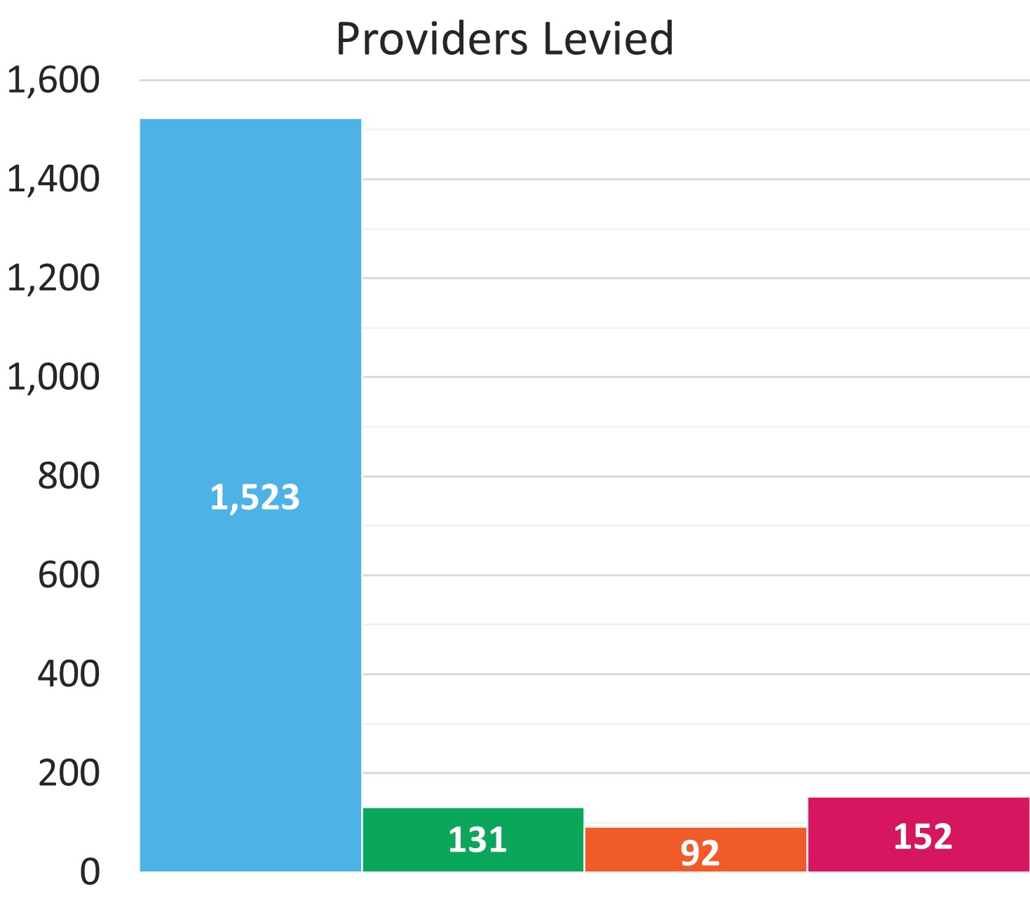
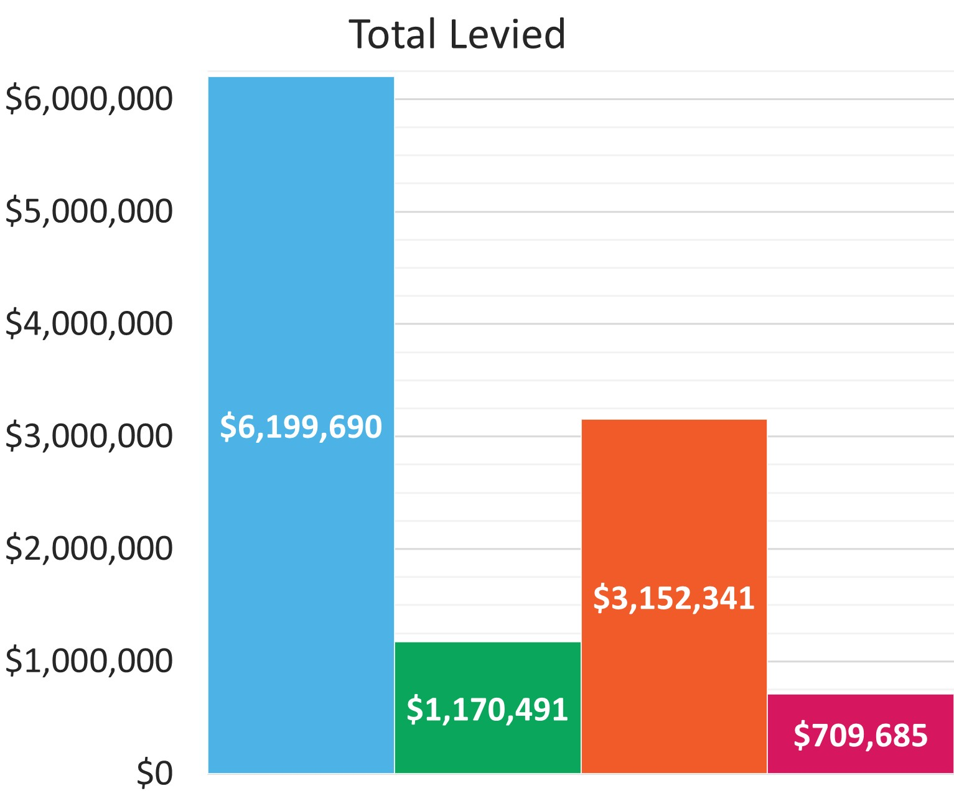
2025 Levy Collection Overview
www.tps.gov.au

Slide 16
2025 Domestic Levies: Late Payments
Invoices issued mid-November 2025, due mid-December 2025
 | VSL Levy | HELP Levy | Up-front Levy
Providers invoiced | 131 | 92 | 152
Levies not paid by due date | 23 | 14 | 26
Payments still not received (as at 31 Jan 2026) | 3 | 2 | 5
www.tps.gov.au

Slide 17
Late or Non-Payment of Domestic Levies
The TPS is obligated to give providers notice of their levy amounts. The due date to pay must be at least:
14 days after the notice is given (VSL)
30 days after the notice is given (HELP and Up-front).
Providers that pay their levies after the due date may receive a late payment penalty for the next three years’ levy risk rating calculation.
Levy invoices are sent to contacts identified in HITS with the contact type 'CEO/VC' and are copied to those listed as 'CFO', 'Senior Authorised Officer' and 'Primary Contact – HE/VET'. Keep your contact information in HITS up to date.
www.tps.gov.au

Slide 18
Domestic Levy Components and Draft 2026 Settings
www.tps.gov.au

Slide 19
Domestic Tuition Protection Levy Components
Component | Key elements | Purpose and authority
Administrative Fee | Sum of a ‘per provider’ and ‘per student’ charge | Designed to cover administrative costs Set by relevant Minister
Risk Rated Premium | Considers 3 risk factors: Financial strength Completion rate Non-compliance history and registration renewal | Intended to reflect risk of provider default Set by TPS Director with Board advice
Special Tuition Protection | Percentage multiplied by total loan amounts or up-front payments received | Builds Fund balances when below target range and facilitates repayment of seed funding Set by TPS Director with Board advice
www.tps.gov.au

Slide 20
Draft 2026 Domestic Tuition Protection Levy Settings
Component | VSL Levy | HELP Levy | Up-front Levy
Administrative Fee | $129 per provider + $10.85 per VSL student | $129 per provider + $10.85 per HELP student | $129 per provider + $10.85 per up-front student
Risk Rated Premium | $6 per VSL student + 0.13% x total 2025 loan amounts | $6 per HELP student + 0.06% x total 2025 loan amounts | $2 per up-front fee-paying student + 0.04% x total 2025 up-front payments
Special Tuition Protection | 0% x total 2025 VSL loan amounts | 0.10% x total 2025 HELP loan amounts | 0.10% x total 2025 up-front payments
*Administrative Fee figures quoted are 2025 rates. These are yet to be set by relevant Ministers for 2026.
Note: 2026 levies will be calculated using 2025 calendar year student enrolment numbers and revenue
www.tps.gov.au

Slide 21
Risk Rated Premium component
Considers 3 risk factors designed to reflect the risk of provider closure
Providers receive a risk value against each risk factor
The sum of a provider’s risk values give a total risk factor value
Providers with a high total risk factor value present a higher risk of closure and will pay a higher levy amount
www.tps.gov.au

Slide 22
Risk Rated Premium Component: Risk Factors
Risk Factor 1 Financial Strength
Based on 2 ratios: return on assets and debt to equity
Calculations use provider’s most recent financial data
Risk Factor 2 Unit Completion Rate
Based on the unit completion rate of students
Risk Factor 3 Non-Compliance History and Registration Renewal
Late payment history of the relevant tuition protection levy and annual registration provider charges; and
If a provider’s registration was renewed for a period less than the maximum allowable for risk management reasons
www.tps.gov.au

Slide 23

Financial Strength
Assessed using two ratios:
Ratio | Formula
Return on Assets: Measures the profitability of a provider relative to its total assets | NPBT / total assets
Debt to Equity: Measures the degree to which a provider is financing its operations through debt | Total liabilities / total equity
NPBT: Net profit before tax
‘Net profit ratio’ was also used to calculate financial strength in previous years but was removed from the 2024 levy calculations in response to concerns raised by some not-for-profit providers at the 2023 consultation sessions
www.tps.gov.au

Slide 24
Financial Strength
Proposed 2026 risk factor values unchanged from 2025 (and since 2022)
Financial strength score | Risk factor value (2022-25) | Proposed risk factor value (2026)
9 | 0.0 | 0.0
6 or 7.5 | 1.0 | 1.0
3 or 4.5 | 2.0 | 2.0
Provider does not submit financial statements | 2.5 | 2.5
Providers receive a score of 1.5, 3.0 or 4.5 for each ratio, which are summed together to give an overall financial strength score
Financial strength scores determine providers’ financial strength risk factor values
www.tps.gov.au

Slide 25

Completion Rate
Low student unit completion rates are correlated with an increased likelihood of closure
Unit completion rate percentage calculation:
Passed EFTSL
X 100
(Passed + Failed + Ongoing + Data missing EFTSL)
EFTSL: Equivalent full-time student load for a year
‘Withdrawn EFTSL’ was included in the calculation denominator in previous years but was removed from the 2025 levy calculations in accordance with AGA and Board advice
www.tps.gov.au

Slide 26
Completion Rate
Proposed 2026 risk factor values unchanged from 2025 (and since 2023)
Completion rate percentage | Risk factor value (2023-25) | Proposed risk factor value (2026)
85% or higher | 0.0 | 0.0
60% to <85% | 1.0 | 1.0
35% to <60% | 2.5 | 2.5
0% to <35% | 3.5 | 3.5
www.tps.gov.au

Slide 27

Non-Compliance History and Registration Renewal
Assesses the risk of a provider based on their history of non-compliance and lack of risk management practices
Non-compliance history
Penalises providers for a late payment history of the relevant levy and annual registration provider charges over the previous 3 years (i.e. 2023-2025)
Registration renewal
Penalises providers that applied for renewal of its registration and, for risk management reasons, had its registration renewed for a period less than the maximum allowable
www.tps.gov.au

Slide 28
Non-Compliance History and Registration Renewal
Proposed 2026 risk factor values unchanged from 2025 (and since 2022)
Non-compliance history and registration renewal | Risk factor value (2022-25) | Proposed risk factor value (2026)
Weighted late payment measure of 30 days or more | 2.0 | 2.0
Weighted late payment measure of 15 to >30 days | 0.9 | 0.9
Weighted late payment measure of 1 to >15 days | 0.7 | 0.7
Weighted late payment measure of <1 day | 0.0 | 0.0
PLUS
Applied to have its registration renewed and, for risk management reasons, had its registration renewed for a period less than the maximum allowable | 1.0 | 1.0
www.tps.gov.au

Slide 29
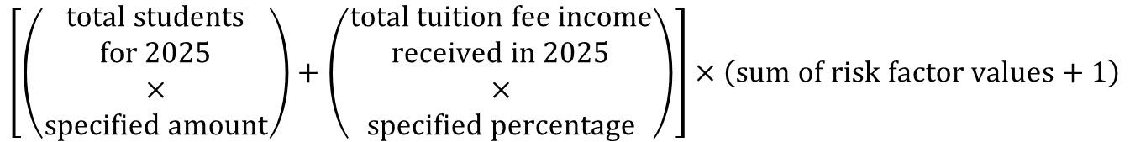
Risk Rated Premium Component
Risk Rated Premium component formula:
$$\left[\left(\begin{aligned}total students \\ for 2025 \\ × \\ specified amount\end{aligned}\right)+\left(\begin{aligned}total tuition fee income \\ received in 2025 \\ × \\ specified percentage\end{aligned}\right)\right]×\left(sum of risk factor values+1\right)$$
The sum of a provider’s risk factor values is a multiplier for the Risk Rated Premium component calculation
www.tps.gov.au

Slide 30
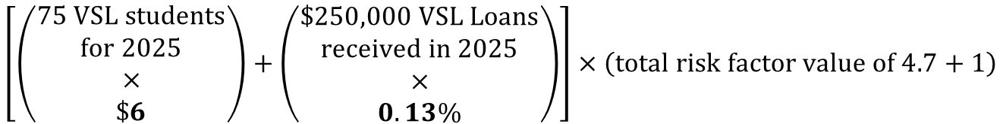
Risk Rated Premium Component: VSL Example
$$\left[\left(\begin{aligned}75 VSL students \\ for 2025 \\ × \\ \$6\end{aligned}\right)+\left(\begin{aligned}\$250,000 VSL Loans \\ received in 2025 \\ × \\ 0.13\%\end{aligned}\right)\right]×\left(total risk factor value of 4.7+1\right)$$
= $450
= $325
= 5.7
= ($450 + $325) x 5.7
= $4,417.50
www.tps.gov.au

Slide 31
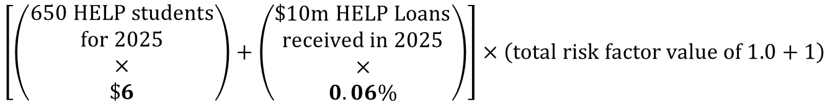
Risk Rated Premium Component: HELP Example
$$\left[\left(\begin{aligned}650 HELP students \\ for 2025 \\ × \\ \$6\end{aligned}\right)+\left(\begin{aligned}\$10m HELP Loans \\ received in 2025 \\ × \\ 0.06\%\end{aligned}\right)\right]×\left(total risk factor value of 1.0+1\right)$$
= $3,900
= $6,000
= 2.0
= ($3,900 + $6,000) x 2.0
= $19,800
www.tps.gov.au

Slide 32
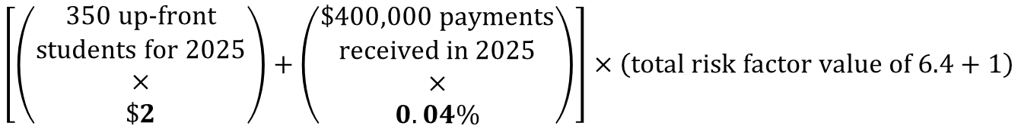
Risk Rated Premium Component: Up-front Example
$$\left[\left(\begin{aligned}350 up‑front \\ students for 2025 \\ × \\ \$2\end{aligned}\right)+\left(\begin{aligned}\$400,000 payments \\ received in 2025 \\ × \\ 0.04\%\end{aligned}\right)\right]×\left(total risk factor value of 6.4+1\right)$$
= $700
= $160
= 7.4
= ($700 + $160) x 7.4
= $6,364
www.tps.gov.au

Slide 33
Special Tuition Protection component (STPC)
Helps build the balance of the Funds when below their target range and facilitates seed funding repayments
One proposed change for 2026 VSL Levy: STPC percentage to be reduced from 0.10% to 0%
Proposed 2026 STPC percentages for HELP and Up-front Levies unchanged from 2025 (and since 2022)
Levy | STPC percentage (2022-25) | Proposed STPC percentage (2026)
VSL | 0.10% | 0%
HELP | 0.10% | 0.10%
Up-front | 0.10% | 0.10%
www.tps.gov.au

Slide 34
2026 Domestic Levies Timeline and Takeaways
www.tps.gov.au

Slide 35
2026 Domestic Tuition Protection Levies Timeline
March 26
April 26
May 26
August 26
Oct-Dec 26
4 March
Draft advice on 2026 Levy settings confirmed at TPS Advisory Board meeting
March
Online consultation session for all providers
State-based in-person and online consultation sessions
Meetings with stakeholders
April
Online feedback session for all providers
Legislative instruments prepared
20 May
TPS Advisory Board considers sector feedback
Final advice on 2026 Levy settings confirmed at TPS Advisory Board meeting
1 August
Legislative Instruments must be made by 1 August and published online
October
Early advice notices sent
Levy estimate notice with link to estimator tool sent to providers
November
Domestic levy invoices issued
December
Domestic levy payments due
www.tps.gov.au

Slide 36

Takeaways
One proposed change for 2026: VSL Special Tuition Protection component percentage to be reduced from 0.10% to 0%
No proposed changes for 2026 to:
Risk Rated Premium component settings (all levies)
Special Tuition Protection component settings for HELP and Up-front levies
2026 domestic levies collected in November-December 2026
www.tps.gov.au

Slide 37

Key messages
Ensure contact details in HITS and enrolment data in TCSI are current
Check account details before making a payment
Pay the right amount, on time to avoid being penalised for non-compliance for the following three years
Ensure all financial statements:
are signed by an auditor
contain financial information from previous year (2025), previous financial year or the previous applicable financial reporting period
display the ABN of the entity the TPS is levying
Do not use parent company’s financial statements
www.tps.gov.au

Slide 38
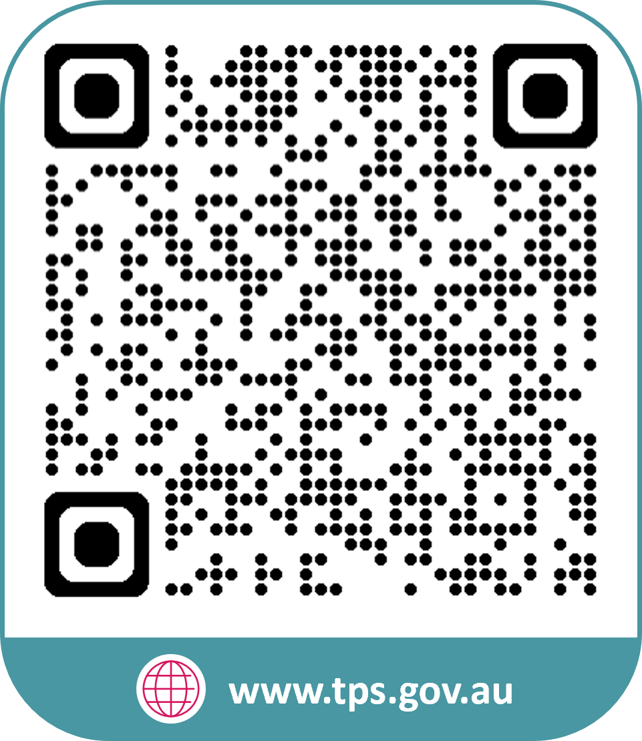


www.tps.gov.au
operations@tps.gov.au

