Slide 1
Welcome to the EFS
How to view payments & submit address collection
For approved authorities
February 2026

Slide 2


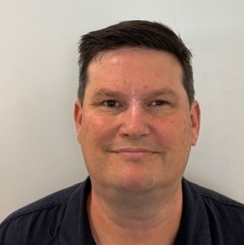
WELCOME TO
.
VIEW PAYMENTS
&
SUBMIT ADDRESS COLLECTION
Bethany Eggins
EFS Communication Lead
Education Funding System team
Department of Education
Saranga Witharana
Senior Program Officer
Schools Data Production team
Department of Education
Greg Wells
Assistant Director
School Approvals and Payments team
Department of Education

Slide 3

Acknowledgement of Country
The Department of Education respectfully acknowledges the Traditional Owners of Country throughout Australia and recognises their continuing connection to land, waters and community.
We pay our respect to Aboriginal and Torres Strait Islander cultures; and to Elders past and present.
Ancestral Lines, Jeremy Morgan Worrall : 2025 National NAIDOC Week Poster | NAIDOC | CC BY-NC-N4 4.0

Slide 4


AGENDA
PAYMENTS
ADDRESS COLLECTION
Payments hub
Data collection hub
Search payments
Submit address collection
View payments
Declare a data collection
View payment notifications
Search & monitor data collections

Slide 5
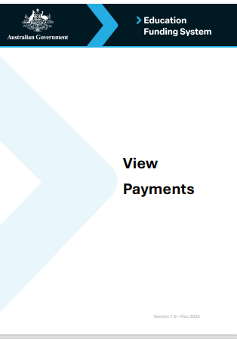
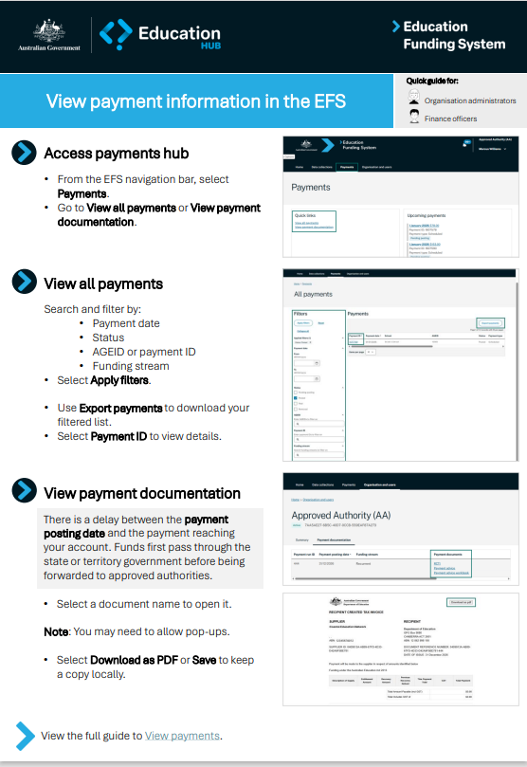
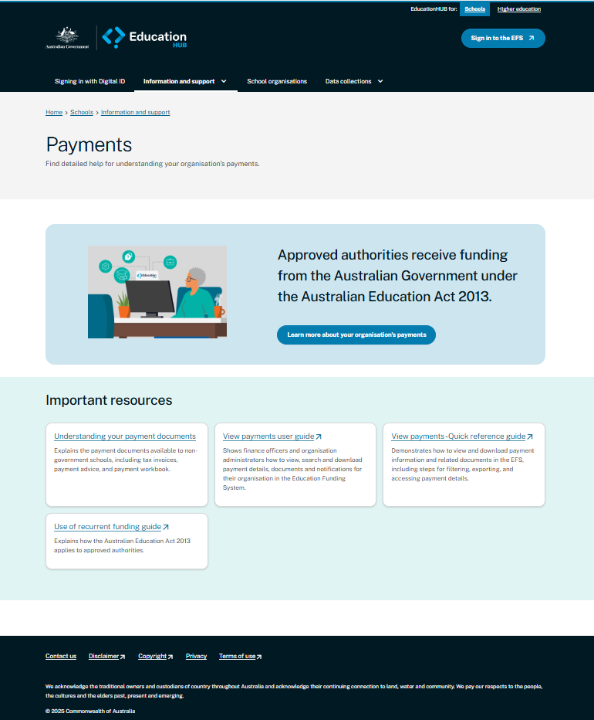

TRAINING MATERIALS
USER GUIDES
QUICK REFERENCE GUIDES
AVAILABLE ON EDUCATIONHUB
VIDEOS

Slide 6









6
6
Understanding change, preparing for the EFS
6
2025
RELEASE 1
17 November 2025
2026
WE ARE HERE!
OCTOBER | NOVEMBER | DECEMBER | JANUARY | FEBRUARY | MARCH
SCHOOL HOLIDAYS
RECURRENT
FUNDING PAYMENT
ADDRESS
COLLECTION
EMAIL & SUPPORT CAMPAIGN
WEBINARS
WEBINARS
WEBINARS
USER GUIDES
USER GUIDES
TRAINING
TRAINING
READINESS

Slide 7

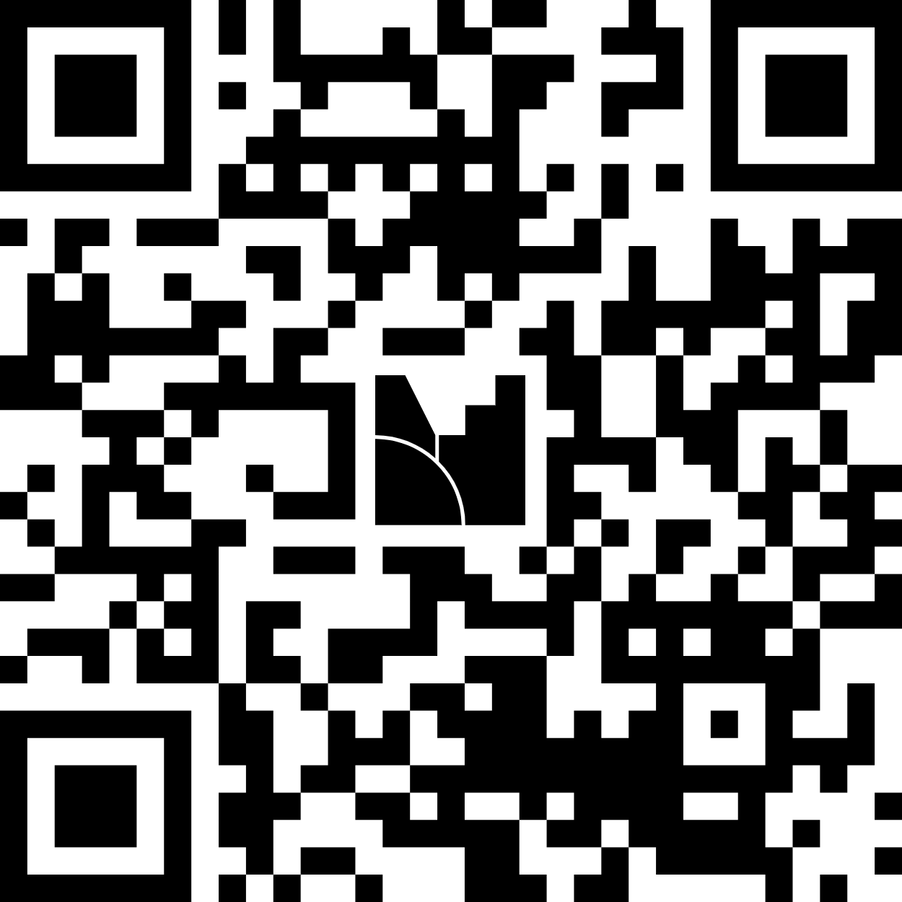
AUDIENCE PARTICIPATION
WWW.MENTI.COM
Enter the code
8699 8027

Slide 8









8
8
8
WHAT YOU NEED TO DO AND WHEN
8
STEP
BEFORE: 17 November 2025
STEP
ON: 17 November 2025
1
SET UP MYID
4
EFS
ACCESS THE EFS
myID
   COMPLETE
   COMPLETE
  WE ARE HERE!
STEP
BEFORE: 17 November 2025
STEP
FROM: January 2026
2
5
SET UP RAM
VIEW PAYMENT ADVICE
RAM
  January 2026 recurrent funding payment details available in EFS.
   COMPLETE
STEP
BEFORE: 17 November 2025
STEP
FROM: February 2026
3
CHECK ROLES
6
SUBMIT ADDRESS COLLECTION
   COMPLETE
  Submit February 2026 address collection.
  Use new browser-based validation tool (no XML batching required).

Slide 9
VIEW PAYMENTS

Slide 10





VIEW PAYMENTS USER ROLES
ORGANISATION
ADMINISTRATOR
ACCESS
MANAGER
FINANCE
OFFICER
DATA
DECLARER
DATA
REPORTER
Assign user roles | Assign user roles
Invite new users | Invite new users
View organisation details | View organisation details | View organisation details | View organisation details | View organisation details
View organisation role details | View organisation role details | View organisation role details | View organisation role details | View organisation role details
View school & school location details | View school & school location details | View school & school location details | View school & school location details | View school & school location details
View payments |  | View payments
View data collection details |  |  | View data collection details | View data collection details
View data collection requirements |  |  | View data collection requirements | View data collection requirements
Draft data collection requirements |  |  | Draft data collection requirements | Draft data collection requirements
Submit data collection requirements |  |  | Submit data collection requirements | Submit data collection requirements
Declare data collection requirements |  |  | Declare data collection requirements

Slide 11
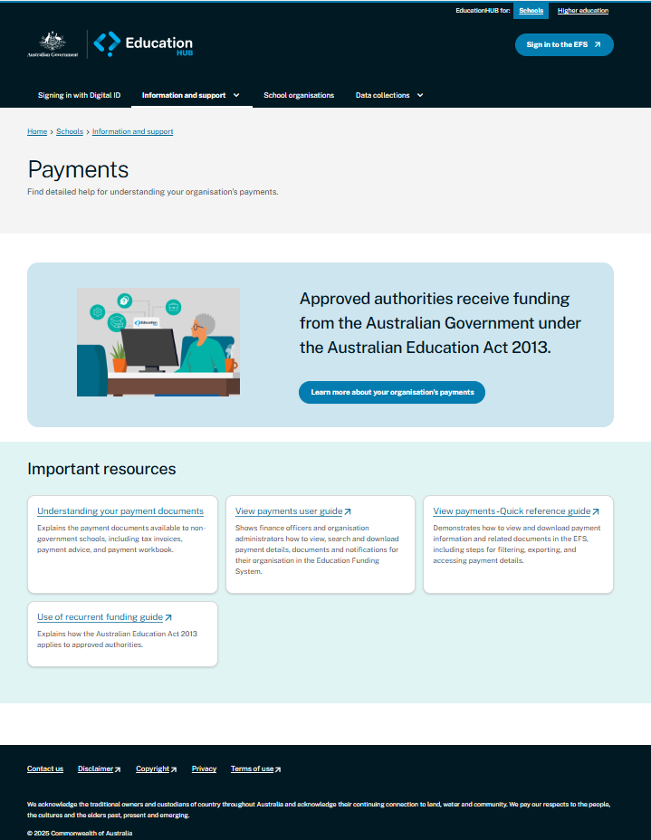
Payment support on
EducationHUB.gov.au
schools@education.gov.au
1800 677 027 (option 3)

Slide 12
SUBMIT ADDRESS COLLECTION

Slide 13
DATA COLLECTION USER ROLES
ORGANISATION
ADMINISTRATOR
ACCESS
MANAGER
FINANCE
OFFICER
DATA
DECLARER
DATA
REPORTER
Assign user roles | Assign user roles
Invite new users | Invite new users
View organisation details | View organisation details | View organisation details | View organisation details | View organisation details
View organisation role details | View organisation role details | View organisation role details | View organisation role details | View organisation role details
View school & school location details | View school & school location details | View school & school location details | View school & school location details | View school & school location details
View payments |  | View payments
View data collection details |  |  | View data collection details | View data collection details
View data collection requirements |  |  | View data collection requirements | View data collection requirements
Draft data collection requirements |  |  | Draft data collection requirements | Draft data collection requirements
Submit data collection requirements |  |  | Submit data collection requirements | Submit data collection requirements
Declare data collection requirements |  |  | Declare data collection requirements

Slide 14
STEPS TO SUBMITTING ADDRESS COLLECTION
​
1​
2​
3​
4​
5​
BEFORE YOU START
UPLOAD DATA
MANUAL ENTRY
REVIEW VALIDATIONS
ERRORS & WARNINGS
DECLARE
Address collection template on EducationHUB.
Select file and upload.
Manually enter student records with unusual circumstances.
Check overall data validity
Review and correct errors.
95% valid student records
95% for student records.
95% for guardian records.
XML file from your system
Review school locations (correct any errors).
Review and acknowledge warnings
95% valid guardian records.
Have your data ready to go.
Review statement of student addresses (correct any errors).
Action any errors.
No errors.
Option to manually drop location pins.
Warnings acknowledged.
Submit and declare

Slide 15
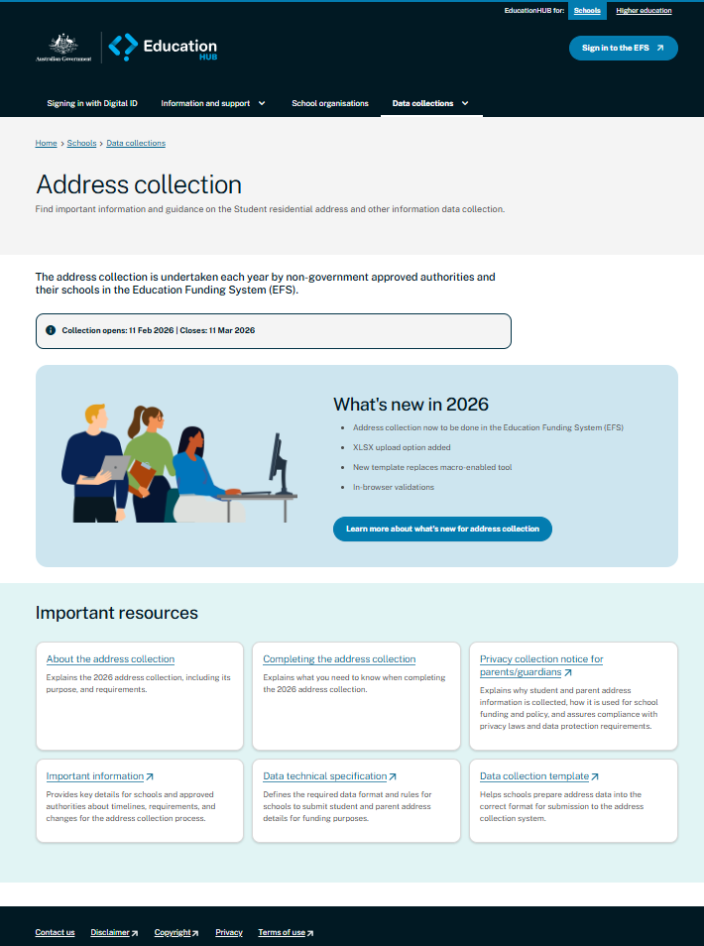
Address collection support on
EducationHUB.gov.au
seshelpdesk@education.gov.au
1800 677 027

Slide 16







16
16
REGISTER NOW
EXCEL DATA TEMPLATE
MAJOR CHANGES TO ADDRESS COLLECTION
XLSX | XML
CTC SCORES CAN ONLY BE CALCULATED ONCE ALL SCHOOLS
HAVE SUBMITTED ADDRESS COLLECTION DATA
ADDRESS COLLECTION
11 FEBRUARY to
11 MARCH 2026
CAN BE UPLOADED
DATA VALIDATIONS NOW
UNDERTAKEN IN-BROWSER
NO NEED FOR MACROS!
APPEND OR REPLACE OCCURS WITHOUT WARNING
PREVIOUS ADDRESS
COLLECTION TOOL
NO LONGER AVAILABLE
SUGGESTED ADDRESSES
NO LONGER AVAILABLE
NO DATA VISIBLE TO DOE
UNTIL SUBMITTED
(unsubmitted data is lost)
BASED ON LOCATION
AGEID AND SRN

Slide 17

QUESTIONS

Slide 18
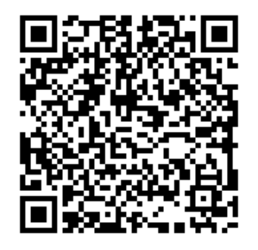
Education Funding
System
MORE THAN JUST
ANOTHER PLATFORM
CHANGE WILL
BE GRADUAL
BUT SUPPORT
WILL BE CONTINUOUS

