Slide 1
Welcome
NATIONAL HIGHER EDUCATION CODE TO PREVENT
AND RESPOND TO GENDER-BASED VIOLENCE
WEBINAR: Standard 3 of the National Code – Knowledge and Capability

Slide 2
Acknowledgement of Country
The Department of Education acknowledges the Traditional Owners and Custodians of Country throughout Australia and their continuing connection to land, waters and community. We pay our respects to them and their cultures, and Elders past and present.
We extend our respects to any Aboriginal and Torres Strait Islander people with us today.
Notes:
Acknowledgement of Country
I am joining you today from the crisp and beautiful lands of the Ngunnawal and Ngambri people, and I would like to begin by acknowledging the Traditional Owners and Custodians of Country throughout Australia and their continuing connection to land, waters and community. I pay my respects to them and their cultures, and Elders past and present.
I also extend that respect to any Aboriginal and Torres Strait Islander people with us today.

Slide 3
Victim-survivor acknowledgement
We acknowledge the profound strength, courage and resilience of those who have experienced gender-based violence. Their lived experiences and tireless advocacy have been instrumental in shaping the National Code.
We also recognise the commitment of advocates, practitioners and community members who have stood alongside victim survivors, amplifying their stories and driving change.

Slide 4
Agenda
Standard 3 Overview
Standard 3 Requirements
  Education and training
  Targeted and tailored communication
  Staff expertise
Q&A

Slide 5
Standard 3 –Knowledge and Capability
Building institutional capability
Comprehensive, trauma-informed education and training
Tailored communication initiatives
Staff expertise and experience for key roles
  Responding to disclosures
  Undertaking risk assessments
  Undertaking investigations
  Determining disciplinary procedures
11

Slide 6
Prevention Education and Training
  Content including
  Key concepts
    Gender-based violence
    Gender
    Drivers and contributing factors
    Power dynamics
    Respectful relationships
    Consent
Support services, reporting channels and resources
Ethical bystanders
Compassionate responses to disclosure
14

Slide 7
Prevention Education and Training
Supporting ongoing learning
Role of evidence, frameworks, approaches and practices
Moving beyond awareness to address drivers
Tailoring to target audiences
Trauma-informed
Culturally appropriate
Inclusive and accessible
Ensuring safe management of disclosure
14

Slide 8
Prevention Education and Training
Collaboration and engagement
Prevention experts
Students
Staff
People with experience of gender-based violence
People disproportionately affected
  Women
  First Nations people
  Culturally and linguistically diverse communities
  People with disability
  People of diverse sexual orientation and gender identity
14

Slide 9
Prevention communication and initiatives
Requirements
Evidence-informed communication across study, work, living and social environments
Planning considerations
Objectives, target audiences and outcomes
Tailored key messages, tested with target audiences
Methods to reach target groups
Activities that are:
  Accessible
  Inclusive
  Responsive to disproportionately impacted groups
13

Slide 10
Responding to disclosures education and training
Requirements
Enabling participants to apply trauma-informed and person-centred approaches
Increasing awareness of trauma’s effects
Accounting for community needs - particularly members disproportionally affected
  Women
  First Nations people
  Culturally and linguistically diverse communities
  People with disability
  People of diverse sexual orientation and gender identity
Safely managing arising disclosures
13

Slide 11
Monitoring and evaluation of education and training
Considerations
Learning outcomes
Feedback from
  Participants
  Prevention and response experts
Providers may be required to
Report on how evaluation has informed future education and training
Provide copies of evaluation reports
13

Slide 12
Expertise and experience
Required knowledge
Staff who undertake risk assessments, formal reports and investigations, and disciplinary proceedings
Evidence based risk and protective factors
Types, patterns and effects
Experiences with different groups of people
Coercive control
Additional knowledge
Staff who undertake risk assessments
Expertise in gender-based violence risk assessment
Competency with specific cohorts
13

Slide 13
Expertise and experience
Additional knowledge
Staff undertaking risk assessments, formal reports and investigations, and disciplinary proceedings:
Responding effectively to people who have experienced and use gender-based violence
Effects of trauma
Competency in working with specific cohorts
Procedural fairness
  Taking and recording statements
  Handling reports and disclosures
13

Slide 14
Q & A

Slide 15
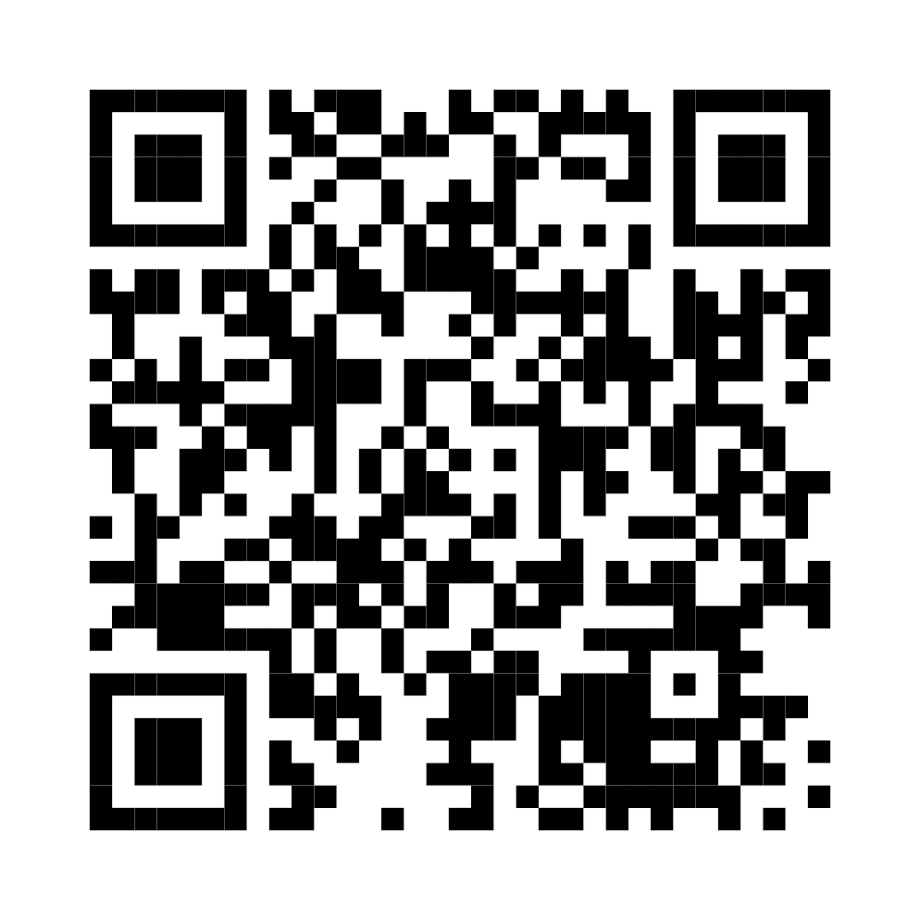
Thank you
https://www.education.gov.au/highereducationGBVcode

