Slide 1
Welcome
NATIONAL HIGHER EDUCATION CODE TO PREVENT
AND RESPOND TO GENDER-BASED VIOLENCE
WEBINAR: Standard 7 of the National Code - Safe Student Accommodation

Slide 2
Acknowledgement of Country
The Department of Education acknowledges the Traditional Owners and Custodians of Country throughout Australia and their continuing connection to land, waters and community. We pay our respects to them and their cultures, and Elders past and present.
We extend our respects to any Aboriginal and Torres Strait Islander people with us today.
Notes:
Acknowledgement of Country
I am joining you today from the crisp and beautiful lands of the Ngunnawal and Ngambri people, and I would like to begin by acknowledging the Traditional Owners and Custodians of Country throughout Australia and their continuing connection to land, waters and community. I pay my respects to them and their cultures, and Elders past and present.
I also extend that respect to any Aboriginal and Torres Strait Islander people with us today.

Slide 3
Victim-survivor acknowledgement
We acknowledge the profound strength, courage and resilience of those who have experienced gender-based violence. Their lived experiences and tireless advocacy have been instrumental in shaping the National Code.
We also recognise the commitment of advocates, practitioners and community members who have stood alongside victim survivors, amplifying their stories and driving change.

Slide 4
Agenda
Overview of Standard 7
  Requirements for:
    Staff screening and staff declarations
    Directly owned, operated or managed student accommodation
    Controlled or affiliated student accommodation
  Next Steps
  Q&A

Slide 5
Three distinct categories
  Directly owned, managed and/or operated by a higher education provider
  Otherwise under the control of a higher education provider
  Affiliated with a higher education provider
Accountability for meeting National Code requirements in student accommodation lies with the higher education provider.
National Code - Application to student accommodation
11

Slide 6
Staff screening and declarations
Requirements for directly owned, operated or managed student accommodation
Student accommodation staff to declare investigations or determinations of gender-based violence
Consider declaration made and arising risks in determining suitability for positions
Consider substantiated allegation with respect to engagement, promotion or recognition
Ask staff to declare past or present intimate personal relationships with residents and manage conflicts of interest
14

Slide 7
Directly owned, managed and/or operated student accommodation
Higher education provider requirements for directly owned, managed and/or operated student accommodation:
Included in Whole-of-Organisation Prevention and Response Plans
Included in actions to comply across Standards 1 – 6
14

Slide 8
Controlled or affiliated student accommodation
Requirements
  Whole of organisation approach
  Safe environments and systems
  Knowledge and capability
  Safety and support
  Data, evidence and impact
14

Slide 9
Whole-of-organisation approach
Whole-of-Organisation Prevention and Response Plan
Approaches to prevent and respond to gender-based violence prioritising safety
Actions to address drivers of gender-based violence
Actions to address systemic gender-based violence risks and barriers
An overview of how requirements under Standards 7.2 - 7.8 will be met
13

Slide 10
Safe environments and systems
Arrangements to be in place, so that student accommodation providers:
Mitigate risks related to any staff history of gender-based violence and intimate personal relationships with a resident
Have appropriate gender-based violence policies and procedures compliant with Standard 5: Safe processes, reviewed at least every three years
Amend policies on the use of non-disclosure and non-disparagement agreements
14

Slide 11
Knowledge and capability
Requirements
Staff and residents are trained in person-centred and trauma-informed prevention and responding to disclosure
Evidence-based prevention communication tailored to student accommodation settings
Undertake risk assessments for disclosures and formal reports by people with the right expertise
15

Slide 12
Safety and support
Responses to disclosure are safe, trauma-informed and person-centred
Promoting access to policies, procedures and support services
If disclosures are made:
  Immediate action to assess and manage risk and prioritise safety
  Enabling disclosers to choose whether their higher education or student accommodation provider lead responses
  Ensuring risk assessments and support plans for disclosers and respondents developed within 48 hours
  Consulting the discloser wherever possible and considering their views
16

Slide 13
Data, evidence and impact
Requirements
Data is collected in a safe, trauma-informed and person-centred manner and is handled securely
Data is used to strengthen the Whole-of Organisation Prevention and Response Plan
Data collection informs evaluation, impact and planning for prevention and response approaches
Providing data to the Department of Education to meet annual data and other reporting requirements
17

Slide 14
What happens next?
The National Code commences on 1 January 2026
Data collection from 1 January 2026 (Table A + B providers)
Prepare, implement and publish a Whole-of-Organisation Prevention and Response Plan
By 30 June each year, higher education providers to provide the names of student accommodation providers that are:
  directly owned, operated, or managed
  under the control
  affiliated

Slide 15
Q & A

Slide 16
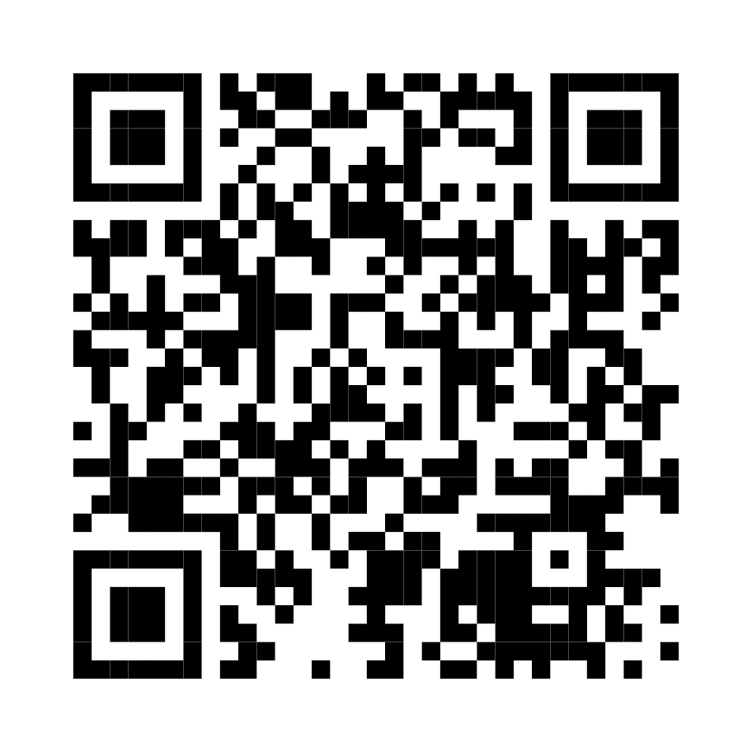
Thank you
https://www.education.gov.au/highereducationGBVcode

