Slide 1


2026 International TPS Levy
Sector Consultation Feedback on Draft Levy Settings
5 November 2025
Kate Tagg
TPS Program Management
www.tps.gov.au

Slide 2
Outline
2026 International TPS Levy consultation summary
Levy components and draft 2026 settings
2026 levy timeline
www.tps.gov.au

Slide 3
2026 International TPS Levy Consultation Summary
www.tps.gov.au

Slide 4
2026 International TPS Levy Setting Process
20 August 2025 | TPS Advisory Board provided draft advice to the TPS Director on the 2026 International Levy settings
Sept-Oct 2025 | TPS consults the sector on the draft levy settings
19 November 2025 | TPS Advisory Board considers the sector’s feedback on the draft levy settings then provides final advice to the TPS Director
By 1 January 2026 | 2026 levy settings finalised in legislative instruments
www.tps.gov.au

Slide 5
2026 International TPS Levy Consultation
Consultation sessions for leviable providers included:
An online session for all providers on 2 September
Six in-person sessions in Melbourne, Sydney, Brisbane and Perth
An online session for providers registered in SA, NT, ACT and TAS
An online session for regional providers
Representatives from peak bodies were also consulted
www.tps.gov.au

Slide 6
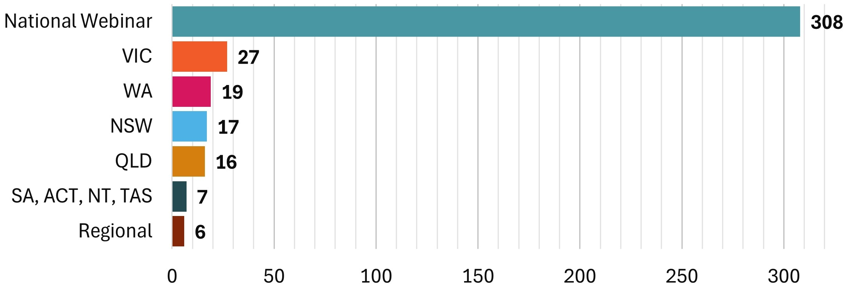
Consultation Session Attendance
Notices about consultation were sent to contacts in PRISMS for leviable providers
400 individuals attended
www.tps.gov.au

Slide 7
Summary of Consultation Feedback
Overall, providers were supportive of the draft 2026 International TPS Levy settings and welcomed holding at the same rates as 2025
Providers were understanding of the need to increase to the target range of the Overseas Students Tuition Fund from $40-60 million to $50-70 million, reflecting higher student numbers and higher tuition fee income
Providers were supportive of the proposal to introduce an additional data point to the ‘non-compliance’ risk factor in 2026 for providers that had at least one student default occur where the refund amount was paid out by the TPS in the previous calendar year
Discussions at the in-person sessions focussed on providers’ obligations to students where a student visa was refused
www.tps.gov.au

Slide 8
2026 International TPS Levy
Levy components, draft 2026 settings and timeline
www.tps.gov.au

Slide 9
Overseas Students Tuition Fund (OSTF)
International TPS Levy paid into OSTF
AGA recommends target range for OSTF to ensure sufficient funds are available for a large provider closure or multiple provider closures
AGA recommends increasing 2026 target range due to increased international student population and tuition fees charged by providers
Balance: $50.45 million (30 June 2025)
Target range | Mid-point of target range
Current: $40-60 million | Current: $50 million
2026 recommendation: $50-70 million | 2026 recommendation: $60 million
www.tps.gov.au

Slide 10
Draft 2026 International TPS Levy Settings
Component | Draft 2026 Settings
Administrative fee* | $107.00 per provider + $0.56 per 2025 overseas student enrolment
Base fee* | $216.00 per provider + $1.37 per 2025 overseas student enrolment
Risk rated premium | [0.05% x total risk factor value] x total 2025 overseas student tuition fees
Special tuition protection | 0% x total 2025 overseas student tuition fees
*Administrative and base fee figures reflect 2025 values and may be indexed to CPI for 2026
Note: 2026 levy calculated using student enrolment numbers and revenue for 2025 calendar year
www.tps.gov.au

Slide 11
2026 International TPS Levy Timeline
August 2025
Sept – Nov 2025
November 2025
December 2025
Feb – May 2026
20 August
Draft advice on 2026 international levy confirmed at TPS Advisory Board meeting
Late August
Draft advice letter published on TPS website
2 September
Online consultation session for all providers
September-October
Consultation sessions in Melbourne, Sydney, Brisbane and Perth
Online sessions for SA, NT, ACT, TAS providers and regional providers
Meetings with stakeholders
5 November
Online feedback session for all providers
19 November
TPS Advisory Board considers sector feedback
Final advice on 2026 International TPS Levy settings confirmed at Board meeting
Mid-November
Legislative instrument drafted and sent to Treasurer
Department of Education briefing for Administrative and Base Fee Components sent to Minister for Education
31 December
Legislative instrument must be approved by Treasurer and signed off by TPS Director
February
Non-exempt providers receive a Request for Information to declare 2025 overseas students tuition fee income and domestic student enrolment figures
March
2026 levy invoices sent to providers
April-May
International levy collected
www.tps.gov.au

Slide 12
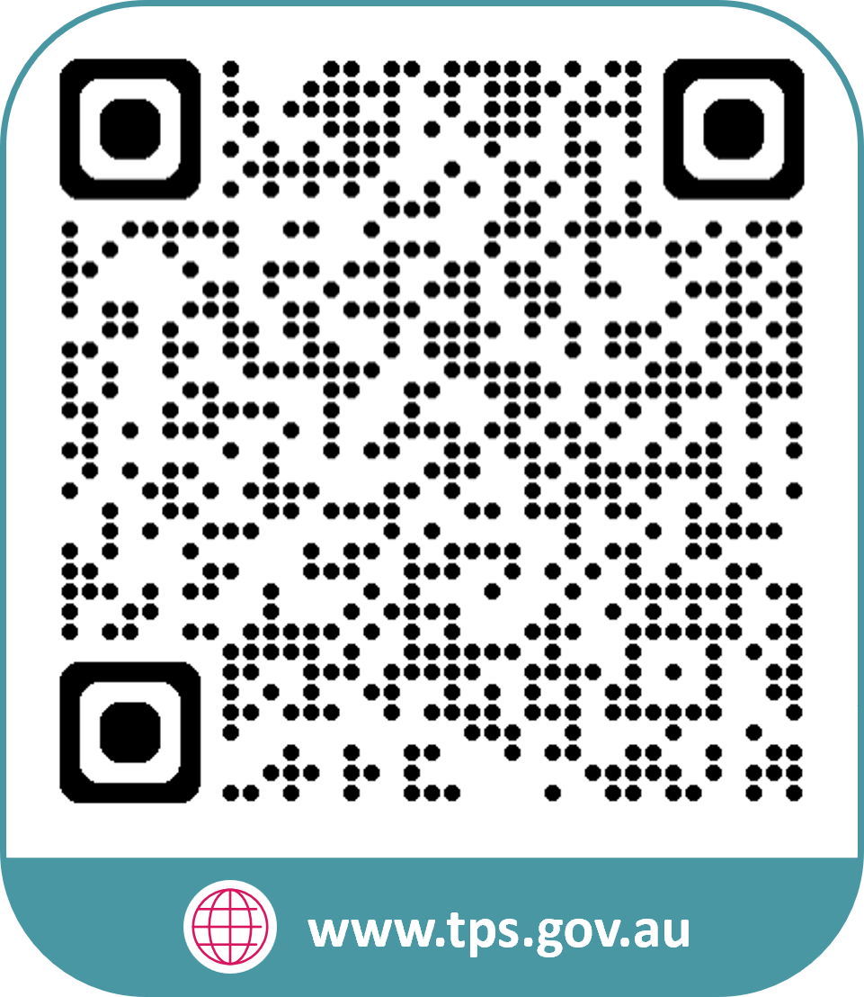


www.tps.gov.au
operations@tps.gov.au

