Slide 1
Education Funding System
Understanding the Change, preparing for EFS
October 2025

Slide 2


Education Funding System
Part 1
Understanding the change, preparing for the EFS recap delivery schedule transitioning to the EFS changes for approved authorities onboarding support
How-to demonstrations how to set up myID how to set up RAM
Bethany Eggins
EFS Communication Lead
Education Funding System team
Department of Education
Part 2
Pam Weekes
EFS Training Manager
Education Funding System team
Department of Education

Slide 3

Acknowledgement of Country
The Department of Education respectfully acknowledges the Traditional Owners of Country throughout Australia and recognises their continuing connection to land, waters and community.
We pay our respect to Aboriginal and Torres Strait Islander cultures; and to Elders past and present.
Ancestral Lines, Jeremy Morgan Worrall : 2025 National NAIDOC Week Poster | NAIDOC

Slide 4







4
4
Understanding change, preparing for the EFS
4
This webinar is an overview of the onboarding process, with details of what you need to do ahead of accessing the EFS on 17 November 2025.
RELEASE 1
17 November 2025
2025
2026
OCTOBER | NOVEMBER | DECEMBER | JANUARY | FEBRUARY | MARCH
SCHOOL HOLIDAYS
EMAIL & SUPPORT CAMPAIGN
WEBINARS
WEBINARS
USER GUIDES
USER GUIDES
TRAINING
TRAINING
READINESS

Slide 5
EFS Recap

Slide 6





EDUCATION
FUNDING
SYSTEM
$51 BILLION
MODERN
RESILIENT
FLEXIBLE
NEW DIGITAL
PLATFORM
EFS
GOVERNMENT FUNDING
SCHOOLS & HIGHER EDUCATION
BETTER
USER
EXPERIENCE
STREAMLINED
DATA COLLECTIONS &
PAYMENT PROCESSES
REPLACING
SCHOOLSHUB
APPROVED
AUTHORITIES
SUBMIT
DATA
UPLIFT CYBER SECURITY
myID
VIEW
PAYMENT
ADVICE
WITH DIGITAL ID
FROM NOVEMBER 2025

Slide 7
7
DELIVERY SCHEDULE
7
APPROVED AUTHORITIES
  EFS via EducationHUB.gov.au using Digital ID (myID)
  Invite your approved authority users
  View payment advice
  Submit school data collections
  SchoolsHUB remains available for historical data and organisation management
RELEASE 5
RELEASE 4
RELEASE 3
RELEASE 2
RELEASE 1
currently scheduled
for March 2026
NOVEMBER 2025
DECEMBER 2026

Slide 8
8
DELIVERY SCHEDULE
8
BGAs & NGRBs
RELEASE 5
RELEASE 4
RELEASE 3
RELEASE 2
RELEASE 1
NOVEMBER 2025
DECEMBER 2026

Slide 9
9
DELIVERY SCHEDULE
9
HIGHER EDUCATION PROVIDERS
RELEASE 5
RELEASE 4
RELEASE 3
RELEASE 2
RELEASE 1
NOVEMBER 2025
DECEMBER 2026

Slide 10












10
10
10
EFS ECOSYSTEM
10
EducationHUB
Digital ID
myID
RAM
EFS
the Entry Point | the Security Framework | the App | the Link | the Platform
Entry point for education providers to access the EFS
Australian Government secure identity verification system
Trusted, government-approved way to prove who you are online
Create and manage your Digital ID
Just like a 100-point ID check
Used to access online government services
Connects your myID to your organisations ABN
Allows you to act on behalf of your organisation in the EFS
Your new platform for transacting with the Department of Education
Replacing SchoolsHUB
View payment information
Submit data collections
Manage your organisation

Slide 11
Changes for AAs

Slide 12



12
12
12
12
3 KEY CHANGES FOR APPROVED AUTHORITIES
12
SYSTEM
ACCESS
DATA
COLLECTIONS
PAYMENTS

Slide 13
13
13
SYSTEM ACCESS
13
SYSTEM ACCESS
ROLE MANAGEMENT
FROM
RELEASE 1
in the EFS
A new digital platform: EFS
via EducationHUB.gov.au
Digital ID (myID and RAM)
Principal Authority link and manage organisations ABN and authorise users
Organisation Administrator role in EFS
(previously Authority Representative)
Organisation Administrator and Access Managers add users and grant permissions
Users receive an email inviting them to accept the role
Most roles will remain the same (Access Manager, Data Reporter, Data Declarer, Finance Officer)
Only key individuals should be assigned to Access Manager, Data Declarer and Finance Officer roles.
SYSTEM
ACCESS

Slide 14
14
14
PAYMENTS
14
PAYMENT INFORMATION
ROLE MANAGEMENT
HISTORICAL DATA
FROM
RELEASE 1
in the EFS
EFS
  January 2026 recurrent funding payment will be the first processed through EFS.
  Payment details viewable in EFS from January 2026.
  Users with Finance Officer or Organisation Administrator roles can view payment information in EFS.
  SchoolsHUB remains for historical data until later releases.
PAYMENTS

Slide 15
15
15
DATA COLLECTIONS
15
DATA COLLECTIONS – ADDRESS COLLECTION
FROM
RELEASE 1
in the EFS
  First collection in EFS: February 2026 Address Collection
  All future data collections via the EFS in line with existing timeframes
  Simplify the process of providing data to the department
  Browser-based validation replaces XML creation step
  No batching for large uploads (>5,000 rows)
  Data attributes unchanged – same information as before
  Notifications will be sent from EFS.
DATA
COLLECTIONS

Slide 16
16
16
16
ENHANCEMENTS FROM RELEASE 2
16
ORGANISATION MANAGEMENT
RELEASE 5
ELIGIBILITY & ENTITLEMENT
USER MANAGEMENT
RELEASE 4
CONTACT CENTRE
RELEASE 3
RELEASE 2
RELEASE 1
currently scheduled
for March 2026
NOVEMBER 2025
DECEMBER 2026

Slide 17
Education Funding System
Sneak Peak

Slide 18


Slide 19
Onboarding to EFS

Slide 20








20
20
20
WHAT YOU NEED TO DO AND WHEN
20
STEP
BEFORE: 17 November 2025
STEP
ON: 17 November 2025
1
SET UP MYID
4
EFS
ACCESS THE EFS
  Download the myID app and create your Digital ID.
  Ensure identity strength is at least Standard
  (Strong recommended) for regular users.
  Strong is required for Principal Authorities to link the business online.
  Log in using Digital ID.
  Invite other users to access the EFS.
myID
STEP
BEFORE: 17 November 2025
STEP
FROM: January 2026
2
5
SET UP RAM
VIEW PAYMENT ADVICE
RAM
  January 2026 recurrent funding payment details available in EFS.
  Principal Authority links the organisation’s ABN in Relationship Authorisation Manager (RAM).
  Authorise users to act on behalf of the organisation.
STEP
BEFORE: 17 November 2025
FROM: February 2026
STEP
3
CHECK ROLES
6
SUBMIT ADDRESS COLLECTION
  Identify who will be Organisation Administrator, Access Manager, Data Declarer, Data Reporter and Finance Officer.
  We recommend you make sure people responsible for the 2026 Address Collection have their myID and been authorisations in RAM before the school holidays commence!
  Submit February 2026 address collection.
  Use new browser-based validation tool (no XML batching required).

Slide 21
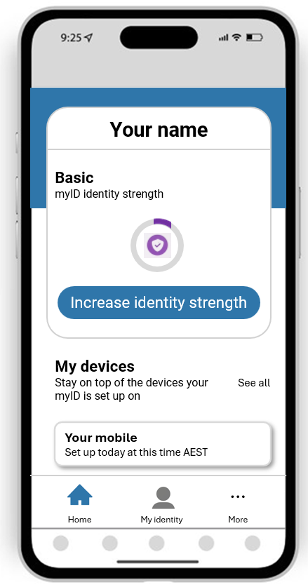
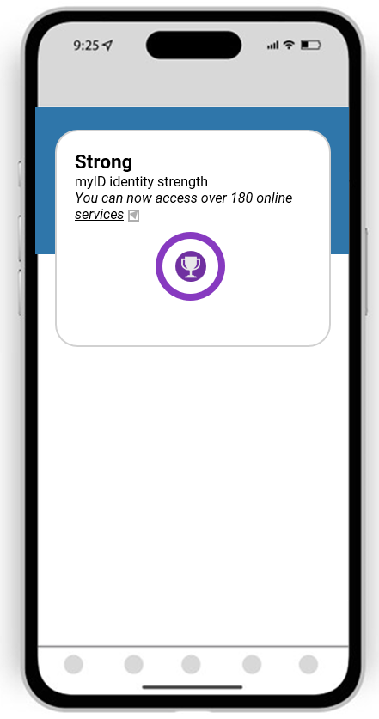
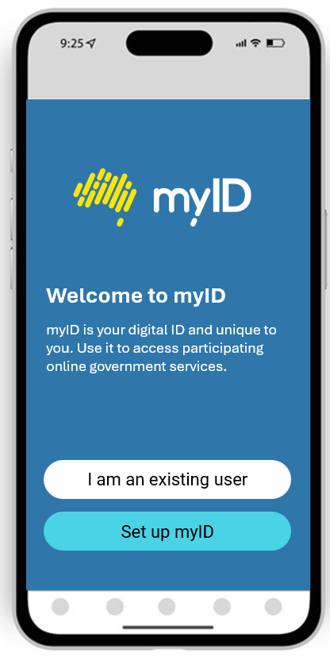



21
21
21
21
myID
21
STEP
RECOMMENDED BEFORE: 17 November 2025
1
SET UP MYID
myID
3. Set your identity strength
2. Enter your details
1. Download myID app

Slide 22



22
22
22
22
22
RAM
22
STEP
RECOMMENDED BEFORE: 17 November 2025
2
SET UP RAM
RAM
Setting up RAM as the Principal Authority
Setting up RAM as a non-Principal Authority
NOTE: the Principal Authority’s
identity strength must be set to Strong.
NOTE: your identity strength must be at least Standard, however Strong is recommended when accessing government services online.
Prepare your myID
Go to the RAM website
Follow the steps to link your business ABN
Invite users to act on behalf of your organisation
Prepare your myID
Receive your invitation
Go to the RAM website and accept the authorisation
https://authorisationmanager.gov.au
SUBJECT: RAM – authorisation request
HOT TIP! Check your details on the Australian Business Register (ABR).
Your name in the ABR must match your Digital ID (myID) details.

Slide 23


23
23
23
23
23
CHECK YOUR ORGANISATIONAL ROLES
23
RECOMMENDED BEFORE: 17 November 2025
STEP
3
CHECK ROLES
Who in your organisation will be the
Organisation Administrator
Access Manager
Data Declarer
DATA REPORTER
Finance Officer
in the EFS?
  Make sure the roles responsible for
  Address Collections are prioritised,
  set up and ready before February 2026!

Slide 24
24
24
24
24
24
EFS ACCESS
24
ON: 17 November 2025
STEP
4
EFS
ACCESS THE EFS
ACCESS THE EFS
Principal Authorities
Sign into the EFS via EducationHUB using your Digital ID.
Invite other users and assign roles
Other Users
Receive an email inviting you to access the EFS
Follow the instructions in your EFS invitation email to complete your onboarding.
Sign into the EFS via EducationHUB using your Digital ID.
HOT TIP! Principal Authorities and will automatically have access to the EFS once the ABN has been linked.

Slide 25
Support

Slide 26





SUPPORT
26
A comprehensive communication and training campaign has commenced
and will be ongoing through to December 2026
ONLINE BRIEFINGS
EMAIL
UPDATES
WEBSITE
UPDATES
USER GUIDES &
TRAINING MATERIALS

Slide 27

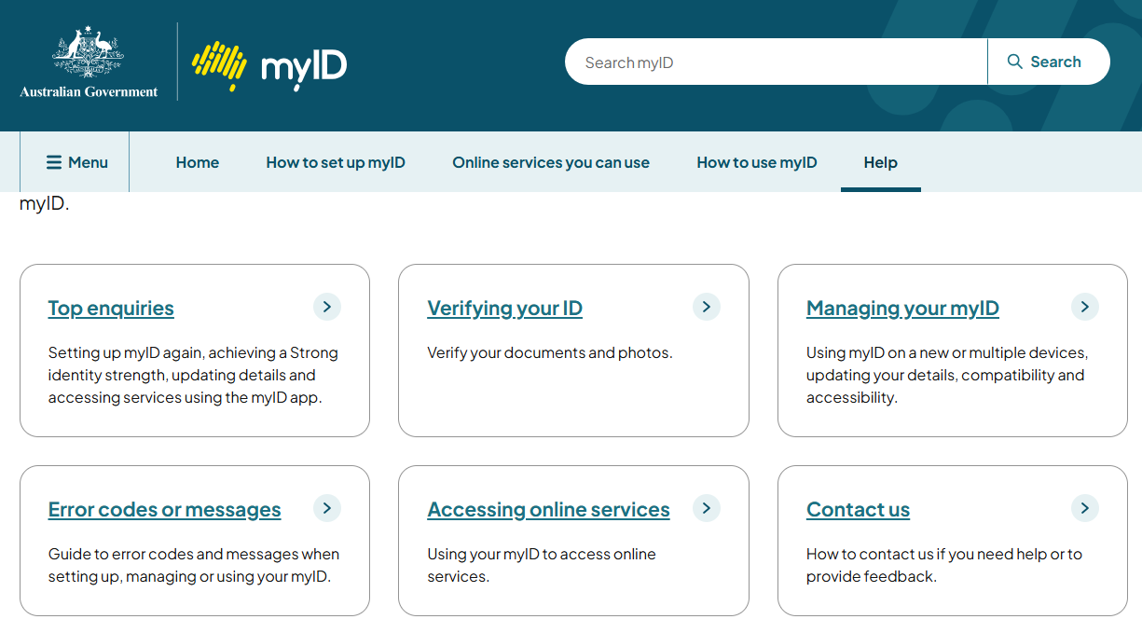
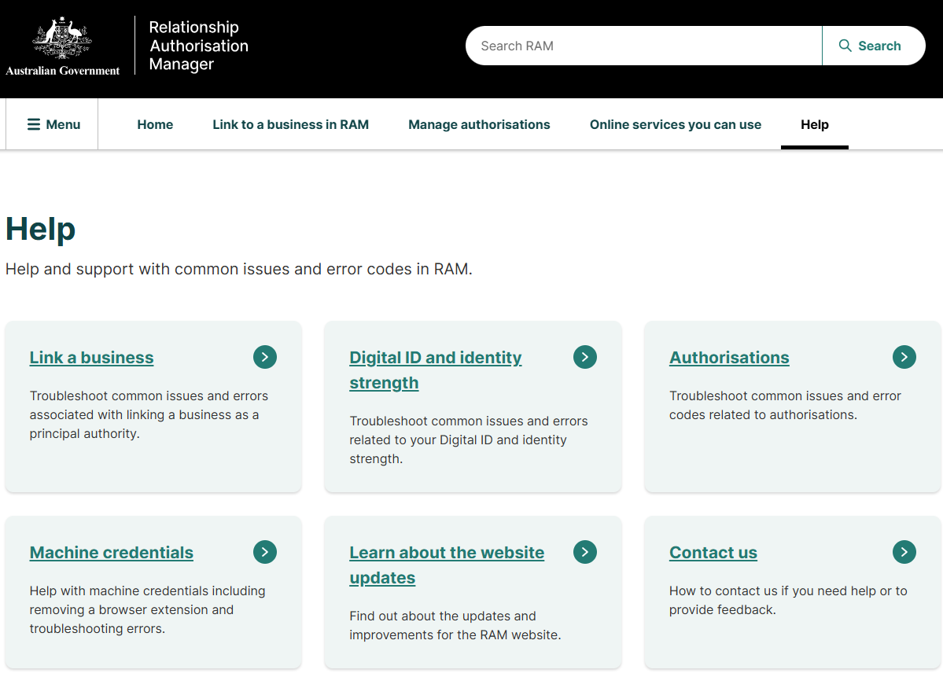
27
27
27
27
27
SUPPORT
27
EDUCATION
AUSTRALIAN TAXATION OFFICE (ATO)
Information, training and support for the Education Funding System
www.education.gov.au/efs
EFSengagement@education.gov.au
myID support, including issues obtaining required identity strength
www.myID.gov.au
RAM support, help linking ABN
info.authorisationmanager.gov.au

Slide 28

QUESTIONS?

Slide 29

Education
Funding
System
more than just another new platform
change will be gradual
but support will be continuous

