Slide 1


2026 International TPS Levy
Sector Consultation on Draft Levy Settings
Sept-Oct 2025
Kate Tagg
TPS Program Management
www.tps.gov.au

Slide 2
Outline
Tuition Protection Service (TPS)
International TPS Levy overview and collection history
Levy components and draft 2026 settings
2026 levy timeline and takeaways
www.tps.gov.au

Slide 3
Tuition Protection Service (TPS)
TPS Director, team and Advisory Board
www.tps.gov.au

Slide 4
Purpose of the Tuition Protection Service (TPS)
Australian Government initiative
Student tuition protection scheme
Developed for international student fee protection and expanded to specified domestic students
Supports students with tuition fee refunds and facilitates alternative course placements following provider closures
Supports education providers to understand and meet obligations to students
Manages tuition protection levy collections
www.tps.gov.au

Slide 5
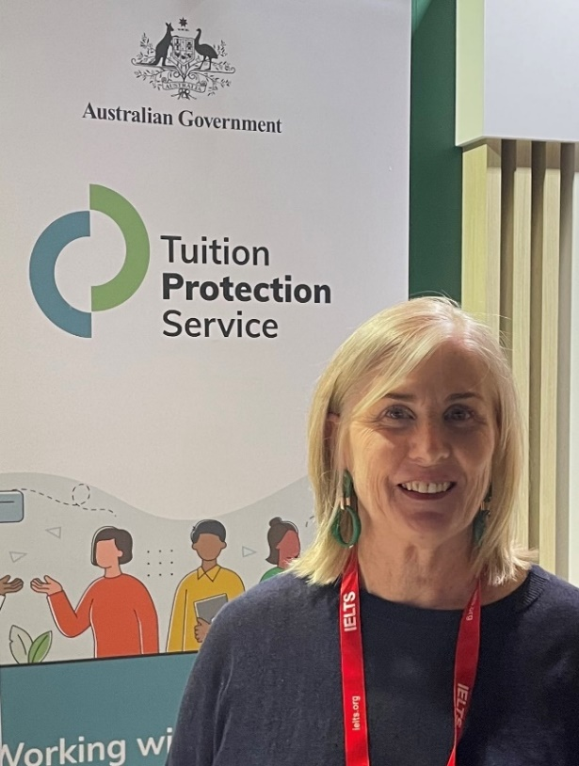
Tuition Protection Service Director
Melinda Hatton, TPS Director
Statutory office holder appointed by the federal Minister for Education
Operational oversight of the daily activities of the TPS
Responsible for the annual collection of TPS levies from CRICOS and eligible domestic education providers
Responsible for managing the levy funds
www.tps.gov.au

Slide 6

TPS Team
www.tps.gov.au

Slide 7
TPS Advisory Board
View Board member profiles at tps.gov.au
Ms Sharon Robertson (Chair)
The Hon. Phil Honeywood (Deputy Chair)
Ms Karen Sandercock, Australian Government Department of Education
Ms Renae Houston, Australian Government Department of Employment and Workplace Relations
Mr Guy Thorburn, Australian Government Actuary
Ms Sophia Hohnen, Australian Prudential Regulation Authority
Ms Rebecca Mok, Australian Government Department of Finance
Ms Libby McDonald, Australian Government Department of Home Affairs
www.tps.gov.au

Slide 8
TPS Advisory Board’s Advice on Levy Settings
When formulating its advice, the Board considers a range of factors including:
The strategic risk environment
Advice from the Australian Government Actuary (AGA)
Views of the sector regulators, industry peak bodies and education providers
The balance of the OSTF and the quantum of funds required for its long-term sustainability
www.tps.gov.au

Slide 9
International TPS Levy
Overview and Collection History
www.tps.gov.au

Slide 10
International TPS Levy
An annual tuition protection levy collected from international education providers
Paid into the Overseas Students Tuition Fund (OSTF) – a quarantined account managed by the TPS Director
Funds the student placement and refund activities of the TPS following an international education provider closure and TPS operational costs
Levy calculation based on an education provider’s size and risk of closure
Legislative Authority: Education Services for Overseas Students (TPS Levies) Act 2012
www.tps.gov.au

Slide 11
International TPS Levy Setting Process
20 August 2025 | TPS Advisory Board provided draft advice to the TPS Director on the 2026 International Levy settings
Sept-Oct 2025 | TPS Director consults the sector on the draft levy settings
19 November 2025 | TPS Advisory Board considers the sector’s feedback on the draft levy settings then provides final advice to the TPS Director
By 1 January 2026 | 2026 levy settings finalised in legislative instruments
www.tps.gov.au

Slide 12
Overseas Students Tuition Fund (OSTF)
International TPS Levy paid into OSTF
AGA recommends target range for OSTF to ensure sufficient funds are available for a large provider closure or multiple provider closures
AGA recommends increasing 2026 target range due to increased international student population and tuition fees charged by providers
Balance: $50.45 million (30 June 2025)
Target range | Mid-point of target range
Current: $40-60 million | Current: $50 million
2026 recommendation: $50-70 million | 2026 recommendation: $60 million
www.tps.gov.au

Slide 13
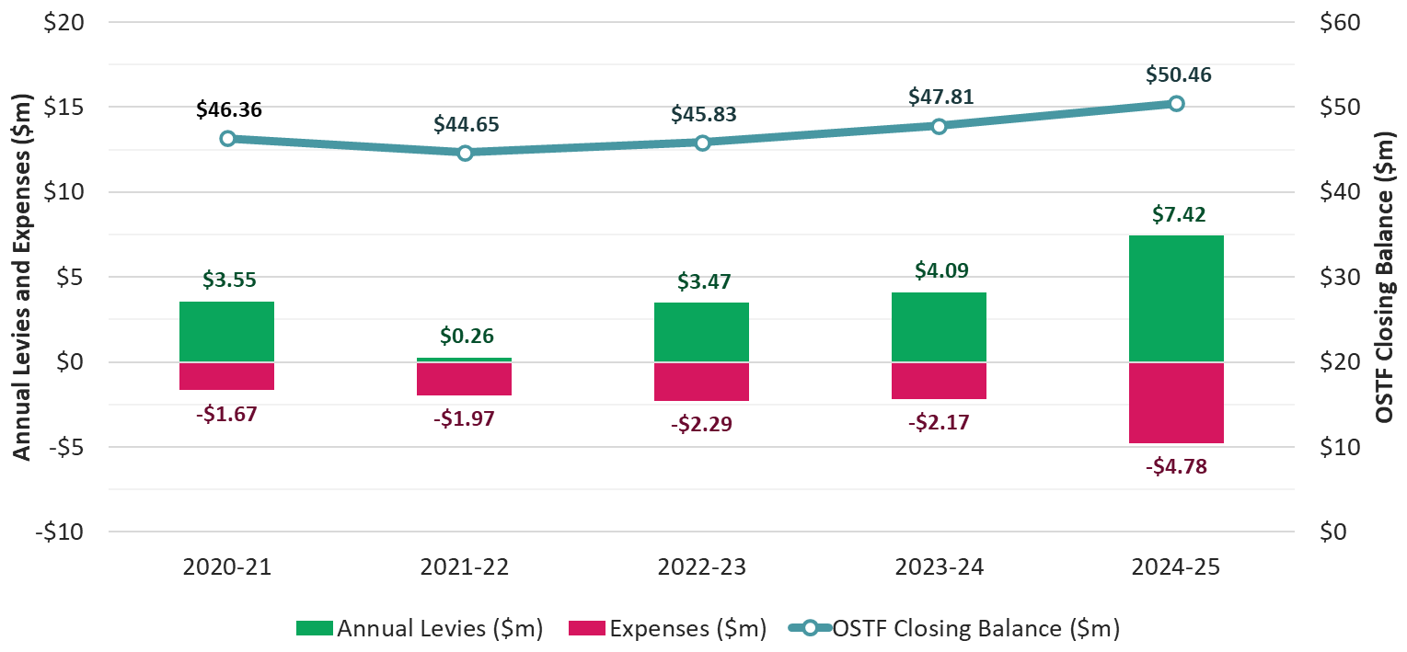
Fund Balance, Annual Levies and Expenses – Last 5 Financial Years
www.tps.gov.au

Slide 14
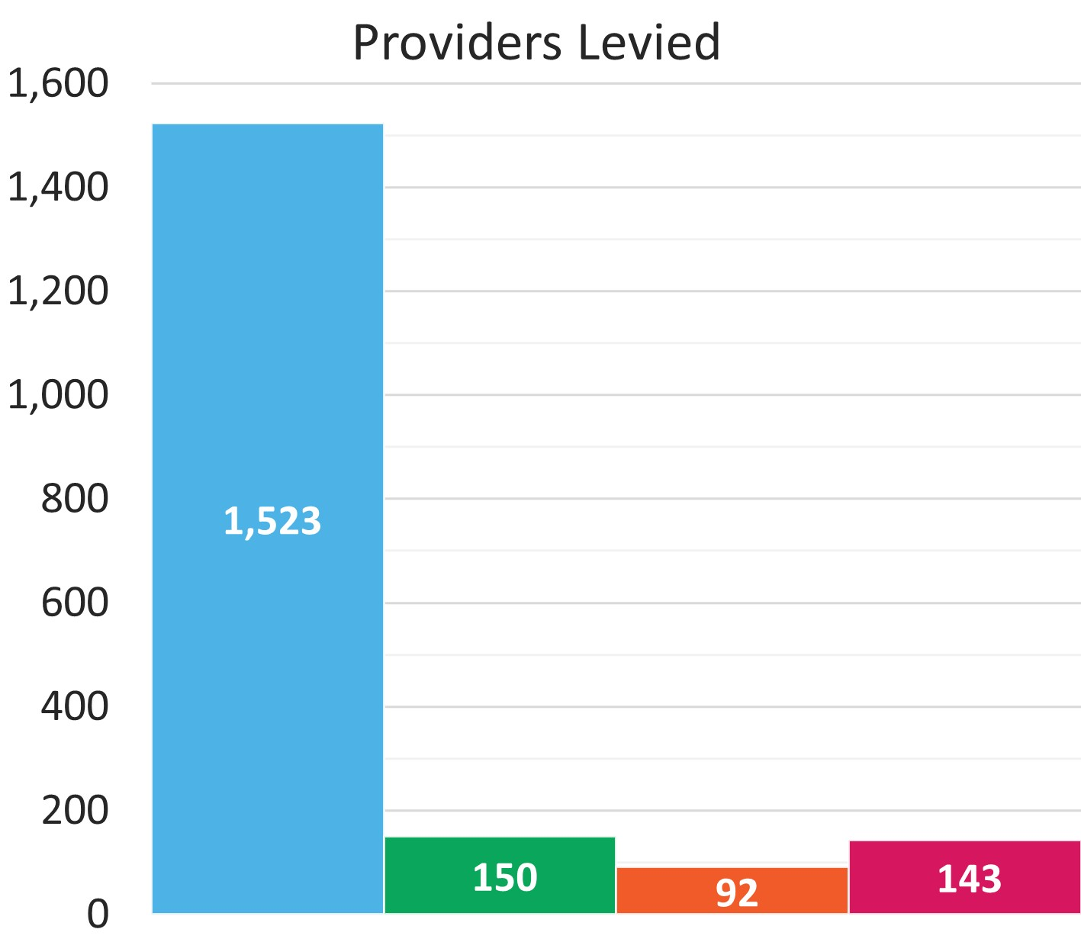
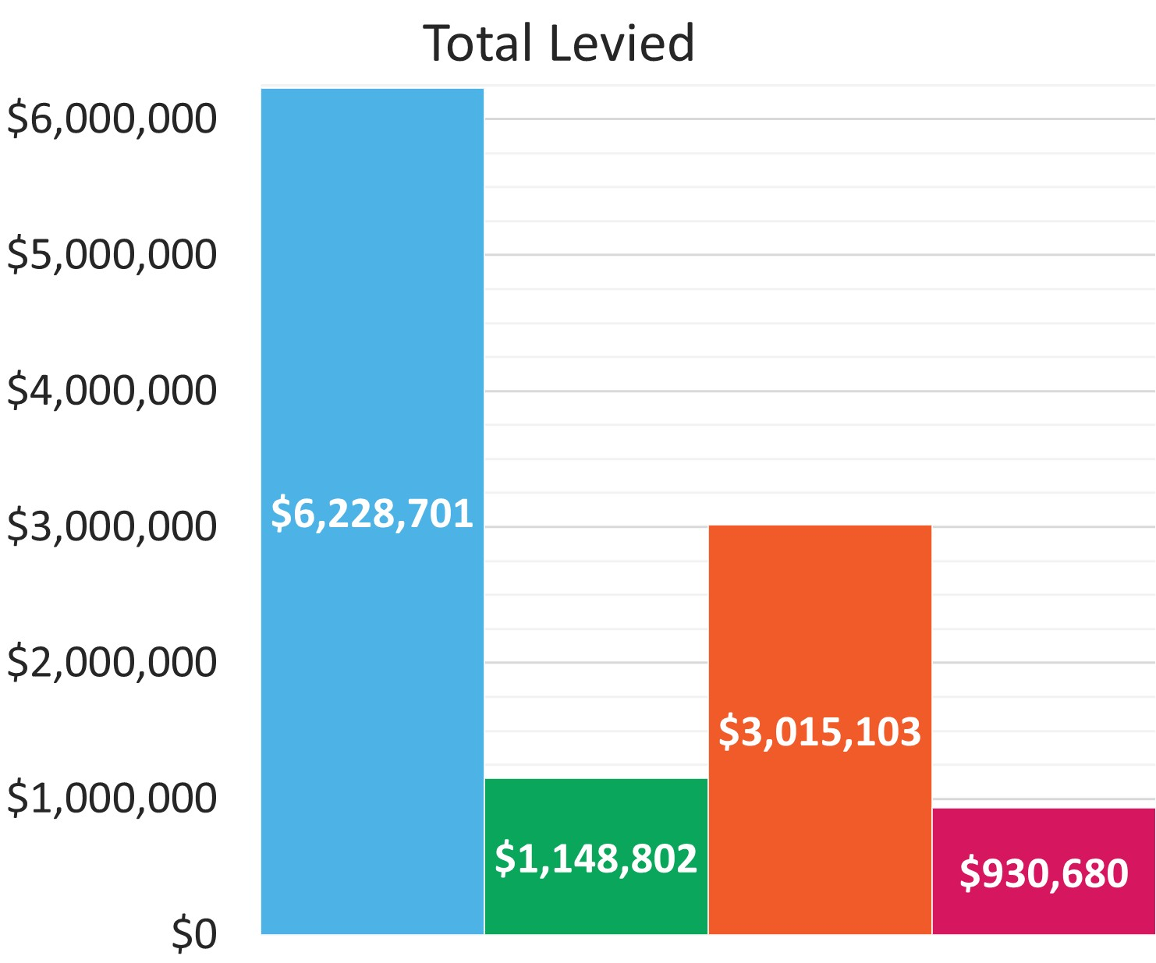
TPS Levy Collection Overview 2024-25
www.tps.gov.au

Slide 15
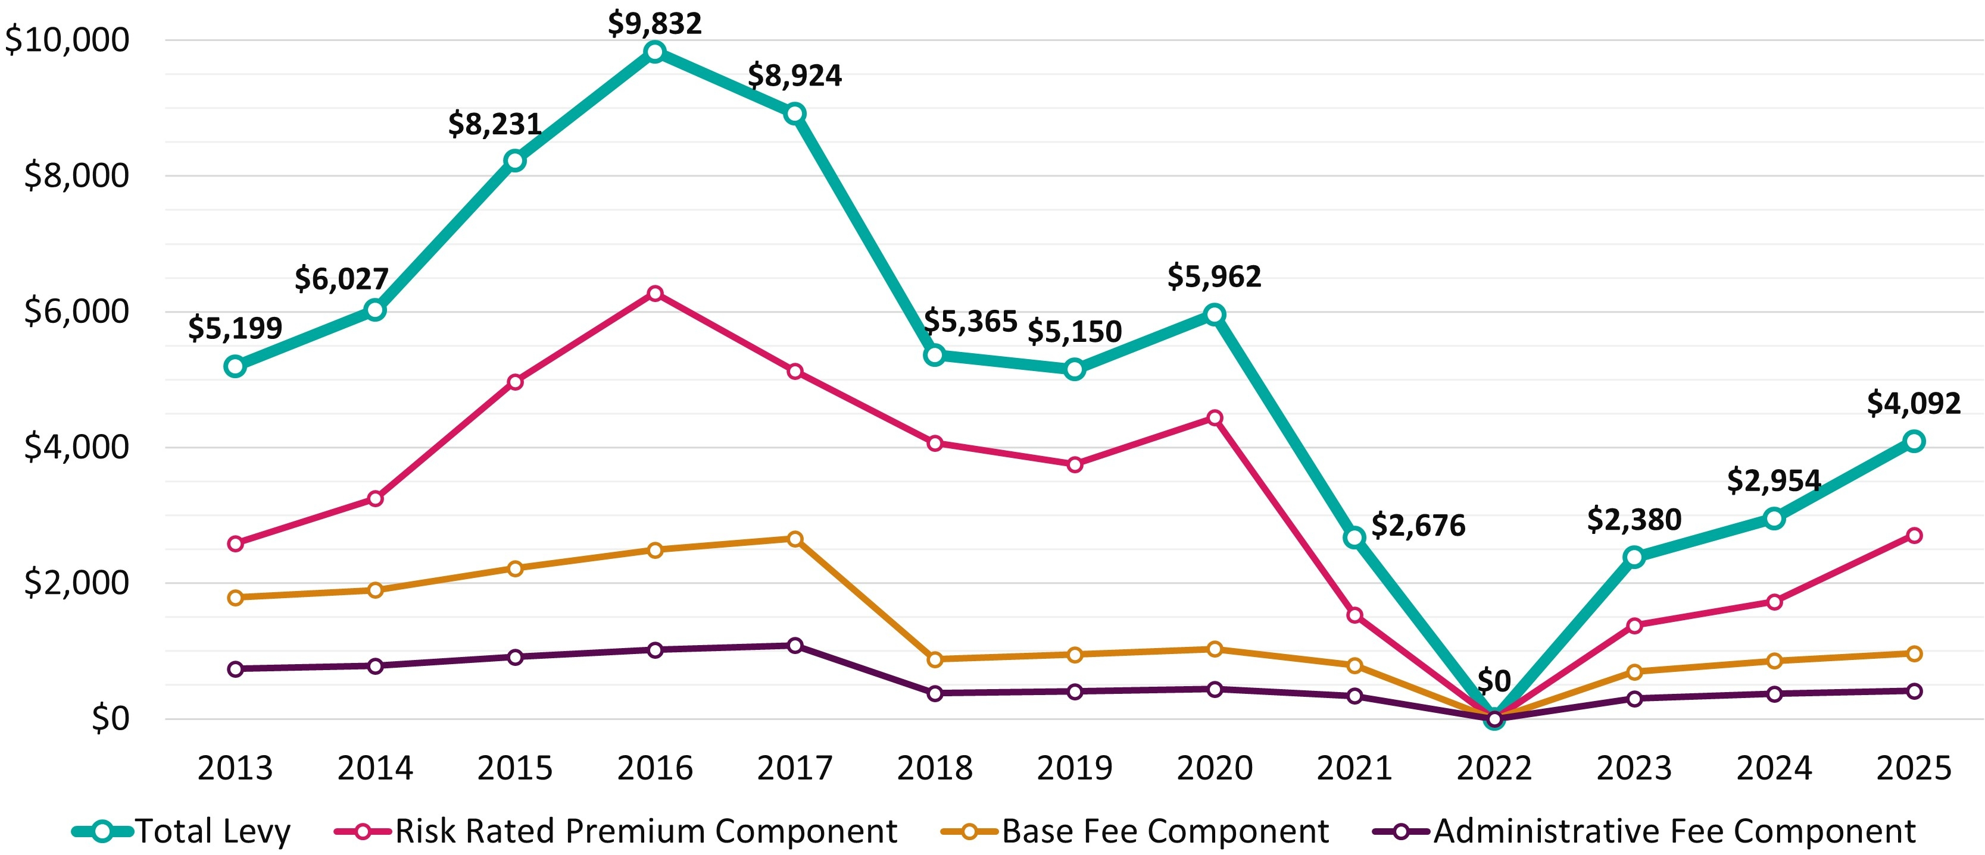
Average International Levy Amount per Provider 2013-25
www.tps.gov.au

Slide 16
International TPS Levy
Levy components and draft 2026 settings
www.tps.gov.au

Slide 17
International TPS Levy Components
Component | Key elements | Purpose and authority
Administrative fee | Sum of a ‘per provider’ and ‘per student’ charge | Designed to cover administrative costs Set by Minister for Education
Base fee | Sum of a ‘per provider’ and ‘per student’ charge | Maintains OSTF balance at a sustainable level Set by Minister for Education
Risk rated premium | Considers 5 risk factors and overseas student tuition fees for previous year | Intended to reflect risk of provider closure Set by TPS Director with Board advice
Special tuition protection | Percentage multiplied by overseas student tuition fees for previous year | Charged when OSTF is below target range Set by TPS Director with Board advice
www.tps.gov.au

Slide 18
Draft 2026 International TPS Levy Settings
Component | Draft 2026 Settings
Administrative fee* | $107.00 per provider + $0.56 per 2025 overseas student enrolment
Base fee* | $216.00 per provider + $1.37 per 2025 overseas student enrolment
Risk rated premium | [0.05% x total risk factor value] x total 2025 overseas student tuition fees
Special tuition protection | 0% x total 2025 overseas student tuition fees
*Administrative and base fee figures reflect 2025 values and may be indexed to CPI for 2026
Note: 2026 levy calculated using student enrolment numbers and revenue for 2025 calendar year
www.tps.gov.au

Slide 19
Risk rated premium component
Considers 5 risk factors designed to reflect the risk of provider closure
Providers receive a risk factor value for each risk factor
Higher risk factor values indicate higher risk of closure
www.tps.gov.au

Slide 20
Risk Rated Premium Component: Risk Factors
Base Risk Factor | Risk factor value of 1.0 applied for all providers
Length of Operation | Higher risk of closure associated with shorter length of operation
Volatility in Overseas Student Enrolments | Higher risk of closure associated with extreme volatility in overseas student enrolments
Maximum Overseas Source Country Concentration | Higher risk of closure associated with heavy reliance on a single source country of overseas students
Non-Compliance and Registration Renewal | Penalty for late payment of the levy or CARC, having sanctions imposed for non-compliance, and/or shorter registration periods due to risk management concerns
1 proposed change for 2026
www.tps.gov.au

Slide 21
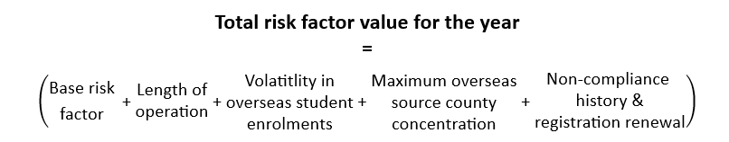
Risk Rated Premium Component: Risk Factor Values
www.tps.gov.au

Slide 22
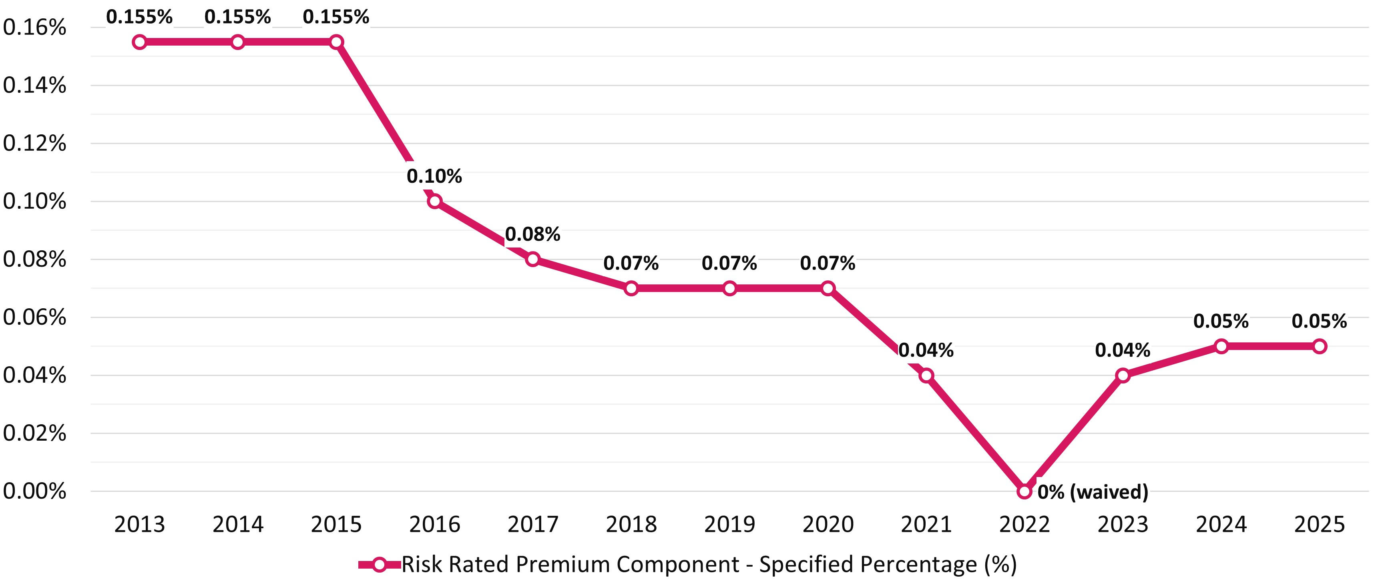
Risk Rated Premium Component Specified Percentage 2013-25
www.tps.gov.au

Slide 23
Proposed change: Non-Compliance and Student Defaults
A student default occurs when:
an international student does not start a course on the agreed starting day, or
an international student withdraws from a course, or
an education provider refuses to provide a course to a student due to the student failing to make payments, breaching student visa conditions, and/or misbehaviour
Following a student default, a provider is legally obligated to refund the student’s tuition fees within the provider obligation period of 4 weeks [47D and 47E ESOS Act]
www.tps.gov.au

Slide 24
Proposed change: Non-Compliance and Student Defaults
Student defaults where the TPS assisted doubled from 2023 to 2024 and represented over 33% of total 2024 refunds paid by the TPS (up from an average of 4% in the previous 3 years)
Analysis conducted by the AGA shows that failure to refund students following a student default is a strong indication of provider closure
As a result of this analysis, the Board proposes introducing an additional component to the Non-Compliance and Registration Renewal risk factor for providers that had at least one student default occur where the refund amount was paid out by the TPS in the previous calendar year
www.tps.gov.au

Slide 25
Risk Rated Premium Component Formula
specified percentage for 2026
provider’s overseas student tuition fees for 2025
X
total risk factor value
X
Proposed specified percentage for 2026: 0.05%
www.tps.gov.au

Slide 26
Risk Rated Premium Component: High risk example
0.05%
4.5
$2,000,000
specified percentage for 2026
provider’s overseas student tuition fees for 2025
X
total risk factor value
X
= 0.00225 x $2,000,000
= $4,500
www.tps.gov.au

Slide 27
Risk Rated Premium Component: Low risk example
0.05%
1.0
$2,000,000
specified percentage for 2026
provider’s overseas student tuition fees for 2025
X
total risk factor value
X
= 0.0005 x $2,000,000
= $1,000
www.tps.gov.au

Slide 28
Special tuition protection component
Charged when the OSTF is below its target size
Formula:
specified percentage for 2026
provider’s overseas student tuition fees for 2025
X
Proposed specified percentage for 2026: 0%
www.tps.gov.au

Slide 29
2025 International Levy Collection Overview
www.tps.gov.au

Slide 30
2025 Request for Information (RFI)
100 providers failed to respond to the RFI by the due date as part of the 2025 levy
The TPS made several attempts to get this information from providers
3 providers did not comply with a Request to Give Information from the regulator
www.tps.gov.au

Slide 31
2026 RFI
Providers will receive an RFI in early 2026 to declare their 2025:
overseas student tuition fee income, and
domestic student enrolment numbers
This information is necessary for levy amounts to be calculated and you will have two weeks to provide this information.
If you fail to respond, the TPS have developed a methodology to determine your levy
www.tps.gov.au

Slide 32
2025 International TPS Levy: Late Payments
1,523 providers invoiced
333 providers did not pay by the due date and were issued a late payment penalty
51 providers did not pay by the reminder notice due date and were suspended
As of 21 August 2025, 24 providers still had outstanding payments, totalling $29,659.05
www.tps.gov.au

Slide 33
Late or Non-Payment of International TPS Levy
The TPS is obligated to send one reminder notice to providers who have not paid their levy at the end of the due date. Providers have seven days to pay their levy after the reminder notice is given.
Providers whose payment is received after the due date will receive a late payment penalty for the next three years’ levy risk rating calculation. The late payment penalty is 20% of a provider's levy amount.
A provider’s registration will be automatically suspended if they fail to comply with the reminder notice (s90 ESOS Act). The provider reinstatement fee in $673.
Levy invoices are sent to PEO contacts in PRISMS. Keep your contact information in PRISMS up to date. To update your PEO details, please contact your regulator.
www.tps.gov.au

Slide 34
2026 International TPS Levy Notices
You will receive the following notices about your 2026 levy:
Early advice
Request for Information (RFI) (with 2 weeks to respond)
Invoice (with 28 days to pay)
Reminder notice (if your payment has not been received on the due date)
Late payment penalty invoice (if applicable)
Suspension notification (if applicable)
Provider reinstatement fee invoice (if applicable)
www.tps.gov.au

Slide 35
2026 International Levy Timeline and Takeaways
www.tps.gov.au

Slide 36
2025 International TPS Levy Timeline
August 2025
Sept – Nov 2025
November 2025
December 2025
Feb – May 2026
20 August
Draft advice on 2026 international levy confirmed at TPS Advisory Board meeting
Late August
Draft advice letter published on TPS website
2 September
Online consultation session for all providers
September-October
Consultation sessions in Melbourne, Sydney, Brisbane and Perth
Meetings with stakeholders
5 November
Online feedback session for all providers
19 November
TPS Advisory Board considers sector feedback
Final advice on 2026 International TPS Levy settings confirmed at Board meeting
Mid-November
Legislative instrument drafted and sent to Treasurer
Department of Education briefing for Administrative and Base Fee Components sent to Minister for Education
31 December
Legislative instrument must be approved by Treasurer and signed off by TPS Director
February
Non-exempt providers receive a Request for Information to declare 2025 overseas students tuition fee income and domestic student enrolment figures
March
2026 levy invoices sent to providers
April-May
International levy collected
www.tps.gov.au

Slide 37
Takeaways
Key features of the Board’s draft advice on 2026 levy settings:
New risk factor value to be added to the non-compliance and registration renewal risk factor for providers that had at least one student default where the refund amount was paid out by the TPS in the previous calendar year
Target range of OSTF to be increased from $40-60 million to $50-70 million
Timeline estimates levy will be collected in April-May 2026
www.tps.gov.au

Slide 38
Key messages
Ensure all contact information and student enrolment data in PRISMS is up to date
  Submit your RFI on time to ensure your levy can be calculated
  Pay the full and correct levy amount on time to avoid receiving a late payment penalty and a non-compliance loading for the next three levies
  Check account details and reference number are correct before making a payment
www.tps.gov.au

Slide 39
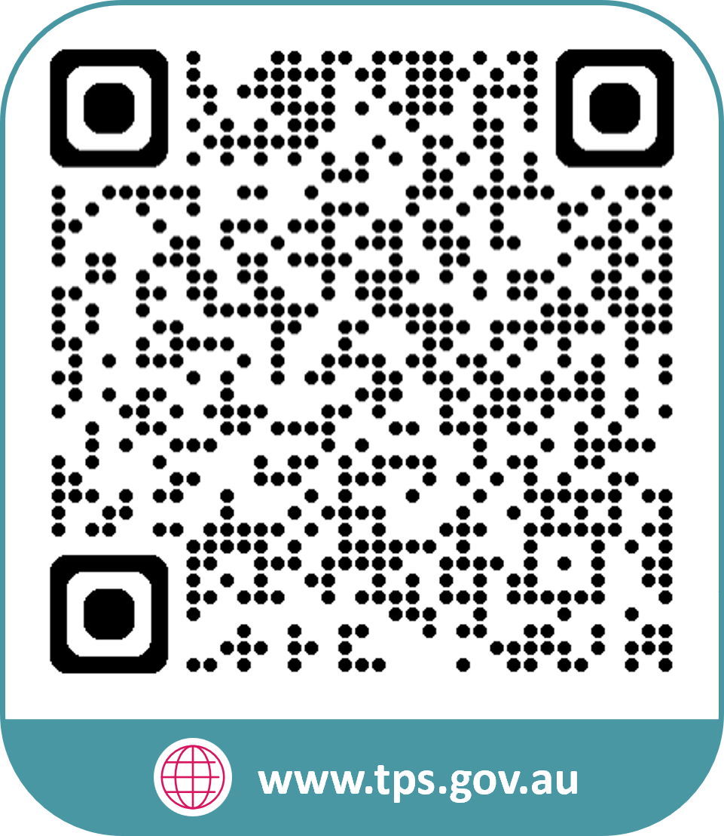


www.tps.gov.au
operations@tps.gov.au

