Slide 1
Managed growth settings in 2026
Provider Webinars | August 2025

Slide 2
What we will cover
2026 National Planning Level and international education settings Progress over 2025 Ministerial Direction changes for 2026 Allocations for higher education providers Allocations for VET providers NPL exemptions and priority processing changes
If you have questions, please use the Q&A function.
We have a lot to cover today, so won’t be answering questions as we go during the presentation. We will try and address common questions at the end and will publish an FAQ document if needed next week. More information is available online at
https://www.education.gov.au/managed-system-international-education-2026
2

Slide 3
The government remains committed to ensuring the quality, integrity, and sustainability of Australia’s international education and training sector
2025 National Planning Level:
On 4 August 2025, the Australian Government announced a National Planning Level (NPL) of 295,000 for 2026.
  This is 9 percent increase on the 2025 NPL, with an additional 25,000 places compared to 2025.
Allocations:
All active international education providers will receive at least their current allocation next year.
Following slides cover allocation arrangements for universities, other higher education providers and VET providers.
Role of allocations:
Ministerial Direction 111 has played a key role in ensuring fairer access to student visa processing, and will be replaced with an updated ministerial direction to reflect 2026 arrangements.
From 2027, the Australian Tertiary Education Commission (ATEC) will oversee international student numbers at public universities and other higher education providers.
Integrity reforms:
In addition to the National Planning Level, government remains committed to strengthening integrity in the international education sector.
3

Slide 4
Over the past year, Government reforms have set international student numbers on a more sustainable path.
Overall, student numbers are tracking close to the National Planning Level (NPL) of 270,000.
As at 1 August 2025:
NOSCs that have commenced study are at 77% of the overall NPL
  Higher education is at 83%
  VET is at 60%
The pipeline of indicative NOSCs (which includes students yet to commence their studies) is at 96% of the overall NPL
  Higher education is at 105%
  VET is at 79%
Given VET has continuous enrolment periods, government expects both to track close to the NPL.
As at 1 August 2025, 259 providers have reached their MD111 prioritisation threshold (80 per cent of their allocation). This includes:
  26 of 38 public universities
  5 of 16 TAFEs
  75 of 140 other higher education/dual sector providers
  153 of 977 VET providers (including 128/762 providers with allocations of 100 NOSC or less)
4

Slide 5




A Ministerial Direction will continue to be used into 2026 to support application of the NPL across both the higher education and VET sectors
01
02
03
04
Indicative allocations for 2026 will be referenced in a new Ministerial Direction for 2026. This will ensure visa processing aligns with provider allocations.
A new Ministerial Direction will retain many of the same characteristic of MD111. This will provide certainty to students and providers on 2026 settings.
The use of a ‘pool’ approach for small VET providers will impact how these visas are processed. This aims to increase utilisation of allocations.
New exemption categories will be included in a new Ministerial Direction to ensure they receive priority processing.
A replacement for Ministerial Direction 111 will be introduced later in 2025 to reflect 2026 settings.
5

Slide 6
Allocations for public universities will be finalised in October
An additional 17,500 NOSCs will be available to public universities.
Eligibility: Publicly funded universities making good progress with their allocations will be able to apply for additional growth places for 2026. All public universities will receive at least their 2025 allocation for 2026.
Application process: Further detail on the application process will be provided to public universities in due course.
Allocation factors: To support strategic priorities, the Australian Government will work with publicly funded universities to grow international student places where institutions demonstrate:
  increased engagement with Southeast Asia, and
  provision of student accommodation to ensure safe and accessible housing for both domestic and international students.
Further information: The Department of Education will be running further webinars for universities to provide guidance on the application process.
Dual sector universities: VET allocations for any dual sector universities have been finalised and published on the DEWR website.
Final 2026 allocations for public universities will be available after the application process for additional growth places is complete.
6

Slide 7
Allocations for other higher education providers in 2026 will be no less than their 2025 allocations
A minimum NOSC allocation of 50 places has been applied
  In 2025, this was set at 10 places.
  This change benefits 59 higher education providers
  Allocations for not-for-profit universities have been adjusted to be more consistent with publicly funded universities.
  Higher education allocations for TAFE institutes delivering HE courses have been increased by 5 per cent.
  Allocations for other higher education providers have been adjusted through growth of 3 per cent or at least an increase of 5 places on their initial 2025 allocation.
  Allocations have then been rounded to the nearest 5 places.
  These changes have been targeted to support providers recruiting from offshore, who are most impacted by MD111
  Indicative 2026 allocations for other higher education providers are available on the Department of Education’s website.
7

Slide 8
International education in 2026:
VET Provider allocations information session
Presenter: Chris Alach

Slide 9
VET Provider allocations for 2026
Government remains committed to ensuring the quality, integrity and sustainability of the international VET sector and modest growth:
  No active provider will receive a lower allocation in 2026 than it received in 2025
  TAFEs will continue to receive unlimited priority processing for VET study
  Small VET providers with allocations up to and including 100 NOSC in 2025, will be placed in a 'pool' to provide growth for providers that need it, and reduce under-utilisation across this cohort
  Large VET providers with allocations above 100 NOSC will all receive 5% growth on their 2025 allocations
  Dual sector providers will continue to receive a single total allocation which is the sum of their HE and VET allocations.
  A reserve pool of NOSC to allocate to future new providers on registration.
In addition, the government plans to introduce a range of additional integrity measures.
9

Slide 10
Supporting small providers in 2026
The international VET market is characterised by a large number of providers with a small allocation of NOSCs.
VET providers with allocations of up to and including 100 NOSC will be placed in a small VET provider pool, where their allocations will be aggregated.
Establishing a pool provides smaller VET providers a more flexible approach to allocations in 2026.
The new approach enables growth for providers who can leverage underutilisation to increase access to Priority 1 (High) processing.​
Providers in the pool will have access to Priority 1 (High) visa processing and be able to draw down on the pool until they reach 80 NOSC, which will be the provider’s individual prioritisation threshold (IPT).​
Providers that reach 80 NOSC will be moved to Priority 2 (Standard) processing and removed from the pool. This will support equitable access to Priority 1 processing for all providers in the pool. ​
If, at any point in time, 80% of the aggregate NOSC in the pool have been used, all providers in the pool will move simultaneously to Priority 2 (Standard) processing.
New entrants to the market in 2026 will enter the pool.
10

Slide 11
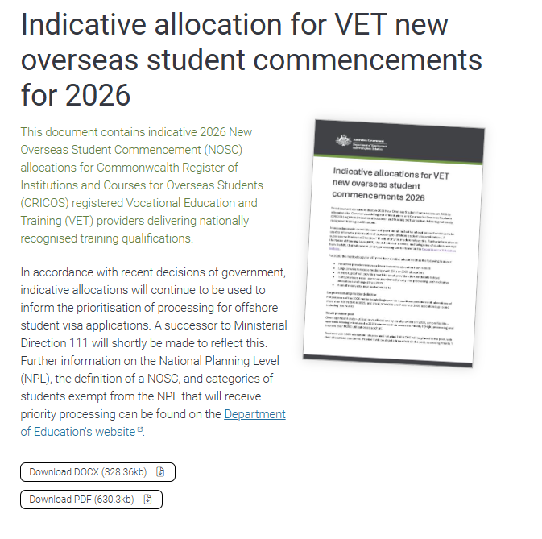
Further information on indicative VET allocations for 2026
Further information on Managed Growth for 2026 is available at https://www.dewr.gov.au/international-skills-engagement/managed-system-international-education-2026 .
You can also contact the department through our ManagedGrowth@dewr.gov.au mailbox.
11

Slide 12
The following categories will continue to be exempt from the NOSC count and receive priority processing:
Exemption categories and priority visa processing
  In 2026, the following categories will also be exempt from the NPL and receive priority processing (where relevant):
01
06
Schools
Standalone ELICOS students
1
Students transitioning to universities or other providers from schools in Australia
02
Non-award students, including short term exchange students
07
All Australian Government sponsored scholars and visa holders
03
Other DFAT or Defence-sponsored students
08
2
Students transitioning to public universities from recognised pathway providers or TAFEs
Certain transnational education students
04
09
Foreign government scholarship holders
Students transferring to another provider because their initial provider has closed or is otherwise unable to deliver training
Aviation pilot students
3
05
10
Students from the Pacific and Timor-Leste
Higher degree by research students
T
Students at TAFE providers will still count as NOSCs but will continue to receive priority processing under the new MD.
12

Slide 13
Arrangements for the three new 2026 exemption categories are currently being finalised
International secondary school students transitioning to universities or other tertiary providers will now be included as an exemption and will not count as an additional NOSC.
This exemption only applies to secondary students who have studied onshore in Australia and already hold a s500 visa
The Department expects that this exemption will be automatically identified in PRISMS based on the student’s school CoE
Students from recognised pathway providers or TAFEs transitioning to public universities will be exempt from the 2026 NPL.
Recognised pathway providers will need to meet certain criteria, such as an enforceable agreement with the affiliated university and delivering courses that are designed and principally intended as a pathway to degree programs at the relevant university
An exemption will also apply where a TAFE institute has a similar arrangement in place with an affiliated university, supported by a written agreement
Details are still being finalised in consultation with the University Pathways Working Group
Students transferring to another provider because their initial provider has closed or is otherwise unable to continue delivering training
Details are still being finalised and will be published once available.
Note, in most cases these students will already hold a s500 Student Visa and be onshore, so won’t require priority processing under MD111.
13

Slide 14
If you have further questions, please use the Q&A function.
More information is available at
Additional information on managed growth - Department of Education, Australian Government

