Slide 1


Lonsdale Institute Pty Ltd
International Students Information Session
28 July 2025
Tanya Benton-Hall
Case Management Team
www.tps.gov.au

Slide 2

Purpose of this meeting
How the Tuition Protection Service (TPS) can assist you
Student visa information
Getting a copy of your student record
Other assistance available
How to use the TPS Online case management system
www.tps.gov.au

Slide 3

Lonsdale Institute Pty Ltd
Lonsdale Institute closed on Monday 14 July 2025
Lonsdale Institute did not meet its obligations to all students
The Tuition Protection Service (TPS) activated on Monday 28 July 2025
We will help you to find an alternative education provider to continue your studies, and provide you with a refund of your unspent tuition fees
www.tps.gov.au

Slide 4

Tuition Protection Service (TPS)
Australian Government initiative supported by the Department of Education
Student tuition fee protection scheme
Supports students following an education provider default to:
  find an alternative provider to continue studying
and
  receive a refund of unspent tuition fees
www.tps.gov.au

Slide 5

TPS Team
www.tps.gov.au

Slide 6

TPS Online system
TPS Online is the system you will use to request and receive TPS assistance
You can request a refund of your unspent tuition fees in TPS Online
We will show you how to use TPS Online later in this presentation
TPS Online step-by-step instructions are on the TPS website
Access TPS Online via the TPS website
www.tps.gov.au

Slide 7

Continuing your studies with an alternative provider
Our priority: To help you to continue your studies with a new education provider
You will be emailed links to find alternative courses at different providers
You will need to contact the new provider to enrol with them
Alternative courses may cost more or less than your current course. If costs are higher, you will need to meet those costs.
www.tps.gov.au

Slide 8

Unspent tuition fees
Unspent tuition fees: The fees that you paid to Lonsdale Institute for education or training that you did not receive
For example, if you paid for 10 weeks of tuition and only attended classes for 7 weeks, the remaining 3 weeks are your unspent tuition fees
The TPS can provide you with a refund of any unspent tuition fees that were paid to Lonsdale Institute
www.tps.gov.au

Slide 9
Unspent tuition fees
Your refund can be paid to:
  your personal bank account
  another nominated bank account (e.g. a family member)
  your new education provider
  your education agent
If you would like your agent to receive your refund on your behalf, you
must request and return an Authority to Act/Refund form by emailing
support@tps.gov.au
www.tps.gov.au

Slide 10
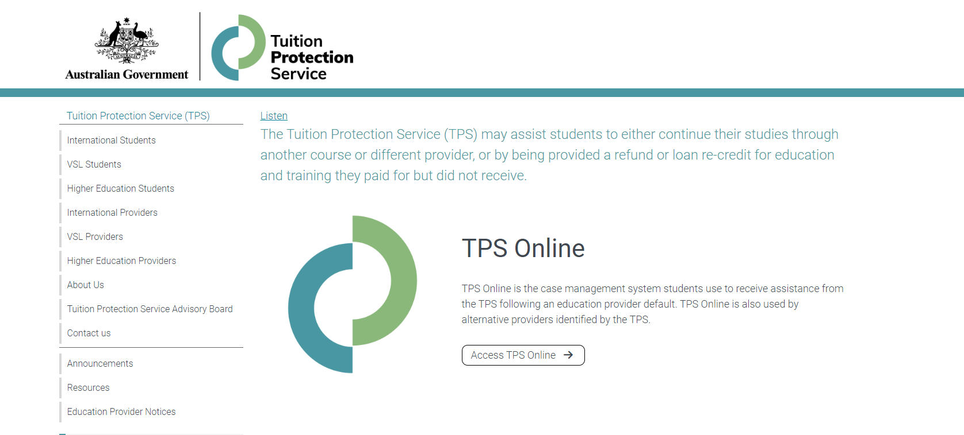
TPS website
For TPS Online, click Access TPS Online.
For information about your provider default, click Education Provider Notices.
www.tps.gov.au

Slide 11

Student visa information
Information about your student visa
Applying for a new student visa
Students under 18
Work conditions
Travelling home

Slide 12
Information about your student visa
Student visa holders must remain enrolled in a registered course
You must finalise a new enrolment within 3 months of your provider defaulting
If you cannot finalise a new enrolment within 3 months, the Department of Home Affairs may offer you an extension. You must provide relevant information for consideration.
If your student visa has not yet been granted, you must finalise a new enrolment and send information about your new enrolment to the Department of Home Affairs. Your visa application will be assessed based on your new enrolment.

Slide 13
Do I need a new student visa?
You will need to apply for a new student visa if you enrol in a new course which:
  is at a lower Australian Qualification Framework (AQF) level than your previous course, or
  will finish after your current visa expires
You will not need to apply for a new student visa if you enrol in a new course which:
  is at the same or a higher AQF level than your previous course, and
  will finish before your current visa expires
Check the expiry date of your student visa by viewing your visa grant notice or by using the Visa Entitlement Verification Online (VEVO) service at online.immi.gov.au/evo/firstParty?actionType=query

Slide 14
Visa Application Charge exemption
If you need to apply for a new student visa because your provider defaulted, you will be eligible for a Visa Application Charge (VAC) exemption if:
  you currently hold a student visa, or your last substantive visa was a student visa, and
  you were enrolled with the provider when it defaulted, and
  you apply for your new visa within 12 months of your provider defaulting
When you apply, tell the Department of Home Affairs that you have been affected by a provider default and attach evidence of your enrolment with a new education provider, such as your CoE

Slide 15
Work conditions
You cannot work more than 48 hours per fortnight while your course is in session
You can work more than 48 hours per fortnight when your enrolment has been cancelled due to a provider default
If you are on a Bridging Visa (BV), refer to the conditions attached to your BV regarding work and other conditions

Slide 16
Travelling home
You can travel home while you arrange your enrolment in another course. You must have a valid student visa to enter Australia on your return.
If you have applied for a student visa and you are awaiting a decision, you must have a valid Bridging Visa B (BVB) to travel

Slide 17
Further information and contacts
Information about your student visa:
immi.homeaffairs.gov.au/visas/getting-a-visa/visa-listing/student-500
Information about how an education provider default may affect your student visa:
immi.homeaffairs.gov.au/visas/getting-a-visa/visa-listing/student-500/education-provider-default
Call the Global Service Centre:
  In Australia: 131 881
  Outside Australia: +61 2 6196 0196

Slide 18

Getting a copy of your student record
Australian Skills Quality Authority (ASQA)

Slide 19

ASQA: Getting a copy of your student record
When closing, a provider is expected to issue:
  a testamur and record of results to a student who has completed the requirements of a qualification, or
  a statement of attainment to a student who has not completed a qualification, but has completed one or more units of competency
You will need evidence of the units of competency you have achieved to continue your training at another provider
If you are unable to obtain an up-to-date copy of your student record, ASQA may be able to assist you

Slide 20
ASQA: Further information and contacts
Information about how ASQA can help students:
www.asqa.gov.au/students/how-asqa-can-help-students
Information about student records:
www.asqa.gov.au/students/student-record
Call ASQA:
  In Australia: 1300 701 801
  Outside Australia: +61 3 8613 3910

Slide 21

Study Melbourne
Support for international students

Slide 22

Study Melbourne Hub
The Study Melbourne Hub provides free help and advice to all international students in Victoria
Student support services include:
Accommodation advice
Wellbeing and mental health support
Financial hardship
Employability programs
Legal information
Education provider problems

Slide 23

Contact the Study Melbourne Hub
Contact the Study Melbourne Hub to speak with a caseworker.
All services are confidential.
Visit: 17 Hardware Lane, Melbourne
(Open Monday to Friday 9am – 5pm)
Phone: 1800 056 449
Email: info@studymelbourne.vic.gov.au

Slide 24

Study New South Wales
Support for international students

Slide 25

Study NSW
The Study NSW website contains information and resources for international students in New South Wales about:
  Studying in NSW
  Living in NSW
  Working in NSW
  Student support services, news and events
Website: www.study.nsw.gov.au/current-students

Slide 26
How to use TPS Online
Using TPS Online to receive assistance from the TPS
Summary of tasks you must complete in TPS Online
www.tps.gov.au

Slide 27
Accessing TPS Online
Visit tps.gov.au and click Access TPS Online.
www.tps.gov.au

Slide 28
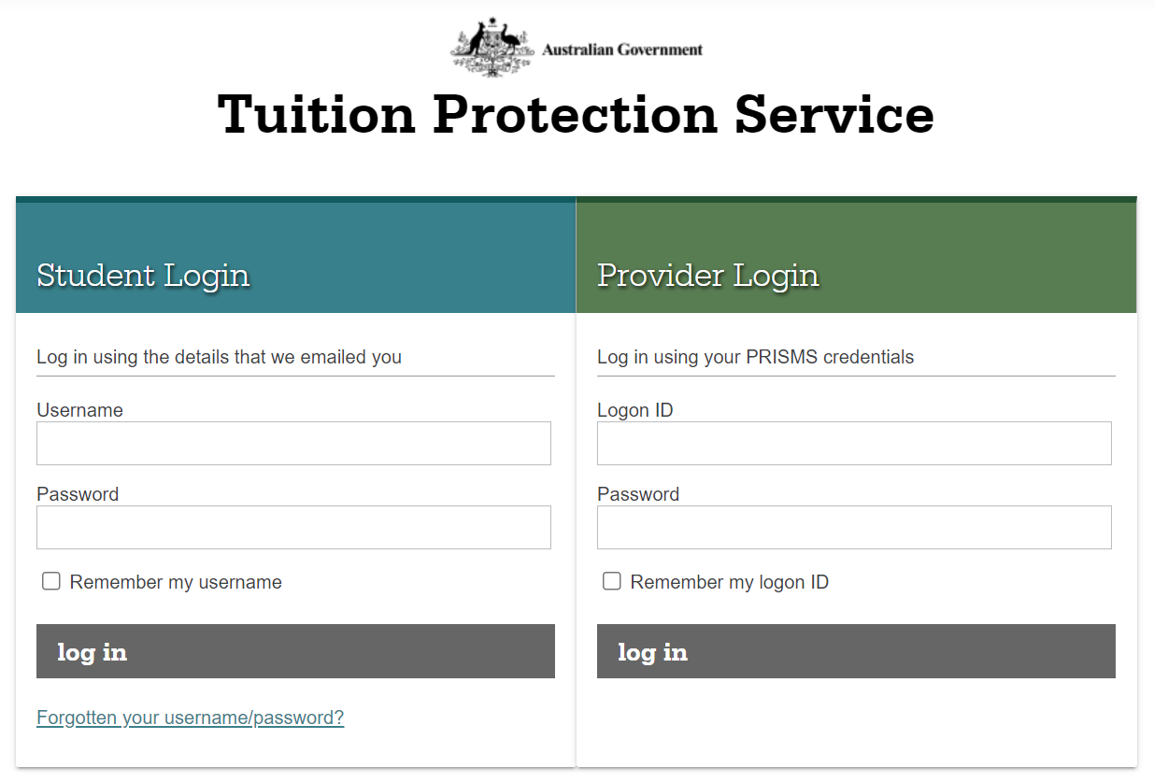
TPS Online: Logging in
Log in.
If you are logging in for the first time, use the username and password emailed to you.
www.tps.gov.au

Slide 29
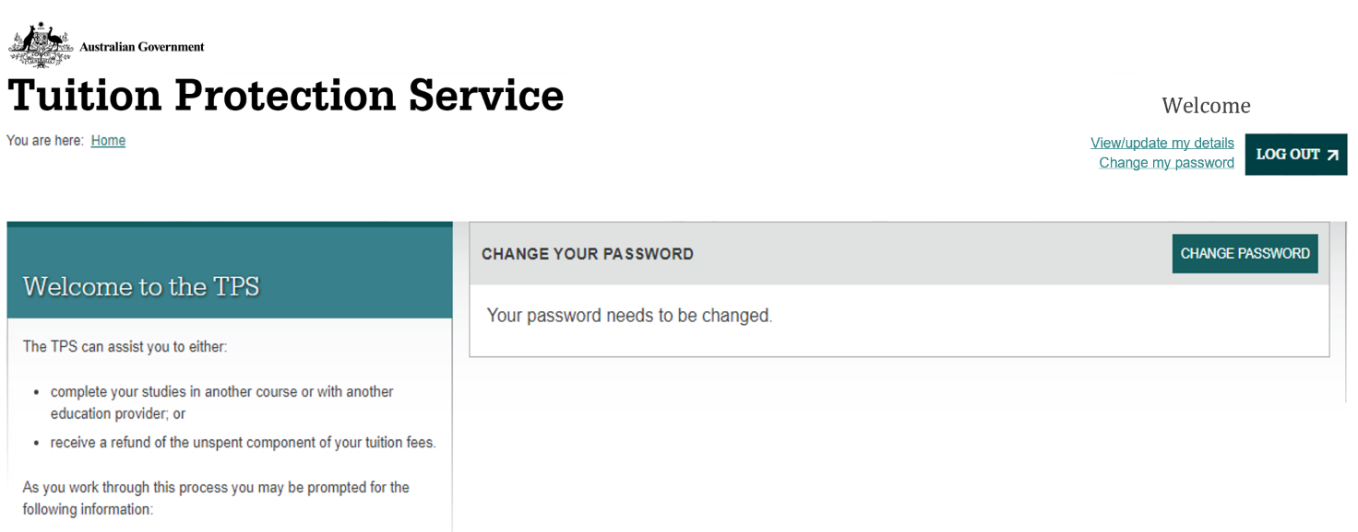
TPS Online: Change your password
Your home page will list any tasks you need to complete to progress your claim with the TPS.
Check your home page regularly for tasks to complete!
After logging in for the first time, you must change your password to continue.
www.tps.gov.au

Slide 30
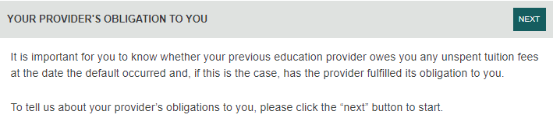
TPS Online: Your provider’s obligation to you
It is important to know whether your provider owed you a refund of any unspent tuition fees on the date your provider defaulted, and whether your provider fulfilled its obligation to you.
On your home page, click NEXT to complete this task.
www.tps.gov.au

Slide 31
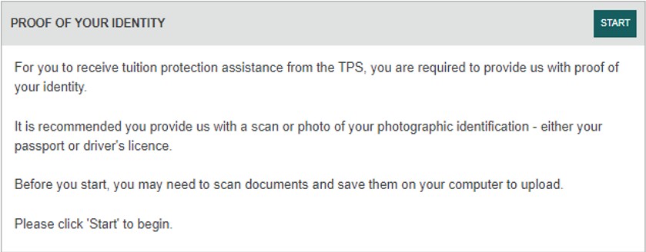
TPS Online: Proof of your identity
To receive any assistance from the TPS, you must provide proof of your identity.
Upload a photo of your passport (preferably) or driver’s licence for the TPS to review. You will be notified via email when your proof of identity has been approved.
On your home page, click START to complete this task.
www.tps.gov.au

Slide 32
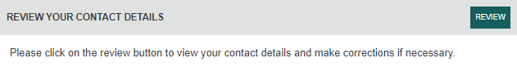
TPS Online: Review your contact details
The TPS will send you any notifications or requests using your contact details in TPS Online. Review your contact details to make sure they are correct and update them if necessary.
On your home page, click REVIEW to complete this task.
www.tps.gov.au

Slide 33
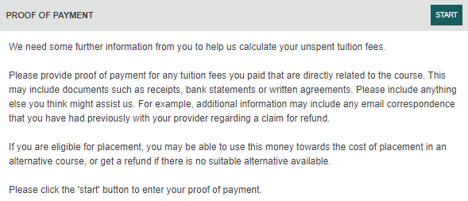
TPS Online: Proof of payment
If your provider owes you a refund of unspent tuition fees, you must submit proof of payment documents. The TPS will use these documents to calculate your refund amount.
On your home page, click START to complete this task.
www.tps.gov.au

Slide 34
TPS Online: Proof of payment document checklist
You must upload the following documents for the TPS to calculate your refund amount:
  Receipts and bank statements for all payments made to your provider for your course
  Letter of Offer outlining all payments due to your provider for your course
  Visa Grant Letter from the Department of Home Affairs
If you have an education agent, you must upload the following additional documents:
Receipts and bank statements for all payments made to your agent
Receipts for all payments your agent made to your provider on your behalf
Agent commission statement or invoice
www.tps.gov.au

Slide 35
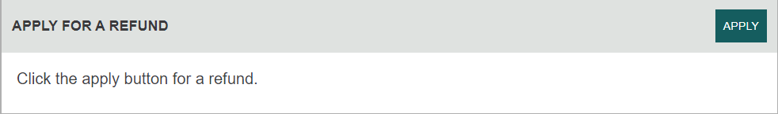
TPS Online: Apply for a refund
If the TPS determines that you are eligible for a refund of unspent tuition fees, you must apply for a refund and provide bank account details for the TPS to process your refund.
On your home page, click APPLY to complete this task.
www.tps.gov.au

Slide 36

TPS Online: Summary of tasks
Log in to TPS Online
Change your password
Indicate whether your provider owes you a refund of unspent tuition fees
Provide proof of your identity
Update your contact details
If your provider owes you a refund of unspent tuition fees, upload proof of payment documents
If you are eligible to receive a refund of unspent tuition fees, apply for a refund
Check your emails and TPS Online regularly for notifications and tasks to complete
www.tps.gov.au

Slide 37

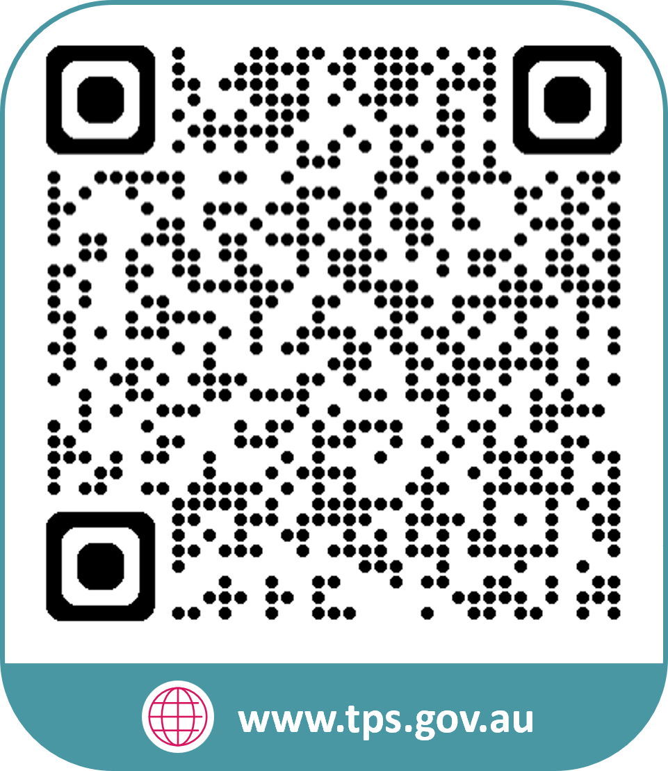


www.tps.gov.au
support@tps.gov.au
1300 131 798

