Slide 1
Perth International College of English
Alternative Providers Information Session
17 June 2025
Melinda Hatton
TPS Director
www.tps.gov.au

Slide 2
Purpose of this meeting
Role of the Tuition Protection Service (TPS) after a provider default
Finding international students a course with an alternative provider
Student visa information
How to use the TPS Online case management system
www.tps.gov.au

Slide 3
Perth International College of English (PAXMIL Education Holdings Pty Ltd)
Perth International College of English closed on Monday 16 June 2025
Perth International College of English did not meet its obligations to students and the Tuition Protection Service (TPS) activated on Monday 16 June 2025
We will be working to arrange for students to continue their studies with an alternative provider, or provide students with a refund of their unspent tuition fees
www.tps.gov.au

Slide 4
Tuition Protection Service (TPS)
Australian Government initiative supported by the Department of Education
Student tuition fee protection scheme
Supports students following an education provider default to:
continue studying with an alternative provider
and/or
receive a refund of unspent tuition fees
Works with education providers to assist students affected by a provider default
www.tps.gov.au

Slide 5
TPS Team
www.tps.gov.au

Slide 6
TPS Online system
TPS Online is the system students use to request and receive TPS assistance
Alternative providers enrol students affected by a provider default through TPS Online
A guide to using TPS Online is on the TPS website
Access TPS Online via the TPS website
www.tps.gov.au

Slide 7
Finding students a course with an alternative provider
Our priority: To help students continue their studies with a new education provider
Students can view suitable alternative courses with other providers in TPS Online
Students need to contact an alternative provider to enrol with them. The provider will then upload an offer in TPS Online for students to accept.
If a student that enrols with an alternative provider through TPS Online is owed a refund of unspent tuition fees, we can pay their refund amount directly to the alternative provider
www.tps.gov.au

Slide 8
Suitable alternative courses
The TPS must meet the following criteria outlined in the Education Services for Overseas Students (Suitable Alternative Courses) Instrument 2022 when identifying suitable alternative courses:
courses are of a similar level and field of education as the original course
courses are delivered in close geographical proximity to the original course
providers have capacity to enrol additional students
providers are not facing regulatory action
www.tps.gov.au

Slide 9
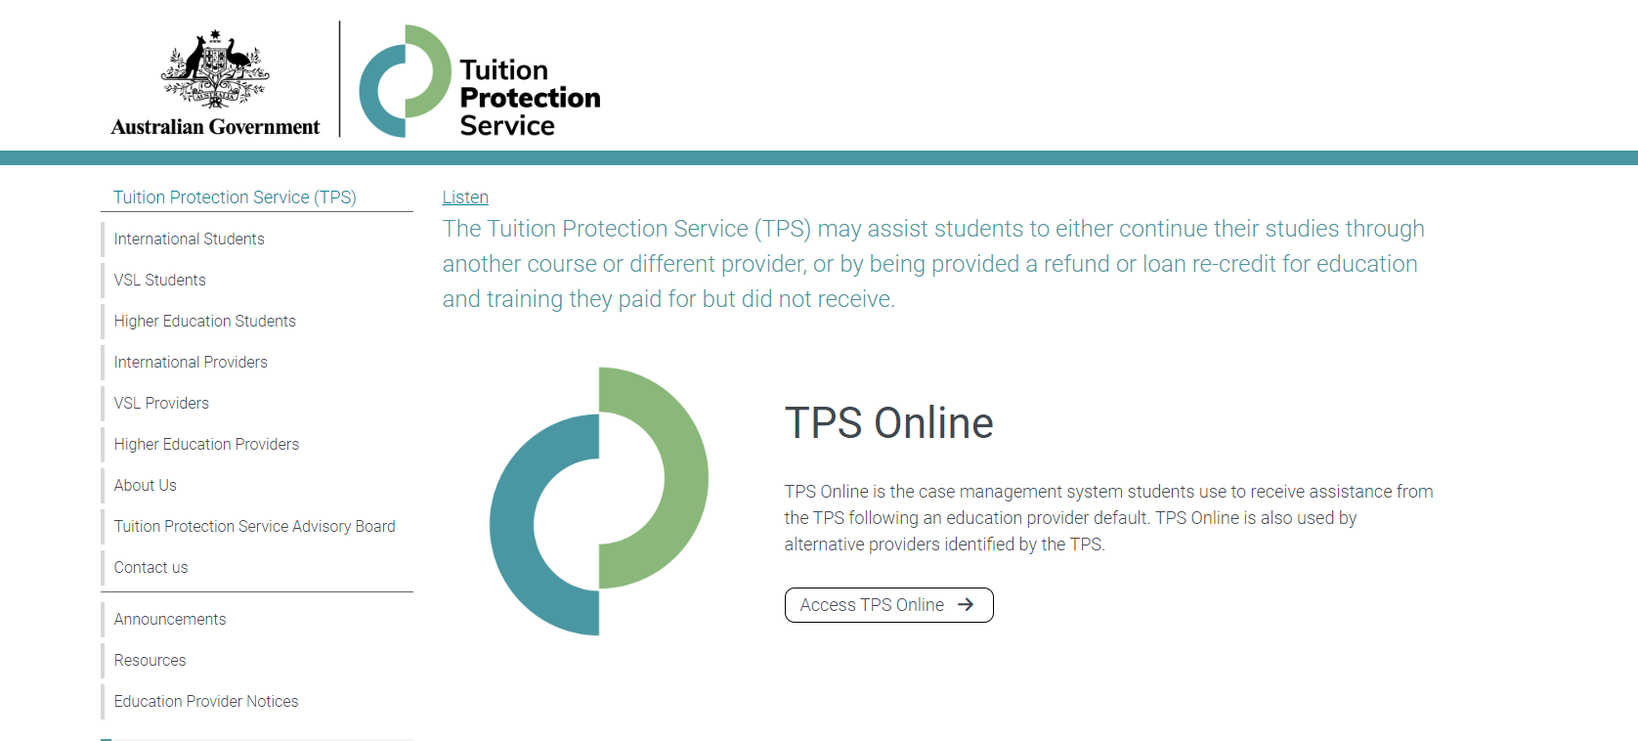
TPS website
For TPS Online, click Access TPS Online.
For information about provider defaults, click Education Provider Notices.
www.tps.gov.au

Slide 10
Student visa information
Student visa holders must remain enrolled in a registered course
Students must finalise a new enrolment within 3 months of their provider defaulting
Students can continue studying on their current visa if:
they enrol in a new course which is at the same or a higher AQF level than their original course, and
they will finish studying before their current visa expires
www.tps.gov.au

Slide 11
How to use TPS Online
Using TPS Online to enrol students affected by a provider default
Summary of tasks you must complete in TPS Online
www.tps.gov.au

Slide 12
Access TPS Online
Visit tps.gov.au and click Access TPS Online.
www.tps.gov.au

Slide 13
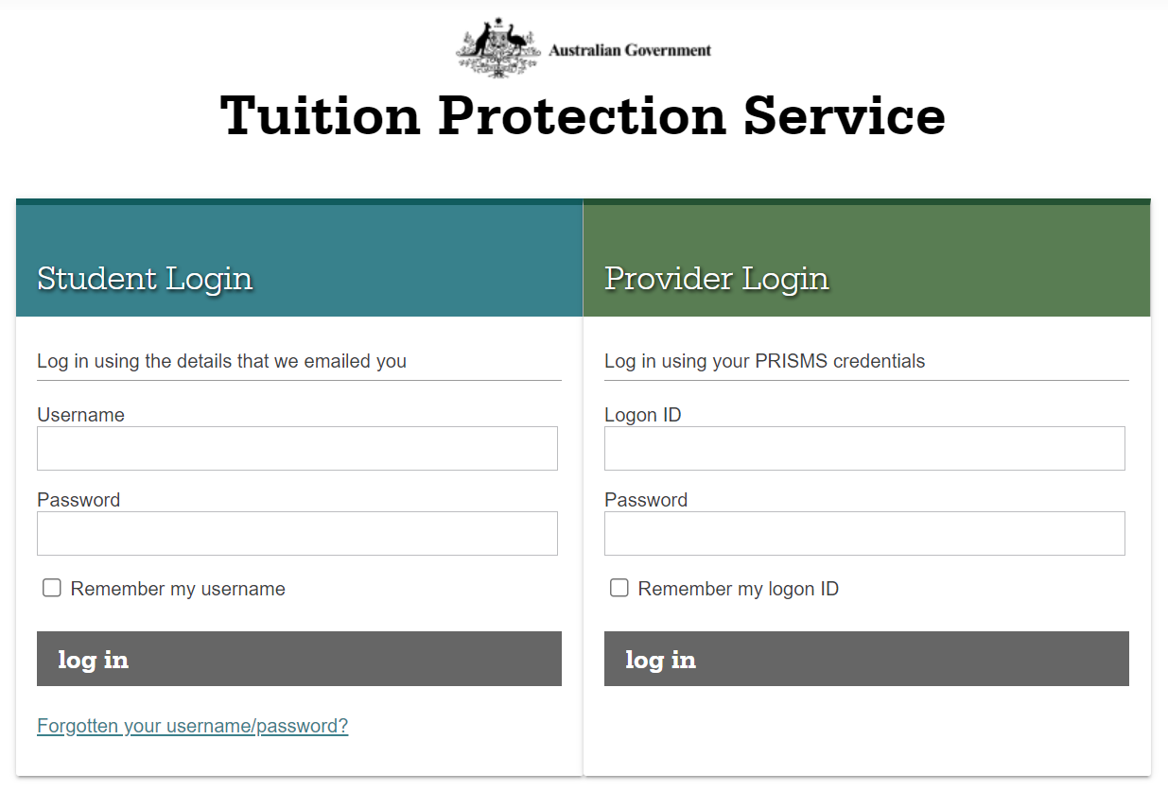
Log in to TPS Online
Staff members with COE Create or COE Administrator access in PRISMS can log in to TPS Online using their PRISMS credentials.
www.tps.gov.au

Slide 14
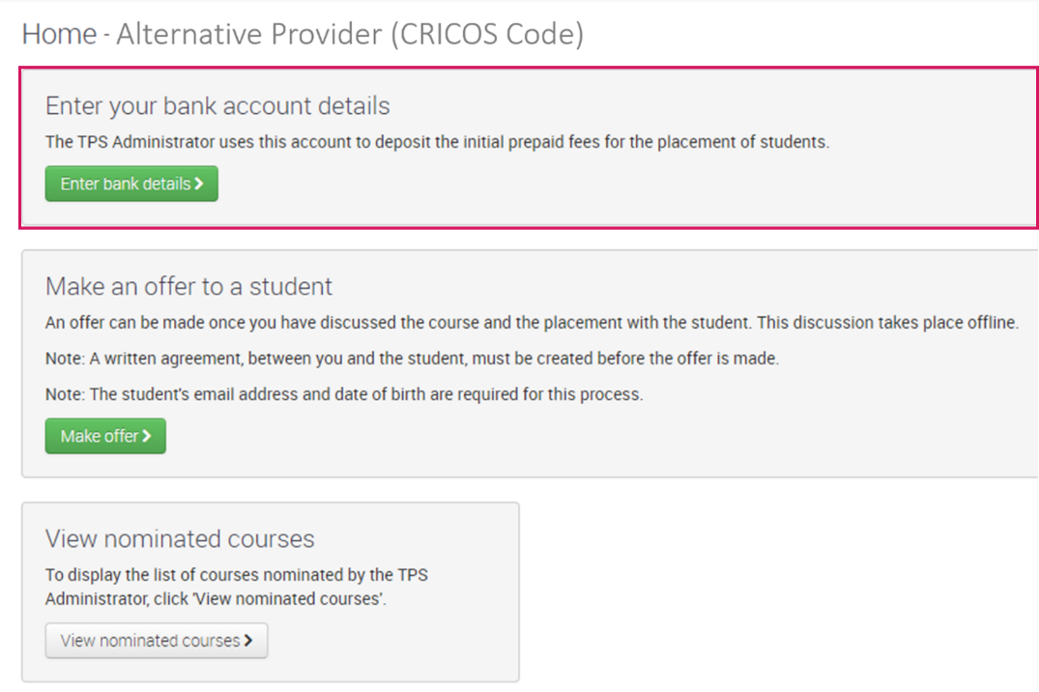
Enter bank account details
Enter your bank account details.
The TPS will deposit any relevant fees for the placement of international students into the nominated bank account.
www.tps.gov.au

Slide 15
Make an offer to a student
An enrolment offer can be made to a student after discussing the course and placement with the student. A written agreement must be created before making an offer to a student.
The student must accept or reject the offer in TPS Online.
After making an offer to a student, you will be able to view all offers and withdraw an offer from a student from your TPS Online home page.
www.tps.gov.au

Slide 16
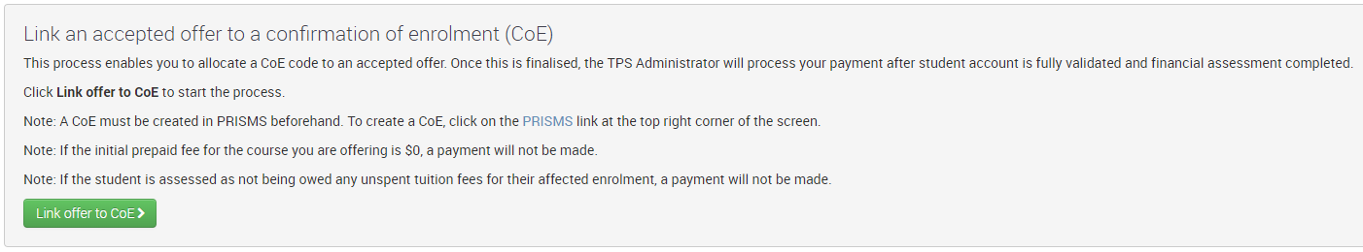
Create a CoE in PRISMS
After a student accepts an offer, a CoE must be created in PRISMS. Refer to the PRISMS Provider User Guide for instructions on how to add a CoE in PRISMS.
An accepted offer must be linked to a CoE. The TPS will not process any payments until this task has been completed.
www.tps.gov.au

Slide 17
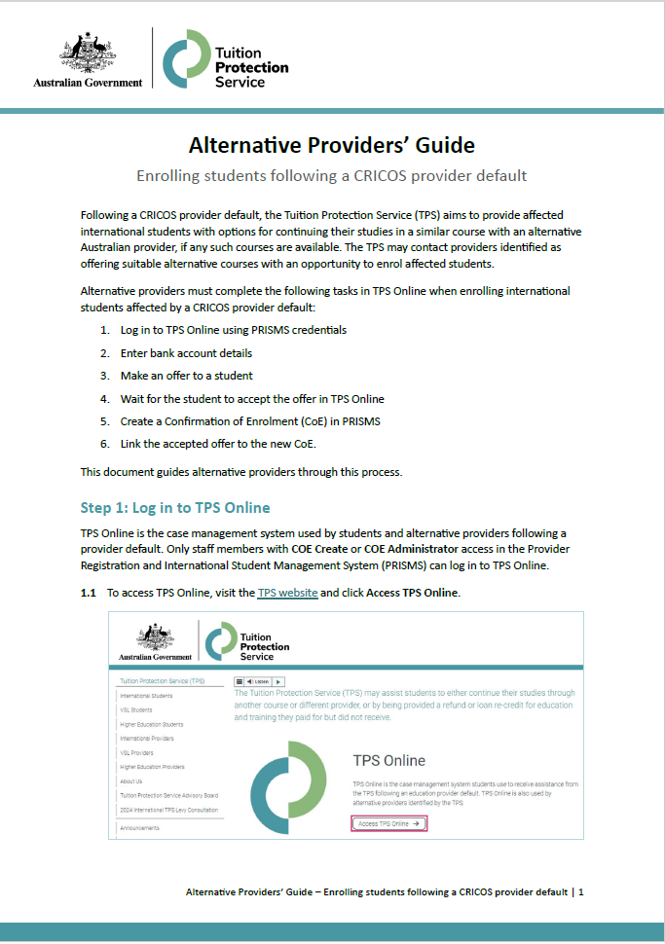
TPS Online: Summary of tasks
Log in to TPS Online using PRISMS credentials
Enter bank account details
Make an offer to a student
Wait for the student to accept the offer in TPS Online
Create a Confirmation of Enrolment (CoE) in PRISMS
Link the accepted offer to the new CoE
Refer to the Alternative Providers’ Guide on the TPS website when completing these tasks
www.tps.gov.au

Slide 18
www.tps.gov.au
support@tps.gov.au
1300 131 798

