Slide 1


2025 VSL, HELP and Up-front Payments Tuition Protection Levies
Sector Consultation Feedback on Draft Levy Settings
30 April 2025
Kate Tagg
TPS Program Management
www.tps.gov.au

Slide 2
Outline
Tuition Protection Service (TPS) and levies
Levy components and draft 2025 settings
Summary of 2025 domestic sector consultation
2025 levy timeline and takeaways
www.tps.gov.au

Slide 3
Tuition Protection Service (TPS)
Australian Government initiative
Student tuition protection scheme
Developed for international student fee protection and expanded to specified domestic students
Supports students with tuition fee refunds and loan re-credits, and facilitates alternative course placements following provider closures
Supports education providers to understand and meet obligations to students
Manages tuition protection levy collections
www.tps.gov.au

Slide 4

TPS Team
www.tps.gov.au

Slide 5
TPS Advisory Board
View Board member profiles at tps.gov.au
Ms Sharon Robertson (Chair)
The Hon. Phil Honeywood (Deputy Chair)
Ms Karen Sandercock, Australian Government Department of Education
Ms Jane Hayden (a/g), Australian Government Department of Employment and Workplace Relations
Mr Guy Thorburn, Australian Government Actuary
Ms Gloria Yu, Australian Prudential Regulation Authority
Ms Rebecca Mok, Australian Government Department of Finance
Ms Victoria Miller, Australian Government Department of Home Affairs
www.tps.gov.au

Slide 6
Domestic Tuition Protection Levies
Three annual sector-based tuition protection levies collected from domestic education providers
Paid into quarantined accounts managed by the TPS Director
VSL Levy → VSL Tuition Protection Fund
HELP Levy → Higher Education Tuition Protection Fund
Up-front Payments Levy → Higher Education Tuition Protection Fund
Fund the student placement, loan re-credit and refund activities of the TPS following an education provider closure and TPS operational costs
Levy calculation based on an education provider’s size and risk of closure
www.tps.gov.au

Slide 7
Domestic Tuition Protection Levy Setting Process
5 Feb 2025 | TPS Advisory Board provided draft advice to the TPS Director on the 2025 domestic levy settings
Mar-Apr 2025 | TPS Director consults the sector on the draft Levy settings
21 May 2025 | TPS Advisory Board considers the sector’s feedback on the draft levy settings then provides final advice to the TPS Director
By 1 August 2025 | 2025 levy settings finalised in legislative instruments
www.tps.gov.au

Slide 8
VSL and Higher Education Tuition Protection Funds
Two tuition protection Funds for domestic schemes:
VSL Tuition Protection Fund
Higher Education Tuition Protection Fund
AGA recommends target range for Funds to ensure sufficient funds are available for a large provider closure or multiple provider closures
Fund | Target range | Balance | Seed funding
VSL Fund | $6.75-9.5 million | $12.27 million (as at 31 Dec 2024) | $7.73 million (as at 31 Dec 2024)
Higher Education Fund | $21-25 million | $18.03 million (as at 31 Dec 2024) | $8.62 million (as at 31 Dec 2024)
www.tps.gov.au

Slide 9
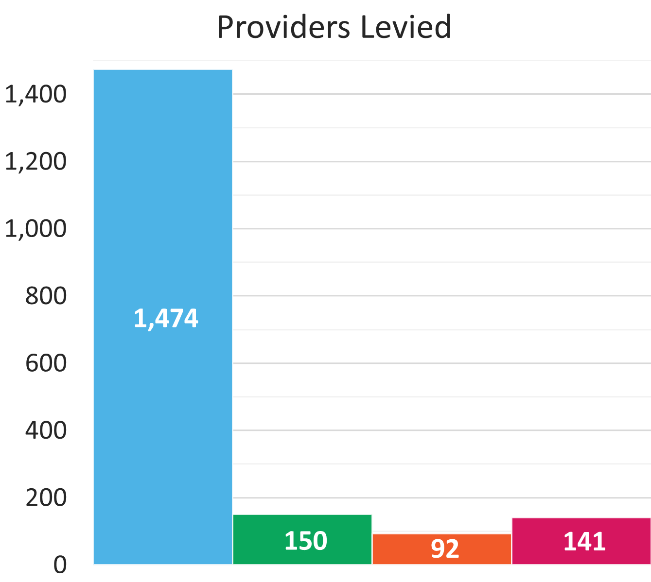
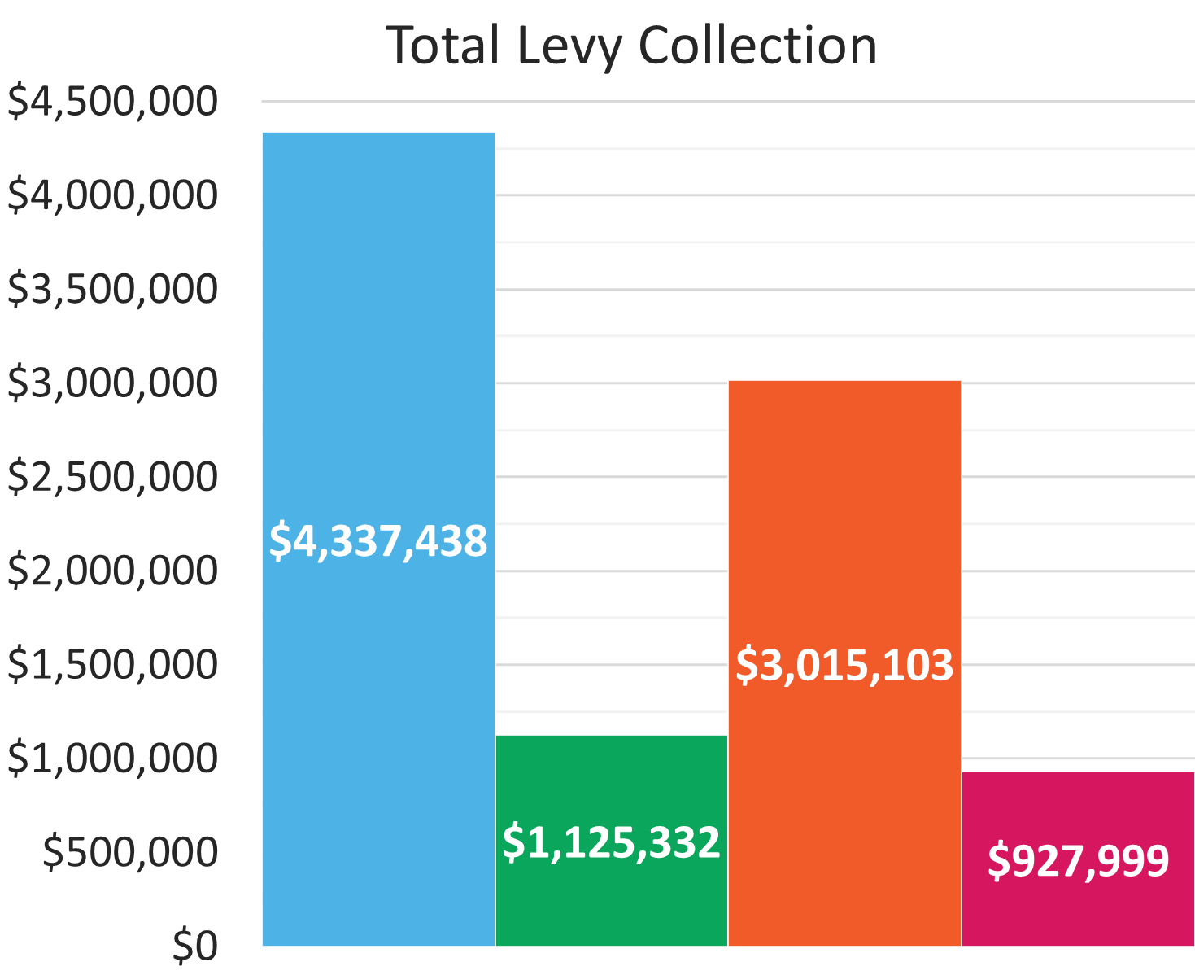
2024 Levy Collection Overview
www.tps.gov.au

Slide 10
Domestic Levy Components and
Draft 2025 Settings
www.tps.gov.au

Slide 11
Domestic Tuition Protection Levy Components
Component | Key elements | Purpose and authority
Administrative fee | Sum of a ‘per provider’ and ‘per student’ charge | Designed to cover administrative costs Set by relevant Minister
Risk rated premium | Considers 3 risk factors: Financial strength Completion rate Non-compliance history and registration renewal | Intended to reflect risk of provider default Set by TPS Director with Board advice
Special tuition protection | Percentage multiplied by total loan amounts or up-front payments received | Builds Fund balances when below target range and facilitates repayment of seed funding Set by TPS Director with Board advice
www.tps.gov.au

Slide 12
Draft 2025 Domestic Tuition Protection Levy Settings
Component | VSL Levy | HELP Levy | Up-front Levy
Administrative fee | $125 per provider + $10.55 per VSL student | $125 per provider + $10.55 per HELP student | $125 per provider + $10.55 per up-front student
Risk rated premium | $6 per VSL student + 0.13% x total 2024 loan amounts | $6 per HELP student + 0.06% x total 2024 loan amounts | $2 per up-front fee-paying student + 0.04% x total 2024 up-front payments
Special tuition protection | 0.10% x total 2024 VSL loan amounts | 0.10% x total 2024 HELP loan amounts | 0.10% x total 2024 up-front payments
*Administrative fee figures quoted were applied for the 2024 levies and may be indexed to CPI for 2025
Note: 2025 levies will be calculated using student enrolment numbers and revenue for the 2024 calendar year
www.tps.gov.au

Slide 13
Risk rated premium component
Considers 3 risk factors designed to reflect the risk of provider closure
Providers receive a risk value against each risk factor
The sum of a provider’s risk values give a total risk factor value
Providers with a high total risk factor value present a higher risk of closure and will pay a higher levy amount
www.tps.gov.au

Slide 14
Risk Rated Premium Component: Risk Factors
Risk Factor 1 Financial Strength
Based on 2 ratios: return on assets and debt to equity
Calculations use providers’ most recent financial data
Risk Factor 2 Unit Completion Rate
Based on the unit completion rate of students
Note: One change to the 2025 completion rate calculation
Risk Factor 3 Non-Compliance History and Registration Renewal
Late payment history of the relevant tuition protection levy and annual registration provider charges; and
If a provider’s registration was renewed for a period less than the maximum allowable for risk management reasons
www.tps.gov.au

Slide 15

Financial Strength
Assessed using two ratios:
Ratio | Formula
Return on Assets: Measures the profitability of a provider relative to its total assets | NPBT / total assets
Debt to Equity: Measures the degree to which a provider is financing its operations through debt | Total liabilities / total equity
NPBT: Net profit before tax
‘Net profit ratio’ was also used to calculate financial strength in previous years but was first removed from the 2024 levy calculations in response to concerns raised by some not-for-profit providers at the 2024 consultation sessions
www.tps.gov.au

Slide 16
Financial Strength
Proposed 2025 risk factor values unchanged from 2024 (and since 2022)
Financial strength score | Risk factor value (2022-24) | Proposed risk factor value (2025)
8 or 9 | 0.0 | 0.0
6 or 7 | 1.0 | 1.0
1 to 5 | 2.0 | 2.0
Provider does not submit financial statements | 2.5 | 2.5
Providers receive a score of 1.5, 3.0 or 4.5 for each ratio, which are summed together to give an overall financial strength score
Financial strength scores determine providers’ financial strength risk factor values
www.tps.gov.au

Slide 17

Completion Rate: Change to calculation
Consultation feedback in 2024 included concerns raised by some providers about the use of ‘withdrawn EFTSL’ and ‘ongoing EFTSL’ in the unit completion rate calculation
In response to this feedback, the AGA tested alternative calculation methods
AGA recommendations supported by the TPS Advisory Board for 2025:
Remove ‘withdrawn EFTSL’ from the calculation, as withdrawn students no longer qualify for TPS assistance following a closure
Maintain ‘ongoing EFTSL’ in the calculation. In the event of a closure, providers with a higher number of ongoing students pose a greater cost to the levy funds as it is students with incomplete units that are eligible for TPS assistance
www.tps.gov.au

Slide 18
Completion Rate
Low student unit completion rates are correlated with an increased likelihood of closure
Unit completion rate percentage calculation:
Passed EFTSL
X 100
(Passed + Failed + Ongoing + Data missing EFTSL)
EFTSL: Equivalent full-time student load for a year
‘Withdrawn EFTSL’ was included in the calculation denominator in previous years, but is recommended for removal in accordance with AGA and Board advice for 2025
www.tps.gov.au

Slide 19
Completion Rate
Proposed 2025 risk factor values unchanged from 2024 (and since 2023)
Completion rate percentage | Risk factor value (2020) | Risk factor value (2022) | Risk factor value (2023-24) | Proposed risk factor value (2025)
85% or higher | 0.0 | 0.0 | 0.0 | 0.0
60% to <85% | 0.0 | 0.0 | 1.0 | 1.0
35% to <60% | 3.5 | 1.7 | 2.5 | 2.5
0% to <35% | 5.5 | 2.7 | 3.5 | 3.5
www.tps.gov.au

Slide 20

Non-Compliance History and Registration Renewal
Assesses the risk of a provider based on their history of non-compliance and lack of risk management practices
Non-compliance history
Penalises providers for a late payment history of the relevant levy and annual registration provider charges over the previous 3 years (i.e. 2022-2024)
Registration renewal
Penalises providers that applied for renewal of its registration and, for risk management reasons, had its registration renewed for a period less than the maximum allowable
www.tps.gov.au

Slide 21
Non-Compliance History and Registration Renewal
Proposed 2025 risk factor values unchanged from 2024 (and since 2022)
Non-compliance history and registration renewal | Risk factor value (2022-24) | Proposed risk factor value (2025)
Weighted late payment measure of 30 days or more | 2.0 | 2.0
Weighted late payment measure of 15 to >30 days | 0.9 | 0.9
Weighted late payment measure of 1 to >15 days | 0.7 | 0.7
Weighted late payment measure of >1 day | 0.0 | 0.0
PLUS
Applied to have its registration renewed and, for risk management reasons, had its registration renewed for a period less than the maximum allowable | 1.0 | 1.0
www.tps.gov.au

Slide 22
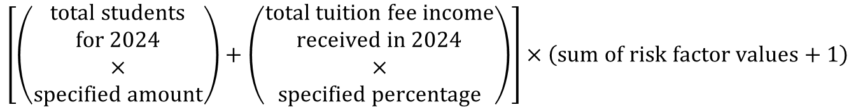
Risk Rated Premium Component
Risk rated premium component formula:
$$\left[\left(\begin{aligned}total students \\ for 2024 \\ × \\ specified amount\end{aligned}\right)+\left(\begin{aligned}total tuition fee income \\ received in 2024 \\ × \\ specified percentage\end{aligned}\right)\right]×\left(sum of risk factor values+1\right)$$
The sum of a provider’s risk factor values is a multiplier for the risk rated premium component calculation
www.tps.gov.au

Slide 23
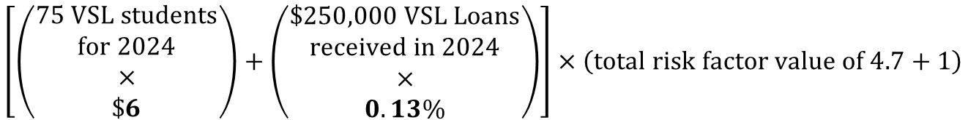
Risk Rated Premium Component: VSL Example
$$\left[\left(\begin{aligned}75 VSL students \\ for 2024 \\ × \\ \$6\end{aligned}\right)+\left(\begin{aligned}\$250,000 VSL Loans \\ received in 2024 \\ × \\ 0.13\%\end{aligned}\right)\right]×\left(total risk factor value of 4.7+1\right)$$
= $450
= $325
= 5.7
= ($450 + $325) x 5.7
= $4,417.50
www.tps.gov.au

Slide 24
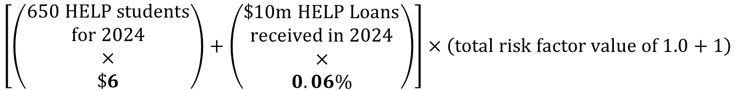
Risk Rated Premium Component: HELP Example
$$\left[\left(\begin{aligned}650 HELP students \\ for 2024 \\ × \\ \$6\end{aligned}\right)+\left(\begin{aligned}\$10m HELP Loans \\ received in 2024 \\ × \\ 0.06\%\end{aligned}\right)\right]×\left(total risk factor value of 1.0+1\right)$$
= $3,900
= $6,000
= 2.0
= ($3,900 + $6,000) x 2.0
= $19,800
www.tps.gov.au

Slide 25
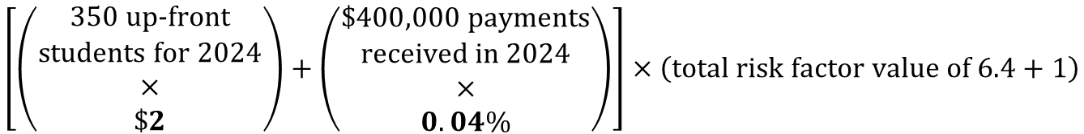
Risk Rated Premium Component: Up-front Example
$$\left[\left(\begin{aligned}350 up‑front \\ students for 2024 \\ × \\ \$2\end{aligned}\right)+\left(\begin{aligned}\$400,000 payments \\ received in 2024 \\ × \\ 0.04\%\end{aligned}\right)\right]×\left(total risk factor value of 6.4+1\right)$$
= $700
= $160
= 7.4
= ($700 + $160) x 7.4
= $6,364
www.tps.gov.au

Slide 26
Special tuition protection component
Helps to build the balance of the Funds when below their target range
Facilitates repayment of seed funding
Proposed percentage for 2025 levies: 0.10%
www.tps.gov.au

Slide 27
Summary of 2025 Domestic Sector Consultation
www.tps.gov.au

Slide 28
2025 Domestic Sector Consultation
A national webinar, in-person consultation sessions in NSW and VIC, and an online session for QLD-based providers were held throughout March 2025 to:
Present the draft settings of the 2025 domestic levies to providers
Collect providers’ feedback on the draft levy settings before they are finalised
Representatives from peak bodies were also consulted
Feedback received from the sector will be presented to the TPS Advisory Board ahead of its May 2025 meeting
www.tps.gov.au

Slide 29
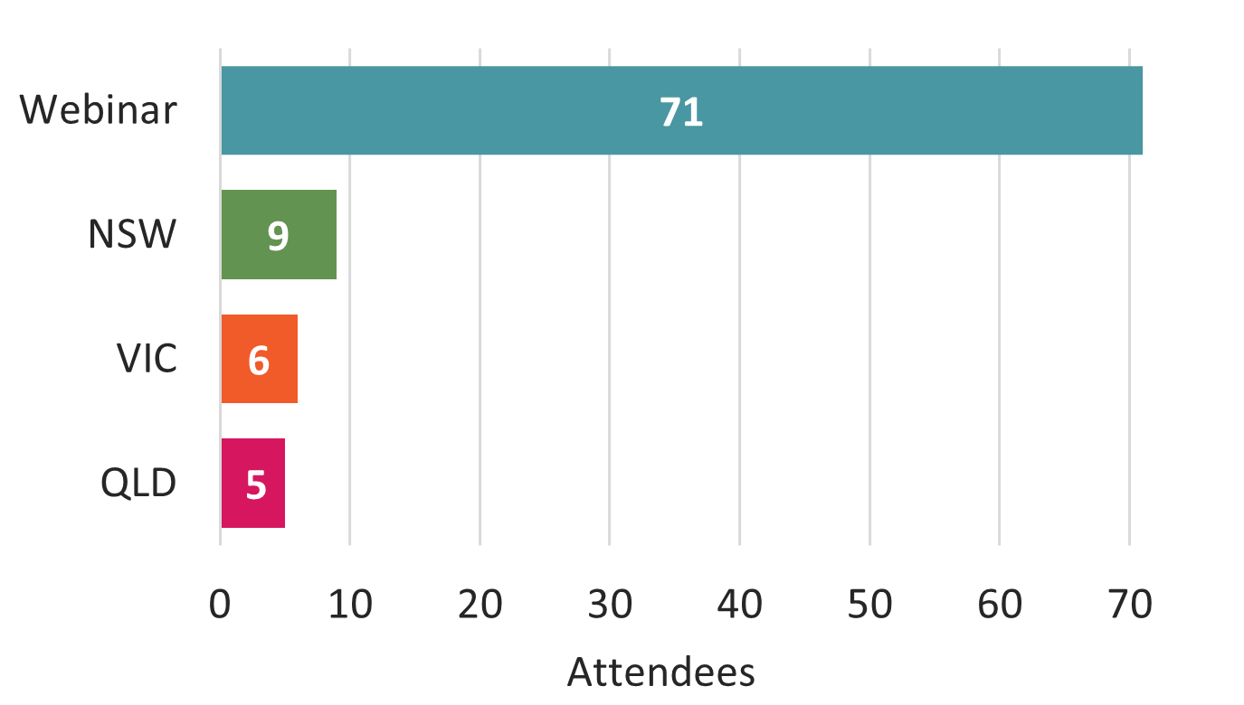
Consultation Session Attendance
Contacts in HITS for leviable providers invited to the consultation sessions
91 individuals attended
78% at the national webinar
22% at the in-person sessions
www.tps.gov.au

Slide 30
Summary of Sector Consultation Feedback
We had robust discussions with providers, particularly regarding the risk factor calculations
Each levy model is designed to be a ‘best fit’ for all providers across the sector
We recognise diversity of providers across the sector
We take all feedback into account and work with the TPS Advisory Board and AGA to trial different levy settings that address providers’ concerns and are suitable for all providers in the sector
www.tps.gov.au

Slide 31
Summary of Sector Consultation Feedback
Overall, providers are supportive of the draft 2025 domestic levy settings
Providers supportive of removing ‘withdrawn EFTSL’ from the Unit Completion Rate risk factor calculation
Providers appreciate being involved in the decision-making process and learning about how the levies are calculated
www.tps.gov.au

Slide 32
Takeaways
One proposed change for the 2025 levy settings: Withdrawn students to be removed from the Unit Completion Rate risk factor calculation
Seed funding repayments for VSL Fund to commence in the 2024-25 financial year subject to balance of the Fund
2025 domestic levies collected November/December 2025
www.tps.gov.au

Slide 33
2025 Domestic Levies Timeline and
Key Messages
www.tps.gov.au

Slide 34
2025 Domestic Tuition Protection Levies Timeline
Feb 25
Mar-Apr 25
May-Jul 25
Aug 25
Oct-Dec 25
5 February
Draft advice on 2025 Levy settings confirmed at TPS Advisory Board meeting
Mid-February
Draft advice letters published on TPS website
March
Online consultation session for all providers
Consultation sessions in Sydney, Melbourne and Brisbane
Meetings with stakeholders
30 April
Online feedback session for all providers
21 May
TPS Advisory Board considers sector feedback
Final advice on 2025 Levy settings confirmed at TPS Advisory Board meeting
June-July
Legislative Instruments prepared
1 August
Legislative Instruments must be made by 1 August and published online
October
Request for Information (RFI) sent to up-front providers
Early advice notices sent
Return of RFI forms and results compiled
November
Domestic levy invoices issued
December
Domestic levy payments due
www.tps.gov.au

Slide 35

Key messages
Ensure contact information in HITS and enrolment data in TCSI are up to date
Check account details before making a payment
  Pay the full and correct amount on time to avoid receiving a late payment penalty for the following three years
  Ensure all financial statements:
  are signed by an auditor
  contain financial information from previous year (2024)
  display the ABN of the entity the TPS is levying
  Do not use Parent company’s financial statements
www.tps.gov.au

Slide 36



www.tps.gov.au
operations@tps.gov.au

