Slide 1
HELP Communications Working Group 27 February 2025

Slide 2
Section | Attendees
Student Engagement Team | Kellie McInnes, Nicole Ranieri, Stephanie Stockwell, Abbi Peters, Dylan Parker, Beth Betts, Abby Walsh, Michelle Scott and Nathan Twomey
Regional University Study Hubs | Libby Beattie
HELP Integrity and Superannuation | Ryan Herbert
Equity and Support Projects | Tristan Krautz
Social Cohesion Team | Nathan Riches
Commonwealth Prac Payment (CPP) | Annette Cannell
HELP Programs | Cameron De Jong
Tuition Protection Services | Tanya Benton-Hall
TCSI | Phil Blagus
VET Student Loans | Ben Houston and Leigh Hughes
Department of Finance | Ben Stilling

Slide 3
Item | Speaker | Representing | Agenda Item
1 | Kellie McInnes | MC | Welcome, housekeeping and introduction
2a | Libby Beattie | Regional University Study Hubs | Update on 2024 Regional University Study Hubs application round
2b | Nicole Ranieri | Student Engagement Team | National Student Ombudsman
2c | Annette Cannell | Industry Linkages and Advanced Apprenticeships | Commonwealth Prac Payment (CPP)
2d | Tristan Krautz | Equity and Support Projects | Reminder: First Compliance Report Due 1 March 2025 for the Support for Students Policy Tertiary Access Payment: Changes to Eligibility from 1 January 2025
2e | Tanya Benton-Hall | Tuition Protection Service | Upcoming Domestic Levy Consultations
3a | Cameron De Jong | HELP Program | USI verification reminder
3b | Ben Stilling | Department of Finance | Digital ID Update
3c | Nathan Riches | Social Cohesion Team | 2025 Racism study survey
3d | Phil Blagus | TCSI | Student Data Verification Webinar in April
3e | Nicole Ranieri, Steph Stockwell Beth Betts | Student Engagement Team | HELP 2025 Booklets and Fact Sheets Administrative Information for Providers – January 2025 update Student Experience Research 2025 eCAF, FFUR eCAF and eCAF Stocktake Early childhood educators practicum exchange network
4 | Kellie McInnes | MC | Other Business and Q&A
5 | Kellie McInnes | MC | Meeting Close and Wrap-up

Slide 4
New locations:
Clermont and Moranbah, QLD
Hughenden, QLD
Hay, NSW
Tumut, NSW
Kununurra, WA
Northam, WA
Kingscote, SA
Hamilton, VIC
St Helens, TAS
Burnt Pine, Norfolk Island.
For more information, please contact: regional@education.gov.au

Slide 5
National Student Ombudsman
From 1 February 2025, the NSO is accepting escalated complaints from students about the actions of their higher education provider.
The NSO can consider complaints from prospective and current higher education students including Higher Degree Research students, students enrolled part-time or full-time, domestic or international students.
Higher education complaint handlers can refer to the 'NSO Launch Kit' for content to use for student and staff communications. The NSO Launch Kit is at: www.nso.gov.au/__data/assets/pdf_file/0024/315843/NSO-e-kit-complaint-handlers.pdf

Slide 6
Commonwealth Prac Payment: Student Eligibility setting
Courses
Higher Education
Entry-to-practice Bachelor or Masters qualification in Teaching, Nursing, Midwifery, Social Work
VET Student
Diploma of Nursing
Delivery
Payment delivered via Higher Education providers
Payment delivered via DEWR
Income and
'Need to work' test
Be an income support payment recipient
Work on average >15 hrs per week up to an income limit.
OR
Placement
Minimum mandatory placement hours required as part of entry-to-practice accreditation obligations.
Notes:
The Albanese Government is establishing the ongoing Commonwealth Prac Payment ($427.4 million 2027-28) with $369.2 million to support higher education students, and ​$58.2 million to support vocational education and training students. ​
A payment of $319.50 per week (benchmarked against the single Austudy rate) will be available from 1 July 2025 to support domestic students studying entry to practice Bachelor or Masters courses in teaching, nursing, midwifery, and social work during their mandatory placements. ​
The payment will be means-tested, to target students on income support payments and students who normally need to work more than 15 hours per week during their studies

Slide 7
Commonwealth Prac Payment
Commonwealth Prac Payments (CPP) to commence 1 July 2025
The CPP will provide a payment of $331.65 per week (benchmarked to the single Austudy rate) to eligible Bachelor and Masters nursing, midwifery, teaching and social work students doing their mandatory placements
The CPP Operational Working Group is helping to inform the development of the Provider Guidelines
Communications materials are being developed for students and providers.
For questions, please contact the team at commonwealthpracpayment@education.gov.au

Slide 8
Support for Students Policy
A support for students policy outlines the academic and non-academic supports available to assist students progress in and complete their studies.
HESA approved higher education providers need to submit an annual report describing how they have complied with their support for students policy.
A reporting template was sent to all HESA higher education providers and is available on the department’s website at: www.education.gov.au/new-requirements-support-students
First Compliance Report Due 1 March 2025

Slide 9
Tertiary Access Payment (TAP)
The TAP eligibility requirement to ‘commence tertiary studies within 12 months of completing Year 12’ has changed.
All other criteria remain in place.
Eligible students who have taken a gap year/s can apply from 9 June 2025.
The department is developing communications to ensure students and parents know about the change and when applications can be submitted.

Slide 10
2025 HELP Tuition Protection Levy Consultation
Tuition Protection Service (TPS) consulting with leviable providers on the 2025 HELP Tuition Protection Levy draft settings throughout March and April 2025
Combination of online and in-person consultation sessions
Opportunity to provide feedback on draft levy settings before they are finalised
Further information and registration links available under ‘announcements’ on the TPS website
Email operations@tps.gov.au with any queries

Slide 11
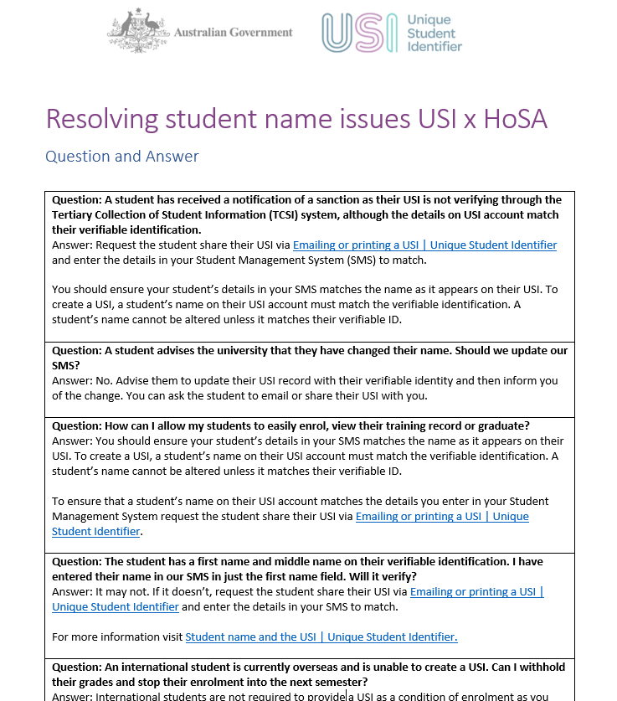
Unique Student Identifier (USI)
When a student’s name in USI and the name recorded by the higher education provider does not match, the USI will not verify in TCSI.
The role of the provider is to ask the student to confirm exactly how their name is entered on their USI account, and then report the matching details in TCSI or Student Management Systems (SMS) exactly as it appears on their USI account.
A student’s USI account details cannot be changed to reflect a provider’s record. In the case where a student needs to change their name in their USI account, they can update their details through the USI Student Portal.
The HOSA (Heads of Student Administration) association recently provided this message to their members; Q&As from the USI Office were attached.
The USI Office have offered to facilitate a webinar to present FAQs, and hints & tips to further assist providers resolve verification issues. If you are interested in a webinar, contact stakeholders@usi.gov.au.

Slide 12
Digital ID update
With a Digital ID, people can confirm who they are online without needing to share information such as copies of their ID documents. This helps to reduce the amount of data that is shared, stored and at risk of being stolen.
The Digital ID Act 2024 (the Digital ID Act) establishes a voluntary accreditation scheme for Digital ID providers, with civil penalties for non-compliance.
The Digital ID Act also enables the Australian Government Digital ID System (AGDIS) to expand over time. By December 2026, private sector services will be able to apply to join the AGDIS and make use of participating Digital ID services.
To find out more, visit www.digitalidsystem.gov.au.

Slide 13
Social Cohesion Policy Team
Our team:
Leads policy advice and projects to improve social cohesion and inclusion in higher education to ensure all students and staff are safe, supported and free from discrimination and harassment.
Is focused on strengthening policy capability on social cohesion issues in higher education to drive a strategic approach to address existing and emerging issues including campus protests, student wellbeing, and student experiences for ensuring social cohesion in higher education.
Is responsible for supporting the Australian Human Rights Commission’s Respect at Uni: Study into Antisemitism, Islamophobia, racism and the experience of First Nations people.

Slide 14
Respect at Uni Study
In 2024 the Department of Education contracted the Australian Human Rights Commission to undertake a groundbreaking study into the prevalence, nature, and impact of racism at universities.
All forms of racism will be addressed in this project. The antisemitism, Islamophobia, anti-Palestinian and anti-Arab racism currently being seen on campuses, and systemic racist practices against First Nations student and staff will be considered.
The study implements part of a key recommendation from the Australian Universities Accord Final Report.
The Study is intended to be a first step in the design and development of a national, longitudinal approach to measuring and tracking racism in the tertiary sector.

Slide 15
Respect at Uni Study
The Study is supported by three streams of work:
National Online Prevalence Survey – looking at the prevalence and impact of racism experienced by students and staff in Australian universities (including those with dual-sector operations).
Literature review - the Literature Review will investigate practical evidence-based solutions. The final report of the Literature Review will include detailed recommendations to supplement other data from the Study. Other Commission projects, such as the National Anti-Racism Framework, provide a successful model for this approach.
Fieldwork – the collection of qualitative data through focus groups and consultations with key stakeholder groups

Slide 16
National Online Prevalence Survey
The quantitative data will be used to help establish a baseline of the experiences of racism and inform development of recommendations to foster a safe, respectful and inclusive environment for all university students and staff.
The Survey will be run during first semester this year.
The AHRC will be holding information sessions with Vice-chancellors on 5 and 10 March 2025.
We ask that your institutions encourage participation in the survey once released by the AHRC.

Slide 17
Item | Speaker | Representing | Agenda Item
1 | Kellie McInnes | MC | Welcome, housekeeping and introduction
2a | Libby Beattie | Regional University Study Hubs | Update on 2024 Regional University Study Hubs application round
2b | Nicole Ranieri | Student Engagement Team | National Student Ombudsman
2c | Annette Cannell | Industry Linkages and Advanced Apprenticeships | Commonwealth Prac Payment (CPP)
2d | Tristan Krautz | Equity and Support Projects | Reminder: First Compliance Report Due 1 March 2025 for the Support for Students Policy Tertiary Access Payment: Changes to Eligibility from 1 January 2025
2e | Tanya Benton-Hall | Tuition Protection Service | Upcoming Domestic Levy Consultations
3a | Cameron De Jong | HELP Program | USI verification reminder
3b | Ben Stilling | Department of Finance | Digital ID Update
3c | Nathan Riches | Social Cohesion Team | 2025 Racism study survey
3d | Phil Blagus | TCSI | Student Data Verification Webinar in April
3e | Nicole Ranieri, Steph Stockwell Beth Betts | Student Engagement Team | HELP 2025 Booklets and Fact Sheets Administrative Information for Providers – January 2025 update Student Experience Research 2025 eCAF, FFUR eCAF and eCAF Stocktake Early childhood educators practicum exchange network
4 | Kellie McInnes | MC | Other Business and Q&A
5 | Kellie McInnes | MC | Meeting close and wrap-up

Slide 18
2025 Booklets and Factsheets​
Interim products available since September 2024​. Final 2025 products now published on Study Assist: www.studyassist.gov.au/financial-and-study-support/help-publications.
Administrative Information for Providers
Reviewed and published at: www.education.gov.au/higher-education-publications/higher-education-administrative-information-providers.
Government eCAF
2025 eCAFs released last year via text tag references, with additional text changes in December.
FFUR eCAF - interim arrangement is the Government smart PDF FFUR CAF. The Department will share information about the release of the Government FFUR eCAF as soon as possible.
eCAF Stocktake – analysis ongoing in March 2025.
For questions about the Government eCAF, please contact HEenquiries@education.gov.au.
Student Experience Research
The department is interested to understand more about the lived experience of students, particularly of First Nations, Culturally and linguistically diverse, students with a disability and other equity groups.
Early Childhood higher ed students – new website to search for pracs​
The Department has launched a new website for higher ed students in early childhood to search for and arrange practicums. Please share with Education faculties: https://prac.education.gov.au/.​

Slide 19
Thank you all for attending For questions or feedback, reach out to us at HEenquiries@education.gov.au
Subscribe to the Provider Updates at https://www.education.gov.au/higher-education-provider-updates

