Slide 1
2025 International TPS Levy
Sector Consultation Feedback on Draft Levy Settings
8 Oct 2024
Melinda Hatton
TPS Director
www.tps.gov.au

Slide 2
Outline
2025 International TPS Levy consultation summary
Levy collection overview
Levy components and draft 2025 settings
2025 levy takeaways
www.tps.gov.au

Slide 3
2025 International TPS Levy Consultation Summary
www.tps.gov.au

Slide 4
2025 International TPS Levy Consultation
An online session and nine in-person consultation sessions were held for leviable providers from mid-August to mid-September 2024 to:
Present the draft settings of the 2025 International TPS Levy
Collect providers’ feedback on the draft levy settings
Representatives from peak bodies were also consulted
Consultation feedback will be presented to the TPS Advisory Board ahead of its October 2024 meeting
www.tps.gov.au

Slide 5
Consultation Session Attendance
Contacts in PRISMS for leviable providers were invited to the consultation sessions
461 individuals attended
74% at the online session
26% at the in-person sessions
www.tps.gov.au

Slide 6
Summary of Consultation Feedback
Overall, providers were supportive of the draft 2025 International TPS Levy settings
Providers were understanding of the need to reintroduce risk factor values for positive volatility in the ‘volatility in overseas student enrolments’ risk factor
Providers acknowledged that the ESOS policy changes currently under consultation in the sector are likely to have significant impacts in the sector, particularly as they may contribute to increased provider closures
www.tps.gov.au

Slide 7
Consultation Feedback: National Planning Level
27 August 2024: Australian Government announced that, subject to the passage of legislation, it would set a National Planning Level (NPL) for new overseas student commencements (NOSC) of 270,000 for the 2025 calendar year
While the consultation sessions were intended for the draft 2025 International TPS Levy settings, we had robust discussions with providers about the NPL at all sessions (detailed in following slides)
www.tps.gov.au

Slide 8
Consultation Feedback: National Planning Level
Q: Does the TPS expect to see an increase in provider closures in 2025?
We will be preparing for more closures to occur in 2025 regardless of whether that situation eventuates
We expected and prepared for a large volume of closures when COVID lockdowns and border closures began, but less providers closed than in pre-COVID years
If you believe you are at risk of closing, please familiarise yourself with your Provider Default Obligations under sections 46A to 46F of the ESOS Act, and notify the TPS as soon as possible
www.tps.gov.au

Slide 9
Consultation Feedback: National Planning Level
Q: Following a provider closure, are students enrolling with a new provider exempted from their new provider’s enrolment limit?
A student sometimes moves providers where their provider can no longer deliver their course. This might occur because the provider closes, or loses approval required to deliver the course. This may require activation of the Tuition Protection Service.
In these circumstances, students are excluded from the National Planning Level and are not counted against their new provider’s limit.
www.tps.gov.au

Slide 10
Consultation Feedback: National Planning Level
Concerns were raised about providers that have already issued confirmation of enrolments (CoEs) for more international students than their 2025 NOSC limit allows
Non-exempt providers are obligated to maintain an account containing the ‘protected amount’ (ss 28-29 ESOS Act), which includes all tuition fees received by a provider for international students who have not yet commenced their course
The protected amount should be used to provide tuition fee refunds to students who will not be able to start their course in 2025
Please familiarise yourself with your Provider Default Obligations and Student Default Obligations under sections 46A-46F and sections 47A-47H of the ESOS Act
www.tps.gov.au

Slide 11
Consultation Feedback: National Planning Level
Q: Will the ESOS policy changes affect how the International TPS Levy is calculated?
As the 2025 levy will be calculated using 2024 data, any ESOS policy changes will not impact how the 2025 levy is calculated
The introduction of NOSC limits may affect the efficacy of some of the levy risk factors (e.g. ‘volatility in overseas student enrolments’). Adjustments to the current risk factor settings and/or the introduction of alternative risk factors is likely required for the 2026 International TPS Levy.
We have committed to consult with the sector on this matter and invite your suggestions on alternative risk factors that could be used to indicate that an education provider may be at risk of closing
www.tps.gov.au

Slide 12
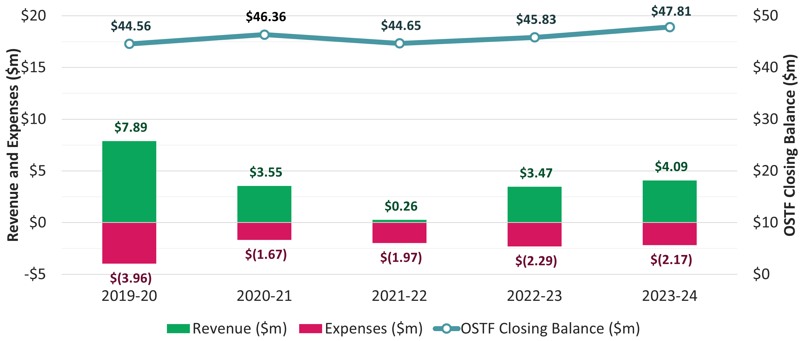
Fund Balance, Revenue and Expenses – Last 5 Financial Years
www.tps.gov.au

Slide 13
International TPS Levy Collection Overview
www.tps.gov.au

Slide 14
International TPS Levy Setting Process
7 August 2024 | TPS Advisory Board provided draft advice to the TPS Director on the 2025 International Levy settings
Aug-Oct 2024 | TPS Director consulted the sector on the draft levy settings
16 October 2024 | TPS Advisory Board considers the sector’s feedback on the draft levy settings then provides final advice to the TPS Director
By 1 January 2025 | 2025 levy settings finalised in legislative instruments
www.tps.gov.au

Slide 15
Overseas Students Tuition Fund (OSTF)
International TPS Levy paid into OSTF
AGA recommends target range for OSTF to ensure sufficient funds are available for a large provider closure or multiple provider closures
AGA recommends increasing 2025 target range due to increase in studying international students and higher forecasted closures than previous few years
Balance: $47.8 million (30 June 2024)
Target range | Mid-point of target range
Current: $35-60 million | Current: $47.5 million
2025 recommendation: $40-60 million | 2025 recommendation: $50 million
www.tps.gov.au

Slide 16
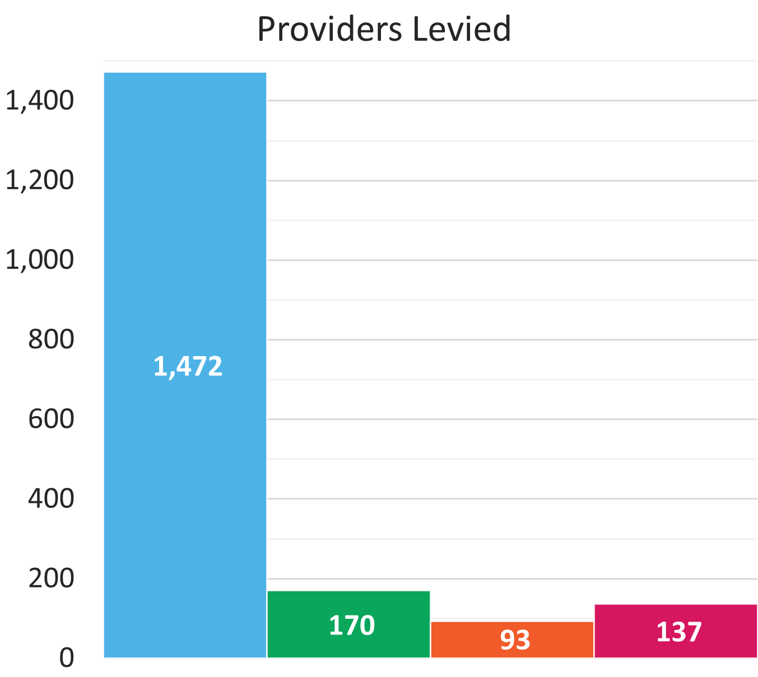
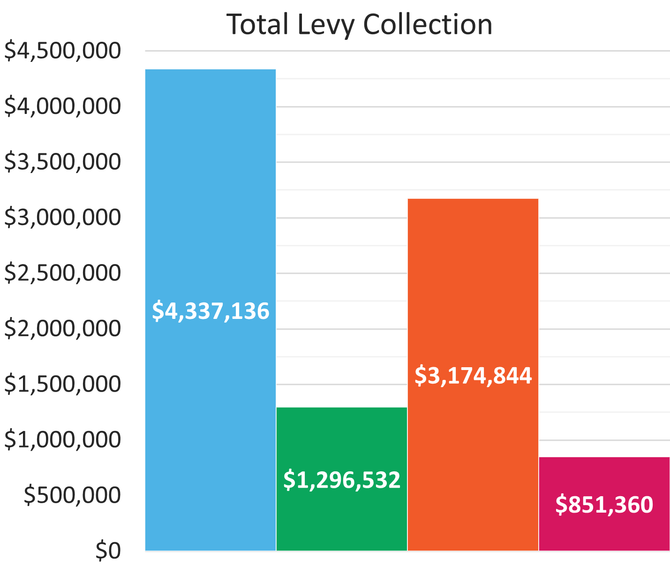
TPS Levy Collection Overview 2023-24
www.tps.gov.au

Slide 17
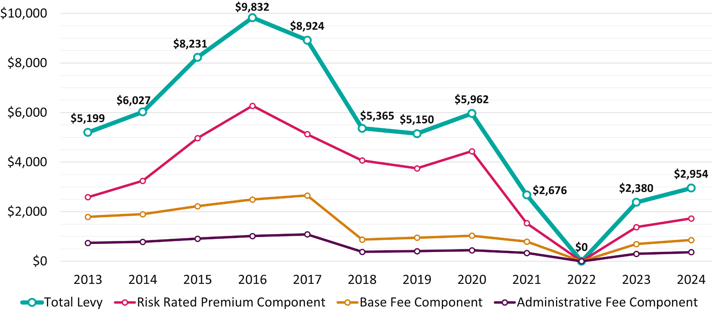
Average International Levy Amount per Provider 2013-24
www.tps.gov.au

Slide 18
2024 International TPS Levy: Late Payments
1,472 providers invoiced
174 providers did not pay by the invoice due date
24 providers were charged late payment penalties for not paying after receiving a final reminder notice. Of this group, 9 (those who had a ‘registered’ status) were suspended for non-payment, and the other 15 providers have been triggered for debt recovery action as they carry a debt to the Commonwealth.
As of 30 September 2024, 21 providers still had outstanding payments, totalling $21,486.76
www.tps.gov.au

Slide 19
Late or Non-Payment of International TPS Levy
The TPS is obligated to send one reminder notice to providers who have not paid their levy close to the due date. Providers have seven days to pay their levy after the reminder notice is given.
A provider’s registration will be automatically suspended if they fail to comply with the reminder notice (s90 ESOS Act) and will be charged a late payment fee and a reinstatement fee
Providers that pay their levies after the due date will receive a late payment penalty for the next three years’ levy risk rating calculation
Levy invoices are sent to PEO contacts in PRISMS. Keep your contact information in PRISMS up to date. To update your PEO details, please contact your regulator.
www.tps.gov.au

Slide 20
2025 International TPS Levy Notices
You will receive the following notices about your 2025 levy:
Early advice
Request for Information (RFI)
Invoice (with 28 days to pay)
Reminder notice (if your payment has not been received on the due date)
www.tps.gov.au

Slide 21
International TPS Levy
Levy components and draft 2025 settings
www.tps.gov.au

Slide 22
International TPS Levy Components
Component | Key elements | Purpose and authority
Administrative fee | Sum of a ‘per provider’ and ‘per student’ charge | Designed to cover administrative costs Set by Minister for Education
Base fee | Sum of a ‘per provider’ and ‘per student’ charge | Maintains OSTF balance at a sustainable level Set by Minister for Education
Risk rated premium | Considers 5 risk factors and overseas student tuition fees for previous year | Intended to reflect risk of provider closure Set by TPS Director with Board advice
Special tuition protection | Percentage multiplied by overseas student tuition fees for previous year | Charged when OSTF is below target range Set by TPS Director with Board advice
www.tps.gov.au

Slide 23
Draft 2025 International TPS Levy Settings
Component | Draft 2025 Settings
Administrative fee* | $104.00 per provider + $0.54 per 2024 overseas student enrolment
Base fee* | $210.00 per provider + $1.33 per 2024 overseas student enrolment
Risk rated premium | [0.05% x total risk factor value] x total 2024 overseas student tuition fees
Special tuition protection | 0% x total 2024 overseas student tuition fees
*Administrative and base fee figures reflect 2024 values and may be indexed to CPI for 2025
Note: 2025 levy calculated using student enrolment numbers and revenue for 2024 calendar year
www.tps.gov.au

Slide 24
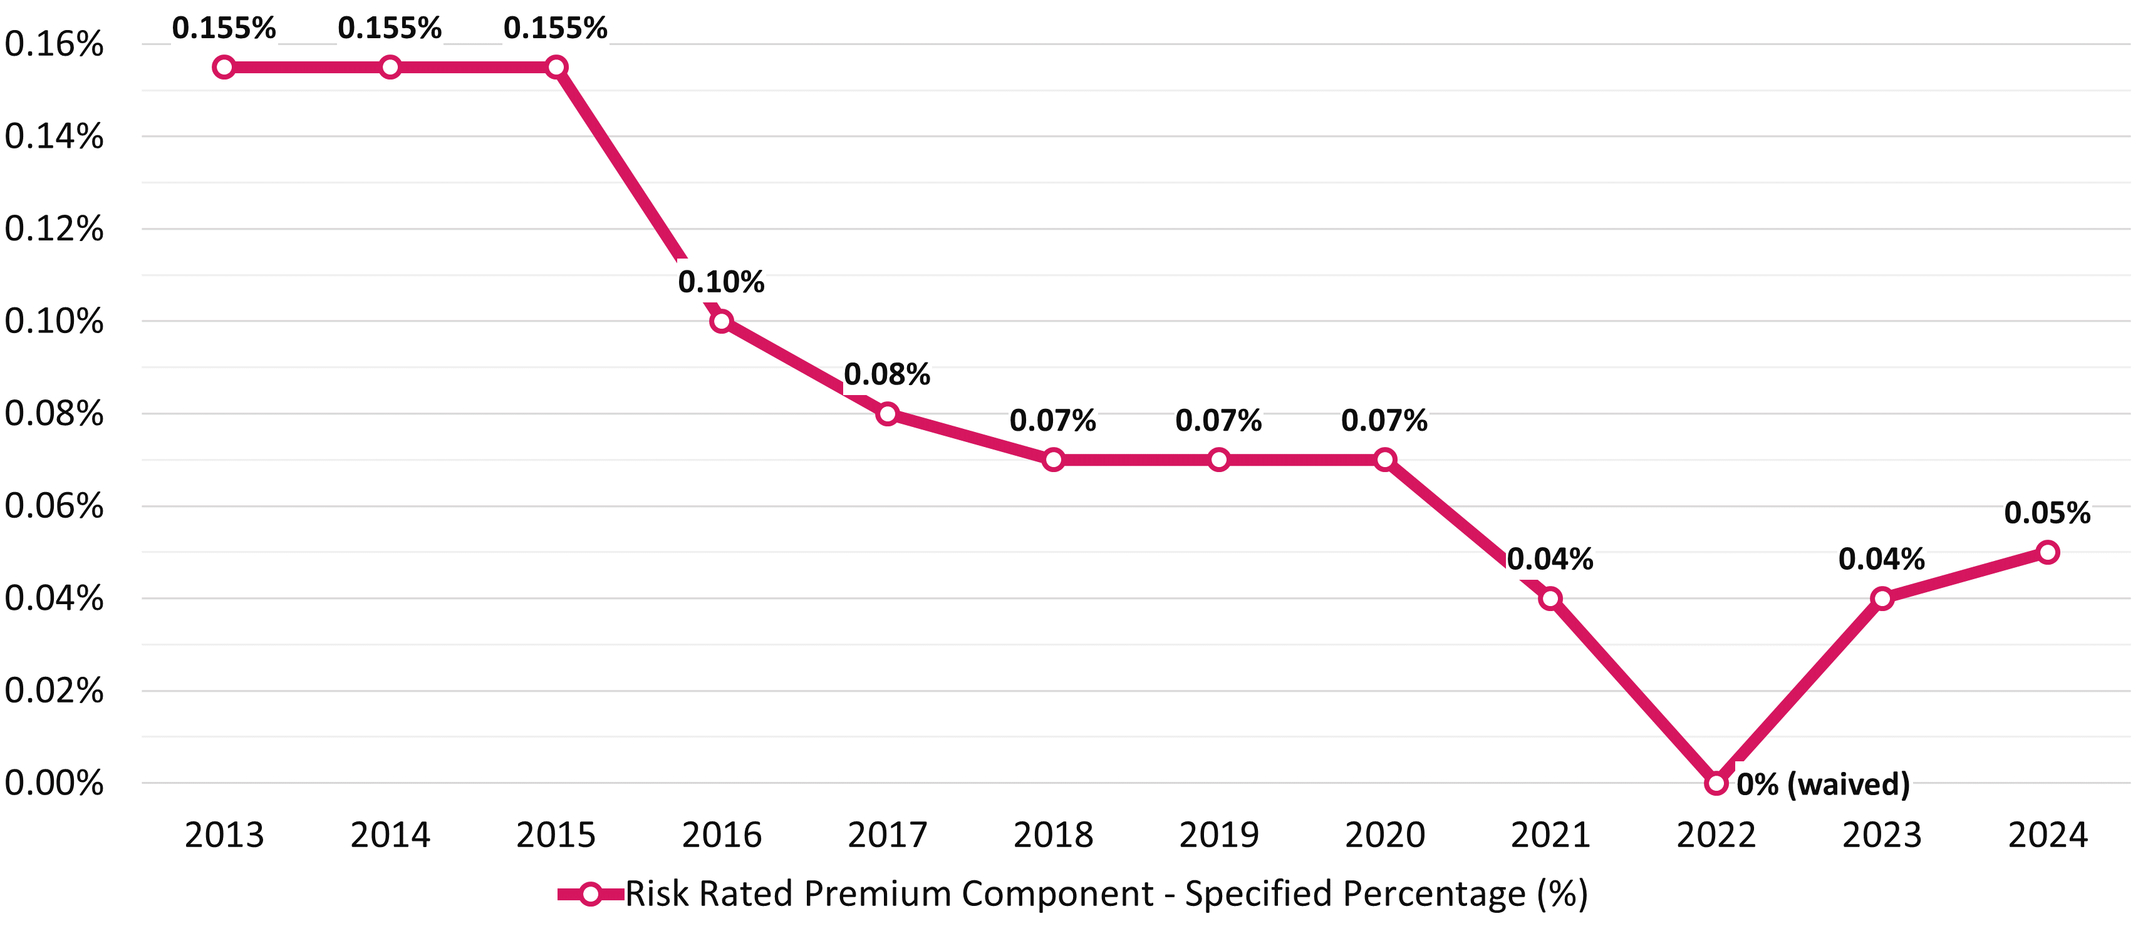
Risk Rated Premium Component Specified Percentage 2013-24
www.tps.gov.au

Slide 25
Risk Rated Premium Component: Risk Factors
Base Risk Factor | Risk factor value of 1.0 applied for all providers
Length of Operation | Higher risk of closure associated with shorter length of operation
Volatility in Overseas Student Enrolments | Higher risk of closure associated with extreme volatility in overseas student enrolments
Maximum Overseas Source Country Concentration | Higher risk of closure associated with heavy reliance on a single source country of overseas students
Non-Compliance and Registration Renewal | Penalty for late payment of the levy or CARC, having sanctions imposed for non-compliance, and/or shorter registration periods due to risk management concerns
www.tps.gov.au

Slide 26
Volatility in Overseas Student Enrolments
Risk factor values for positive volatility (growth) in overseas student enrolments were temporarily waived in 2023 and 2024 to avoid penalising providers experiencing growth in student enrolments post-COVID
Board proposes the positive volatility risk factor values be reinstated for 2025 to pre-pandemic levels
AGA analysis shows correlation between positive volatility and provider closures
Historically, periods of rapid growth can be followed by increased closures
4 closures in 2024 so far vs. 2 closures in 2023
www.tps.gov.au

Slide 27
2025 International TPS Levy Takeaways
www.tps.gov.au

Slide 28
Takeaways
Key features of the Board’s draft advice on 2025 levy settings:
Positive volatility risk factor values to be reinstated for the volatility in overseas student enrolments risk factor after 2-year temporary waiver
Target range of OSTF to be increased from $35-60 million to $40-60 million
Timeline estimates levy will be collected in May 2025
www.tps.gov.au

Slide 29
2025 International TPS Levy Timeline
August 2024
September 2024
October 2024
November 2024
December 2024
Feb – May 2025
7 August
Draft advice on 2025 international levy confirmed at TPS Advisory Board meeting
Mid-August
Draft advice letter published on TPS website
Online consultation session for all providers
Mid-Late August
Consultation sessions in Adelaide and Brisbane
Meetings with stakeholders
September
Consultation sessions in Melbourne and Sydney
Meetings with providers in Perth
Meetings with stakeholders
Early October
Online feedback session for all providers
16 October
TPS Advisory Board considers sector feedback
Final advice on 2025 international levy confirmed at TPS Advisory Board meeting
Late October
Final advice letter published on TPS website
Mid-November
Legislative instrument drafted and sent to Treasurer with a noting brief sent to Minister for Education
Department of Education briefing for Administrative and Base Fee Components sent to Minister for Education
31 December
Legislative instrument must be approved by Treasurer and signed off by TPS Director
February
Non-exempt providers receive a Request for Information to declare 2024 overseas students tuition fee income and domestic student enrolment figures
March-April
2025 levy invoices sent to providers
April-May
International levy collected
www.tps.gov.au

Slide 30
Key messages
Ensure all contact information and student enrolment data in PRISMS is up to date
Pay the full and correct levy amount on time to avoid receiving a late payment penalty for the next three levies
Check account details and reference number are correct before making a payment
www.tps.gov.au

Slide 31
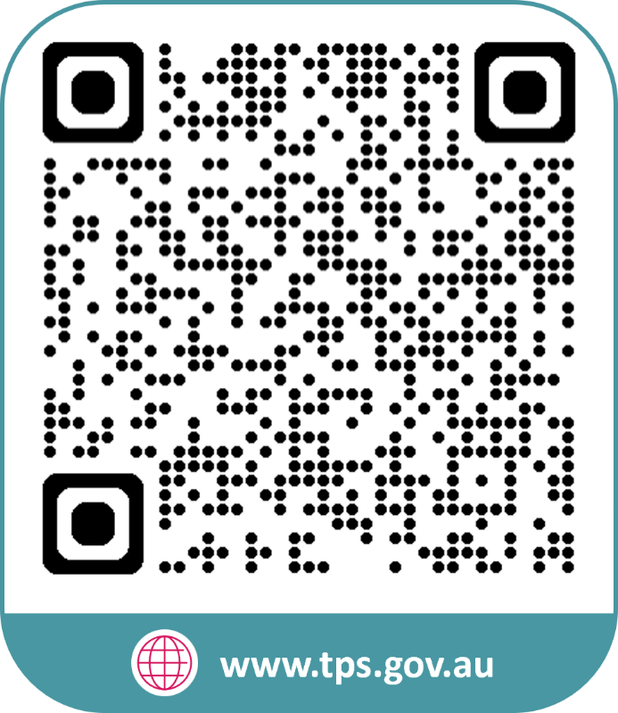
www.tps.gov.au
operations@tps.gov.au

