Slide 1
HELP Communications Working Group 5 September 2024

Slide 2
Department of Education attendees
Team | Attendees
Student Engagement Team | Kellie McInnes, Nicole Ranieri, Stephanie Stockwell, Abbigail Peters, Dylan Parker, Beth Betts, Danni Montesin and Carley Adams
HELP Policy | Phil Hawkins
Governance and Funding Branch | Craig Nightingale
Program Management Team | Tristan Krautz
Regional University Study Hubs | Libby Beattie
Commonwealth Prac Payment (CPP) Program | Annette Cannell
Governance and Funding Branch | Eric Bennett
HELP Integrity and Superannuation | Ryan Herbert

Slide 3
Item | Speaker | Representing | Agenda Item
Item 1 | Kellie McInnes | MC | Welcome, housekeeping and introduction
Policy updates
Item 2 | Phil Hawkins | HELP Policy Team | Introduction of the Universities Accord (Student Support and Other Measures) Bill.
Item 3 | Craig Nightingale | Workforce Programs Team | FEE-FREE Uni Ready courses
Item 4 | Libby Beattie | Regional University Study Hubs Team | Regional University Study Hubs
Item 5 | Eric Bennett | Modelling and Payments Team | University course closures
Item 6 | Annette Cannell | Industry Linkage and Advanced Apprenticeships Team | Commonwealth Prac Payment (CPP)
Communication activities
Item 7 | Tristan Krautz | Higher Education Program Management Team | Tertiary Access Payment (TAP) Stakeholder Content Kit
Item 8 | Nicole Ranieri Beth Betts | Student Engagement Team | Study Assist website and videos Communication strategy | eCAF Update – Stocktake; what's required; eCAF Factsheet; and Rolling eCAF
Item 9 | Kellie McInnes | MC | Other business and Q&A
Item 10 | Kellie McInnes | MC | Meeting close and wrap-up

Slide 4
Introduction of the Universities Accord (Student Support and Other Measures) Bill
The Bill includes five measures:
HELP indexation 2024-25 Budget measure
Commonwealth Prac Payment 2024-25 Budget measure
Student Services and Amenities Fees 2024-25 Budget measure
FEE Free Uni Ready 2024-25 Budget measure
Adelaide University Merger
Introduced:
Thursday 15 August 2024

Slide 5
Introduction of the Universities Accord (Student Support and Other Measures) Bill
The Bill includes five measures:
HELP indexation 2024-25 Budget measure
Commonwealth Prac Payment 2024-25 Budget measure
Student Services and Amenities Fees 2024-25 Budget measure
FEE Free Uni Ready 2024-25 Budget measure
Adelaide University Merger
Introduced:
Thursday 15 August 2024

Slide 6
Regional University Study Hubs
Last year the Australian Government announced funding to double the number of University Study Hubs.
Cohort 5 | Cohort 4
Applications are open until 18 October 2024, to establish up to 10 new Hubs. As a trial, this cohort invites universities to apply to operate a Regional University Study Hub. Universities must meet all requirements – including supporting students from any provider and be community-embedded | In March, the Minister announced 12 Regional University Study Hubs funded in Cohort 4. Some Hubs are already open, the remainder will open by Semester 1 2025.
There are 46 operating (or establishing) Hubs across Australia, see a list at: www.education.gov.au/regional-university-study-hubs/list-regional-university-study-hubs.
Universities are strongly encouraged to build partnerships with new and existing Regional University Study Hubs; University partnerships are a key element of the program overall.
Universities are encouraged to make their regional and remote students aware of the hubs as an additional support service.

Slide 7
Item | Speaker | Representing | Agenda Item
Item 1 | Kellie McInnes | MC | Welcome, housekeeping and introduction
Policy updates
Item 2 | Phil Hawkins | HELP Policy Team | Introduction of the Universities Accord (Student Support and Other Measures) Bill.
Item 3 | Craig Nightingale | Workforce Programs Team | FEE-FREE Uni Ready courses
Item 4 | Libby Beattie | Regional University Study Hubs Team | Regional University Study Hubs
Item 5 | Eric Bennett | Modelling and Payments Team | University course closures
Item 6 | Annette Cannell | Industry Linkage and Advanced Apprenticeships Team | Commonwealth Prac Payment (CPP)
Communication activities
Item 7 | Tristan Krautz | Higher Education Program Management Team | Tertiary Access Payment (TAP) Stakeholder Content Kit
Item 8 | Nicole Ranieri Beth Betts | Student Engagement Team | Study Assist website and videos Communication strategy | eCAF Update – Stocktake; what's required; eCAF Factsheet; and Rolling eCAF
Item 9 | Kellie McInnes | MC | Other business and Q&A
Item 10 | Kellie McInnes | MC | Meeting close and wrap-up

Slide 8
University Course Closures
Funding Agreement requirements to notify the Department
Justification
Exclusions
31 July cut-off
Forthcoming changes to requirements

Slide 9
Introduction of the Universities Accord (Student Support and Other Measures) Bill
The Bill includes five measures:
HELP indexation 2024-25 Budget measure
Commonwealth Prac Payment 2024-25 Budget measure
Student Services and Amenities Fees 2024-25 Budget measure
FEE Free Uni Ready 2024-25 Budget measure
Adelaide University Merger
Introduced:
Thursday 15 August 2024

Slide 10
Commonwealth Prac Payment Overview
Placements are an important part of qualifications that provide students with the opportunity to translate learned theory into practice; and get the skills and experience they need to enter the workforce. ​
The Australian Government is investing $427.4 million over 2024-25 to 2027-28 introducing a new CPP for eligible teaching, nursing, midwifery, and social work students in higher education and VET complete their placements.​
≈68,000 eligible higher education teaching, nursing, midwifery & social work students | Commencing 1 July 2025 | $319.50 Benchmarked against the single Austudy rate.​
Notes:
The Albanese Government is establishing the ongoing Commonwealth Prac Payment ($427.4 million 2027-28) with $369.2 million to support higher education students, and ​$58.2 million to support vocational education and training students. ​
The CPP will support around 68,000 higher education students undertaking a Bachelor or Masters qualification in teaching, nursing , midwifery and social work, and around 5,000 VET students undertaking a diploma of nursing.

Slide 11
Commonwealth Prac Payment: Student Eligibility setting
Courses
Higher Education
Entry-to-practice Bachelor or Masters qualification in Teaching, Nursing, Midwifery, Social Work
VET Student
Diploma of Nursing
Delivery
Payment delivered via Higher Education providers
Payment delivered via DEWR
Income and
'Need to work' test
Be an income support payment recipient
Work on average >15 hrs per week up to an income limit.
OR
Placement
Minimum mandatory placement hours required as part of entry-to-practice accreditation obligations.
Notes:
The Albanese Government is establishing the ongoing Commonwealth Prac Payment ($427.4 million 2027-28) with $369.2 million to support higher education students, and ​$58.2 million to support vocational education and training students. ​
A payment of $319.50 per week (benchmarked against the single Austudy rate) will be available from 1 July 2025 to support domestic students studying entry to practice Bachelor or Masters courses in teaching, nursing, midwifery, and social work during their mandatory placements. ​
The payment will be means-tested, to target students on income support payments and students who normally need to work more than 15 hours per week during their studies

Slide 12
Commonwealth Prac Payment: Indicative timeline
2024
2025
JUL​ | AUG​ | SEP​ | OCT​ | NOV​ | DEC​ | JAN​ | FEB​ | MAR​ | APR​ | MAY​ | JUN​
Consultation and engagement finalise guidelines and establish administrative and system processes to support student payments
Feedback and consultation for Program Guidelines and FAQs
Publish Program Guidelines and FAQs
Engagement w/ sector to monitor and support implementation with Providers and alignment to DEWR
1 July 2025
CPP live
6 May 2024
CPP announced in 2024-25 Budget
Consultation
Consultation
15 August 2024
The Universities Accord (Student Support and Other measures) Bill introduced into Parliament
Promotion and campaign of CPP to students
Drafting of Higher Education (Other Grants) Guidelines 2022 amendment
Notes:
The Universities Accord (Student Support and Other measures) Bill introduced into Parliament on 15 August 2024 and Education is in the process of drafting the supporting Guidelines and documentation for the program.
Consultation in underway with higher education providers, including Universities Australia, Councils of Deans, Australian Network of University Planners and corporate areas, as well as other stakeholders to support the implementation of the CPP.
We would be very interested in engaging with this working group around the promotion and campaign communications material for students, particularly in ensuring the eligibility and other requirements of the programs are clearly articulated.

Slide 13
Commonwealth Prac Payment: Further questions
CommonwealthPracPayment@education.gov.au

Slide 14
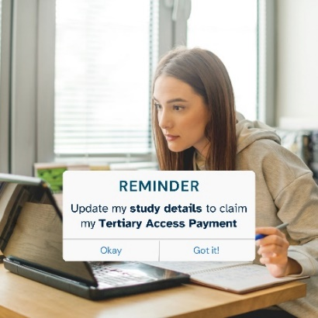
Tertiary Access Payment Stakeholder Content Kit
The Tertiary Access Payment (TAP) is a non-indexed, means-tested payment of up to $5,000 to school-leavers from regional or remote areas who need to relocate for full-time, higher-level tertiary education at a provider located at least 90 minutes by public transport from their family home.
TAP Stakeholder content kit contains text and images for social media, newsletters, and websites.
We encourage all stakeholders to review the kit and use the content in relevant communications with students.
www.education.gov.au/tertiary-access-payment/resources/shareable-content-tertiary-access-payments-resources

Slide 15
StudyAssist Website Redesign

Slide 16
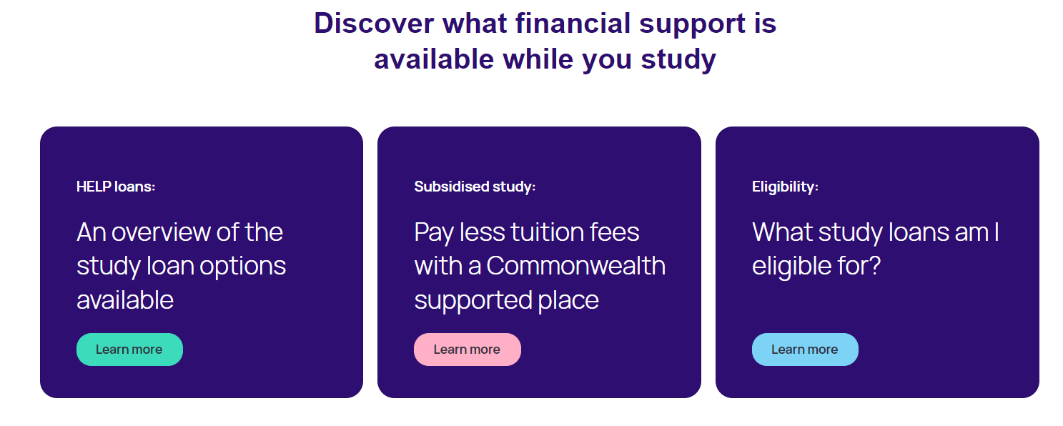
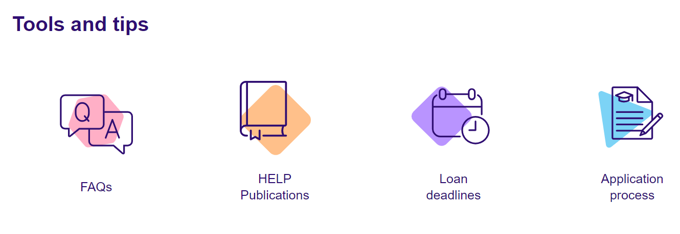
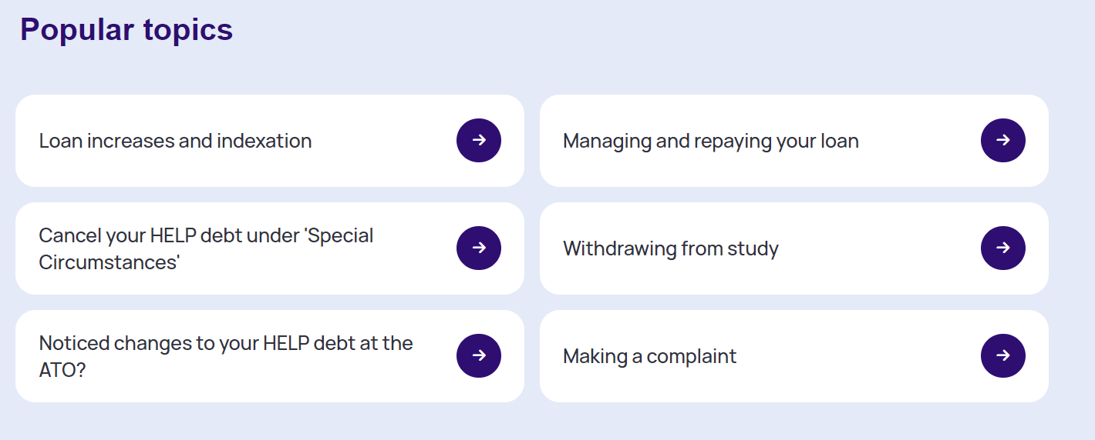
StudyAssist Homepage

Slide 17
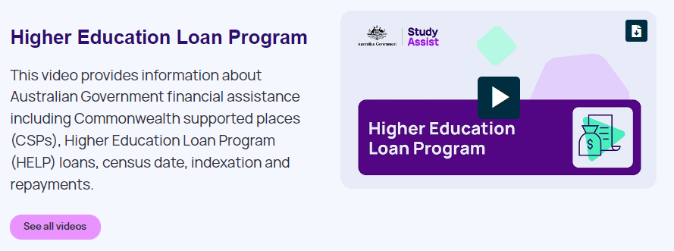
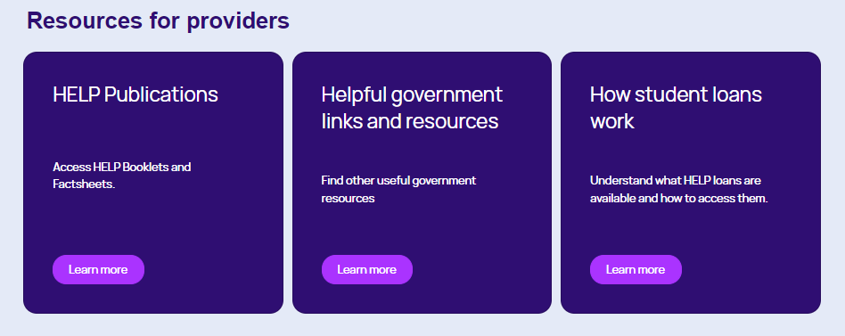
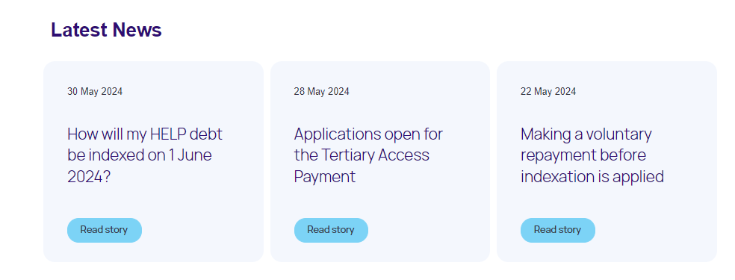
Provider Concierge Page

Slide 18
User Testing Progression: Round 1 to 4

Slide 19
Item | Speaker | Representing | Agenda Item
Item 1 | Kellie McInnes | MC | Welcome, housekeeping and introduction
Policy updates
Item 2 | Phil Hawkins | HELP Policy Team | Introduction of the Universities Accord (Student Support and Other Measures) Bill.
Item 3 | Craig Nightingale | Workforce Programs Team | FEE-FREE Uni Ready courses
Item 4 | Libby Beattie | Regional University Study Hubs Team | Regional University Study Hubs
Item 5 | Eric Bennett | Modelling and Payments Team | University course closures
Item 6 | Annette Cannell | Industry Linkage and Advanced Apprenticeships Team | Commonwealth Prac Payment (CPP)
Communication activities
Item 7 | Tristan Krautz | Higher Education Program Management Team | Tertiary Access Payment (TAP) Stakeholder Content Kit
Item 8 | Nicole Ranieri Beth Betts | Student Engagement Team | Study Assist website and videos Communication strategy | eCAF Update – Stocktake; what's required; eCAF Factsheet; and Rolling eCAF
Item 9 | Kellie McInnes | MC | Other business and Q&A
Item 10 | Kellie McInnes | MC | Meeting close and wrap-up

Slide 20
Thank you all for attending For questions or feedback, reach out to us at HEenquiries@education.gov.au
Subscribe to the Provider Updates at https://msg.dese.gov.au/subscribe-help-providers

