Slide 1
2025 International TPS Levy
Sector Consultation on Draft Levy Settings
Aug-Oct 2024
Melinda Hatton
TPS Director
www.tps.gov.au
Notes:
Acknowledgement of Country
'I begin by acknowledging the Traditional Custodians of the land on which we meet today and pay my respects to their Elders past and present. I extend that respect to Aboriginal and Torres Strait Islander peoples here today.’
Canberra: lands of the Ngunnawal people
Sydney: lands of the Gadigal people of the Eora nation
Melbourne: lands of the Wurundjeri (wuh-run-jeh-ree) people of the Kulin (Kooh-lin) nation
Brisbane: lands of the Jagera (Yug-er-rah) and Turrbal (Tur-a-bul) peoples
Adelaide: lands of the Kaurna (Gar-nah) people
Perth: lands of the Whadjuk (Wod-juk) Noongar (noong-uh) people
Darwin: lands of the Larrakia (La-ruh-kee-ah) people
Hobart: lands of the Muwinina (Moo-we-nin-ah) people

Slide 2
Outline
Tuition Protection Service (TPS)
International TPS Levy setting process, guiding principles and legislation
Levy collection overview
Levy components and draft 2025 settings
2025 levy timeline and takeaways
www.tps.gov.au
Notes:
Session purpose:
To share the TPS Advisory Board’s draft advice on the 2025 International TPS Levy settings, and gather feedback from you on the proposed settings
To explain the international levy components and calculations
To answer your questions about the international levy
We invite you to provide feedback on the Board’s draft advice at this session, or by emailing the TPS at operations@tps.gov.au
Feedback from sector consultation will be provided to the TPS Advisory Board ahead of its October meeting. The Board will consider feedback before providing its final advice to the TPS Director on the 2025 international levy.

Slide 3
Tuition Protection Service (TPS)
TPS Director, team and Advisory Board
www.tps.gov.au

Slide 4
Purpose of the Tuition Protection Service (TPS)
Australian Government initiative
Student tuition protection scheme
Developed for international student fee protection and expanded to specified domestic students
Supports students with tuition fee refunds and facilitates alternative course placements following provider closures
Supports education providers to understand and meet obligations to students
Manages tuition protection levy collections
www.tps.gov.au
Notes:
Australian Government initiative supported by federal Department of Education
Student tuition protection scheme that safeguards Australia’s reputation as an education destination
Developed for international student fee protection and expanded to domestic VSL and HELP students in 2020, and HE up-front fee-paying students in 2021
Supports students with tuition fee refunds (and Government loan re-credits) and facilitates alternative course placements following provider closures
Supports education providers to understand and meet obligations to students
Manages tuition protection levy collections from registered education providers to support these activities

Slide 5
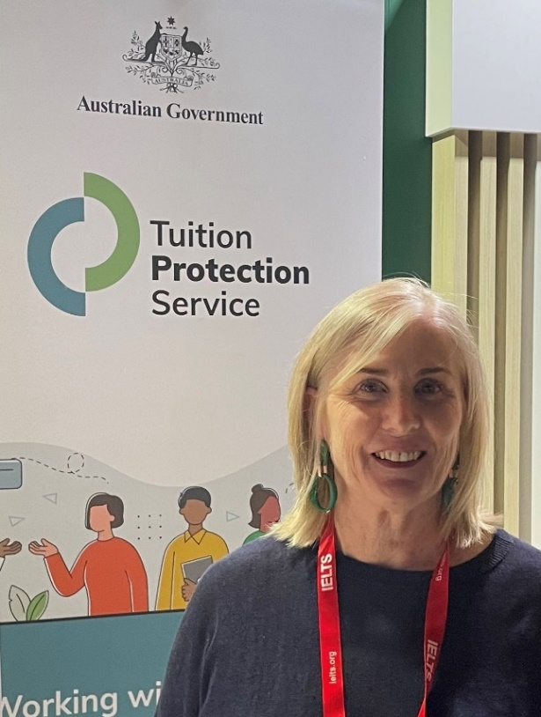
Tuition Protection Service Director
Melinda Hatton, TPS Director
Statutory office holder appointed by the federal Minister for Education
Operational oversight of the daily activities of the TPS
Responsible for the annual collection of TPS levies from CRICOS and eligible domestic education providers
Responsible for managing the levy funds
www.tps.gov.au
Notes:
Statutory office holder appointed by federal Minister for Education
Operational oversight of the daily activities of the TPS
Responsible for the annual collection of tuition protection levies from CRICOS and eligible domestic education providers
Responsible for managing the levy funds

Slide 6
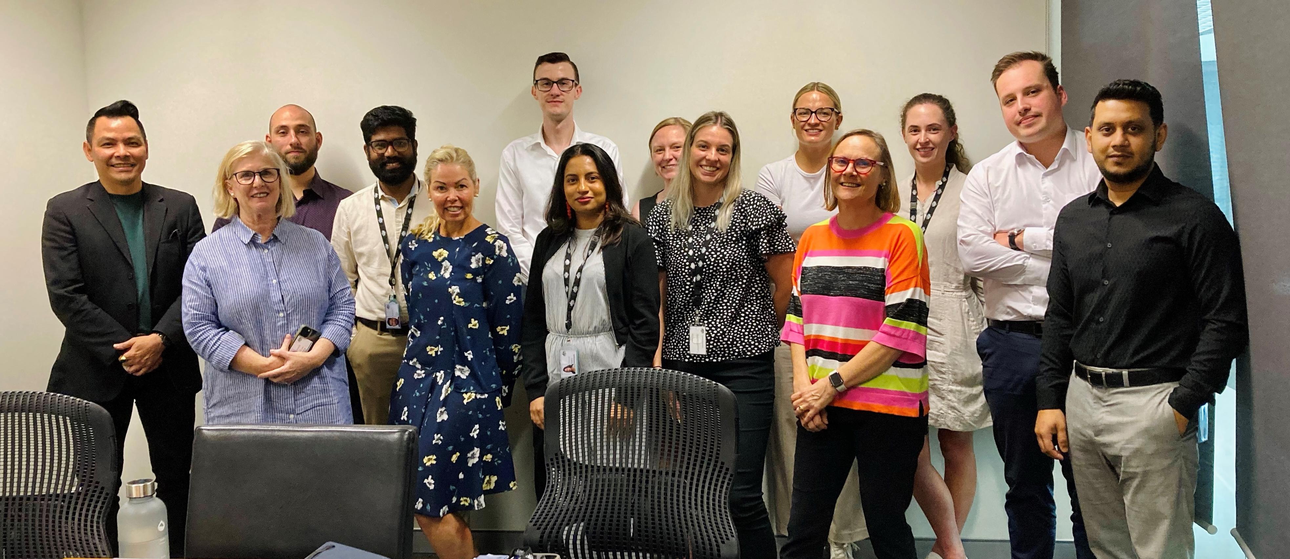
TPS Team
www.tps.gov.au
Notes:
Led by TPS Director
Small team of 15
Canberra

Slide 7
TPS Advisory Board
View Board member profiles at tps.gov.au
Ms Sharon Robertson (Chair)
The Hon. Phil Honeywood (Deputy Chair)
Ms Yeganeh Soltanpour, Council of International Students Australia
Ms Karen Sandercock, Australian Government Department of Education
Mr George Thiveos, Australian Government Department of Employment and Workplace Relations
Mr Guy Thorburn, Australian Government Actuary
Ms Gloria Yu, Australian Prudential Regulation Authority
Ms Rebecca Mok, Australian Government Department of Finance
Ms Victoria Miller, Australian Government Department of Home Affairs
www.tps.gov.au

Slide 8
International TPS Levy
Levy setting process, guiding principles and legislation
www.tps.gov.au

Slide 9
International TPS Levy
An annual tuition protection levy collected from international education providers
Paid into the Overseas Students Tuition Fund (OSTF) – a quarantined account managed by the TPS Director
Funds the student placement and refund activities of the TPS following an international education provider closure and TPS operational costs
Levy calculation based on an education provider’s size and risk of closure
www.tps.gov.au
Notes:
An annual tuition protection levy collected from international education providers
Paid into the Overseas Students Tuition Fund (OSTF) – a quarantined account managed by the TPS Director
Funds the student placement and refund activities of the TPS following an international provider closure and TPS operational costs
Levy calculation based on a provider’s size (i.e. student enrolment numbers and tuition fee income) and risk of closure
Providers operating in multiple sectors pay separate levies for each sector
2022 International Levy waived as a COVID-19 pandemic relief measure

Slide 10
International TPS Levy Setting Process
7 August 2024 | TPS Advisory Board provided draft advice to the TPS Director on the 2025 International Levy settings
Aug-Oct 2024 | TPS Director consults the sector on the draft levy settings
16 October 2024 | TPS Advisory Board considers the sector’s feedback on the draft levy settings then provides final advice to the TPS Director
By 1 January 2025 | 2025 levy settings finalised in legislative instruments
www.tps.gov.au
Notes:
7 Aug: TPS Advisory Board provided its draft advice on the 2025 levy settings to the TPS Director at its August meeting
Aug-Oct: Sector consulted on draft levy settings as proposed by the Board
16 Oct: Feedback from the sector will be provided to the Board for consideration before providing its final advice on the 2025 levy settings to the TPS Director at its October meeting
I invite your comments, questions and feedback on the draft levy settings
By 1 Jan: Legislative Instruments must be made by 1 January 2025 specifying the 2025 levy settings

Slide 11
TPS Advisory Board’s Advice on Levy Settings
When formulating its advice, the Board considers a range of factors including:
The strategic risk environment
Advice from the Australian Government Actuary (AGA)
Views of the sector regulators, industry peak bodies and education providers
The post-COVID operating environment
The balance of the OSTF and the quantum of funds required for its long-term sustainability
www.tps.gov.au
Notes:
The Board considers a range of factors when formulating its levy setting advice, including:
The strategic risk environment
Advice from the AGA
Views of the sector regulators, industry peak bodies and providers
The post-COVID operating environment
The balance of the OSTF and the quantum of funds required for its long-term sustainability

Slide 12
Guiding Principles for Board’s Levy Setting Advice
Advice should reflect the overall risk environment
The model for each levy should reflect gradual change
The model should be as simple and transparent as possible
Risk premiums should provide incentives for education providers to adopt positive behaviours
Additional imposts on industry, such as data collection, should be minimised as far as possible
www.tps.gov.au
Notes:
The Board’s levy setting advice is guided by these principles:
Advice should reflect the overall risk environment and ensure that revenue sustains the relevant fund, while also being sustainable for the industry
The model for each levy should reflect gradual change and assist the industry with business planning by providing a stable regulatory environment
The model should be as simple and transparent as possible, preferably based on a small number of risk factors
Risk premiums should provide incentives for education providers to adopt positive behaviours
Additional imposts on industry, such as data collection, should be minimised as far as possible, consistent with the ability to set sound risk-based levies

Slide 13
TPS Levy Framework
Developed by the Australian Government Actuary (AGA)
Annual international levy settings are set through two legislative instruments:
one for the administrative fee component and base fee component (made by the Minister for Education)
one for the risk rated premium component and special tuition protection component (made by the TPS Director)
Levy calculations based on an education provider’s size and risk of closure
AGA provides advice on levy settings to ensure the arrangements are financially sound
www.tps.gov.au
Notes:
Levy Framework developed by the AGA
Annual levy settings are set through 2 legislative instruments – one made by the Education Minister and one by the TPS Director
A provider’s levy amount is calculated based on the size of the provider (i.e. student enrolment numbers and tuition fee income) and its risk of closure
AGA provides advice on the levy settings to ensure the arrangements are financially sound

Slide 14
Legislative Authority
Education Services for Overseas Students (TPS Levies) Act 2012 www.legislation.gov.au/C2012A00011
www.tps.gov.au

Slide 15
International TPS Levy Collection Overview
www.tps.gov.au

Slide 16
Overseas Students Tuition Fund (OSTF)
International TPS Levy paid into OSTF
AGA recommends target range for OSTF to ensure sufficient funds are available for a large provider closure or multiple provider closures
AGA recommends increasing 2025 target range due to increased international student population and higher forecasted closures than previous few years
Balance: $47.8 million (30 June 2024)
Target range | Mid-point of target range
Current: $35-60 million | Current: $47.5 million
2025 recommendation: $40-60 million | 2025 recommendation: $50 million
www.tps.gov.au
Notes:
International Levy paid into OSTF – a quarantined account managed by the TPS Director
AGA recommends a target range for the OSTF, which is endorsed by the Board
Target range guides the TPS Director in managing the OSTF
Target range ensures sufficient funds are available to support students and replacement providers in the event of a large provider closure or multiple small to medium provider closures within a year
AGA considers the risk profile of providers, particularly large providers, as not all providers that close will be ‘average’ in size
AGA recommends increasing target range for 2025
Increased student population
Forecasted provider closures are higher than the previous few years
First change since 2018
Balance: $47.8 million (30 June 2024)
Target range:
Current: $35-60 million
2025 recommendation: $40-60 million
Mid-point of target range:
Current: $47.5 million
2025 recommendation: $50 million
International student numbers:
2023 (Jan-Dec): 786,891 international students
2024 (YTD Jan-Apr): 704,931 international students
Change of 20% compared to the same period in 2023
Source: https://www.education.gov.au/international-education-data-and-research/international-student-numbers-country-state-and-territory

Slide 17
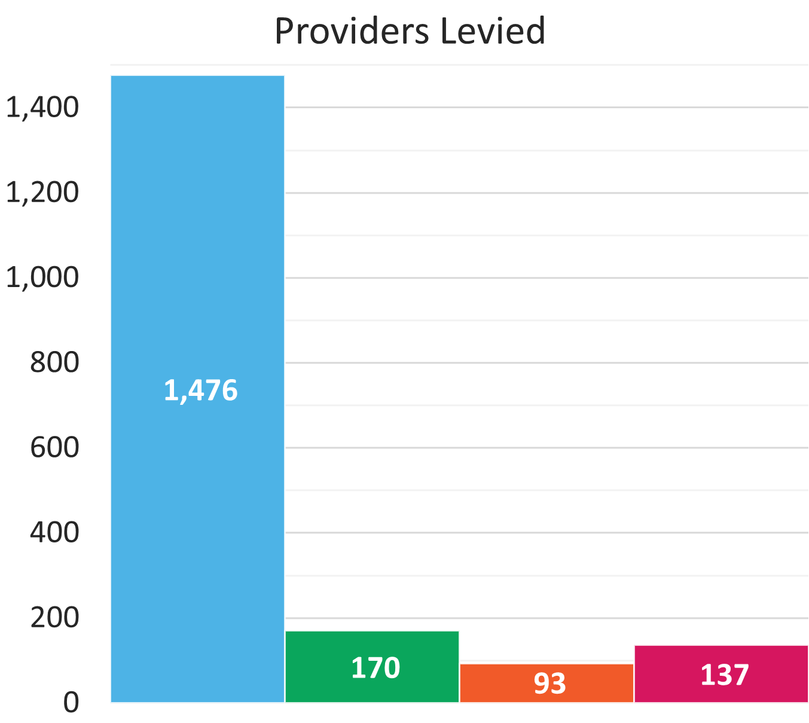
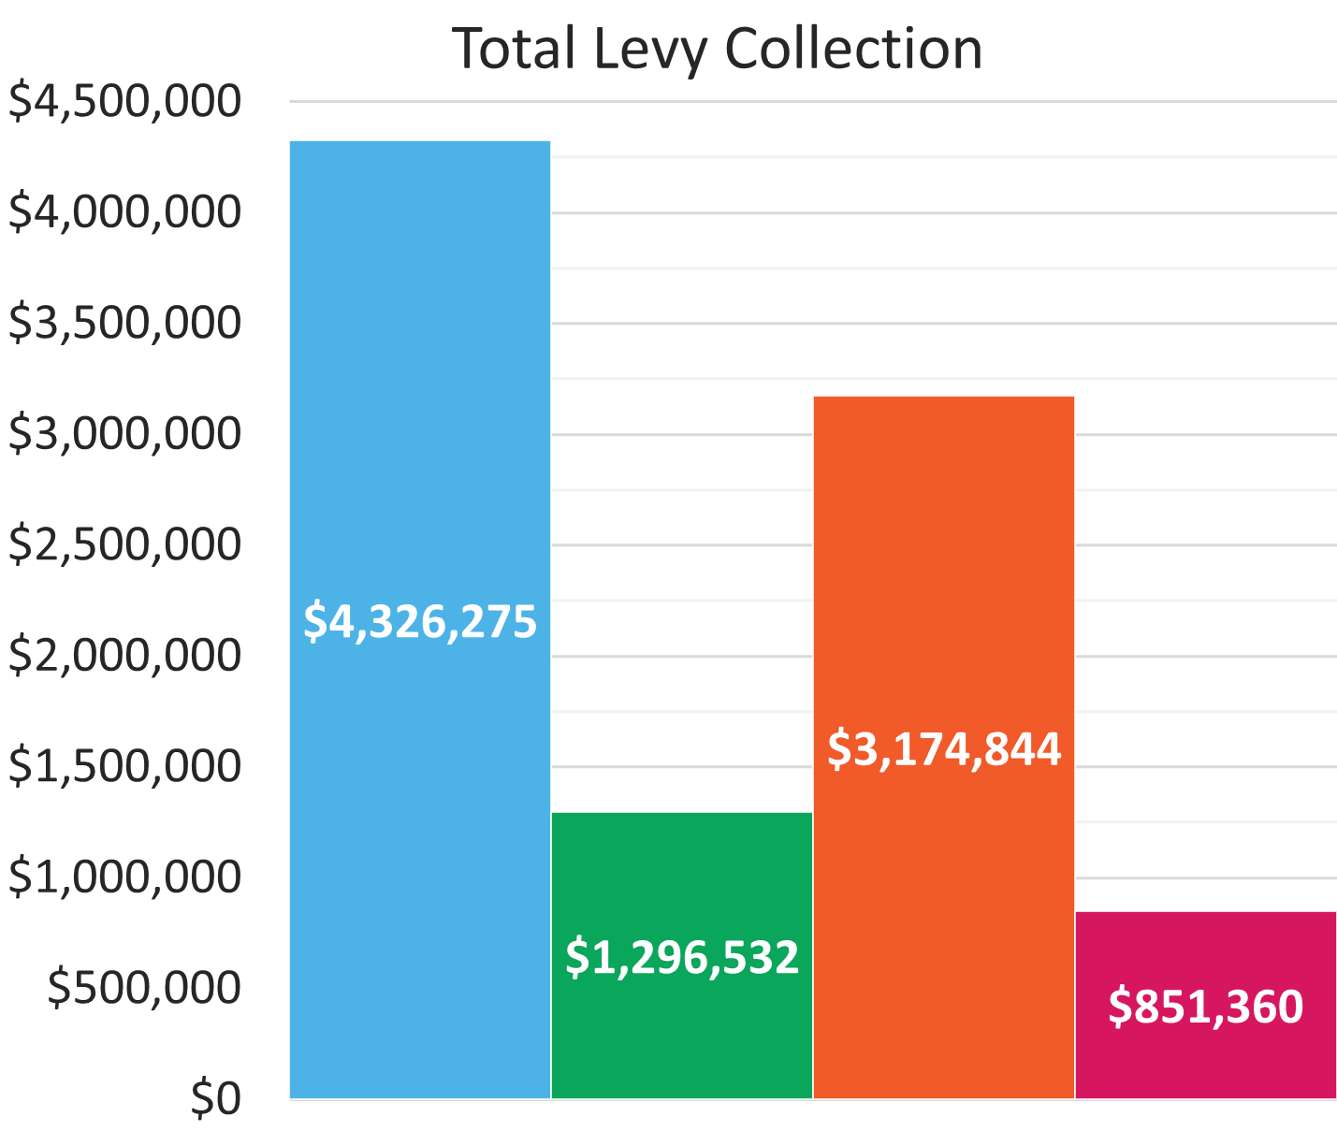
TPS Levy Collection Overview 2023-24
www.tps.gov.au
Notes:
Graphs show number of providers levied and total levy amount collected in most recent international and domestic levy collections
Domestic levies collected for the first time in 2022
International: Highest number of levied providers and levy amount collected of the 4 levies
Levy collection amount quoted = actual amount collected as at 6 Aug 2024
Estimated total = $4.36m (including $37,538 overdue payments)
Higher Education: Higher ratio of HE students to HE providers, hence larger HELP and up-front levy amount collected
VSL: Lower ratio of VSL students to VSL providers, hence smaller VSL levy amount collected

Slide 18
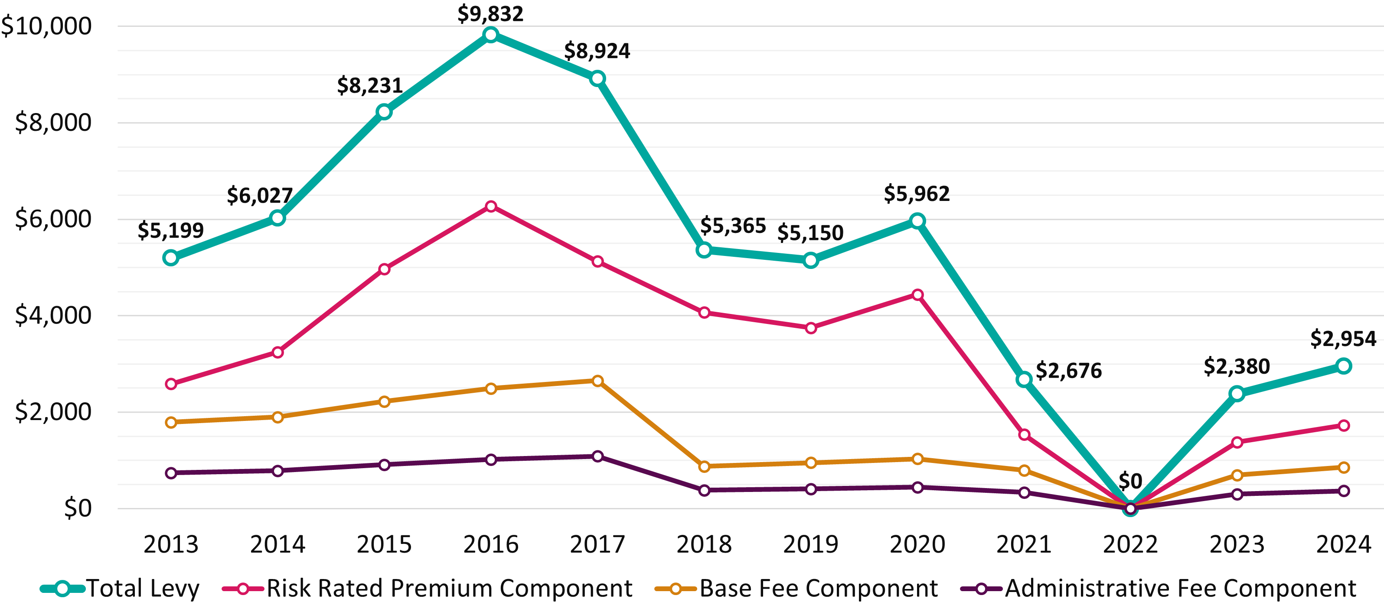
Average International Levy Amount per Provider 2013-24
www.tps.gov.au
Notes:
2022 international levy waived by Australian Government as a COVID-19 relief measure
Data shows a decreasing trend overall in providers’ average international levy payment (blue line = total levy amount)
Increase to average payment for 2024:
Still low despite increased student numbers
RRPC specified percentage increased from 0.04% to 0.05% to create a more robust Fund that could meet higher costs associated with a higher number of forecasted closures
Base and Administrative Fee Components indexed
2025:
Maintain RRPC specified percentage at 0.05%

Slide 19
2024 International TPS Levy: Late Payments
1,476 providers invoiced
179 providers did not pay by the due date
Several notices were sent to providers acting as a reminder to pay the 2024 levy
As of 5 August 2024, 36 providers still had outstanding payments, totalling $37,538.84
www.tps.gov.au
Notes:
Levy funds our international sector operating costs
1,476 providers levied in 2024
179 providers did not pay by the due date
Providers were given a minimum of 28 days to pay the levy even though TPS is only obligated to give 14 days (under ESOS)
TPS sent out several notices to ensure providers paid their 2024 levy invoices, including:
Early advice: 10 weeks prior to sending invoice
Request for information: 9 weeks prior to sending invoice
Reminders: 2 weeks prior to invoice due date
Overdue notices: 1 week after due date to providers who had not paid
Phone call: 2 weeks after due date where funds were still outstanding
Of the 56 calls made, 17 of them were either disconnected or rang out
Of these 17 providers, 75% were VET providers
10 of these 17 providers had alternative contacts who were then contacted by the TPS
4 of these calls were successful
Of these 4, 3 providers have now paid ($3,128.83)
Of the other 7, 2 have since paid ($2,143.68)
5 Aug 2024: 36 providers still had outstanding payments totalling $37,538.84

Slide 20
Late or Non-Payment of International TPS Levy
The TPS is obligated to send one reminder notice to providers who have not paid their levy close to the due date. Providers have seven days to pay their levy after the reminder notice is given.
A provider’s registration will be automatically suspended if they fail to comply with the reminder notice (s90 ESOS Act)
Providers that pay their levies after the due date will receive a late payment penalty for the next three years’ levy risk rating calculation
Levy invoices are sent to PEO contacts in PRISMS. Keep your contact information in PRISMS up to date. To update your PEO details, please contact your regulator.
www.tps.gov.au
Notes:
The TPS is obligated to send one reminder notice to providers who have not paid their levy close to the invoice due date (section 53D ESOS Act)
Levy must be paid within 7 days of the reminder notice being given
If a provider fails to comply with the reminder notice, the provider’s registration will be automatically suspended (section 90 ESOS Act)
Generally, a suspended provider cannot:
Recruit/enrol international students
Solicit or accept money from international students
Permit students to start studying (if they have not already begun)
The provider is still registered for the course for the location for all other purposes
Suspension will be removed when the provider has paid:
The levy amount owing; and
Any associated late payment penalty; and
The associated reinstatement fee
Providers that pay their levies after the due date will receive a late payment penalty for the next three years levy risk rating calculation.
Non-compliance risk factor
Levy invoices are sent to PEO contacts in PRISMS. Keep your contact info in PRISMS up to date.
Providers are responsible for keeping their contact info up to date
TPS cannot update your contact details for you
You must contact your regulator to update your PEO contact details in PRISMS
Additionally, there are actions you must take to ensure you are complying with your obligations as an education provider. For example, providers who deliver VET courses must submit an annual declaration to ASQA which states your ownership and management structure details are up-to-date. Providers submit this declaration at the end of February each year, so when the TPS is sending out invoices for the international levy in April, contact details should be accurate.
Pay your levy on time and in full to avoid all penalties.

Slide 21
2025 International TPS Levy Notices
You will receive the following notices about your 2025 levy:
Early advice
Request for Information (RFI)
Invoice (with 28 days to pay)
Reminder notice (if your payment has not been received on the due date)
www.tps.gov.au
Notes:
We will send out fewer notices in 2025
Providers will receive the following notices about their 2025 levy:
Early advice
RFI
Invoice (with 28 days to pay)
TPS obligated to give 14 days to pay
Reminder notice (if payment has not been received)

Slide 22
International TPS Levy
Levy components and draft 2025 settings
www.tps.gov.au

Slide 23
International TPS Levy Components
Component | Key elements | Purpose and authority
Administrative fee | Sum of a ‘per provider’ and ‘per student’ charge | Designed to cover administrative costs Set by Minister for Education
Base fee | Sum of a ‘per provider’ and ‘per student’ charge | Maintains OSTF balance at a sustainable level Set by Minister for Education
Risk rated premium | Considers 5 risk factors and overseas student tuition fees for previous year | Intended to reflect risk of provider closure Set by TPS Director with Board advice
Special tuition protection | Percentage multiplied by overseas student tuition fees for previous year | Charged when OSTF is below target range Set by TPS Director with Board advice
www.tps.gov.au
Notes:
Administrative and Base Fee components
Set by the Minister for Education, not the TPS Director (i.e. only consulting on risk rated premium and special tuition protection components)
An indexation will apply if the Minister decides not to determine new administrative fee and base fee component amounts (Section 8 of ESOS (TPS Levies) Act 2012)
Risk rated premium component
Determined annually by TPS Director with advice from the TPS Advisory Board, AGA and feedback from stakeholders
Risk factors and calculations designed to reflect the risk of a provider closure
Special tuition protection component
Calculated as a percentage of a provider’s income from overseas student tuition fees
Charged in the initial years when the OSTF is below the target range

Slide 24
Draft 2025 International TPS Levy Settings
Component | Draft 2025 Settings
Administrative fee* | $104.00 per provider + $0.54 per 2024 overseas student enrolment
Base fee* | $210.00 per provider + $1.33 per 2024 overseas student enrolment
Risk rated premium | [0.05% x total risk factor value] x total 2024 overseas student tuition fees
Special tuition protection | 0% x total 2024 overseas student tuition fees
*Administrative and base fee figures reflect 2024 values and may be indexed to CPI for 2025
Note: 2025 levy calculated using student enrolment numbers and revenue for 2024 calendar year
www.tps.gov.au
Notes:
Reminder: Only consulting on risk rated premium and special tuition protection components as they are the components the TPS Director is responsible for setting
Administrative and base fee components
Administrative and base fee figures reflect 2024 values
Figures will be indexed to CPI for 2025 if the Minister decides not to determine new administrative fee and base fee component amounts in a legislative instrument
2025 levy will be calculated using student enrolment numbers and revenue for the 2024 calendar year

Slide 25
Risk rated premium component
Considers 5 risk factors designed to reflect the risk of provider closure
Providers receive a risk factor value for each risk factor
Higher risk factor values indicate higher risk of closure
www.tps.gov.au
Notes:
RRPC considers 5 risk factors designed to reflect the risk of provider closure (and therefore a need to use funds from the OSTF)
Providers receive a risk factor value for each risk factor
Risk factor values are multipliers for a provider’s RRPC calculation
Higher risk factor values = higher risk of closure = higher levy amount

Slide 26
Risk Rated Premium Component: Risk Factors
Base Risk Factor | Risk factor value of 1.0 applied for all providers
Length of Operation | Higher risk of closure associated with shorter length of operation
Volatility in Overseas Student Enrolments | Higher risk of closure associated with extreme volatility in overseas student enrolments
Maximum Overseas Source Country Concentration | Higher risk of closure associated with heavy reliance on a single source country of overseas students
Non-Compliance and Registration Renewal | Penalty for late payment of the levy or CARC, having sanctions imposed for non-compliance, and/or shorter registration periods due to risk management concerns
www.tps.gov.au
Notes:
Risk factors proposed by AGA and endorsed by the Board
Risk factors intended to reflect the risk of provider closure and, therefore, a need to use the levy funds

Slide 27
Volatility in Overseas Student Enrolments
Risk factor values for positive volatility (growth) in overseas student enrolments were temporarily waived in 2023 and 2024 to avoid penalising providers experiencing growth in student enrolments post-COVID
Board proposes the positive volatility risk factor values be reinstated for 2025 to pre-pandemic levels
AGA analysis shows correlation between positive volatility and provider closures
Historically, periods of rapid growth can be followed by increased closures
4 closures in 2024 so far vs. 2 closures in 2023
www.tps.gov.au
Notes:
Board proposes that all risk factor settings for 2025 remain unchanged from 2024 except volatility in overseas student enrolments
Risk factor values for positive volatility (i.e. growth) in overseas student enrolments numbers temporarily waived in 2023 and 2024
To avoid penalising providers experiencing growth in enrolments post-COVID
Board proposes positive volatility risk factor values be reinstated for 2025 to pre-pandemic levels
AGA analysis shows correlation between positive volatility and provider closures
Experience has shown that periods of rapid growth (like the previous 2 years) can be followed by increased closures
4 closures in 2024 so far vs. 2 closures in 2023

Slide 28
Risk Rated Premium Component Formula
specified percentage for 2025
provider’s overseas student tuition fees for 2024
X
total risk factor value
X
Specified percentage for 2025: 0.05%
www.tps.gov.au
Notes:
Proposed specified percentage for 2025: 0.05% (unchanged)
Risk factor values are multipliers for the provider’s RRPC calculation
Higher risk factor values = higher risk of closure = higher levy amount

Slide 29
Risk Rated Premium Component: High risk example
0.05%
4.5
$2,000,000
specified percentage for 2025
provider’s overseas student tuition fees for 2024
X
total risk factor value
X
= 0.00225 x $2,000,000
= $4,500
www.tps.gov.au
Notes:
This hypothetical provider:
Received $2m in overseas student tuition fees in 2024
Yielded a total risk factor value of 4.5 (indicates high risk of closure)
Total risk rated premium component amount for 2025 levy: $4,500

Slide 30
Risk Rated Premium Component: Low risk example
0.05%
1.0
$2,000,000
specified percentage for 2025
provider’s overseas student tuition fees for 2024
X
total risk factor value
X
= 0.0005 x $2,000,000
= $1,000
www.tps.gov.au
Notes:
This hypothetical provider:
Received $2m in overseas student tuition fees in 2024
Yielded a total risk factor value of 1.0 (indicates low risk of closure)
Total risk rated premium component amount for 2025 levy: $1,000

Slide 31
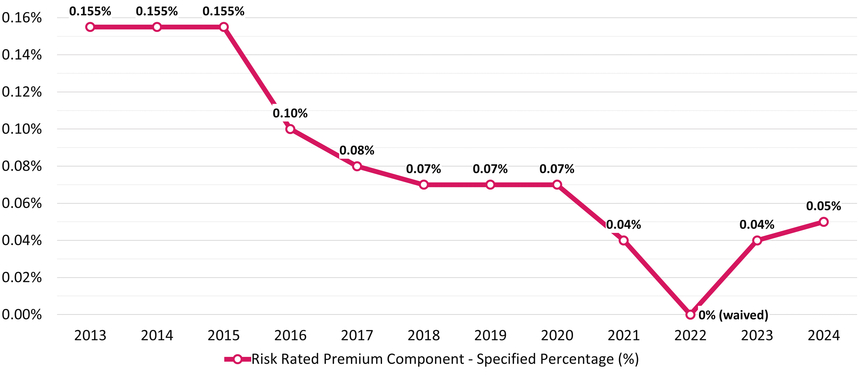
Risk Rated Premium Component Specified Percentage 2013-24
www.tps.gov.au
Notes:
Graph shows RRPC specified percentage settings for 2013-2024
2024: first year specified percentage has been increased (by 0.01 percentage points)
Increase was necessary to create a more robust Fund that could meet higher costs associated with a higher number of forecasted closures
Forecast was correct: 4 closures in 2024 so far vs. 2 closures in 2023
Board proposes retaining specified percentage at 0.05% for 2025
Specified percentage is still at relatively low rate

Slide 32
Special tuition protection component
Charged when the OSTF is below its target size
Formula:
specified percentage for 2025
provider’s overseas student tuition fees for 2024
X
Specified percentage for 2025: 0%
www.tps.gov.au
Notes:
Proposed specified percentage for 2025: 0% (unchanged)

Slide 33
2025 International Levy Timeline and Takeaways
www.tps.gov.au

Slide 34
2025 International TPS Levy Timeline
August 2024
September 2024
October 2024
November 2024
December 2024
Feb – May 2025
7 August
Draft advice on 2025 international levy confirmed at TPS Advisory Board meeting
Mid-August
Draft advice letter published on TPS website
Online consultation session for all providers
Mid-Late August
Consultation sessions in Adelaide and Brisbane
Meetings with stakeholders
September
Consultation sessions in Melbourne and Sydney
Meetings with providers in Perth
Meetings with stakeholders
Early October
Online feedback session for all providers
16 October
TPS Advisory Board considers sector feedback
Final advice on 2025 international levy confirmed at TPS Advisory Board meeting
Late October
Final advice letter published on TPS website
Mid-November
Legislative instrument drafted and sent to Treasurer with a noting brief sent to Minister for Education
Department of Education briefing for Administrative and Base Fee Components sent to Minister for Education
31 December
Legislative instrument must be approved by Treasurer and signed off by TPS Director
February
Non-exempt providers receive a Request for Information to declare 2024 overseas students tuition fee income and domestic student enrolment figures
March-April
2025 levy invoices sent to providers
April-May
International levy collected
www.tps.gov.au
Notes:
Consultation:
Aug: Board provides draft advice on 2025 levy settings to TPS Director
Aug-Oct: TPS consults the sector on the draft levy settings
Oct: Board considers sector’s feedback then provides final advice on 2025 levy settings to TPS Director
2025 levy collection:
Feb: Non-exempt providers receive RFI to declare 2024 tuition fee income
Mar-Apr: Invoices sent
Apr-May: Levy due/collected

Slide 35
Request for Information (RFI)
New filter applied to the volatility in overseas student enrolments and maximum overseas source country concentration risk factors in 2024 for providers whose proportion of international students was less than 20% of its total student population in the previous year
Eligible providers’ risk factor values set to 0 for these risk factors
Providers will receive an RFI in early 2025 to declare their 2024:
overseas student tuition fee income, and
domestic student enrolment numbers
www.tps.gov.au
Notes:
New filter applied in 2024 to the volatility in overseas student enrolments and maximum overseas source country concentration risk factors
For providers whose proportion of international students was less than 20% of its total student population in the previous year
Risk factor values will be set to 0 for these providers
The filter recognises that providers with a low proportion of international students to domestic students are at less risk of closure than providers who are reliant on international students
RFI
We will send an RFI to providers in early 2025 to declare their 2024:
overseas student tuition fee income, and
domestic student enrolment numbers

Slide 36
Takeaways
Key features of the Board’s draft advice on 2025 levy settings:
Positive volatility risk factor values to be reinstated for the volatility in overseas student enrolments risk factor after 2-year temporary waiver
Target range of OSTF to be increased from $35-60 million to $40-60 million
Timeline estimates levy will be collected in May 2025
www.tps.gov.au
Notes:
Key features of Board’s draft advice:
Positive volatility risk factor values to be reinstated for the ‘volatility in overseas student enrolments’ risk factor after 2-year temporary waiver
OSTF target range to be increased from $35-60 million to $40-60 million
Timelines estimates levy will be collected in May 2025

Slide 37
Key messages
Ensure all contact information and student enrolment data in PRISMS is up to date
Pay the full and correct levy amount on time to avoid receiving a late payment penalty for the next three levies
Check account details and reference number are correct before making a payment
www.tps.gov.au
Notes:
Ensure all contact information and student enrolment data in PRISMS is up to date
We contact you using contacts listed in PRISMS
We receive many bounce backs when contact information is incorrect, and requests for contact information to be updated. Providers are responsible keeping contact information up to date. We cannot update your contact information for you.
Pay the full and correct amount on time to avoid receiving a late payment penalty for the following three years
Check account details and reference number are correct before making a payment

Slide 38
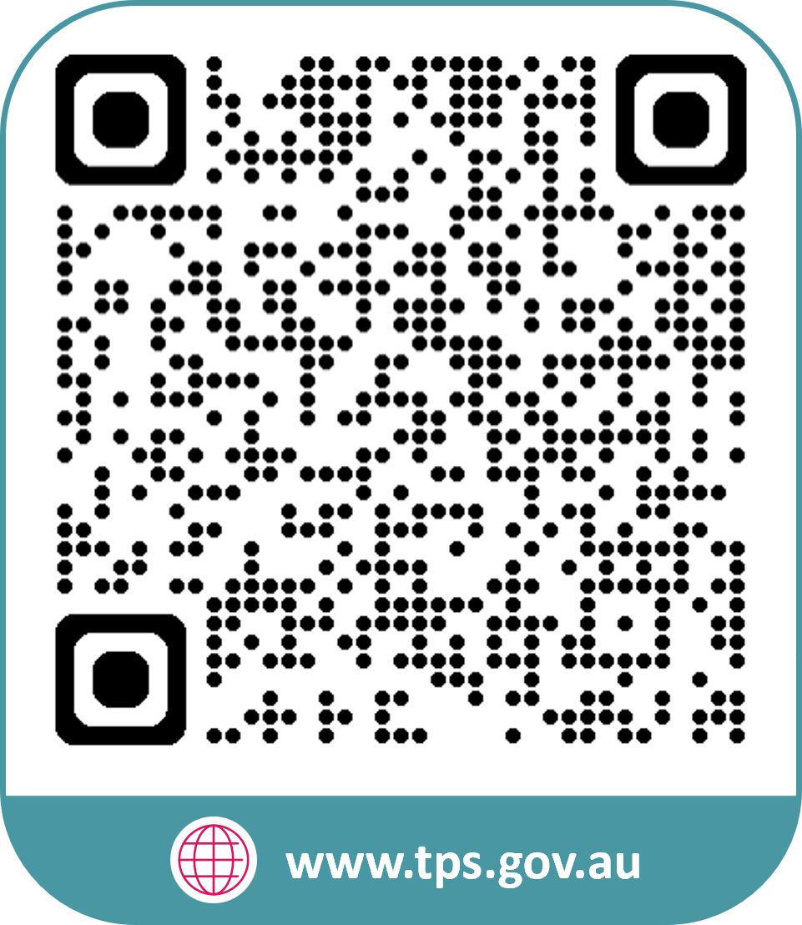
www.tps.gov.au
operations@tps.gov.au
Notes:
Any questions/feedback?
Questions and feedback can be emailed to the TPS via operations@tps.gov.au

