Slide 1


TMG College Australia
International Students Information Session
March 2024
Tanya Benton-Hall
Case Management Team
www.tps.gov.au
Notes:
Good morning – introduce yourself
Thank you for joining us for this session
This information session is for the international students affected by the closure of TMG College Australia
Session will be recorded and published on our website along with these slides

Slide 2

Purpose of this meeting
Inform students about how the Tuition Protection Service can assist
Present information on visa matters
Present information on getting a copy of your study record
Identify other assistance available
Show you how to use the TPS Online case management system
www.tps.gov.au
Notes:
During this session we will cover:
What the Tuition Protection Service is and how it can help you
Information relating to your student visa
How to get a copy of your student record
Other assistance available, such as Study New South Wales
How to use the TPS Online case management system

Slide 3
TMG College Australia (The Malka Group)
TMG College Australia closed on Thursday 14 March 2024
TMG College Australia has appointed an administrator, and we are working together over the next 10 days before the TPS officially activates the closure
After the 10 days' notice period the TPS will be working to arrange for you to continue your studies with an alternative provider, or provide you with a refund of your unspent tuition fees
www.tps.gov.au

Slide 4
What is the Tuition Protection Service (TPS)?
www.tps.gov.au

Slide 5
Tuition Protection Service (TPS)
Australian Government initiative within the Department of Education
Student tuition fee protection scheme
Supports students following an education provider closure by:
  arranging for students to continue their studies with an alternative provider
  or
  providing students with a refund of unspent tuition fees
www.tps.gov.au
Notes:
The TPS is an Australian Government student tuition fee protection scheme operating within the Department of Education
We support students who are affected by an education provider closure to:
Continue studying with an alternative provider; or
Receive a refund of unspent tuition fees

Slide 6

TPS Operations Team
Led by TPS Director
Small team of around 16
Located in Canberra
www.tps.gov.au
Notes:
The TPS is a small team operating in Canberra

Slide 7

TPS Online system
TPS Online is the system you will use to request and receive TPS assistance
You can request a place with an alternative provider or request a refund in TPS Online
We will show you how to use TPS Online later in this presentation
TPS Online step-by-step instructions are on the TPS website
www.tps.gov.au
Notes:
You will use a system called ‘TPS Online’ to receive assistance from us
You can request a place with an alternative provider or request a refund of unspent tuition fees through TPS Online
We will show you how to use TPS Online later in this presentation
Access TPS Online from the TPS website home page (tps.gov.au)

Slide 8

Continuing your studies with an alternative provider
Our priority: To help you find a new education and training provider so you can continue your studies
TPS Online contains a list of alternative courses at different providers nearby
You will need to contact the new provider to enrol with them. The provider will upload an offer in TPS Online that you will need to accept. The TPS will pay what is owed to you by TMG College Australia directly to your new provider
If you have already enrolled at a new education provider, you can receive a refund of your unspent tuition fees from the TPS through TPS Online
Alternative courses may cost more or less than your current
course. If costs are higher, you will need to meet those costs
www.tps.gov.au
Notes:
Our priority is to find a different education and training provider where you can continue your studies
You will find alternative provider options identified by the TPS in your TPS Online account. You can find your own alternative provider to enrol with to continue your studies if you want to.
If you enrol in a new course which costs more than your current course, you will need to meet those costs

Slide 9

Unspent tuition fees
Unspent tuition fees are the fees that you paid to TMG College Australia for education or training that you did not receive:
  For example, if you paid for 10 weeks of tuition and only attended classes for 7 weeks, the remaining 3 weeks are your unspent tuition fees.
The TPS can provide you with a refund of any unspent tuition fees that were paid to TMG College Australia for your tuition
If the TPS does not identify any suitable alternative courses for you,
or if you have already enrolled at a new provider, you will receive a
refund of your unspent tuition fees
www.tps.gov.au
Notes:
If the TPS does not find any alternative provider options for you, or if you choose to enrol with a different provider yourself, the TPS can provide you with a refund of your unspent tuition fees

Slide 10
Unspent tuition fees
Your refund can be paid to:
  your personal bank account
  another nominated bank account (e.g. a family member)
  your new education provider (if you have secured a placement in an alternative course)
  your education agent.
If you would like your agent to receive your refund on your behalf,
you must request and return an Authority to Act form by emailing support@tps.gov.au
www.tps.gov.au
Notes:
We will pay your refund to your nominated bank account
Please note: If you want your refund to be paid into an account owned by your agent, you must email the TPS at support@tps.gov.au and request an Authority to Act form

Slide 11
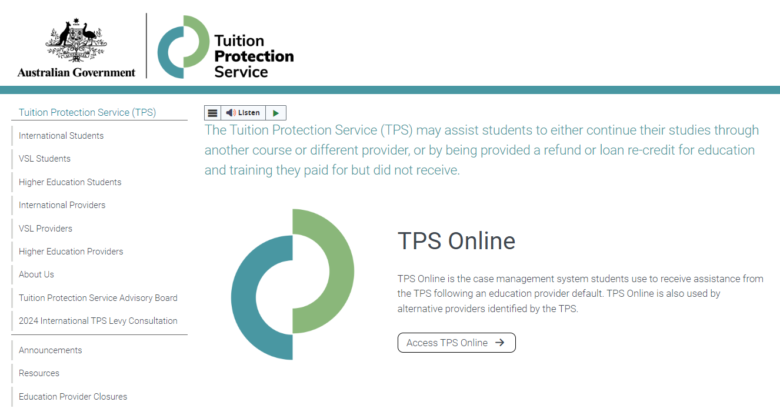
TPS website: www.tps.gov.au
For TPS Online, click on Access TPS Online
For information about the TMG College Australia closure, click on Education Provider Closures
www.tps.gov.au
Notes:
Visit the TPS website at www.tps.gov.au to access TPS Online or find more information about TMG College Australia
TMG College Australia closure webpage:
There is a webpage on the TPS website specifically for students affected by the TMG College Australia closure
Visit the TPS website then click on ‘Education Provider Closures’ (in the pink box on the left of your screen)
We will keep this webpage updated with important information and useful resources for you
A recording of this information session and the slides will also be published on that webpage

Slide 12

Visa Matters
Visa applications and status
Visa Application Charge exemption
Students under 18
Work conditions
Travelling home
Contacts and further information
Notes:
We are sharing information relating to your visa on behalf of the Department of Home Affairs
Any questions relating to your visa should be directed to the Department of Home Affairs.

Slide 13
Information session on education provider closures
Department of Home Affairs

Slide 14
What will we cover?
Visa applications and status
Visa Application Charge (VAC) exemption
Work conditions
Travelling home
Contacts and further information

Slide 15
What is my status?
International student visa holders need to maintain enrolment in a course that is registered on the Commonwealth Register of Institutions and Courses for Overseas Students (CRICOS) at all times while in Australia.
You can continue staying in Australia on your valid student visa if you enrol with another provider to study a course at the same level.
Students affected by a provider default are afforded an extended period of three months in which to finalise a new enrolment.
If you have a student visa application that has not yet been decided and your provider has closed, the Department of Home Affairs will contact you to request a new CoE from another provider. Your application will be assessed based on the new course you have chosen to study, and you will be afforded additional time to provide a new CoE.
Notes:
International student visa holders need to maintain enrolment in a course that is registered on the Commonwealth Register of Institutions and Courses for Overseas Students (CRICOS) at all times while in Australia.
You can travel outside Australia while waiting to be placed with a new provider as long as you return while your visa is valid.
You can continue staying in Australia on your valid student visa if you enrol with another provider to study a course at the same level.
Where a student is no longer enrolled in a registered course, the Department of Home Affairs would normally allow 28 days in which time a student could enrol with another education provider before the Department would consider visa cancellation.
Students affected by provider default are afforded an extended period of three months in which to finalise a new enrolment.
This is in acknowledgement that consumer protection processes may take longer than 28 days and that the situation is beyond the control of affected students.
Where the consumer protection mechanisms take more than three months, Department of Home Affairs may further extend its special arrangements on a case-by-case basis.
If you have a student visa application that has not yet been decided and your provider has closed, the Department of Home Affairs will contact you to request a new CoE from another provider. Your application will be assessed based on the new course you have chosen to study.
We will give you a chance to enrol in an alternative course if your education provider defaults after you have applied for a student visa but before we make a decision on your application.
Respond as quickly as you can to any request from your visa processing officer.
Send us information about your new enrolment as soon as possible.
Ensure you upload your information on your ImmiAccount as soon as it is available.

Slide 16
Do I need a new visa?
You will need to apply for a new student visa if:
  You enrol in an alternative course, which will finish after the expiry date of your current student visa; or
  You enrol in an alternative course that is at a lower Australian Qualification Framework (AQF) level than your previous course.
You can check the expiry date of your student visa by viewing your visa grant notice or by using the Visa Entitlement Verification Online (VEVO) service at https://immi.homeaffairs.gov.au/visas/already-have-a-visa/check-visa-details-and-conditions/check-conditions-online/visa-holders.
Notes:
If you require more time to finish your new course, or you move to a new course that is at a lower AQF level than your previous course, you must apply for a new student visa before your current visa expires or before you commence your lower AQF level course.
If your new course will finish after the expiry date of your current visa, you will need to apply for a new Student visa (subclass 500) before your current visa expires.
If you change to a lower AQF level course, you must apply for a new visa. If you do not, you are in breach of your visa condition and your visa may be cancelled.
For example: if you are changing from a Diploma level course to a Certificate 4 course, or if you change from a Bachelor Degree to an Advanced Diploma, you will need to apply for a new student visa as they are all lower AQF levels.
The only exception is if you are changing from an AQF level 10 course (doctoral degree) to an AQF level 9 course (masters degree), you will not need to apply for a new visa.
Student visa (subclass 570-575) holders must enrol in a course in the same sector or apply for a new Student visa (subclass 500).
You can check your visa expiry date by viewing your visa grant notice or by using the Department of Home Affairs’ Visa Entitlement Verification Online (VEVO) service, which is available on the Department’s website (link provided).

Slide 17
Do I need a new visa?
The Visa Application Charge (VAC) will be waived for students affected by an education provider closure if you apply within 12 months.
  You must hold a student visa, or your last substantive visa must have been a student visa.
  When you apply let us know you have been affected by a provider default and attach evidence of your enrolment with the new education provider, such as your CoE.
Notes:
There are arrangements in place to waive the Visa Application Charge (VAC) for students affected by an education provider closure who need to extend their stay in Australia, if they apply within 12 months.
You must hold a student visa, or your last substantive visa must have been a student visa.
Your family members will only be eligible for a VAC exemption if they are included in your application, not if they apply separately.
You might also be eligible for a VAC exemption if you apply for a Student Guardian visa (subclass 590) and the nominating student is affected by provider default.

Slide 18
Students under 18
You must maintain welfare arrangements at all times as a condition of your student visa if you are under 18.
If your education provider issued a Confirmation of Appropriate Accommodation and Welfare (CAAW) to take responsibility for your welfare in Australia, you must seek alternative enrolment immediately and make alternative welfare arrangements.
If you will turn 18 soon, you will still need to ensure you have appropriate arrangements in place until you turn 18.
Notes:
You must maintain welfare arrangements at all times as a condition of your student visa if you are under 18.
If you do not have appropriate welfare arrangements, you will be in breach of your visa conditions and your visa may be cancelled.
If you will be turning 18 soon but are still a minor at the time of closure, you still need appropriate welfare arrangements in place until you turn 18
If your education provider issued a Confirmation of Appropriate Accommodation and Welfare (CAAW) to take responsibility for your welfare in Australia, seek alternative enrolment immediately and make alternative welfare arrangements.

Slide 19
Work conditions
Condition 8105 – Work restriction
All student visa holders have this condition on their visa. Normally there are two main scenarios to consider:
  Study has started – you can work 48 hours per fortnight
  Study has not yet started – you cannot work if you have not commenced your course, unless you held a visa when you applied for your student visa and your previous visa permitted you to work.
If you are on a Bridging visa (BV), you will need to refer to the conditions attached to your BV regarding work and other conditions

Slide 20
Travelling home and delays
You can travel home and return to Australia while you arrange your enrolment and commencement in another course. You must have a valid student visa to enter Australia on your return.
  If you have applied for a student visa and you are awaiting a decision, you must have a valid Bridging Visa B to travel.
Students affected by a provider default have up to three months to finalise a new enrolment.
If it takes longer than three months to finalise your enrolment, the Department of Home Affairs may further extend its special arrangements on a case-by-case basis. You must provide relevant information for consideration.
Notes:
If you are planning to travel overseas within the 3-month grace period, make sure all the necessary arrangements are in place re: obtaining educational assessments and updating TPS and Home Affairs with their contact details etc and perhaps identify potential new providers to enrol with and seek enrolment before you travel.
You could do these activities whilst you are overseas, but it could be that much harder. You will need to return to Australia before your current Student visa expires. And you need to provide a new COE within the 3-month period unless you can substantiate compelling circumstances, which would be assessed on a case-by-case basis.

Slide 21
Further information and contacts
Further information about your student visa:
https://immi.homeaffairs.gov.au/visas/getting-a-visa/visa-listing/student-500
Queries or concerns about visa arrangements:
http://www.homeaffairs.gov.au/
Specific information on education provider defaults:
https://immi.homeaffairs.gov.au/visas/getting-a-visa/visa-listing/student-500/education-provider-default
Global Service Centre: 9am-5pm Monday to Friday
In Australia: 131 881
Overseas: +61 2 6196 0196

Slide 22

Australian Skills Quality Authority
Getting a copy of your study record
Notes:
You are strongly encouraged to obtain an up-to-date copy of your student record from TMG College Australia for the units of study you have already completed
If you are unable to get a copy of your students records from TMG College Australia , the Australian Skills Quality Authority (ASQA) may be able to help you
Unfortunately, the TPS cannot help you to get a copy of your student record

Slide 23

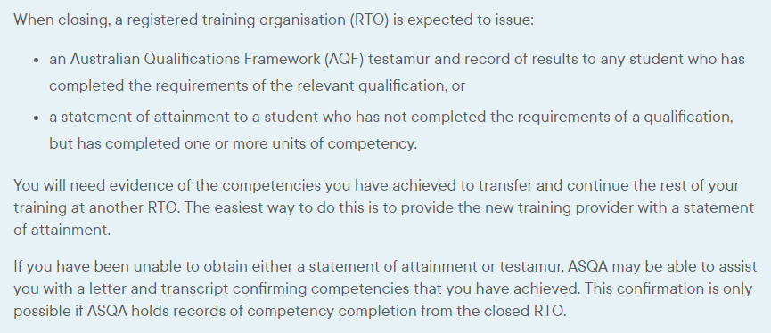
www.asqa.gov.au/students/student-record

Slide 24
Contact details for ASQA
www.asqa.gov.au/students/how-asqa-can-help-students
www.asqa.gov.au/students/student-record
Phone from in Australia: 1300 701 801 between 9am to 7pm (AEDT) Monday to Friday
Phone from outside Australia: +61 3 8613 3910

Slide 25

Study Melbourne
Support for international students
Notes:
Study Melbourne support services for international students are on the Study Melbourne website (www.studymelbourne.vic.gov.au)

Slide 26
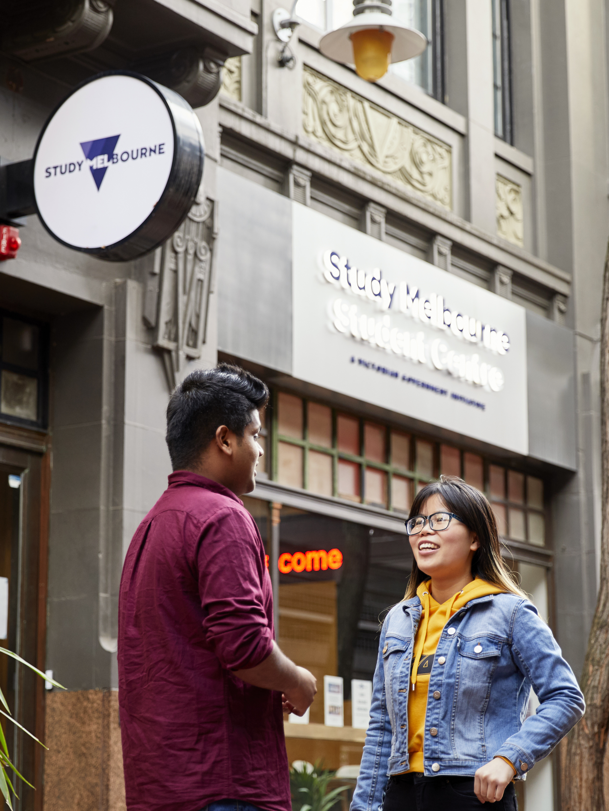

Study Melbourne Hub
The Study Melbourne Hub provides free help and support for all international students in Victoria
We support students with a range of enquiries including:
  Financial Hardship
  Accommodation Advice
  Employment Programs
  Employment and Accommodation Legal Service
  Education Provider Problems
  Wellbeing & Mental Health
Notes:
The friendly, multi-lingual staff can answer your questions about health, accommodation, student safety, work rights and managing your finances

Slide 27
Contact Study Melbourne Hub
Contact the Study Melbourne Hub to speak with a caseworker. All services are confidential.
Support is available online, by phone, and in person
  Website: https://www.studymelbourne.vic.gov.au/study-melbourne-hub
  Visit: 17 Hardware Lane, Melbourne
  Open 9am-5pm Monday to Friday
  Phone: In Australia: 1800 056 449
  Overseas: +61 3 9623 1512
  Phone lines operate 24/7
  Email: info@studymelbourne.vic.gov.au
Notes:
Study Melbourne Hub located in the heart of Melbourne’s iconic laneways at 17 Hardware Lane
Open 9am-5pm Monday to Friday
Note that our phone line operates 24 hours

Slide 28

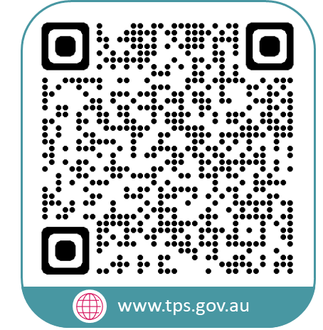


www.tps.gov.au
support@tps.gov.au
1300 131 798

