Slide 1
2024 Tuition Protection Levies
VET Student Loans, HELP and Higher Education Up-front Payments
2024 Sector Consultation
Melinda Hatton
TPS Director
www.tps.gov.au
Notes:
Acknowledgement of Country
'I begin by acknowledging the Traditional Custodians of the land on which we meet today and pay my respects to their Elders past and present. I extend that respect to Aboriginal and Torres Strait Islander peoples here today.’
Canberra: lands of the Ngunnawal people
Sydney: lands of the Gadigal people of the Eora nation
Melbourne: lands of the Wurundjeri (wuh-run-jeh-ree) people of the Kulin (Kooh-lin) nation
Brisbane: lands of the Jagera (Yug-er-rah) and Turrbal (Tur-a-bul) peoples
Adelaide: lands of the Kaurna (Gar-nah) people
Perth: lands of the Whadjuk (Wod-juk) Noongar (noong-uh) people
Darwin: lands of the Larrakia (La-ruh-kee-ah) people
Hobart: lands of the Muwinina (Moo-we-nin-ah) people

Slide 2
Outline
Purpose of the Tuition Protection Service (TPS)
Tuition protection levy setting process, guiding principles and legislation
Levy components and draft 2024 risk rating settings
2024 levy timeline and takeaways
www.tps.gov.au
Notes:
Session purpose:
To share the TPS Advisory Board’s draft advice on the 2024 Domestic levy settings, and gather feedback from you on the proposed settings
To explain the domestic levy components and calculations
To answer any questions you have about the domestic levies
We invite you to provide feedback on the Board’s draft advice at this session, or by emailing the TPS at operations@tps.gov.au.
Feedback from sector consultation will be provided to the TPS Advisory Board ahead of its June meeting. The Board will consider feedback before providing its final advice to the TPS Director on the 2024 domestic levies.

Slide 3
Purpose of the Tuition Protection Service (TPS)
www.tps.gov.au

Slide 4
Purpose of the Tuition Protection Service (TPS)
Australian Government initiative
Student tuition protection scheme
Developed for international student fee protection and expanded to specified domestic students
Supports students with refunds and loan re-credits, and facilitates alternative course placements following provider closures
Supports education providers to understand and meet obligations to students
Manages tuition protection levy collections
www.tps.gov.au
Notes:
Australian Government initiative supported by federal Department of Education
Student tuition protection scheme that safeguards Australia’s reputation as an education destination
Developed for international student fee protection and expanded to domestic VSL and HELP students in 2020, and HE up-front fee-paying students in 2021
Manages tuition protection levy collections from registered education providers
Supports students with refunds and Government loan re-credits, and facilitates alternative course placements following provider closures
Supports education providers to understand and meet obligations to students

Slide 5
TPS Director, TPS team and Advisory Board
www.tps.gov.au

Slide 6
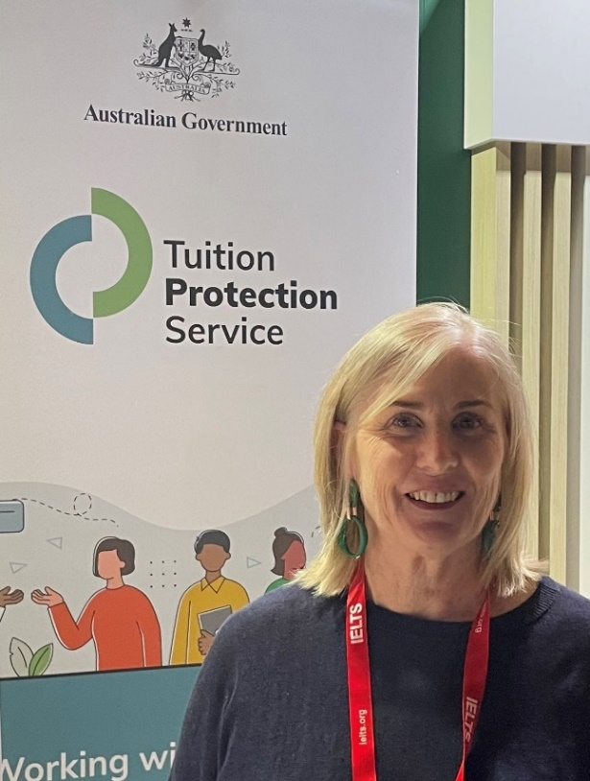
Tuition Protection Service Director
Melinda Hatton, TPS Director
Statutory office holder appointed by the federal Minister for Education
Operational oversight of the daily activities of the TPS
Responsible for the annual collection of TPS levies from CRICOS and eligible domestic education providers
Responsible for managing the levy funds
www.tps.gov.au
Notes:
Statutory office holder appointed by federal Minister for Education
Operational oversight of the daily activities of the TPS
Responsible for the annual collection of tuition protection levies from CRICOS and eligible domestic education providers
Responsible under law for managing the levy funds

Slide 7
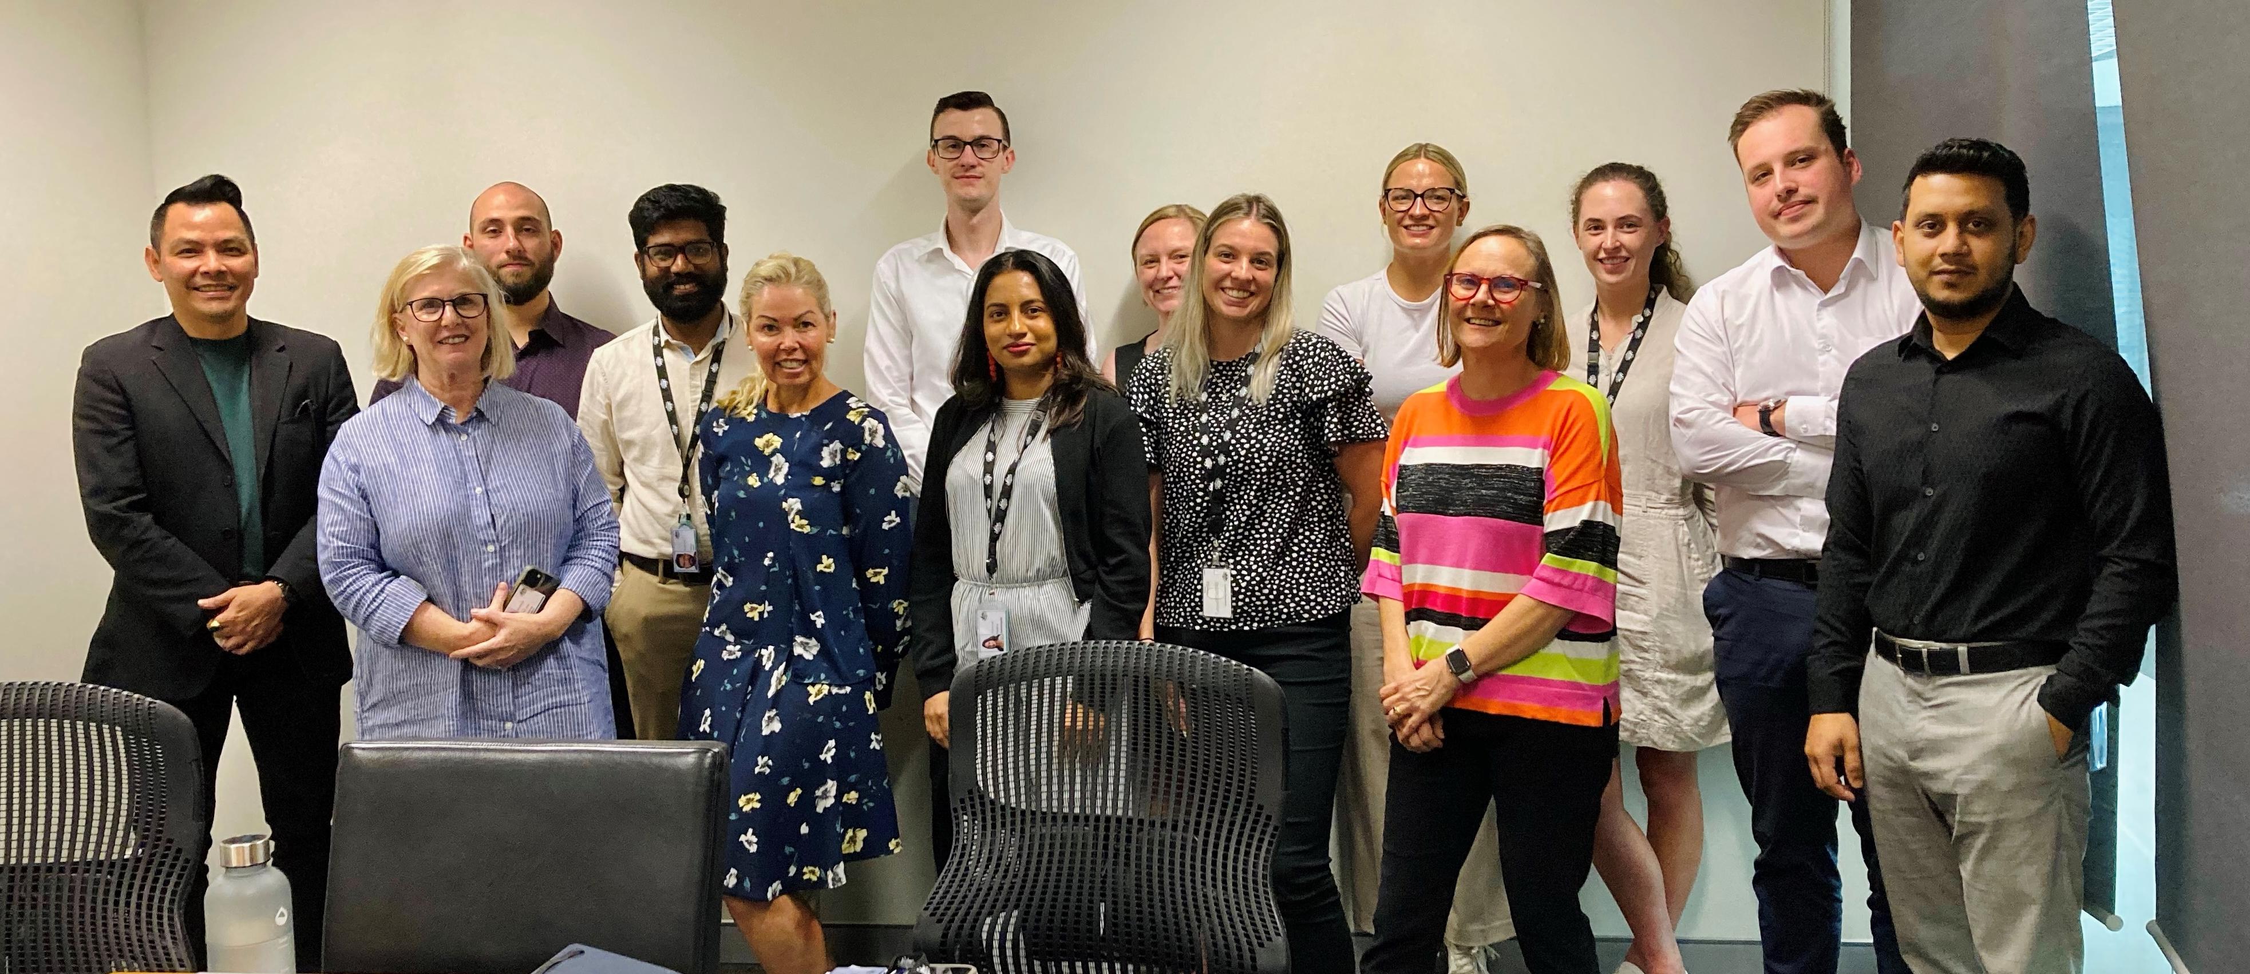
TPS Team
www.tps.gov.au
Notes:
Led by TPS Director
Small team of 15
Canberra

Slide 8
TPS Advisory Board
View Board member profiles at www.tps.gov.au
Ms Sharon Robertson (Chair)
The Hon. Phil Honeywood (Deputy Chair)
Ms Yeganeh Soltanpour, Council of International Students Australia
Ms Karen Sandercock, Australian Government Department of Education
Mr Matthew Hardy, Australian Government Department of Employment and Workplace Relations
Mr Guy Thorburn, Australian Government Actuary
Ms Gloria Yu, Australian Prudential Regulation Authority
Ms Rebecca Mok, Australian Government Department of Finance
Ms Victoria Miller, Australian Government Department of Home Affairs
www.tps.gov.au

Slide 9
Domestic Tuition Protection Levies
Levy setting process, guiding principles and legislation
www.tps.gov.au

Slide 10
Domestic Tuition Protection Levies
Three annual sector-based tuition protection levies collected from domestic education providers
Domestic levies paid into quarantined accounts managed by the TPS Director
VSL Levy → VSL Tuition Protection Fund
HELP Levy → Higher Education Tuition Protection Fund
Up-front Payments Levy → Higher Education Tuition Protection Fund
Levies fund the student placement, loan re-credit and refund activities of the TPS following an education provider closure and TPS operational costs
Domestic levies collected for the first time in 2022
www.tps.gov.au
Notes:
Three annual sector-based tuition protection levies collected from domestic education providers
Domestic levies paid into sector-specific quarantined accounts managed by the TPS Director. This means there will be no cross-subsidisation across the existing tuition protection arrangements for international students, eligible higher education students, or VSL students.
VSL Levy → VSL Tuition Protection Fund
HELP Levy → Higher Education Tuition Protection Fund
Up-front Payments Levy → Higher Education Tuition Protection Fund
Levies fund the student placement, loan re-credit and refund activities of the TPS following an education provider closure as well as TPS operational costs
All domestic levies waived in 2020 and 2021 as a COVID-19 pandemic relief measure
Domestic levies collected for the first time in 2022
Separate levy for international students
Providers operating in multiple sectors pay separate levies for each sector
All domestic levies waived in 2020 and 2021 as a COVID-19 relief measure

Slide 11
Domestic Tuition Protection Levy Setting Process
8 March 2024 | TPS Advisory Board provided draft advice to the TPS Director on the 2024 domestic levy settings
March-May 2024 | TPS Director consults the sector on the draft levy settings
12 June 2024 | TPS Advisory Board considers the sector’s feedback on the draft 2024 levy settings then provides its final advice to the TPS Director
By 1 August 2024 | 2024 levy settings finalised in legislative instruments
www.tps.gov.au
Notes:
Purpose of today’s session is to consult you on the draft 2024 VSL, HELP and Up-front Payments levy settings as proposed by the Board
Feedback from the sector will be provided to the Board for consideration before providing its final advice to the TPS Director on the 2024 levy settings
I invite your comments, questions and feedback on the draft levy settings
Board will provide its final advice on the 2024 levy settings at its next meeting on 12 June 2024
Legislative Instruments must be made by 1 August 2024 specifying the 2024 levy settings

Slide 12
TPS Advisory Board’s Advice on Levy Settings
When formulating its advice, the Board considers a range of factors including:
The strategic risk environment
Advice from the Australian Government Actuary (AGA)
Views of the sector regulators, industry peak bodies and providers
The post-COVID-19 operating environment
The current balance of the respective levy Funds and the quantum of funds required for their long-term sustainability
www.tps.gov.au
Notes:
TPS Advisory Board provides advice and makes recommendations to the TPS Director on the levy settings
The Board provided its draft advice to the TPS Director at the 8 March 2024 Board meeting
The Board considers a range of factors when formulating its advice, including:
The strategic risk environment
Advice from the AGA
Views of the sector regulators, industry peak bodies and providers
The post-COVID-19 operating environment
The current balance of the levy Funds and the quantum of funds required for their long-term sustainability

Slide 13
Guiding Principles for Board’s Levy Setting Advice
Advice should reflect the overall risk environment
The model for each levy should reflect gradual change
The model should be as simple and transparent as possible
Risk premiums should provide incentives for education providers to adopt positive behaviours
Additional imposts on industry, such as data collection, should be minimised as far as possible
www.tps.gov.au
Notes:
The Board’s levy setting advice is guided by these principles:
Advice should reflect the overall risk environment and ensure that revenue sustains the relevant fund, while also being sustainable for the industry
The model for each levy should reflect gradual change and assist the industry with business planning by providing a stable regulatory environment
The model should be as simple and transparent as possible, preferably based on a small number of risk factors
Risk premiums should provide incentives for education providers to adopt positive behaviours
Additional imposts on industry, such as data collection, should be minimised as far as possible, consistent with the ability to set sound risk-based levies

Slide 14
TPS Levy Framework
Developed by the Australian Government Actuary (AGA)
Annual VSL, HELP and Up-front levy settings are set through two legislative instruments each:
one for the Administrative Fee component (made by the relevant Minister); and
one for the Risk Rated Premium component and Special Tuition Protection component (made by the TPS Director)
Education providers operating across multiple education sectors pay separate levies for each sector, which may be collected at different times during the year
Levy calculations based on an education provider’s size and risk of closure
AGA provides advice on levy settings to ensure the arrangements are financially sound
www.tps.gov.au
Notes:
TPS Levy Framework developed by the AGA
Annual levy settings are set through 2 legislative instruments each – one made by the relevant Minister and one by the TPS Director. We will go through the levy components in more detail later.
Providers operating across multiple sectors pay separate levies for each sector, which may be collected at different times during the year
Independent levy amounts are calculated based on data for each sector, and levies may be collected at different times during the year
The AGA provides advice on the levies to ensure the arrangements are financially sound

Slide 15
Legislative Authority
VET Student Loans (VSL Tuition Protection Levy) Act 2020 https://www.legislation.gov.au/Series/C2020A00005
Higher Education Support (HELP Tuition Protection Levy) Act 2020 https://www.legislation.gov.au/Series/C2020A00004
Higher Education (Up-front Payments Tuition Protection Levy) Act 2020 https://www.legislation.gov.au/Series/C2020A00102
www.tps.gov.au

Slide 16
2023 Domestic Tuition Protection Levy Collection
www.tps.gov.au

Slide 17
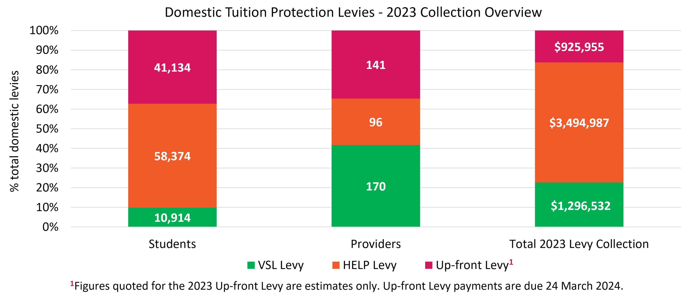
Domestic Levies – 2023 Collection Overview
www.tps.gov.au
Notes:
Important note: The 2023 up-front levy was invoiced much later than the 2023 VSL and HELP levies due to a data lag. Figures quoted in this graph for the 2023 up-front levy are estimates only. 2023 up-front levy payments are due 24 March 2024.
VSL
Lower ratio of VSL students to VSL providers
Average of 64 students per provider
Hence smaller levy amount collected from VSL providers
Higher Education
Higher ratio of HE students to HE providers
HELP: average of 608 students per provider
Up-front: average of 292 students per provider
Hence larger levy amount collected from HE providers

Slide 18
Tuition Protection Funds
Two tuition protection Funds for domestic schemes:
VSL Tuition Protection Fund
Higher Education Tuition Protection Fund
AGA recommends target Fund balances to ensure sufficient funds are available for a large provider closure or multiple provider closures
Fund | Target range | Balance | Seed funding to be repaid
VSL Fund | $6.75-9.5 million | $10.85 million (as at 31 Dec 2023) | $7.73 million (as at 31 Dec 2023)
Higher Education Fund | $21-25 million | $14.04 million (as at 31 Dec 2023) | $8.62 million (as at 31 Dec 2023)
www.tps.gov.au
Notes:
Domestic levies paid into 2 quarantined accounts managed by the TPS Director
VSL levy paid into the VSL Tuition Protection Fund
HELP and Up-front levies paid into the Higher Education Tuition Protection Fund
Target ranges
AGA recommends a target range for each Fund, which are endorsed by the TPS Advisory Board
Target ranges guide the TPS Director in managing the Funds
AGA’s target range recommendations are based on ensuring sufficient funds are available to support students and replacement providers in the event of a large provider closure or multiple small to medium provider closures within a year
AGA considers the risk profile of providers, particularly large providers, as not all providers that close will be ‘average’ in size
The larger the provider, the larger the claim on the funds
Target range of VSL Fund lower than HE Fund due to the different risk profile of the VSL and HE Funds
HE Fund exposed to a low frequency of expected closures, but with a high potential cost for some providers
HE example: If one of the top 5 HE providers by revenue closed, the estimated cost for the HE Fund would be between $30-55 million
VSL example: If all top 5 VSL providers by revenue closed, the estimated cost for the VSL Fund would be ~$6.4 million. If the top VSL provider by revenue closed, the estimated cost for the VSL Fund would be ~$2.3 million.
High concentration of revenue in both the VSL and HE sectors
Revenue of top 5 VSL providers accounts for 41% of the total loan revenue in the sector
Revenue of top 5 HE providers accounts for more than 30% of revenue in the sector
VSL Fund
VSL Fund balance is above its target range due to seed funding and the absence of claims
Note: One VSL provider closed in early 2024. The TPS is currently working to assist the affected VSL students. This is the first VSL closure the TPS has activated for.
Repayment of seed funding likely to commence in 2024-25 based on the surplus generated in 2023-24
This would bring the VSL Fund balance back to the midpoint of the target range (i.e. $8.125 million)
If all VSL seed funding was repaid in one instalment (which has never been the intention), the Fund balance would be below the target range
Higher Education Fund
HE Fund balance is below its target range and has some way to go to reach its target range
This fund was also established with seed funding that needs to be repaid once it is within its target range

Slide 19
Domestic levy components and draft 2024 settings
www.tps.gov.au

Slide 20
Domestic Tuition Protection Levy Components
Component | Key elements | Purpose and authority
Administrative fee | Sum of a ‘per provider’ and ‘per student’ charge | Designed to cover administrative costs Set by relevant Minister
Risk rated premium | Considers 3 risk factors: Financial strength Completion rate Non-compliance history and registration renewal | Intended to reflect risk of provider default Financial reward for positive provider behaviour and risk management practices Set by TPS Director with Board advice
Special tuition protection | Percentage multiplied by total loan amounts or up-front payments received | Builds Fund balances when below target range Facilitates repayment of seed funding Set by TPS Director with Board advice
www.tps.gov.au
Notes:
Administrative fee component
Set by the relevant Minister, not the TPS Director (i.e. only consulting on risk rated premium and special tuition protection components)
An indexation will apply if the responsible Minister decides not to determine new administrative fee component amounts (see Section 10 of the VSL, HELP and Up-front Payments Levy Acts)
If a provider is a new provider for a year, the provider’s administrative fee component will be the ‘per provider’ amount only
Risk rated premium component
Determined annually by TPS Director on advice from the TPS Advisory Board, AGA and feedback from stakeholders
Risk factors and calculations designed to reflect the risk of a provider closure
Not same methodology to the risk assessments conducted by the regulators as ours are specifically designed to reflect risk of closure
If a provider is a new provider for a year, the risk rated premium component for the year will be 0
Special tuition protection component
Calculated as a percentage of a provider’s income from loan amounts or up-front payments
If a provider is a new provider for a year, the special tuition protection component for the year will be 0

Slide 21
Draft 2024 Domestic Tuition Protection Levy Settings
Levy | Administrative fee* | Risk rated premium | Special tuition protection
VSL | $119 per provider + $10.01 per VSL student | $6 per VSL student + 0.13% x total 2023 loan amounts | 0.10% x total 2023 VSL loan amounts
HELP | $119 per provider + $10.01 per HELP student | $6 per HELP student + 0.06% x total 2023 loan amounts | 0.10% x total 2023 HELP loan amounts
Up-front | $119 per provider + $10.01 per up-front student | $2 per up-front fee-paying student + 0.04% x total 2023 up-front payments | 0.10% x total 2023 up-front payments
*Administrative fee figures quoted were applied for the 2023 levies and may be indexed to CPI for 2024
Note: 2024 levies will be calculated using student enrolment numbers and revenue for the 2023 calendar year
www.tps.gov.au
Notes:
Note: Administrative fee figures quoted were applied for the 2023 levies. Figures may be indexed to CPI for 2024 if the responsible Minister decides not to determine new administrative fee component amounts
Reminder: Only consulting on risk rated premium and special tuition protection components as they are the components the TPS Director is responsible for
2024 levies will be calculated using student enrolment numbers and revenue for the 2023 calendar year
One change from 2023 settings: reduction of the risk rated premium component specified percentage for the VSL Levy from 0.17% to 0.13%
Previous VSL Levy settings assumed that 2% of VSL providers (just over 3 providers) would close per year. This was based on the actual closure rate of VSL providers in the VET Fee-HELP Program.
No VSL closures prior to Dec 2023. 1 VSL closure in early 2024.
Assumed rate of VSL provider closures has been reduced to 1.5%
Risk rated premium component specified percentage reduced from 0.17% to 0.13% in recognition of lower expected VSL provider closures
By comparison, the assumed rate of HE provider closures is 0.5% (i.e. less than one provider per year). No HE providers have closed to date.

Slide 22
Risk rated premium component
Considers 3 risk factors designed to reflect the risk of provider closure
Providers receive a risk value against each risk factor
The sum of a provider’s risk values give a total risk factor value
Providers with a high total risk factor value present a higher risk of closure and will pay a higher levy amount
www.tps.gov.au
Notes:
Calculation of the risk rated premium component is based on 3 risk factors
Risk factors are intended to reflect the risk of provider closure and, therefore, a need to call on the levy funds
Providers yield a risk value for each risk factor, which are summed together to give a total risk factor value
Total risk factor value is a multiple for the provider’s risk rated premium component calculation. A high total risk factor value = higher levy amount.
A provider that yields a high total risk factor value presents a high risk of closure

Slide 23
Risk Rated Premium Component: Risk Factors
Risk Factor 1 Financial Strength
Based on 2 ratios: return on assets and debt to equity
Note: One change to the 2024 financial strength calculation
Calculations use providers’ most recent financial data
Risk Factor 2 Unit Completion Rate
Based on the unit completion rate of students
Risk Factor 3 Non-Compliance History and Registration Renewal
Late payment history of the relevant tuition protection levy and annual registration provider charges; and
If a provider’s registration was renewed for a period less than the maximum allowable for risk management reasons
www.tps.gov.au
Notes:
Risk factors proposed by AGA and reviewed / considered by TPS Advisory Board
Risk factors intended to reflect the risk of provider closure and, therefore, a need to call on the levy funds
Financial strength
All providers must provide their latest financial statements through the HELP IT System (HITS). For the 2024 levies, this can be 2022-23 financial year data or 2023 calendar year data.
Note: Providers will attract the highest risk value for this risk factor if:
No financial statements are provided; or
Only parent entity statements are provided and not financial statements for the approved entity
Completion rate
AGA analysis has identified a correlation between low unit completion rates and an increased likelihood of provider closure
Calculation of passed equivalent full-time student load (EFTSL) as a percentage of total EFTSL
Non-compliance history and registration renewal
Providers are penalised if they paid the relevant levy and/or their annual registration charge late over the previous 3 years
Providers are also penalised if they applied to the regulator to have their registration renewed and, due to risk management reasons, their registration was renewed for a period less than the maximum allowable

Slide 24
Financial Strength
Assessed using two ratios:
Ratio | Formula
Return on Assets: Measures the profitability of a provider relative to its total assets | NPBT / total assets
Debt to Equity: Measures the degree to which a provider is financing its operations through debt | Total liabilities / total equity
NPBT: Net profit before tax
‘Net profit ratio’ was also used to calculate financial strength in previous levy calculations
The Board proposes removing the ‘net profit ratio’ from the 2024 levy calculations to respond to concerns raised by some not-for-profit providers
www.tps.gov.au
Notes:
Assessed using 2 ratios:
Return on assets ratio
Debt to equity ratio
Removal of ‘net profit ratio’
The ‘net profit ratio’ was also used to assess providers’ financial strength in previous levy calculations
The Board’s draft advice recommends removing the ‘net profit ratio’ from the 2024 levy calculations to respond to concerns raised by some not-for-profit providers (will discuss this more later)

Slide 25
Financial Strength
Proposed 2024 risk factor values unchanged from 2023
Financial strength score | Risk factor value (2022 and 2023) | Proposed risk factor value (2024)
8 or 9 | 0.0 | 0.0
6 or 7 | 1.0 | 1.0
1 to 5 | 2.0 | 2.0
Provider does not submit financial statements | 2.5 | 2.5
Providers receive a score of 1.5, 3.0 or 4.5 for each ratio, which are summed together to give an overall financial strength score
Financial strength scores determine providers’ financial strength risk factor values
www.tps.gov.au
Notes:
Proposed 2024 risk factor values unchanged from 2023
Providers receive a score of 1.5, 3.0 or 4.5 for each ratio, which are summed together to give an overall financial strength score (left column)
A provider’s financial strength score determines the provider’s corresponding risk factor value for the financial strength risk factor
Risk factor values are multiples for providers’ risk rated premium component calculation and therefore influence each provider’s levy amount
Note: Providers will attract the maximum financial strength risk factor value if:
No financial statements are provided; or
Only parent entity statements are provided and not financial statements for the approved entity

Slide 26
Financial Strength: Removal of net profit ratio
Previous financial strength calculations were based on three ratios:
Net profit ratio: Net profit before tax / total revenue
Return on assets: Net profit before tax / total assets
Debt to equity: Total liabilities / total equity
In 2023, some not-for-profit providers raised concerns about the use of the net profit ratio to calculate financial strength by suggesting the ratio unfairly penalised them
AGA tested alternative calculations that are less weighted towards profit for 2024 levies
AGA recommendation: Remove net profit ratio from the 2024 Financial Strength calculation
Not-for-profit providers will yield a better financial strength risk score
Increases the proportion of not-for-profit providers in the lowest risk category to similar levels to the for-profit providers
www.tps.gov.au
Notes:
2 of the 3 ratios used to calculate financial strength in all previous levy calculations were driven by net profit before tax (i.e. net profit ratio and return on assets)
In 2023, some not-for-profit providers raised concerns about the use of the net profit ratio to calculate financial strength
These providers suggested the use of the net profit ratio to assess the financial strength resulted in not-for-profit providers being unfairly penalised
Investigation by AGA
AGA investigated whether the net profit ratio unfairly penalised not-for-profit providers
Investigation was based on VSL provider data as equivalent higher education provider data was not available
Found that the proportion of not-for-profit providers that fell into the ‘low risk’ financial strength category dropped significantly in 2022
Only 13% of not-for profit providers attained a risk factor value of 8 or 9, exempting them from the financial strength loading
AGA tested alternative financial strength calculations
Incorporating a providers’ for-profit status as a specific risk measure is not possible without collecting additional data from providers
AGA tested three alternative financial strength calculations that were less weighted towards profit to address the concerns of not-for-profit providers
AGA found that removing the ‘net profit ratio’ from the financial strength calculation was the best solution to address the concerns of not-for-profit providers
AGA’s recommendation: remove the net profit ratio from the financial strength calculation for the 2024 levies
Removing the net profit ratio strengthened the inverse relationship between financial risk scores and provider closure rates (i.e. better reflects the relative risk of provider closure)
Also increased the proportion of not-for-profit providers in the ‘low risk’ financial strength category to similar levels to the for-profit providers (i.e. the financial strength calculation is more equitable for not-for-profit and for-profit providers)
This change will help not-for-profit providers to yield a better financial strength risk score (i.e. would lower some providers’ levies)
Board supported the AGA’s recommendation in its draft advice

Slide 27
Unit Completion Rate
Providers with low student unit completion rates correlated with an increased likelihood of closure
Unit completion rate percentage calculation:
Passed EFTSL
X 100
(Passed + Failed + Withdrawn + Ongoing + Data missing EFTSL)
EFTSL: Equivalent full-time student load for a year
www.tps.gov.au
Notes:
Student unit completion rate is an important metric in tuition protection as it is ultimately the students with incomplete courses that are eligible for tuition protection
Providers with low completion rates have been correlated with an increased likelihood of closure
Calculates Passed equivalent full-time student load (EFTSL) as a Percentage of Total EFTSL

Slide 28
Unit Completion Rate
Proposed 2024 risk factor values unchanged from 2023
Completion rate percentage | Risk factor value (2020) | Risk factor value (2022) | Risk factor value (2023) | Proposed risk factor value (2024)
85% or higher | 0.0 | 0.0 | 0.0 | 0.0
60% to <85% | 0.0 | 0.0 | 1.0 | 1.0
35% to <60% | 3.5 | 1.7 | 2.5 | 2.5
0% to <35% | 5.5 | 2.7 | 3.5 | 3.5
www.tps.gov.au
Notes:
Risk factor values were increased in 2023, but were still lower than the 2020 level overall
Proposed 2024 risk factor values unchanged from 2023
2020 risk factor values
Reminder: The VSL, HELP and Up-front levies were collected for the first time in 2022
The VSL and HELP levies were waived in 2020 and 2021, and up-front levy was waived in 2021 to support providers through COVID-19
Changes to completion rate settings over time
2022: risk factor values were reduced as a temporary COVID-19 support measure
Recognised the impact of COVID-19 on ability of students to complete courses
2023: risk factor values were increased but were still lower than pre-covid settings overall
Increased loading from 0.0 to 1.0 for ‘60% to <85%’ completion rate category - “better aligns overall risk loadings to relative rates of failure and better reflects the experience to date”
AGA analysis found that providers with a completion rate between 60% and 85% presented a higher risk of closure than providers with completion rates above 85%
2024: Draft levy settings unchanged from 2023
AGA: Providers’ completion rates are stabilising at higher than pre-COVID levels

Slide 29
Non-Compliance History and Registration Renewal
Assesses the risk of a provider based on their history of non-compliance and lack of risk management practices
Non-compliance history
Penalises providers for a late payment history of the relevant levy and annual registration provider charges over the previous 3 years (i.e. 2021-2023)
Registration renewal
Penalises providers that applied for renewal of its registration and, for risk management reasons, had its registration renewed for a period less than the maximum allowable
www.tps.gov.au
Notes:
Financial incentive to adopt positive behaviours
2 components to this risk factor:
Non-compliance history
Registration renewal
Non-compliance history
Considers whether a provider has a history of paying the relevant tuition protection levy and annual registration change late over the previous 3 years
A weighted late payment measure applies, meaning late payment of charges in 2023 will have a larger impact on a provider’s risk factor calculation than late payment of charges in 2021
Registration renewal
Penalises any providers that applied to have its registration renewed and, for risk management reasons, had its registration renewed for a period less than the maximum allowable
AGA: Rate of provider closures is “clearly higher” for providers that had their registration renewed for a period less than the maximum allowable for risk management reasons

Slide 30
Non-Compliance History and Registration Renewal
Proposed 2024 risk factor values unchanged from 2022 and 2023
Non-compliance history and registration renewal | Risk factor value 2022 and 2023 | Proposed risk factor value 2024
A weighted late payment measure of 30 days or more | 2.0 | 2.0
A weighted late payment measure of 15 to >30 days | 0.9 | 0.9
A weighted late payment measure of 1 to >15 days | 0.7 | 0.7
A weighted late payment measure of >1 day | 0.0 | 0.0
PLUS
Applied to have its registration renewed and, for risk management reasons, had its registration renewed for a period less than the maximum allowable | 1.0 | 1.0
www.tps.gov.au
Notes:
Proposed 2024 risk factor values unchanged from 2022 and 2023

Slide 31
Risk Rated Premium Component
Risk rated premium component formula:
$$\left[\left(\begin{aligned}total students \\ for 2023 \\ × \\ specified amount\end{aligned}\right)+\left(\begin{aligned}total tuition fee income \\ received in 2023 \\ × \\ specified percentage\end{aligned}\right)\right]×\left(sum of risk factor values+1\right)$$
The sum of a provider’s risk factor values is a multiplier for the risk rated premium component calculation
www.tps.gov.au
Notes:
Calculation based on data for previous calendar year (i.e. 2023)
Tuition fee income is either VSL loans, HELP loans, or up-front payments received (depending on which levy is being calculated)
Total risk factor value is a multiplier for the provider’s risk rated premium component calculation. A high total risk factor value = higher levy amount.
If a provider is a new provider for a year, the risk rated premium component for the year will be 0

Slide 32
Risk Rated Premium Component: VSL Example
$$\left[\left(\begin{aligned}75 VSL students \\ for 2023 \\ × \\ \$6\end{aligned}\right)+\left(\begin{aligned}\$250,000 VSL Loans \\ received in 2023 \\ × \\ 0.13\%\end{aligned}\right)\right]×\left(total risk factor value of 4.7+1\right)$$
= $450
= $325
= 5.7
= ($450 + $325) x 5.7
= $4,417.50
www.tps.gov.au
Notes:
Risk rated premium component calculation example for a VSL provider with:
75 VSL students in 2023
$250,000 in VSL loans received in 2023
Yielding a total risk factor value of 4.7 (i.e. presenting moderate risk of closure)

Slide 33
Risk Rated Premium Component: HELP Example
$$\left[\left(\begin{aligned}650 HELP students \\ for 2023 \\ × \\ \$6\end{aligned}\right)+\left(\begin{aligned}\$10m HELP Loans \\ received in 2023 \\ × \\ 0.06\%\end{aligned}\right)\right]×\left(total risk factor value of 1.0+1\right)$$
= $3,900
= $6,000
= 2.0
= ($3,900 + $6,000) x 2.0
= $19,800
www.tps.gov.au
Notes:
Risk rated premium component calculation example for a HELP provider with:
650 HELP students in 2023
$10m in HELP loans received in 2023
Yielding a total risk factor value of 1.0 (i.e. presenting low risk of closure)

Slide 34
Risk Rated Premium Component: Up-front Example
$$\left[\left(\begin{aligned}350 up‑front \\ students for 2023 \\ × \\ \$2\end{aligned}\right)+\left(\begin{aligned}\$400,000 payments \\ received in 2023 \\ × \\ 0.04\%\end{aligned}\right)\right]×\left(total risk factor value of 6.4+1\right)$$
= $700
= $160
= 7.4
= ($700 + $160) x 7.4
= $6,364
www.tps.gov.au
Notes:
Risk rated premium component calculation example for an up-front provider with:
350 HELP students in 2023
$400,000 in up-front payments received in 2023
Yielding a total risk factor value of 6.4 (i.e. presenting high risk of closure)

Slide 35
Special tuition protection component
Helps to build the balance of the Funds when below their target range
Facilitates repayment of seed funding
Proposed percentage for 2024 levies: 0.10%
www.tps.gov.au
Notes:
Proposed 2024 special tuition protection component percentage unchanged from 2022 and 2023
Note the maximum percentage that can be charged for the special tuition protection component is 0.15% - proposed setting is 0.05% under the limit
The VSL Fund balance is currently above its target range, but seed funding needs to be repaid
The HE Fund is still below its target range and has a way to go to reach its target before seed funding needs to be repaid

Slide 36
2024 Domestic Levies Timeline and Takeaways
www.tps.gov.au

Slide 37
2024 Domestic Tuition Protection Levies Timeline
Feb-March 2024
March-June 2024
June-July 2024
July-August 2024
Sept-Nov 2024
Dec 24 - Jan 25
Mid-Late February
Up-front levy invoices issued
24 March
Up-front levy payments due
8 March
Draft advice on 2024 levy settings confirmed at TPS Advisory Board meeting
Mid-March
Draft advice letters published on TPS website
Online consultation session for all providers
March-May
Consultation sessions in Perth, Adelaide, Sydney, Brisbane and Melbourne
Meetings with stakeholders
Late May
Online feedback session for all providers
12 June
TPS Advisory Board considers sector feedback
Final advice on 2024 levy settings confirmed at TPS Advisory Board meeting
Mid-Late June
Final advice letters published on TPS website
Legislative Instruments prepared
Early July
Legislative instruments prepared
Late July-Early Aug
Legislative instruments made by 1 August and published online
TEQSA annual information collection – HELP providers’ students numbers data verified (TCSI)
Mid-Late August
Providers emailed with levy settings
Request for Information (RFI) sent to up-front providers
Early advice notices sent
September
Return of RFI forms and results compiled
Levy estimate notice with link to estimator tool sent to VSL and HELP providers
October
VSL and HELP levy invoices issued
November
VSL and HELP levy payments due
TEQSA annual information collection – student numbers data submission by up-front providers due
Late Dec-Early Jan
TEQSA annual information collection – up-front providers’ student numbers data verified (TCSI)
Mid-Late Jan
Levy estimate notice with link to estimator tool sent to up-front providers
Late Jan-Early Feb
TEQSA annual information collection – student numbers data submission by HELP providers due
www.tps.gov.au
Notes:
Important note re: TEQSA annual information collection for up-front providers:
Up-front providers had to submit student numbers data for the TEQSA annual information collection in November 2023. This data was verified in December 2023.
While there is a specified date for the verification of student numbers data supplied by HELP providers, there is no specified date for the verification of data supplied by up-front providers in TCSI.
Ensure HITS and TCSI data is up-to-date
Levy Notices will be sent to contacts provided in the HELP IT System (HITS)
Please ensure all contacts in HITS are up to date
Ensure TCSI data is up to date including course outcome, course outcome date and unit status. This data affects providers’ risk ratings.

Slide 38
Takeaways
Two proposed changes for the 2024 levy settings:
VSL Levy risk rated premium component specified percentage reduced from 0.17% to 0.13%
Net profit ratio removed from the Financial Strength risk factor calculation
VSL and HELP levies collected October/November
Up-front levy collected February/March the following year
www.tps.gov.au
Notes:
2 proposed changes for the 2024 levy settings:
Reduced specified percentage for the risk rated premium component of the VSL Levy from 0.17% to 0.13%
‘Net profit ratio’ removed from the Financial Strength risk factor calculation
Up-front levy will be collected later than the VSL and HELP levies due to a data lag

Slide 39
Key messages
Ensure contact information in HITS and enrolment data in TCSI are up to date
Check account details before making a payment
Pay the full and correct amount on time to avoid receiving a late payment penalty for the following three years
Ensure all financial statements:
are signed by an auditor
contain financial information from previous year (2023)
display the ABN of the entity the TPS is levying
Do not use Parent company’s financial statements
www.tps.gov.au
Notes:
Ensure contact information is up to date in HITS and enrolments data is up to date in TCSI
Check account details before making a payment. Payment details on the VSL Levy invoice are different to all other tuition protection levies.
Pay the full and correct amount on time to avoid receiving a late payment penalty for the following three years
Ensure all financial statements:
are signed by an auditor
contain financial information from previous year (2023)
display the ABN of the entity the TPS is levying
Do not use Parent company’s financial statements. Separate financial statements with ABN and accurate information are required by TPS.

Slide 40
Feedback
Any questions?
How have you found the levy collection process?
What works well for you?
What would you like to see done differently?
www.tps.gov.au
Notes:
We’ve been considering how we can improve the levy collection process. While we’re in the early stages, we’re looking at aspects like:
Aligning levy collections/invoices
Notices and notice periods
Data collection and provider verification of inputs for levy amounts
IT system provider experience
Do you have any thoughts/comments on those or other aspects of the levy collection process?

Slide 41
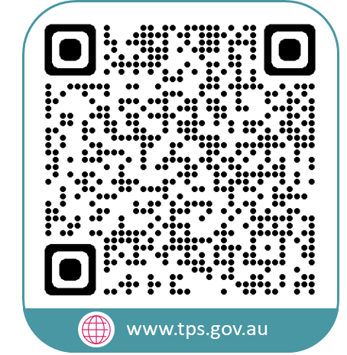
www.tps.gov.au
operations@tps.gov.au

