Slide 1
2024 June HELP Communications Working Group

Slide 2
Department of Education attendees
Team | Attendees
Student Engagement Team | Kellie McInnes, Nicole Ranieri, Stephanie Stockwell, Abbigail Peters, Dylan Parker, Michelle Scott, Abby Walsh, Nathan Twomey, Danni Montesin and Carley Adams
HELP Policy | Scott Channing, Phil Hawkins
TCSI, Department of Education | Phil Blagus
HESA Modelling and Performance | John Castles
Program Management Team, Department of Education | Tristan Krautz
Tuition Protection Service Operations, Department of Education | Mirah Lambert
Student Provider Integrity Branch, Department of Education | Larissa Hinds

Slide 3
Item | Speaker | Representing | Agenda Item
Item 1 | Kellie McInnes | MC | Welcome, housekeeping and introduction
Policy updates
Item 2 | Scott Channing Phil Hawkins | HELP Policy | Support for Students Policy update Budget Measures announcement on HELP indexation TCSI Remediation
Item 3 | Steph Stockwell | Industry Linkage and Adv Apprenticeships, Department of Education | Commonwealth Prac Placements
Item 4 | John Castles | HESA Modelling and Performance | Student Learning Entitlement Management System (SLEMS) updates
Item 5 | Tristan Krautz | Program Management, Department of Education | Tertiary Access Payment (TAP) Program Guidelines
Item 6 | Mirah Lambert | Tuition Protection Service Operations, Department of Education | HELP, Higher Education Upfront and VSL tuition protection levies
Item 7 | Phil Blagus | TCSI, Department of Education | Student concordance is now available in TCSI
Communication activities
Item 8 | Steph Stockwell Dylan Parker Nicole Ranieri | Student Engagement Team | Pre-indexation advertising HELP Provider Workshops NCI digital roadmap | eCAF Update – MFA, multi-template and more myHELPbalance Study Assist website and videos
Item 9 | Kellie McInnes | MC | Other business and Q&A
Item 10 | Kellie McInnes | MC | Meeting close and wrap-up

Slide 4
Support for students policy
The Australian Government introduced the Higher Education Support Amendment (Response to the Australian Universities Accord Interim Report) Bill 2023 in August 2023, and it passed in October 2023.
From 1 January 2024, all higher education providers (HEPs) are required to have, and comply with, a Support for Students policy in accordance with section 19-43 of the Higher Education Support Act 2003 (HESA).
The Support for students policy is designed to ensure that students receive adequate academic and non-academic support to allow them to reach their potential. The policy also recognises student agency: that ultimately students have the primary responsibility for accepting support and for their own success.
Additional requirements commenced on 1 April 2024 and provide further clarity for both providers and students on the kind of supports that are available, how they are communicated to students and how those supports are provided (section 49A and 49B of the Higher Education Provider Guidelines 2023).
The Department has established a Support for students Data Working Group with representation from across the higher education sector to develop a reporting template and requirements. HEPs are required to submit their first report on how they have complied with their Support for students policy by 1 March 2025.
Further information on the Support for students policy is available on the Department of Education’s website at www.education.gov.au/new-requirements-support-students.

Slide 5
Processing of HELP loans to the ATO
The Department of Education, in line with advice from the Australian Government Solicitor, is seeking to progress amendments to the Higher Education Support Act 2003 (HESA). The amendments are being designed to apply a consistent legal framework to the assessment of student eligibility for Commonwealth assistance under HESA.
Until such time as the amendments are passed, the Department has strengthened reporting and approval processes to ensure that students are eligible for and receive the correct HELP loan record.
The Department's process involves the controlled release of loans. HELP loans not yet released will be placed on hold until the controlled release list is reviewed and approved for release by the program delegate. The first release of loans is expected to occur this month and then on a monthly basis.
Loans will be affected where they have a census date on or after 1 July 2023. These loans will not be impacted by indexation on 1 June 2024 as indexation is only applied to loans older than 11 months old.

Slide 6

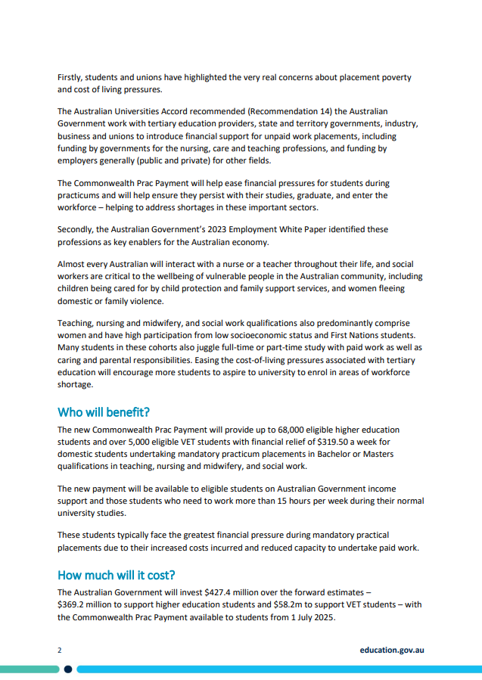
www.education.gov.au/higher-education/commonwealth-prac-payment

Slide 7
Student Learning Entitlement Management System (SLEMS) Enhancements
To help providers manage the Student Learning Entitlement (SLE) policy, the Department is developing the following two SLE specific TCSI Analytics Reports.
Student Learning Entitlement Overview Live Data Report – Contains Three Pages
Summary Student SLE Distribution – Number of students enrolled at provider by groupings of Usable SLE
Student SLE Allocation – SLE details of students enrolled at provider
Student Unit Level Enrolment – Details of units a student is enrolled in at provider
Student Learning Entitlement Course Coverage Live Data Report – Contains Three Pages
Summary Student SLE Coverage of Course Load – Number of students enrolled at provider by groupings of SLE Coverage of Course Load
Student SLE Coverage of Course Load - SLE details of students enrolled at provider with proximity to consuming their SLE amount included
Student Course Level Enrolment – Details of courses a student is enrolled in at provider

Slide 8
SLEMS – Vertical Double Degrees
Enhancements have been made to ensure that Vertical Double Degrees (VDDs) reported in TCSI as a single course will award students the correct amount of Additional SLE (ASLE).
Where a VDD is reported in TCSI as a single course it will have one course type code (E310) that refers to the course as either undergraduate or postgraduate. Only postgraduate components should attract ASLE.
The Department has finalised the design to process VDDs in SLEMS and correctly award ASLE. This has resulted in the creation of a new SLE table containing all VDDs offered by providers who report them as a single course in TCSI and includes the EFTSL value of the postgraduate component.
When a provider reports a course admission for an eligible student that matches the fields in this table, SLEMS will award the student with an amount of ASLE equal to the EFTSL value of the postgraduate component of the course minus any ASLE they have previously consumed.
The table will be populated with input received from providers and reflected in SLEMS from June 2024. This will result in existing student records being reprocessed to ensure they have the correct amount of ASLE awarded where they were enrolled in a listed course on or after 1 January 2022.

Slide 9
SLEMS – Real Time Validation (RTV)
A new warning RTV – RTV10924 has been deployed with the intent of warning providers where a student may not have sufficient SLE to complete the entirety of their course load in a Commonwealth Supported Place (CSP)
This warning will trigger when a course admission is reported for a student that results in their total course load exceeding their SLE amount. This is intended to prompt providers to discuss with students their ongoing enrolments and SLE utilisation.
For any providers that have questions regarding the Student Learning Entitlement policy they should contact studentlearningentitlement@education.gov.au
General updates will be provided as necessary, during future TCSI Provider Webinars and HELP Communication Working Groups

Slide 10
Tertiary Access Payment (TAP)
TAP is a non-indexed, means-tested payment (up to $5,000) to school-leavers from regional or remote areas relocate for full-time, tertiary education
(Certificate IV and above) at an education provider located at least 90 minutes by public transport from their family home.
The program guidelines expire at the end of 2024 and the department will update the program guidelines to cover 2025 to 2027.
We are interested in feedback regarding where we could provide information to potential eligible students to ensure all eligible students have an opportunity to apply for this program.
tertiaryaccesspayment@education.gov.au
www.education.gov.au/tertiary-access-payment
www.servicesaustralia.gov.au/tertiary-access-payment

Slide 11


2024 VSL, HELP and Up-front Payments Tuition Protection Levies
Recent sector consultation & TPS Advisory Board recommendations
Mirah Lambert
www.tps.gov.au
Notes:
Acknowledgement of Country
'I begin by acknowledging the Traditional Custodians of the land on which we meet today and pay my respects to their Elders past and present. I extend that respect to Aboriginal and Torres Strait Islander peoples here today.’
Canberra: lands of the Ngunnawal people

Slide 12
Outline
Domestic levies and consultation
Changes to 2024 levy settings
Key takeaways
www.tps.gov.au

Slide 13
Domestic Tuition Protection Levies
Three annual sector-based tuition protection levies collected from domestic education and training providers
Domestic levies paid into quarantined accounts managed by the TPS Director
VSL Levy → VSL Tuition Protection Fund
HELP Levy → Higher Education Tuition Protection Fund
Up-front Payments Levy → Higher Education Tuition Protection Fund
Levies fund the student placement, loan re-credit and refund activities of the TPS following an education provider closure and some TPS administration costs
Domestic levies collected for the first time in 2022
www.tps.gov.au
Notes:
All domestic levies waived in 2020 and 2021 as a COVID-19 pandemic relief measure
Domestic levies collected for the first time in 2022
Three domestic levies, going into 2 special accounts
Used to support students if providers do not meet their obligations

Slide 14
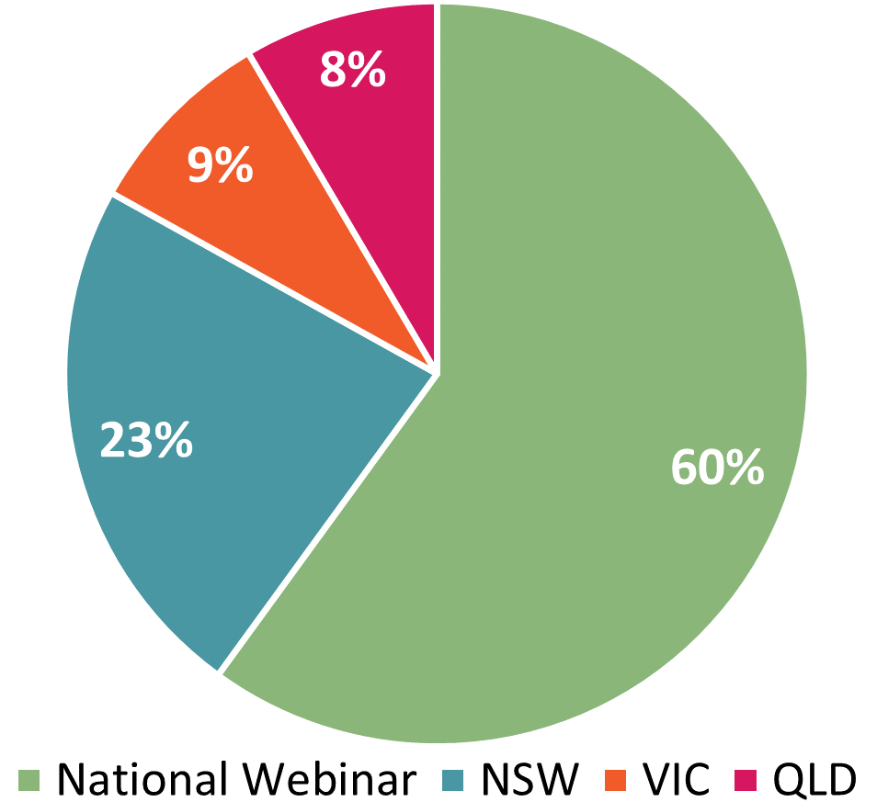
Consultation Session Participation
Contacts in HITS for all leviable providers invited 2024
130 individuals attended
60% at the national webinar
40% at the in-person sessions
www.tps.gov.au
Notes:
National webinar to start the process, and six in-person consultation sessions held from mid-March to mid-May 2024, feedback session to end
In person session in SA and WA cancelled due to low numbers, but providers joined online sessions.
Participation represents, approx. half of leviable providers.
Feedback session held at the end to share Q&A with everyone.

Slide 15

Consultation outcomes and Changes for 2024 Domestic Levies
2 changes to the risk rated premium component levy settings:
  VSL Levy: specified percentage reduced from 0.17% to 0.13%
  All levies: net profit ratio removed from financial strength risk factor calculation
  Levy collection dates for 2024:
VSL and HELP Levies collected in October/November 2024
Up-front Levy collected in February/March of 2025
www.tps.gov.au
Notes:
VSL providers supported lowering the specified percentage from 0.17% to 0.13%
Support for removing ‘net profit ratio’ from the financial strength risk factor calculation, which resulted from sector feedback last year.
Robust discussions, particularly regarding the risk factor calculations
TPS recognise diversity across the sector, each levy model is designed to be a ‘best fit’ for all providers across the sector
Providers appreciate being involved in the decision-making process and learning about how the levies are calculated and were being gradually adjusted.
Board confirmed the settings as they were in draft
Process will commence in the new financial year with early advice notice to outline timeline.

Slide 16
2024 Domestic Tuition Protection Levy Settings
Levy | Administrative fee* | Risk rated premium | Special tuition protection (no change from 2023)
VSL | $119 per provider + $10.01 per VSL student | $6 per VSL student + 0.13% x total 2023 loan amounts | 0.10% x total 2023 VSL loan amounts
HELP | $119 per provider + $10.01 per HELP student | $6 per HELP student + 0.06% x total 2023 loan amounts | 0.10% x total 2023 HELP loan amounts
Up-front | $119 per provider + $10.01 per up-front student | $2 per up-front fee-paying student + 0.04% x total 2023 up-front payments | 0.10% x total 2023 up-front payments
*Administrative fee figures quoted were applied for the 2023 levies and may be indexed to CPI for 2024
Note: 2024 levies will be calculated using student enrolment numbers and revenue for the 2023 calendar year
www.tps.gov.au
Notes:
One change from 2023 settings: reduction of the risk rated premium component specified percentage for the VSL Levy from 0.17% to 0.13%
Previous VSL Levy settings assumed that 2% of VSL providers (just over 3 providers) would close per year. This was based on the actual closure rate of VSL providers in the VET Fee-HELP Program.
No VSL closures prior to Dec 2023. 1 VSL closure in early 2024.
Assumed rate of VSL provider closures has been reduced to 1.5%
Risk rated premium component specified percentage reduced from 0.17% to 0.13% in recognition of lower expected VSL provider closures
By comparison, the assumed rate of HE provider closures is 0.5% (i.e. less than one provider per year). No HE providers have closed to date.
Special tuition protection component
Charged while building Funds.
The HE Fund is still below its target range and has a way to go to reach its target before seed funding needs to be repaid

Slide 17
Risk Rated Premium Component: Risk Factors
Risk Factor 1 Financial Strength
Based on 2 ratios: return on assets and debt to equity
Note: One change to the 2024 financial strength calculation
Calculations use providers’ most recent financial data
Risk Factor 2 Unit Completion Rate
Based on the unit completion rate of students
Levy settings for this remained unchanged.
Risk Factor 3 Non-Compliance History and Registration Renewal
Late payment history & annual registration provider charges Plus, if a provider’s registration was renewed for a period less than the maximum allowable for risk management reasons
Levy settings for this remained unchanged.
www.tps.gov.au
Notes:
Only change is to the financial strength calculation
The settings other two factors remain unchanged.

Slide 18

Financial Strength: Removal of net profit ratio
Previous financial strength calculations were based on three ratios:
  Net profit ratio: Net profit before tax / total revenue
  Return on assets: Net profit before tax / total assets
  Debt to equity: Total liabilities / total equity
In 2023, some not-for-profit providers raised concerns about the use of the net profit ratio to calculate financial strength by suggesting the ratio unfairly penalised them
AGA tested alternative calculations that are less weighted towards profit for 2024 levies
AGA recommendation: Remove net profit ratio from the 2024 Financial Strength calculation
  Not-for-profit providers will yield a better financial strength risk score
  Increases the proportion of not-for-profit providers in the lowest risk category to similar levels to the for-profit providers
www.tps.gov.au
Notes:
Removal of the first one listed here.
Based on feedback from providers last year which AGA modelled.

Slide 19
Financial Strength
Assessed using two ratios:
Ratio | Formula
Return on Assets: Measures the profitability of a provider relative to its total assets | NPBT / total assets
Debt to Equity: Measures the degree to which a provider is financing its operations through debt | Total liabilities / total equity
NPBT: Net profit before tax
www.tps.gov.au
Notes:
Now only one, not two of the calculations uses net profit before tax

Slide 20

Unit Completion Rate
Providers with low student unit completion rates correlated with an increased likelihood of closure
Unit completion rate percentage calculation:
Passed EFTSL
X 100
(Passed + Failed + Withdrawn + Ongoing + Data missing EFTSL)
EFTSL: Equivalent full-time student load for a year
www.tps.gov.au
Notes:
There were several questions during consultation regarding Unit of completion:
Did withdrawn include students who had withdrawn for mental health as there were increasing number of these and often beyond the control of providers. Withdrawn for medical reasons is not included in the withdrawn calculation.
Were long units (longer than 12 months) double counted? The Unit of completion rate is an annual count based on EFTSL. However, we take the real time data in July the year afterwards, so if students have passed by early 2024, they will be counted in the passed EFTSL.

Slide 21

Key messages
Ensure contact information in HITS and enrolment data in TCSI are up to date
Check account details before making a payment and pay the full and correct amount on time to avoid receiving a late payment penalty for the next three years
  Do not use parent company’s financial statements & ensure all financial statements:
  are signed by an auditor
  contain financial information from previous year (2023)
  display the ABN of the entity the TPS is levying
  tps.gov.au/announcements/2024-domestic-tuition-protection-levies-consultation
www.tps.gov.au
Notes:
Key our contacts up to date
Double check details before paying – different codes for levies, may be different to other departmental charges.
Submit financial for the entity that TPS is levying, not the parent company.
The consultation page link includes full slides and recordings to see detail of the levy settings.

Slide 22
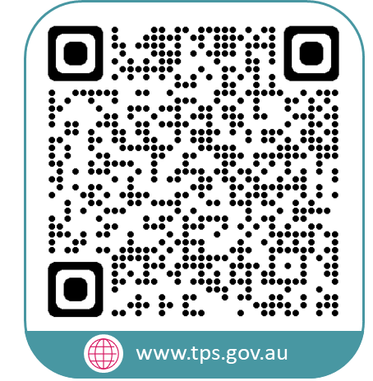


www.tps.gov.au
operations@tps.gov.au

Slide 23
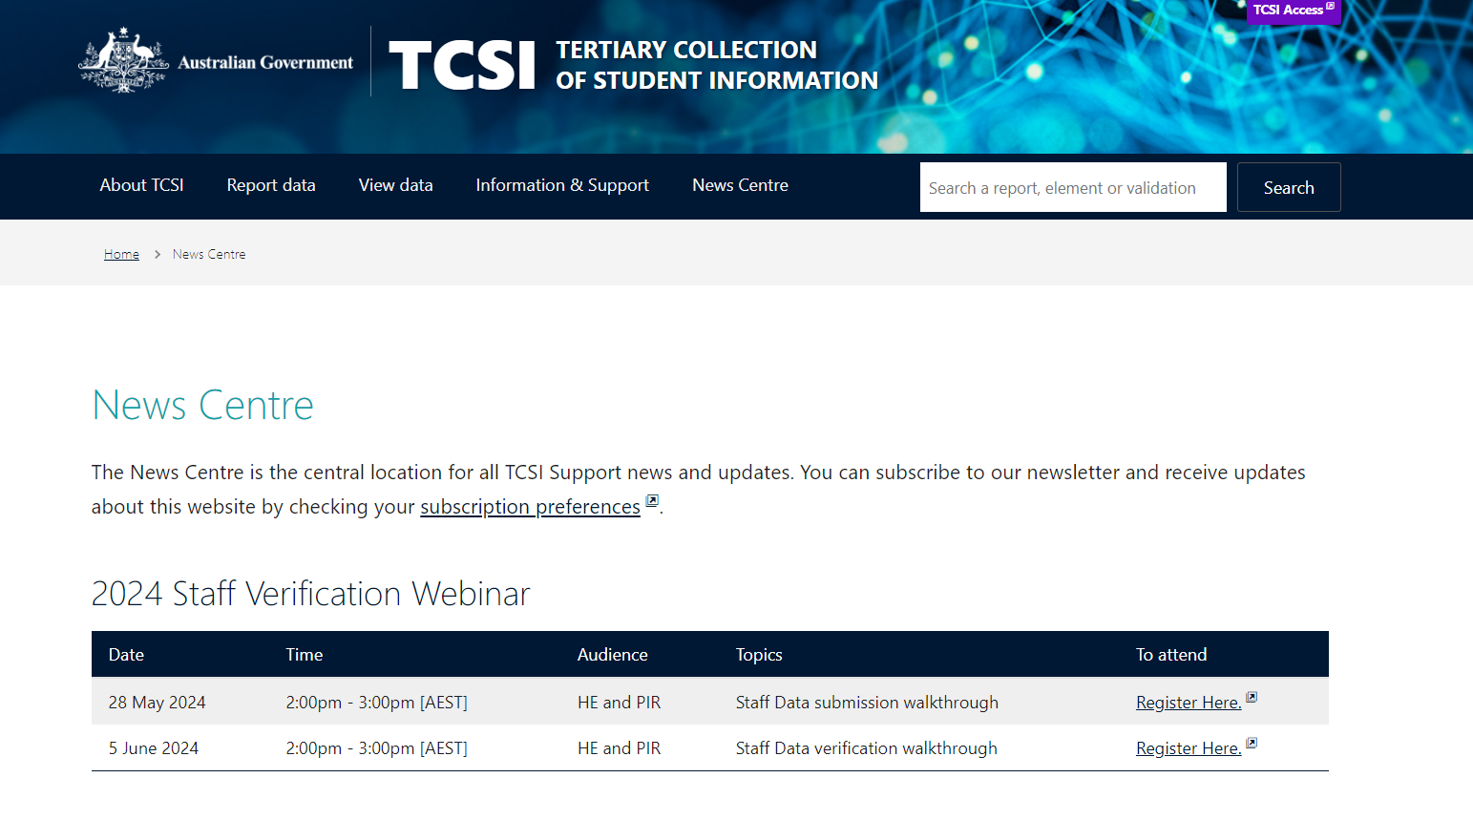
TCSI Update
Student concordance functionality is now in production
Newsletter and monthly webinar updates are www.TCSIsupport.gov.au/news

Slide 24
HELP Provider Workshops
We have recently had providers raise their interest in a HELP Provider Workshops event in 2024-25
We are looking into options for the format and timing
We are seeking insight from providers about their preferences for inclusions/format to help determine costs, content, viability etc

Slide 25
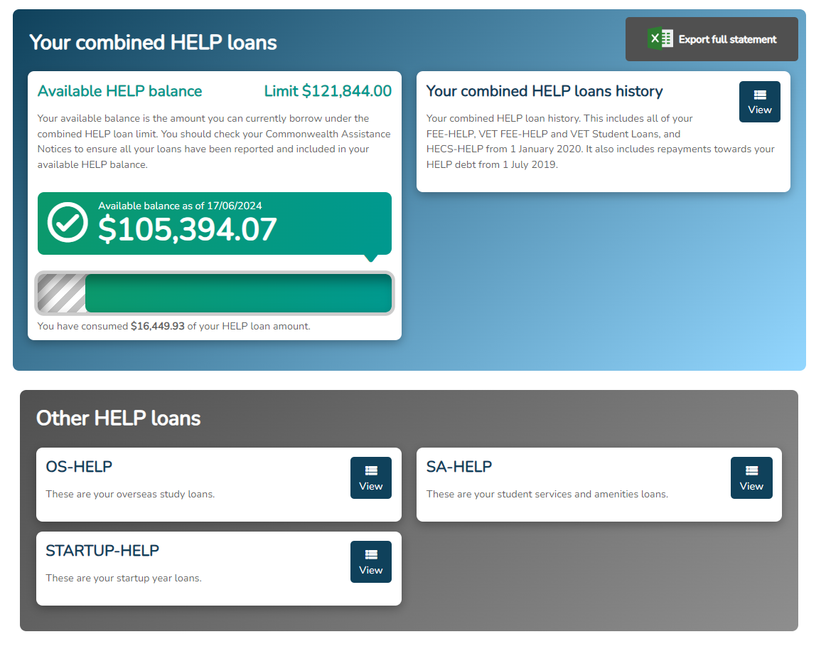
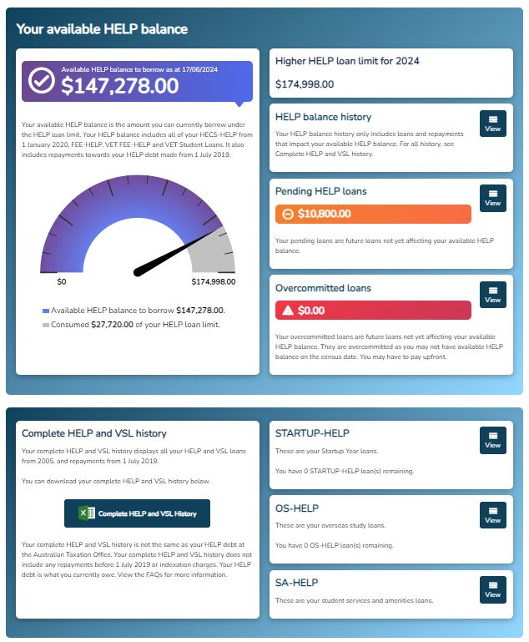
myHELPbalance website re-design
BEFORE
AFTER

Slide 26
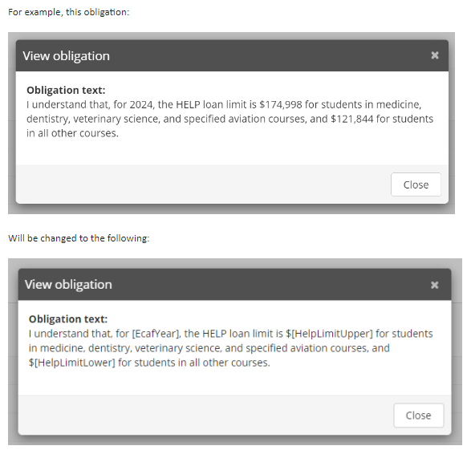
Government eCAF IT Project
Key project outputs – Last 6-months
Introduction of text tag references
Multi-Factor Authentication
Existing eCAF Corrections function
Legislative Changes
Academic Suitability in all HE eCAFs
Pacific Engagement Visa Type
System enhancements
Training environment – Set to expire button
System performance tuning
Duplicate eCAF Checking – Criteria update to
include NZ SCV
Re-direction of personal email address

Slide 27

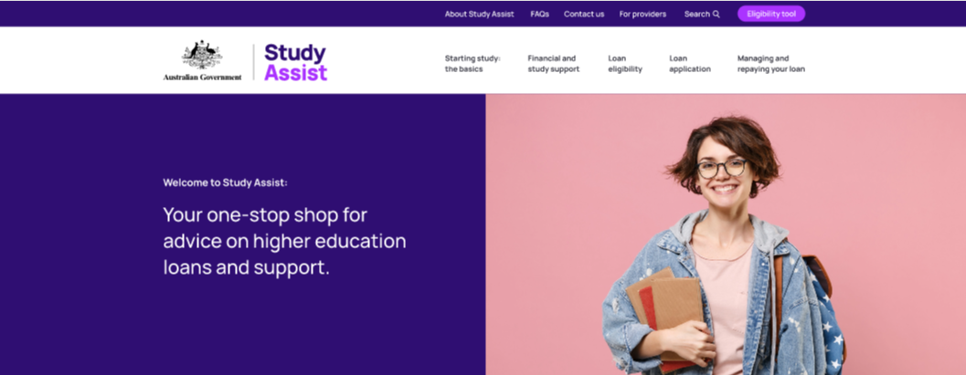

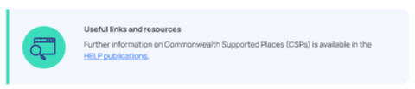

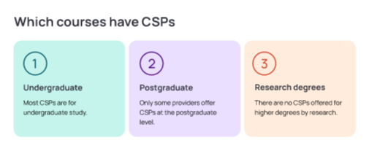
Redesign Project

Slide 28
Thank you all for attending
For questions or feedback, reach out to us at HEenquiries@education.gov.au
Subscribe to the provider updates at https://msg.dese.gov.au/subscribe-help-providers

