Slide 1
Western Sydney Technology College
International Students Information Session
March 2024
Tanya Benton-Hall
Case Management Team
www.tps.gov.au
Notes:
Good morning – introduce yourself
Thank you for joining us for this session
This information session is for the international students affected by the closure of Western Sydney Technology College
Session will be recorded and published on our website along with these slides

Slide 2
Purpose of this meeting
Inform students about how the Tuition Protection Service can assist
Present information on visa matters
Present information on getting a copy of your study record
Identify other assistance available
Show you how to use the TPS Online case management system
www.tps.gov.au
Notes:
During this session we will cover:
What the Tuition Protection Service is and how it can help you
Information relating to your student visa
How to get a copy of your student record
Other assistance available, such as Study New South Wales
How to use the TPS Online case management system

Slide 3
Western Sydney Technology College (Merage Group)
Western Sydney Technology College closed on Monday 11 March 2024
Western Sydney Technology College did not meet its obligations to students and the Tuition Protection Service (TPS) activated on Wednesday 13 March 2024
We will be working to arrange for you to continue your studies with an alternative provider, or provide you with a refund of your unspent tuition fees
www.tps.gov.au

Slide 4
What is the Tuition Protection Service (TPS)?
www.tps.gov.au

Slide 5
Tuition Protection Service (TPS)
Australian Government initiative within the Department of Education
Student tuition fee protection scheme
Supports students following an education provider closure by:
arranging for students to continue their studies with an alternative provider
or
providing students with a refund of unspent tuition fees
www.tps.gov.au
Notes:
The TPS is an Australian Government student tuition fee protection scheme operating within the Department of Education
We support students who are affected by an education provider closure to:
Continue studying with an alternative provider; or
Receive a refund of unspent tuition fees

Slide 6
TPS Operations Team
Led by TPS Director
Small team of around 16
Located in Canberra
www.tps.gov.au
Notes:
The TPS is a small team operating in Canberra

Slide 7
TPS Online system
TPS Online is the system you will use to request and receive TPS assistance
You can request a place with an alternative provider or request a refund in TPS Online
We will show you how to use TPS Online later in this presentation
TPS Online step-by-step instructions are on the TPS website
www.tps.gov.au
Notes:
You will use a system called ‘TPS Online’ to receive assistance from us
You can request a place with an alternative provider or request a refund of unspent tuition fees through TPS Online
We will show you how to use TPS Online later in this presentation
Access TPS Online from the TPS website home page (tps.gov.au)

Slide 8
Continuing your studies with an alternative provider
Our priority: To help you find a new education and training provider so you can continue your studies
TPS Online contains a list of alternative courses at different providers nearby
You will need to contact the new provider to enrol with them. The provider will upload an offer in TPS Online that you will need to accept. The TPS will pay what is owed to you by Western Sydney Technology College directly to your new provider
If you have already enrolled at a new education provider, you can receive a refund of your unspent tuition fees from the TPS through TPS Online
Alternative courses may cost more or less than your current course. If costs are higher, you will need to meet those costs
www.tps.gov.au
Notes:
Our priority is to find a different education and training provider where you can continue your studies
You will find alternative provider options identified by the TPS in your TPS Online account. You can find your own alternative provider to enrol with to continue your studies if you want to.
If you enrol in a new course which costs more than your current course, you will need to meet those costs

Slide 9
Unspent tuition fees
Unspent tuition fees are the fees that you paid to Western Sydney Technology College for education or training that you did not receive:
For example, if you paid for 10 weeks of tuition and only attended classes for 7 weeks, the remaining 3 weeks are your unspent tuition fees.
The TPS can provide you with a refund of any unspent tuition fees that were paid to Western Sydney Technology College for your tuition
If the TPS does not identify any suitable alternative courses for you, or if you have already enrolled at a new provider, you will receive a refund of your unspent tuition fees
www.tps.gov.au
Notes:
If the TPS does not find any alternative provider options for you, or if you choose to enrol with a different provider yourself, the TPS can provide you with a refund of your unspent tuition fees

Slide 10
Unspent tuition fees
Your refund can be paid to:
your personal bank account
another nominated bank account (e.g. a family member)
your new education provider (if you have secured a placement in an alternative course)
your education agent.
If you would like your agent to receive your refund on your behalf, you must request and return an Authority to Act form by emailing support@tps.gov.au
www.tps.gov.au
Notes:
We will pay your refund to your nominated bank account
Please note: If you want your refund to be paid into an account owned by your agent, you must email the TPS at support@tps.gov.au and request an Authority to Act form

Slide 11
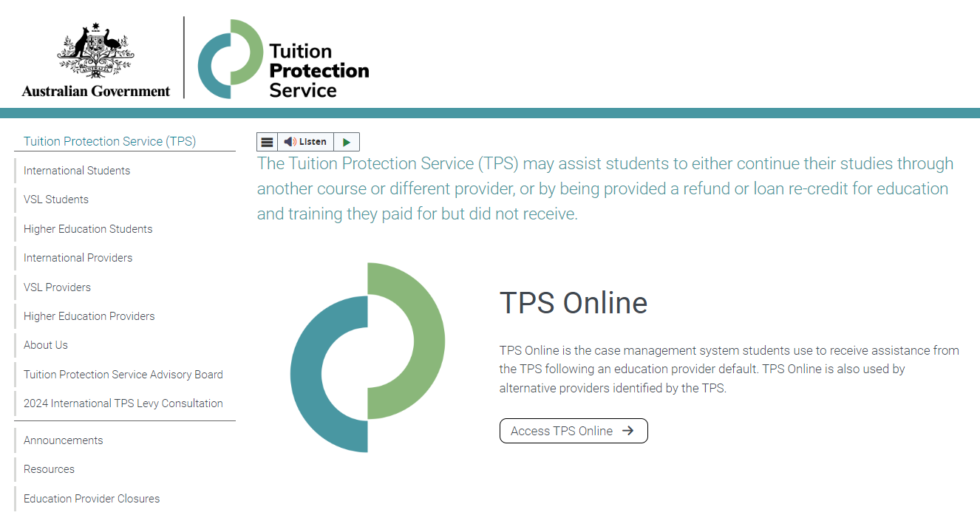
TPS website: www.tps.gov.au
For TPS Online, click on Access TPS Online
For information about the Western Sydney Technology College closure, click on Education Provider Closures
www.tps.gov.au
Notes:
Visit the TPS website at www.tps.gov.au to access TPS Online or find more information about Western Sydney Technology College
Western Sydney Technology College closure webpage:
There is a webpage on the TPS website specifically for students affected by the Western Sydney Technology College closure
Visit the TPS website then click on ‘Education Provider Closures’ (in the pink box on the left of your screen)
We will keep this webpage updated with important information and useful resources for you
A recording of this information session and the slides will also be published on that webpage

Slide 12
Visa Matters
Visa applications and status
Visa Application Charge exemption
Students under 18
Work conditions
Travelling home
Contacts and further information
Notes:
We are sharing information relating to your visa on behalf of the Department of Home Affairs
Any questions relating to your visa should be directed to the Department of Home Affairs.

Slide 13
Information session on education provider closures
Department of Home Affairs

Slide 14
What will we cover?
Visa applications and status
Visa Application Charge (VAC) exemption
Work conditions
Travelling home
Contacts and further information

Slide 15
What is my status?
International student visa holders need to maintain enrolment in a course that is registered on the Commonwealth Register of Institutions and Courses for Overseas Students (CRICOS) at all times while in Australia.
You can continue staying in Australia on your valid student visa if you enrol with another provider to study a course at the same level.
Students affected by a provider default are afforded an extended period of three months in which to finalise a new enrolment.
If you have a student visa application that has not yet been decided and your provider has closed, the Department of Home Affairs will contact you to request a new CoE from another provider. Your application will be assessed based on the new course you have chosen to study, and you will be afforded additional time to provide a new CoE.
Notes:
International student visa holders need to maintain enrolment in a course that is registered on the Commonwealth Register of Institutions and Courses for Overseas Students (CRICOS) at all times while in Australia.
You can travel outside Australia while waiting to be placed with a new provider as long as you return while your visa is valid.
You can continue staying in Australia on your valid student visa if you enrol with another provider to study a course at the same level.
Where a student is no longer enrolled in a registered course, the Department of Home Affairs would normally allow 28 days in which time a student could enrol with another education provider before the Department would consider visa cancellation.
Students affected by provider default are afforded an extended period of three months in which to finalise a new enrolment.
This is in acknowledgement that consumer protection processes may take longer than 28 days and that the situation is beyond the control of affected students.
Where the consumer protection mechanisms take more than three months, Department of Home Affairs may further extend its special arrangements on a case-by-case basis.
If you have a student visa application that has not yet been decided and your provider has closed, the Department of Home Affairs will contact you to request a new CoE from another provider. Your application will be assessed based on the new course you have chosen to study.
We will give you a chance to enrol in an alternative course if your education provider defaults after you have applied for a student visa but before we make a decision on your application.
Respond as quickly as you can to any request from your visa processing officer.
Send us information about your new enrolment as soon as possible.
Ensure you upload your information on your ImmiAccount as soon as it is available.

Slide 16
Do I need a new visa?
You will need to apply for a new student visa if:
You enrol in an alternative course, which will finish after the expiry date of your current student visa; or
You enrol in an alternative course that is at a lower Australian Qualification Framework (AQF) level than your previous course.
You can check the expiry date of your student visa by viewing your visa grant notice or by using the Visa Entitlement Verification Online (VEVO) service at https://immi.homeaffairs.gov.au/visas/already-have-a-visa/check-visa-details-and-conditions/check-conditions-online/visa-holders.
Notes:
If you require more time to finish your new course, or you move to a new course that is at a lower AQF level than your previous course, you must apply for a new student visa before your current visa expires or before you commence your lower AQF level course.
If your new course will finish after the expiry date of your current visa, you will need to apply for a new Student visa (subclass 500) before your current visa expires.
If you change to a lower AQF level course, you must apply for a new visa. If you do not, you are in breach of your visa condition and your visa may be cancelled.
For example: if you are changing from a Diploma level course to a Certificate 4 course, or if you change from a Bachelor Degree to an Advanced Diploma, you will need to apply for a new student visa as they are all lower AQF levels.
The only exception is if you are changing from an AQF level 10 course (doctoral degree) to an AQF level 9 course (masters degree), you will not need to apply for a new visa.
Student visa (subclass 570-575) holders must enrol in a course in the same sector or apply for a new Student visa (subclass 500).
You can check your visa expiry date by viewing your visa grant notice or by using the Department of Home Affairs’ Visa Entitlement Verification Online (VEVO) service, which is available on the Department’s website (link provided).

Slide 17
Do I need a new visa?
The Visa Application Charge (VAC) will be waived for students affected by an education provider closure if you apply within 12 months.
You must hold a student visa, or your last substantive visa must have been a student visa.
When you apply let us know you have been affected by a provider default and attach evidence of your enrolment with the new education provider, such as your CoE.
Notes:
There are arrangements in place to waive the Visa Application Charge (VAC) for students affected by an education provider closure who need to extend their stay in Australia, if they apply within 12 months.
You must hold a student visa, or your last substantive visa must have been a student visa.
Your family members will only be eligible for a VAC exemption if they are included in your application, not if they apply separately.
You might also be eligible for a VAC exemption if you apply for a Student Guardian visa (subclass 590) and the nominating student is affected by provider default.

Slide 18
Students under 18
You must maintain welfare arrangements at all times as a condition of your student visa if you are under 18.
If your education provider issued a Confirmation of Appropriate Accommodation and Welfare (CAAW) to take responsibility for your welfare in Australia, you must seek alternative enrolment immediately and make alternative welfare arrangements.
If you will turn 18 soon, you will still need to ensure you have appropriate arrangements in place until you turn 18.
Notes:
You must maintain welfare arrangements at all times as a condition of your student visa if you are under 18.
If you do not have appropriate welfare arrangements, you will be in breach of your visa conditions and your visa may be cancelled.
If you will be turning 18 soon but are still a minor at the time of closure, you still need appropriate welfare arrangements in place until you turn 18
If your education provider issued a Confirmation of Appropriate Accommodation and Welfare (CAAW) to take responsibility for your welfare in Australia, seek alternative enrolment immediately and make alternative welfare arrangements.

Slide 19
Work conditions
Condition 8105 – Work restriction
All student visa holders have this condition on their visa. Normally there are two main scenarios to consider:
Study has started – you can work 48 hours per fortnight
Study has not yet started – you cannot work if you have not commenced your course, unless you held a visa when you applied for your student visa and your previous visa permitted you to work.
If you are on a Bridging visa (BV), you will need to refer to the conditions attached to your BV regarding work and other conditions

Slide 20
Travelling home and delays
You can travel home and return to Australia while you arrange your enrolment and commencement in another course. You must have a valid student visa to enter Australia on your return.
If you have applied for a student visa and you are awaiting a decision, you must have a valid Bridging Visa B to travel.
Students affected by a provider default have up to three months to finalise a new enrolment.
If it takes longer than three months to finalise your enrolment, the Department of Home Affairs may further extend its special arrangements on a case-by-case basis. You must provide relevant information for consideration.
Notes:
If you are planning to travel overseas within the 3-month grace period, make sure all the necessary arrangements are in place re: obtaining educational assessments and updating TPS and Home Affairs with their contact details etc and perhaps identify potential new providers to enrol with and seek enrolment before you travel.
You could do these activities whilst you are overseas, but it could be that much harder. You will need to return to Australia before your current Student visa expires. And you need to provide a new COE within the 3-month period unless you can substantiate compelling circumstances, which would be assessed on a case-by-case basis.

Slide 21
Further information and contacts
Further information about your student visa: https://immi.homeaffairs.gov.au/visas/getting-a-visa/visa-listing/student-500
Queries or concerns about visa arrangements: http://www.homeaffairs.gov.au/
Specific information on education provider defaults: https://immi.homeaffairs.gov.au/visas/getting-a-visa/visa-listing/student-500/education-provider-default
Global Service Centre: 9am-5pm Monday to Friday
In Australia: 131 881
Overseas: +61 2 6196 0196

Slide 22
Australian Skills Quality Authority
Getting a copy of your study record
Notes:
You are strongly encouraged to obtain an up-to-date copy of your student record from Western Sydney Technology College for the units of study you have already completed
If you are unable to get a copy of your students records from Western Sydney Technology College, the Australian Skills Quality Authority (ASQA) may be able to help you
Unfortunately, the TPS cannot help you to get a copy of your student record

Slide 23
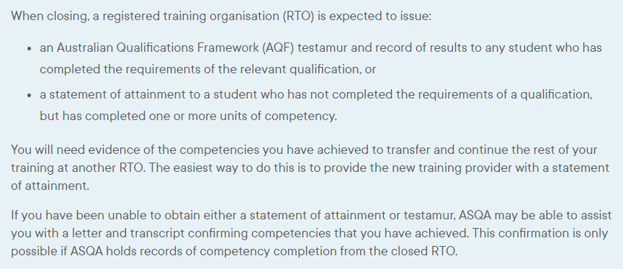
www.asqa.gov.au/students/student-record

Slide 24
Contact details for ASQA
www.asqa.gov.au/students/how-asqa-can-help-students
www.asqa.gov.au/students/student-record
Phone from in Australia: 1300 701 801 between 9am to 7pm (AEDT) Monday to Friday
Phone from outside Australia: +61 3 8613 3910

Slide 25
Study New South Wales
Support for international students
Notes:
Study NSW support services for international students are on the Study NSW website (www.study.nsw.gov.au)

Slide 26
https://www.study.nsw.gov.au/live/support-services

Slide 27
How to use TPS Online
Accessing TPS Online
Using TPS Online to receive assistance from the TPS
Summary of tasks you must complete in TPS Online
www.tps.gov.au
Notes:
I will now show you:
How to access TPS Online
How to use TPS Online to receive assistance from the TPS
A summary of the tasks you must complete in TPS Online to receive our help
We will run through a lot of information in the next few slides. Remember: A recording of this session and these slides will be published on the TPS website for you to access at any time.

Slide 28
TPS Online
Visit tps.gov.au and click on Access to TPS Online to be redirected to the TPS Online system.
www.tps.gov.au

Slide 29
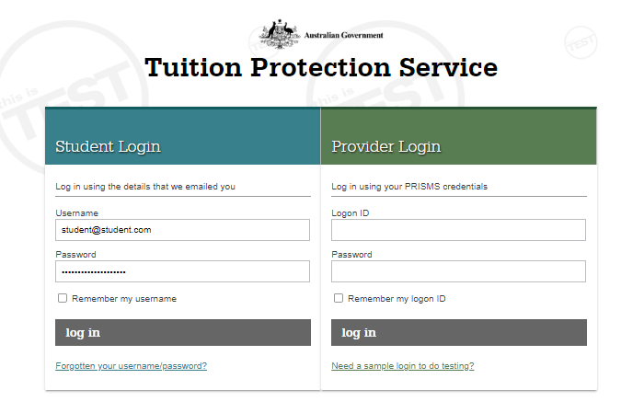
TPS Online: Log-in page
Log in using the username and password emailed to you from TPS Online.
If you have forgotten your log in details, click forgotten your username/password.
www.tps.gov.au

Slide 30
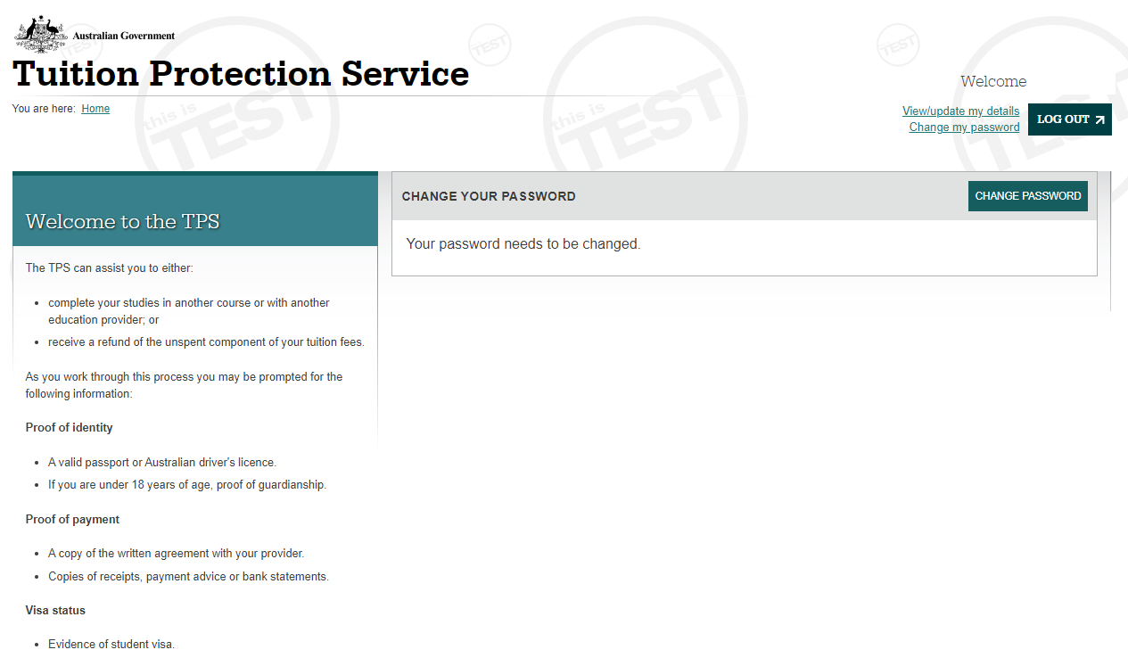
TPS Online: Change your password
You must change your password to continue.
www.tps.gov.au

Slide 31
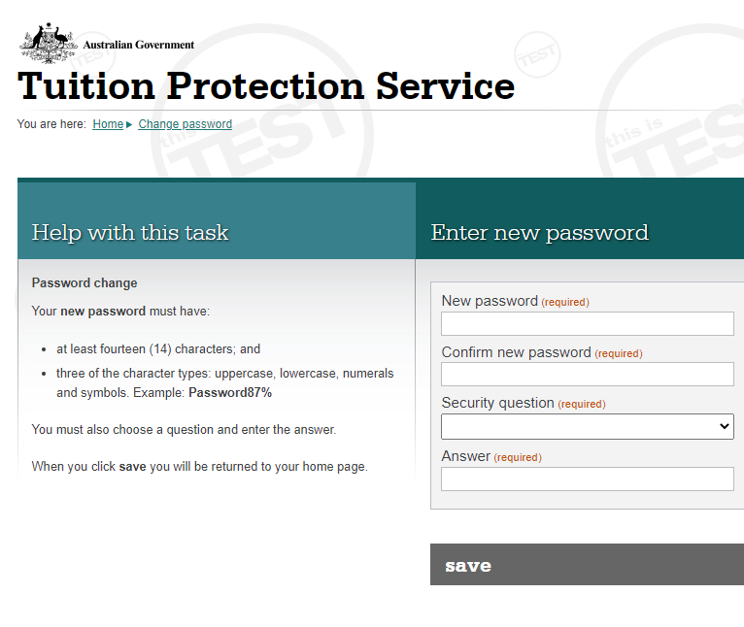
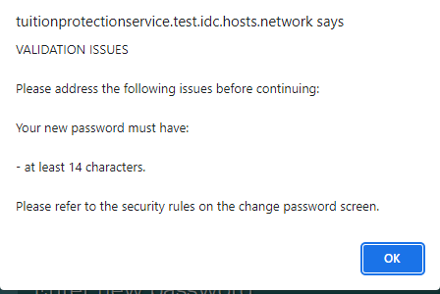
TPS Online: Change your password
Enter your new password twice
Choose a security question and answer
Click save.
Your new password must have fourteen (14) characters including uppercase and lowercase letters, numbers, and symbols (e.g. !, $ or #).
If your new password does not meet the criteria, you will see this message:
www.tps.gov.au

Slide 32
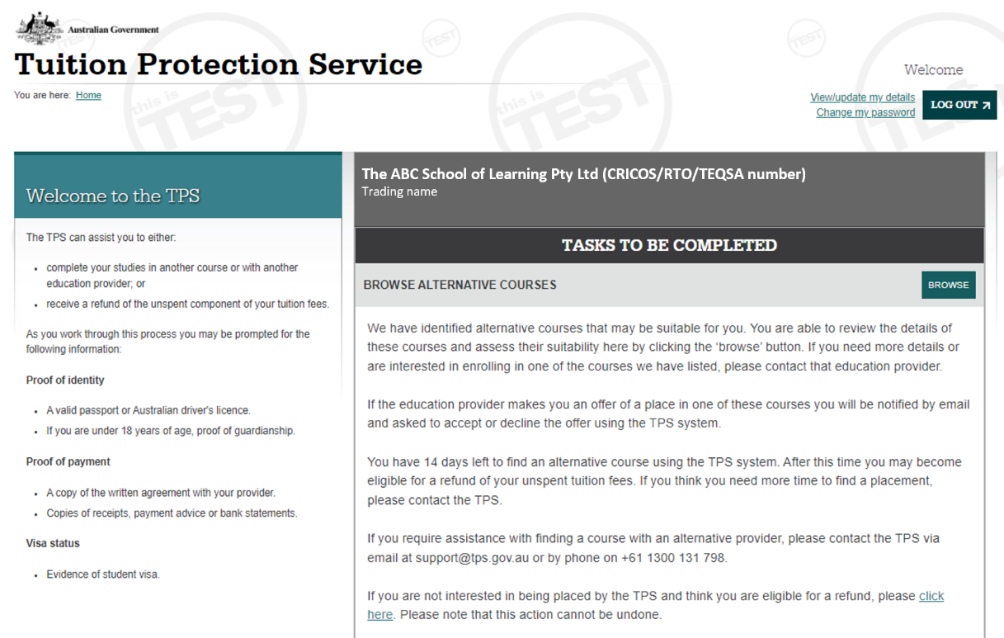
TPS Online: Home page
Your home page will list any tasks you need to complete to progress your claim with the TPS.
Check your home page regularly for tasks to complete!
www.tps.gov.au

Slide 33
TPS Online: Your provider’s obligation to you
It is important to know whether your provider owed you a refund of any unspent tuition fees at the date of the default and whether the provider fulfilled its obligations to you.
On your home page, click next on YOUR PROVIDER’S OBLIGATION TO YOU.
www.tps.gov.au

Slide 34
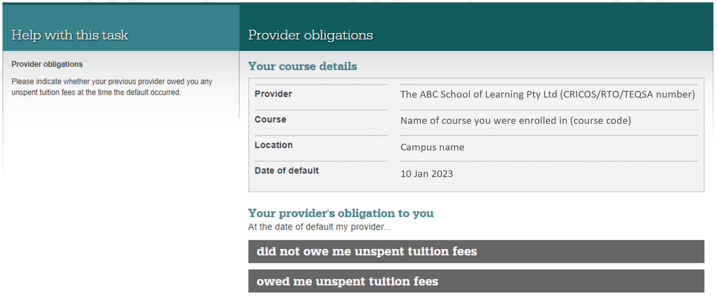
TPS Online: Your provider’s obligation to you
On the date of the default, did your provider owe you any unspent tuition fees?
If you select owed me unspent tuition fees, you will need to provide proof of payment documents.
If you select did not owe me unspent tuition fees, the financial assessment process will end. You will only be able to browse alternative courses.
www.tps.gov.au

Slide 35
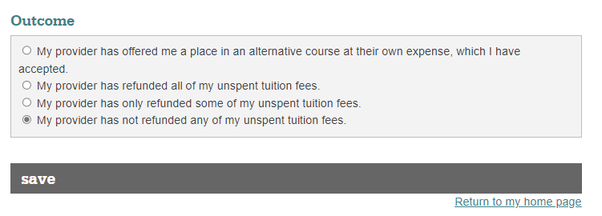
TPS Online: Your provider’s obligation to you
Select the option that applies to you.
Click save.
www.tps.gov.au

Slide 36
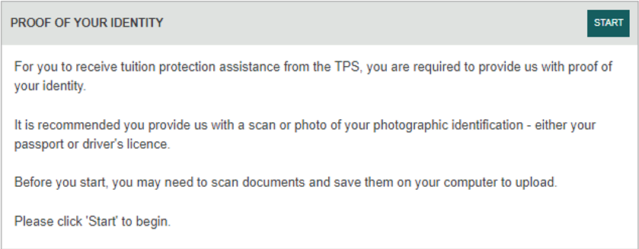
TPS Online: Proof of your identity
To receive any assistance from the TPS, you must provide proof of your identity.
On your home page, click start on PROOF OF YOUR IDENTITY.
www.tps.gov.au

Slide 37
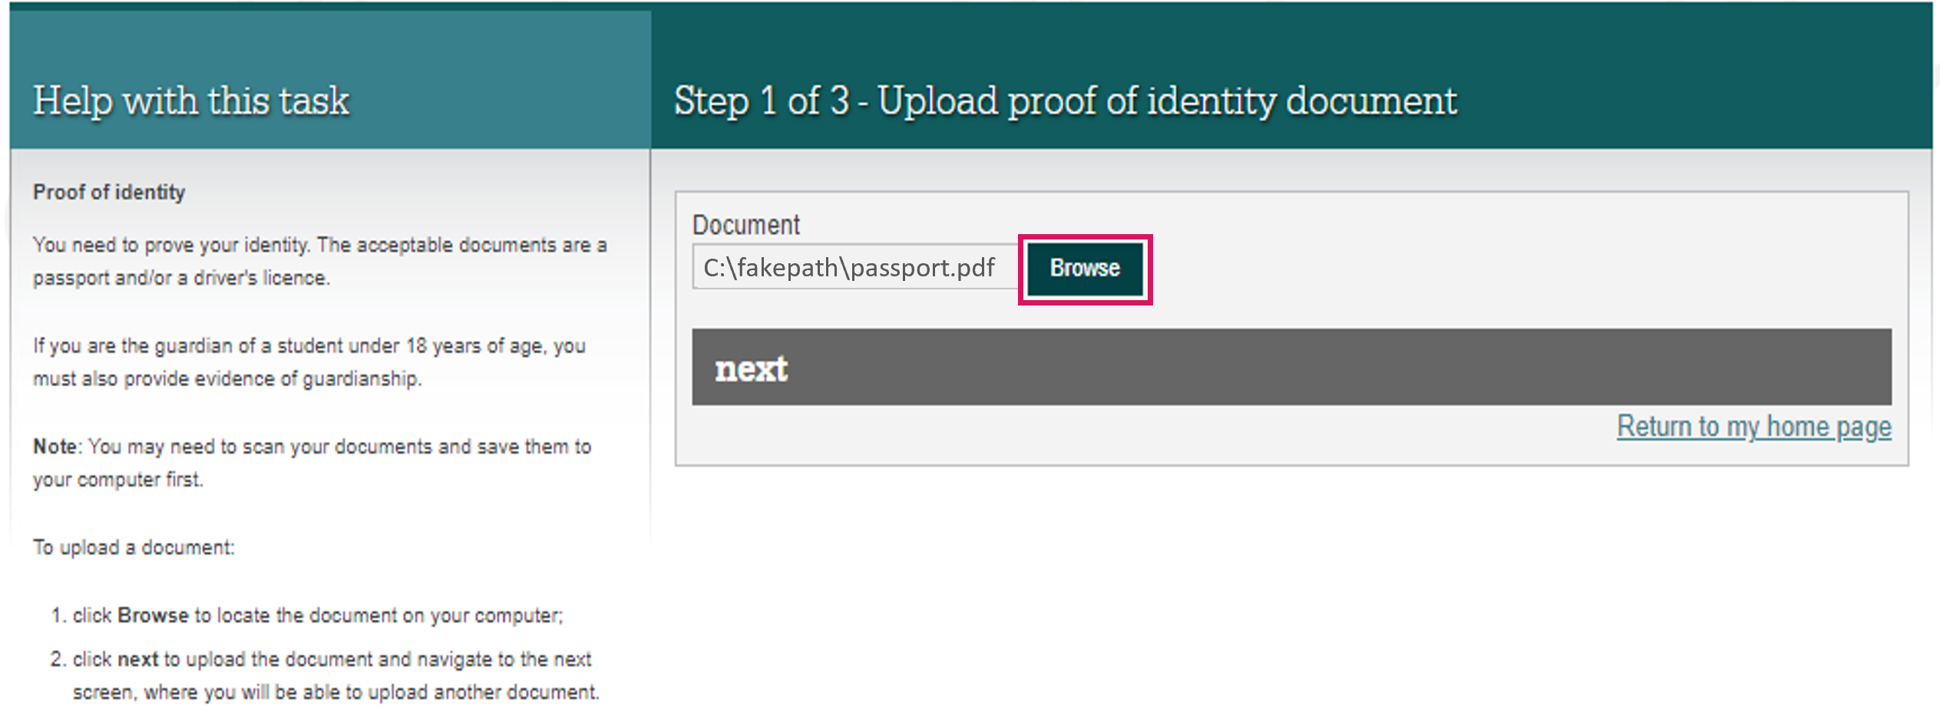
TPS Online: Upload your proof of identity document
You will need to upload a photo of your passport (preferable) or driver’s licence from your device to prove your identity.
Click browse and select the file you wish to upload
Click ok and then next.
www.tps.gov.au

Slide 38
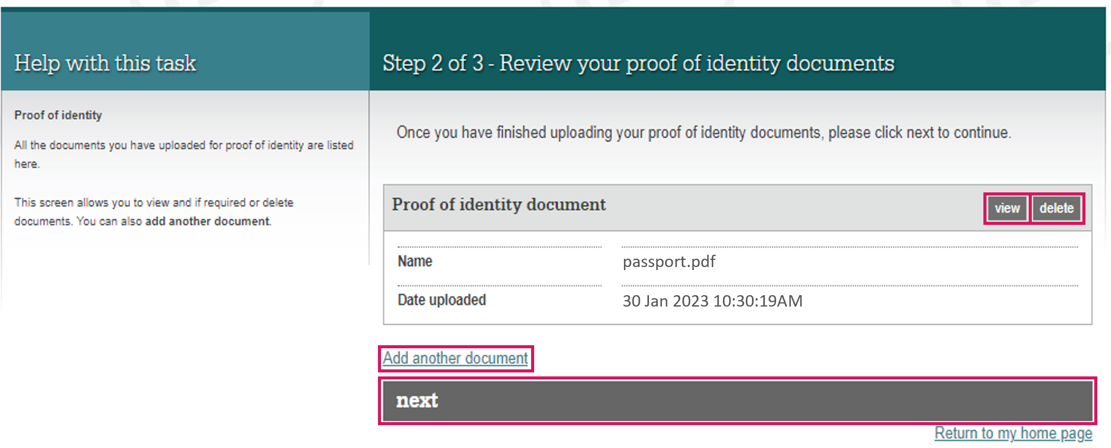
TPS Online: Review your proof of identity document
View the document you uploaded to make sure it is the right document.
If you have uploaded an incorrect document, click delete and then add another document.
If you are happy with the document, click next.
www.tps.gov.au

Slide 39
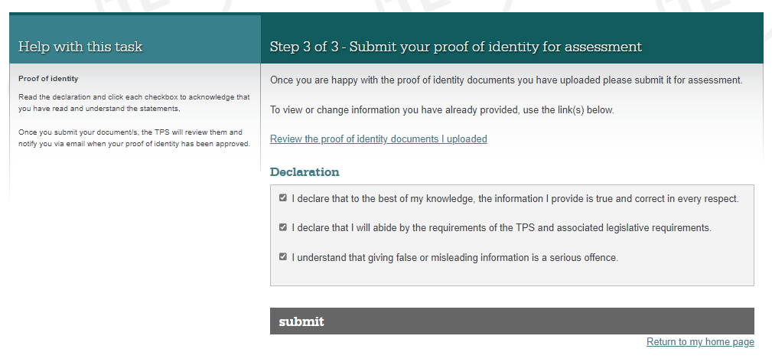
TPS Online: Submit your proof of identity document
Read the declaration.
If you are happy to proceed, tick all three boxes and click submit.
www.tps.gov.au

Slide 40
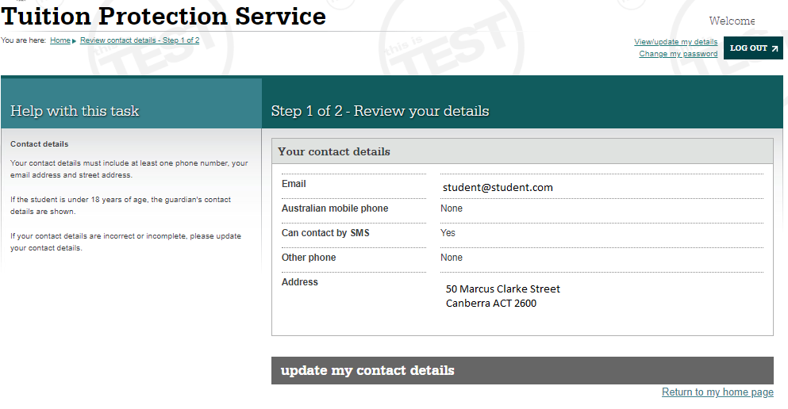
TPS Online: Review your contact details
The TPS will send you any notifications or requests using your contact details in TPS Online.
On your home page, click review on REVIEW YOUR CONTACT DETAILS to make sure your contact details are correct.
Click update my contact details.
www.tps.gov.au

Slide 41
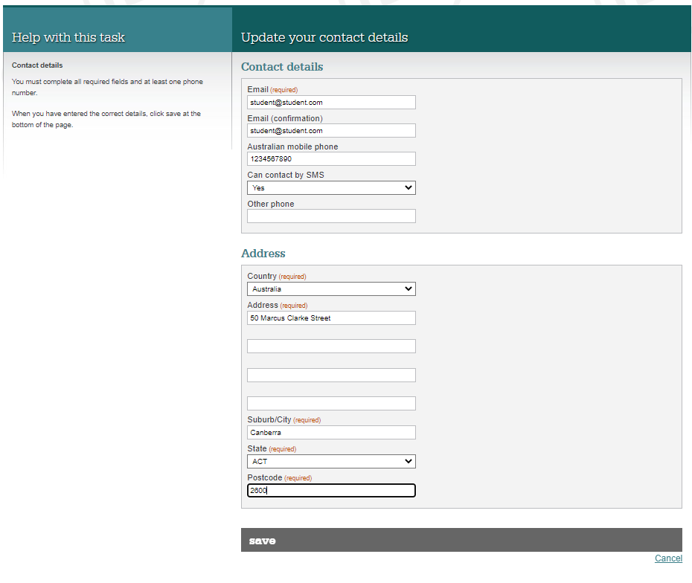
TPS Online: Update your contact details
Update your contact details and click save.
www.tps.gov.au

Slide 42
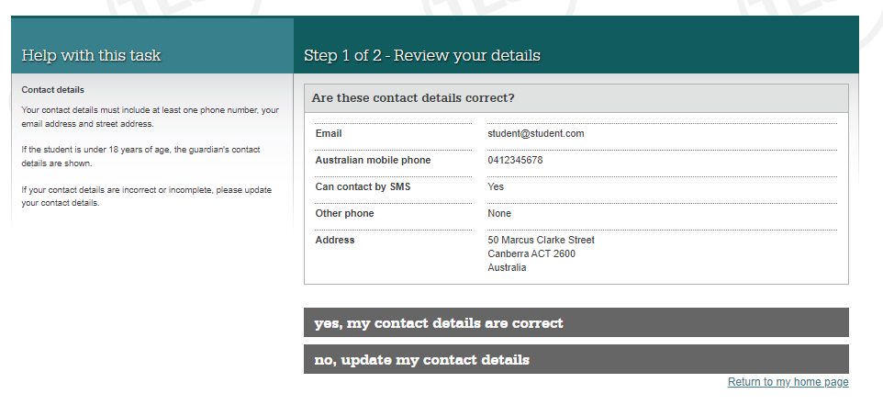
TPS Online: Review your contact details
After updating your contact details, you will be asked to confirm that they are correct.
www.tps.gov.au

Slide 43
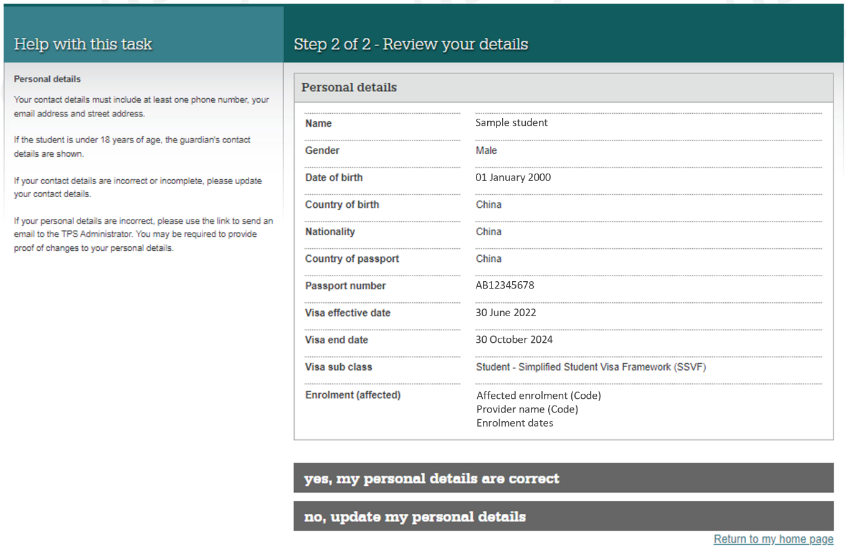
TPS Online: Review your contact details
If your details are correct, click yes, my personal details are correct.
If any of your details are incorrect, click on no, update my personal details. You will be advised to send an email to support@tps.gov.au.
www.tps.gov.au

Slide 44
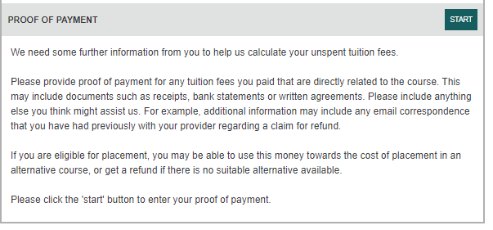
TPS Online: Proof of payment
If your provider owes you a refund of unspent tuition fees, you must submit proof of payment documents.
On your home page, click start on PROOF OF PAYMENT.
www.tps.gov.au

Slide 45
TPS Online: Proof of payment
Payments you made to your provider may have been recorded in our systems.
Click next to review our payment information.
www.tps.gov.au

Slide 46
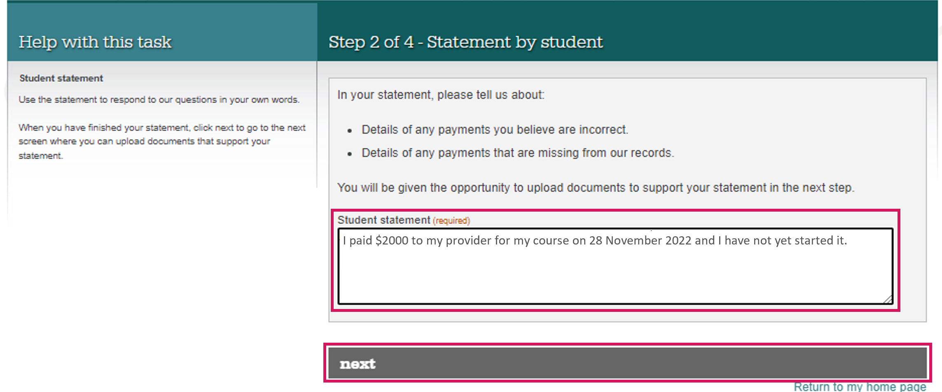
TPS Online: Proof of payment
In the student statement box, please provide:
details about all payments made to your provider (and your agent, if applicable) for your course; and
a brief explanation of your individual circumstances.
Click next to begin uploading documents to support your statement.
www.tps.gov.au

Slide 47
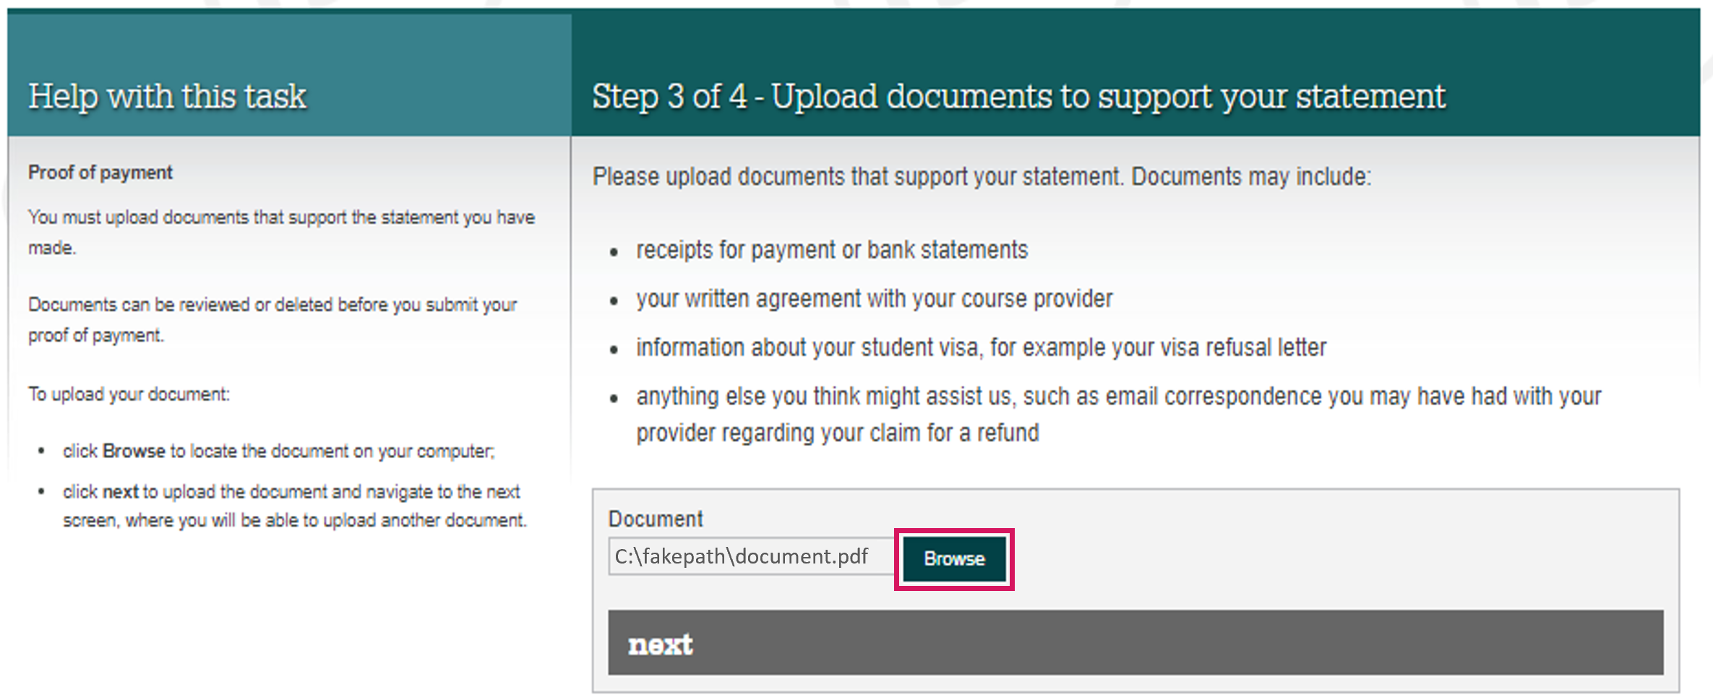
TPS Online: Proof of payment
Click browse to select documents to upload from your device.
Refer to the following checklist to ensure you upload all of the required documentation.
This task will be returned to you to upload additional documentation if necessary.
www.tps.gov.au

Slide 48
TPS Online: Proof of payment document checklist
You must upload the following documents for the TPS to calculate your unspent tuition fees:
Provider and bank receipts for all payments made to your provider for your course
Bank statements showing all payments made to your provider for your course. Bank statements must indicate who owns the bank account.
Letter of offer outlining all payments due to your provider for your course
Any other documentation (e.g. emails) that will assist us in assessing your financial claim.
Do you have an agent? If you have an agent, you must upload the following documentation:
Receipts or bank statements for all payments made to your agent
Receipts for all payments your agent made to your provider on your behalf. You may need to contact your agent to obtain these.
Agent commission statement or invoice. You may need to contact your agent to obtain these.
Did you defer your course? If you deferred your course, you must upload the following documentation:
Approval of deferment
Your deferment form
www.tps.gov.au

Slide 49
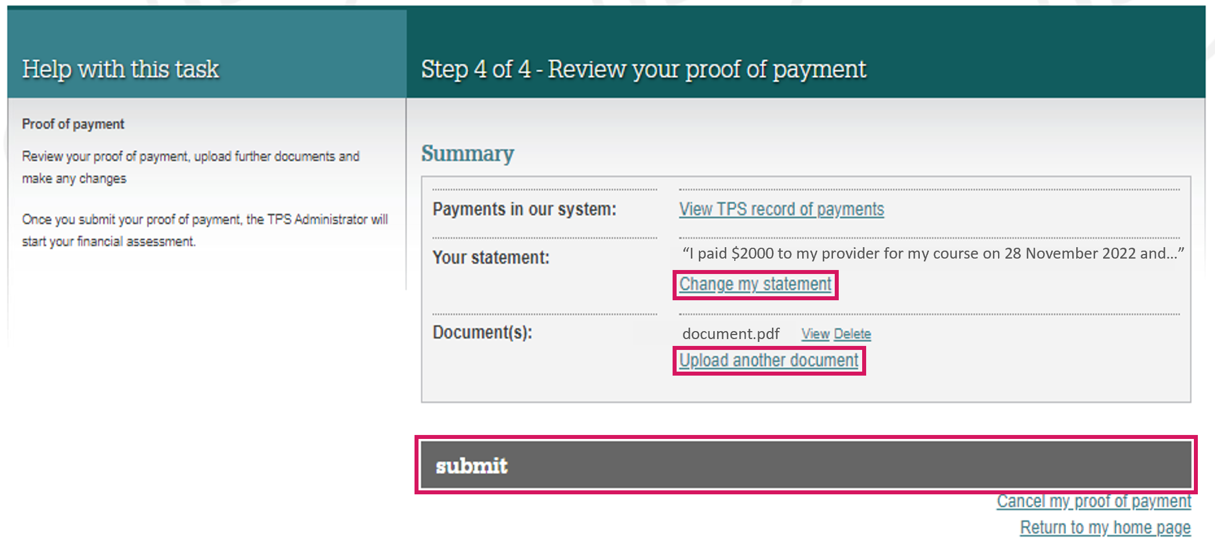
TPS Online: Proof of payment
Click next once you have uploaded all of the required documents.
Review your statement and your proof of payment documents.
To make any changes, click change my statement or upload another document.
Click submit to upload your statement and proof of payment documents.
www.tps.gov.au

Slide 50
TPS Online: Apply for a refund
If the TPS determines that you are eligible for a refund of unspent tuition fees, you will need to apply for a refund.
On your home page, click apply on APPLY FOR A REFUND.
www.tps.gov.au

Slide 51
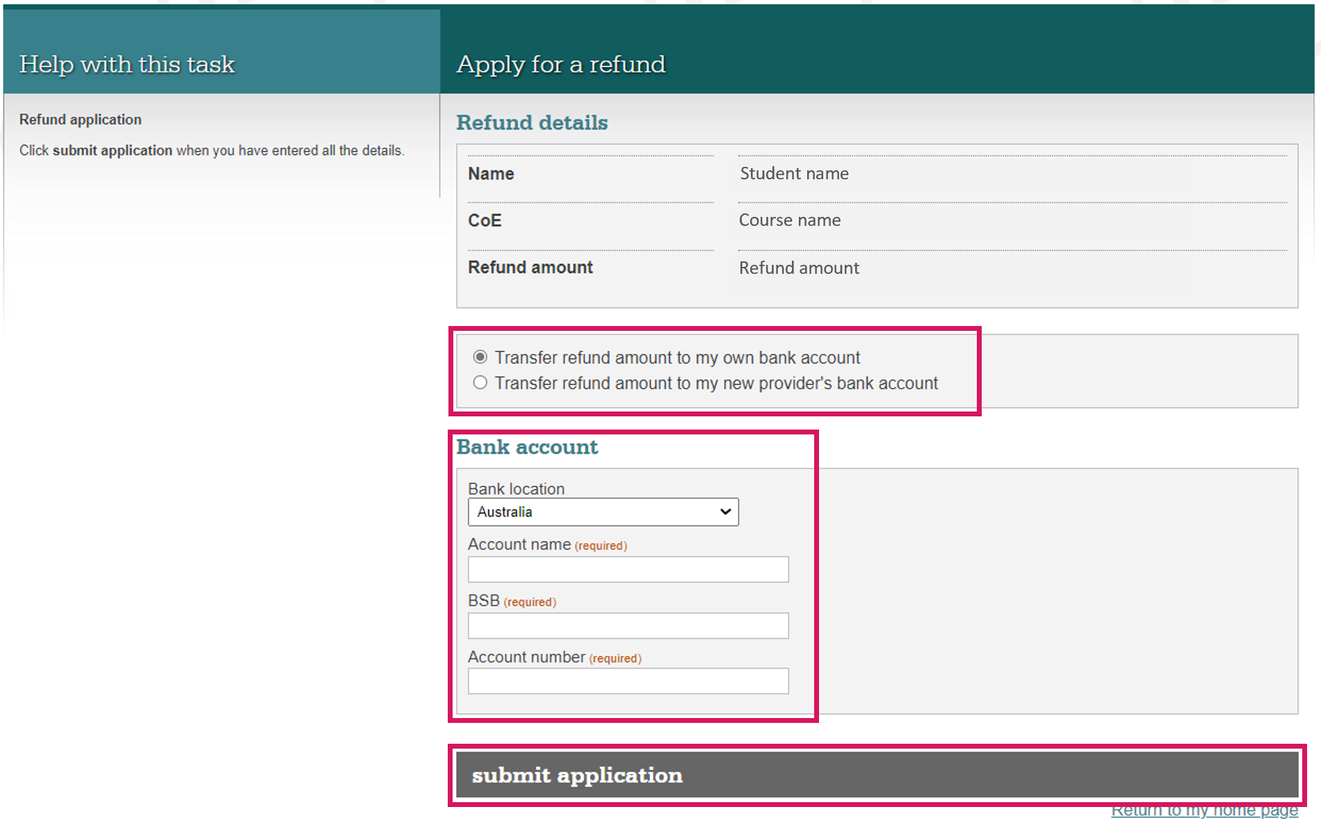
TPS Online: Apply for a refund
Select whether you would like the refund to be transferred to your own bank account or to your new provider (if applicable).
Provide the details of the bank account you would like your refund to be transferred to.
Check the information you have provided, then click submit application.
www.tps.gov.au

Slide 52
TPS Online: Browse alternative courses
On your home page, click browse on BROWSE ALTERNATIVE COURSES to view a list of suitable alternative course options.
Click on the course links to see information about the course and the contact details for the alternative provider.
www.tps.gov.au

Slide 53
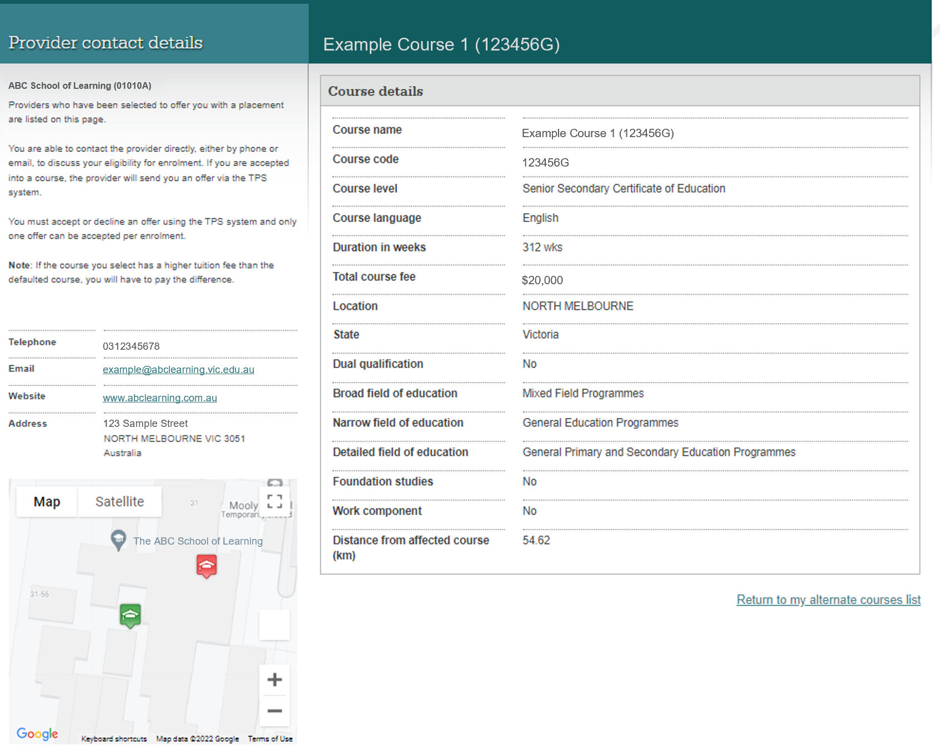
TPS Online: Alternative provider contact details
Contact the new provider to request enrolment using the contact details provided.
Your new provider will upload an offer in TPS Online. You must log into TPS Online and accept this offer.
www.tps.gov.au

Slide 54
TPS Online: Summary of tasks
Log in to TPS Online
Change your password
Indicate whether your provider owed you a refund of unspent tuition fees on the date of the closure
Provide proof of your identity
Update your contact details
If your provider owes you a refund of unspent tuition fees, upload your proof of payment documents
If you are eligible to receive a refund of unspent tuition fees, apply for a refund
Browse the alternative course list and contact alternative providers to request enrolment
View and accept your alternative course offer from your new provider
Check your emails and TPS Online regularly for notifications and tasks to complete. Be quick to respond to TPS requests!
www.tps.gov.au

Slide 55
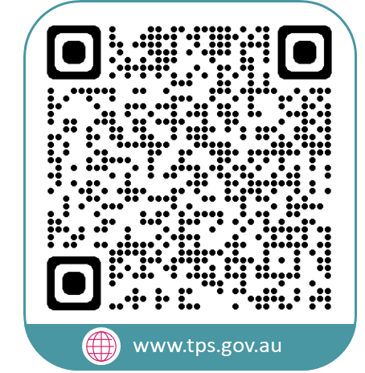
www.tps.gov.au
support@tps.gov.au
1300 131 798

