Slide 1
Draft 2024 International TPS Levy Consultation
Sector Consultation Feedback and FAQs
9 October 2023
Melinda Hatton
Tuition Protection Service Director
www.tps.gov.au
Notes:
Acknowledgement of Country
'I begin by acknowledging the Traditional Custodians of the land on which we meet today and pay my respects to their Elders past and present. I extend that respect to Aboriginal and Torres Strait Islander peoples here today.’
Canberra: lands of the Ngunnawal people

Slide 2
Outline
Tuition Protection Service – purpose, function and TPS Operations team
International TPS Levy – guiding principles and levy fund
Draft 2024 International TPS Levy settings
Summary of International Sector Consultation
Frequently Asked Questions
2024 International Levy Timeline and Information
www.tps.gov.au

Slide 3
Tuition Protection Service Purpose, function and TPS Operations team
www.tps.gov.au

Slide 4
Purpose of the Tuition Protection Service (TPS)
Australian Government initiative supported by federal Department of Education
Student tuition protection scheme that safeguards Australia’s reputation as an education destination
Developed for international student tuition fee protection and expanded to specified domestic student cohorts
Manages levy collections from registered education providers
Supports registered education providers to understand and meet obligations to students
Supports students with refunds and Government loan re-credits, and facilitates alternative course placements
www.tps.gov.au

Slide 5
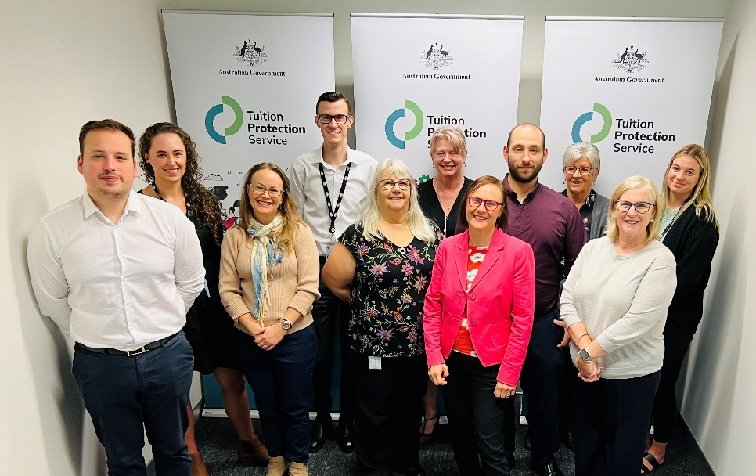
TPS Operations Team
Led by TPS Director
Small team of around 16
Located in Canberra
www.tps.gov.au

Slide 6
International TPS Levy Guiding principles and levy fund
www.tps.gov.au

Slide 7
International TPS Levy
An annual tuition protection levy collected from international education providers
Funds the student placement and refund activities of the TPS following an international education provider closure as well as TPS operational costs
Levy calculation based on an education provider’s size and risk of closure
Paid into the Overseas Students Tuition Fund (OSTF) – a quarantined account managed by the TPS Director
2022 International levy waived as a COVID-19 pandemic relief measure
TPS Advisory Board provides advice and makes recommendations to the TPS Director on the levy settings
www.tps.gov.au
Notes:
TPS Advisory Board provided its draft advice on the levy settings to the TPS Director at its August meeting
The Board will provide its final advice on the levy settings to the TPS Director at its October meeting - following this period of sector consultation and provision of consultation feedback to the Board

Slide 8
Guiding Principles for Levy Settings
Advice should reflect the overall risk environment and ensure that revenue sustains the relevant fund, while also being sustainable for the industry
The model for each levy should reflect gradual change and assist the industry with business planning by providing a stable regulatory environment
The model should be as simple and transparent as possible, preferably based on a small number of risk factors
Risk premiums should provide incentives for education providers to adopt positive behaviours
Additional imposts on industry, such as data collection, should be minimised as far as possible, consistent with the ability to set sound risk-based levies
www.tps.gov.au
Notes:
The TPS Advisory Board’s levy setting advice is guided by these principles.

Slide 9
Overseas Students Tuition Fund (OSTF)
International TPS Levy paid into the OSTF
Australian Government Actuary (AGA) recommends a target Fund range
Target range: $35-60 million
OSTF Mid-point: $47.5 million
Balance as at 30 June 2023: $45.8 million
www.tps.gov.au
Notes:
Below mid-point is not desirable:
Risk forecast
Potential increase in closures
Waived levy in 2022
There are a few ways to address this in 2024 levy settings
TPS Director is responsible for managing the Fund
Target range is recommended by the AGA and endorsed by the TPS Advisory Board. It guides the TPS Director in managing the Fund.
Ensures sufficient funds are available in the event of a large provider closure, or multiple provider closures
Current balance is below mid-point of target range
Balance as at 31 March 2023: $43.3 million ($4.2m below mid-point)
Balance as at 30 June 2023 (after 2023 levy collection): $45.8 million ($1.7m below mid-point)

Slide 10
International Levy – Comparison of Components 2013-2023
www.tps.gov.au
Notes:
2022 international levy waived as a Commonwealth Government COVID-19 relief measure
Base and Administrative Fee Component figures have reduced over time, except for the years when the figures were indexed
RRPC specified percentage has been either maintained or reduced each year
We will talk about this again later

Slide 11
International Levy – Average Payment per Provider 2013-2023
www.tps.gov.au
Notes:
2022 international levy waived by Australian Government as a COVID-19 relief measure
Data shows a decreasing trend in providers’ average international levy payment (blue line = total levy amount)

Slide 12
Draft 2024 International TPS Levy Settings
www.tps.gov.au

Slide 13
International TPS Levy Components
Component | Key elements | Purpose and authority
Administrative fee | Sum of a ‘per provider’ and ‘per student’ charge | Covers ongoing administrative costs Set by Minister for Education
Base fee | Sum of a ‘per provider’ and ‘per student’ charge | Maintains the Fund at a sustainable level Set by Minister for Education
Risk rated premium | Considers 5 risk factors and overseas student tuition fees for previous year | Reflects risk of provider closure Set by TPS Director with Board advice
Special tuition protection | Percentage multiplied by overseas student tuition fees for previous year | Charged when the Fund is below its target size Set by TPS Director with Board advice
www.tps.gov.au
Notes:
Administrative and Base Fee components
If the Minister does not make an Instrument for the administrative and base fee components, a CPI indexation will apply (see Section 8 of ESOS (TPS Levies) Act 2012)
Risk rated premium component
Determined annually by TPS Director in collaboration with the TPS Advisory Board, AGA and feedback from stakeholders
Risk factors designed to reflect the risk of a provider closure
Therefore, they are not equivalent to the risk assessments conducted by the regulators
Special tuition protection component
Charged in the initial years when the levy Fund is below its target size

Slide 14
Draft 2024 International Levy Settings
Administrative fee* | Base fee* | Risk rated premium | Special tuition protection
$99.00 per provider + $0.51 per 2023 international student enrolment | $199.00 per provider + $1.26 per 2023 international student enrolment | [0.05% x increase factor for each risk factor] x total 2023 overseas student tuition fees | 0% x total 2023 overseas student tuition fees
*Administrative and Base fee figures quoted were applied for the 2023 levy and will be indexed to CPI for the 2024 levy if the Minister decides not to make a legislative instrument
www.tps.gov.au
Notes:
Risk rated premium component specified percentage
Proposed increasing the ‘risk rated premium component’ specified percentage rather than the ‘special tuition protection component’ specified percentage because:
It’s risk-related
Proposed increase is a 0.01 percentage point increase (from 0.04% to 0.05%) – small, sensible and required
2024 levy calculated using 2023 international student enrolment numbers and overseas student tuition fee income received
Administrative and Base fee components
Figures quoted were applied for the 2023 levy
If the Minister for Education decides not to make a legislative instrument with new amounts, these figures will be indexed to CPI for the 2024 levy
Risk rated premium component
5 risk factors make up this component
‘Increase factors’ apply to providers for each risk factor
Increase factors are decimal amounts determined by where a provider sits in a given data set
The legislative instrument details each risk factor and their increase factors
The increase factors for each risk factor are added together to calculate a provider’s risk rated premium component

Slide 15
Risk Rated Premium Component: Risk Factors
Risk Factor 1 – Base risk factor
Base risk factor of 1 applied for all providers
Risk Factor 2 – Length of operation
Providers with a shorter length of operation present a higher risk of closure
Risk Factor 3 – Volatility in overseas student enrolments
Providers with extreme volatility in overseas student enrolments present a higher risk of closure
Risk Factor 4 – Maximum overseas source country concentration
Providers with diversified source countries of overseas students present a lesser risk of closure
Risk Factor 5 – Non-compliance and registration renewal
Penalises providers for late payment of the levy and/or CRICOS Annual Registration Charge, having sanctions imposed for non-compliance, and having registration renewed for a period less than the maximum allowable
www.tps.gov.au
Notes:
All risk factors were recommended by the AGA and endorsed by the Board
Data indicates a correlation between the risk factors and likelihood of provider closure

Slide 16
Risk Rated Premium Component: Formula
The following formula is calculated for each of the risk factors, then added together to form the risk rated premium component:
$$\left({Specified percentage \atop for the year} × \begin{matrix}Increase factor for the \\ risk factor for the year\end{matrix}\right) × \begin{matrix}Provider^{′}s overseas student tuition \\ fees for the previous year\end{matrix}$$
Example: (0.05% x 3.0) x $100,000 = 0.0015 x $100,000 = $150
www.tps.gov.au
Notes:
‘Increase factors’ apply to providers for each risk factor
Increase factors are decimal amounts determined by where a provider sits in a given data set
The legislative instrument details each risk factor and their increase factors
The increase factors for each risk factor are added together to calculate a provider’s risk rated premium component

Slide 17
Risk Rated Premium Component: Key Changes
Specified percentage increased from 0.04% to 0.05%
Maintaining the positive volatility increase factor waiver for the volatility in overseas student enrolments risk factor
First applied for 2023 levy
Recognition of the continued return of international students post-COVID-19
The Board will decide whether to reinstate the positive volatility increase factor for the 2025 levy
www.tps.gov.au
Notes:
Specified percentage increased to 0.05%
Maintaining specified percentage at 0.04% would have resulted in a carried deficit (based on expected 2024 levy collection amount and returning to pre-COVID claims levels)
Increase necessary to create a more robust Fund
Risk forecast
Missed levy collection in 2022
Increased closure costs
Maintaining positive volatility increase factor of 0%
Set to 0% for 2023 levy to avoid penalising providers with a high rate of growth in international student numbers post-COVID-19
Post-COVID-19 return of international students does not present the same risk as high rates of growth in a more normal environment
Maintaining this setting recognises the continued disruption to the market
The Board will decide whether to reinstate the increase factor for positive volatility for the 2025 levy
Note: Negative volatility increase factors were set to 0% for the 2021 levy as a concession to the impact of COVID-19 on international student numbers. Would have been maintained for 2022 levy, which was waived entirely for all international providers.

Slide 18
Risk Rated Premium Component: Key Changes
Considering new filter for providers whose ratio of international students constitute less than 20% of its total student population
To be applied to the volatility in overseas student enrolments and maximum overseas source country concentration risk factors
Eligible providers’ increase factors will be set to 0% for these risk factors
Already have filters for these risk factors, which only apply to providers that had either or both of the following apply in the previous year:
Had at least 20 overseas student enrolments
Received $400,000 or more in overseas student tuition fees
Providers with small proportions of international students are at less risk of closure and requiring support from TPS
www.tps.gov.au
Notes:
Fine tuning / nuancing of our risk settings
Implications: data collection trade off
Consideration of new filter
For providers whose ratio of international students constitute less than 20% of its total student population
Increase factors will be set to 0% for these providers for the volatility in overseas student enrolments and maximum overseas source country concentration risk factors
Already have filters for these risk factors
Only apply to providers with at least 20 overseas student enrolments and/or $400,000 in overseas student tuition fees for the previous year
Volatility in overseas student enrolments risk factor also only applicable to providers with a length of operation of 2 years or more
Why has this filter been proposed?
Due to findings from research, the TPS Advisory Board has considered further refinements for these risk factors
There are many leviable providers that cater for international and domestic students
The filter recognises that providers with a low proportion of international students to domestic students are at less risk of closure than providers who are reliant on international students

Slide 19
Risk Rated Premium Component: Key Changes
Considering new filter continued…
Due to a data lag, it is proposed that domestic enrolment numbers for the previous year will be added to the RFI and verified later
www.tps.gov.au
Notes:
How will it work?
Where we have data on providers’ international and domestic student numbers, we will use it to verify data provided, though domestic data is in most instances 12-18 months behind
We will send an RFI to providers to declare overseas student tuition fee income (which we have always done) and domestic student numbers (new information added to the RFI)
The yellow highlighted field shows how the new information will sit with the existing data in PRISMS
The data to view and supply will be updated each year. This year, 2022 will be prepopulated with existing data in PRISMS and providers will be requested to provide 2023 domestic enrolment numbers.
Enrolment data should always be equivalent full-time student enrolments
Are there any comments on this additional data request?

Slide 20
Special Tuition Protection Component
Charged when the Fund is below its target size
Calculated as follows:
$$\left.{Specified percentage \atop for the year} \right.× \begin{matrix}Provider^{′}s overseas student tuition \\ fees for the previous year\end{matrix}$$
Specified percentage for 2024: 0%
www.tps.gov.au

Slide 21
Summary of International Sector Consultation
www.tps.gov.au

Slide 22
International Sector Consultation
Consultation sessions held for CRICOS registered education providers from late August to late September to present the draft settings for the 2024 International TPS Levy
Feedback received from the consultations will be provided to the TPS Advisory Board ahead of its October 2023 meeting
A national webinar and 10 in-person consultation sessions were held in Melbourne, Brisbane, Perth, Sydney and Adelaide
Representatives from peak bodies and industry regulators were also consulted
www.tps.gov.au
Notes:
Peak bodies consulted
Independent Schools Australia (ISA)
Universities Australia
Australian Government Schools International (AGSI)
English Australia
International Education Association of Australia (IEAA)
Independent Higher Education Australia (IHEA) and Independent Tertiary Education Council Australia (ITECA) were not available for a meeting during the consultation period.
Regulators consulted
ASQA
TEQSA

Slide 23
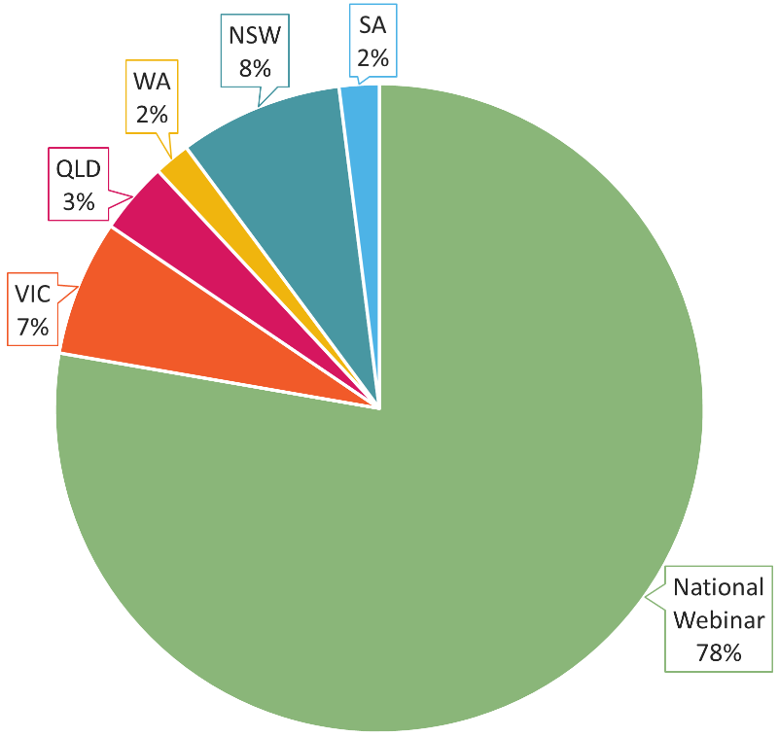
Consultation Session Attendance
Contacts listed in PRISMS for 1,391 leviable international providers were invited to the consultation sessions
503 individuals attended
78% attended the national webinar
22% attended the in-person sessions
www.tps.gov.au

Slide 24
Summary of Sector Consultation Feedback
Mixed feedback on return to pre-covid19 student enrolment levels
Providers were supportive of the new proportionality filter on risk factors:
volatility in overseas student enrolments, and
maximum overseas source country concentration
applied for providers whose proportion of international students constitute less than 20% of its total student population.
All supportive of extra data field request in RFI
Providers were understanding of the need to increase the specified percentage for the risk rated premium component of the levy from 0.04% to 0.05% and agreed that it was a measured response to ensuring the levy account balance was appropriate.
Providers appreciate being involved in the decision-making process and learning about how the levy is calculated
www.tps.gov.au
Notes:
International student enrolments not back to pre-COVID levels
Many providers noted increasing international student enrolments
Maintaining temporary waiver of an increase factor for positive volatility recognises this
Supportive of new proportionality filter
Overall, providers are comfortable with declaring their domestic student enrolment numbers for this filter to be applied
Increased specified percentage
A very minor increase of 0.01%
Necessary to create a more robust fund by ensuring the fund balance is at or above the mid-point of the target range
Providers appreciate being consulted

Slide 25
Frequently Asked Questions
www.tps.gov.au

Slide 26
Is the levy calculation consistent across all sectors of international education?
Yes
Levy setting Guiding Principle #3: The model should be as simple and transparent as possible
Developing separate levy calculations for CRICOS providers operating in different industries and/or sectors would result in a complex model
www.tps.gov.au
Notes:
The model should be as simple and transparent as possible
Separate levy calculations for CRICOS providers operating in different industries/sectors would make the levy model very complex
Each provider’s 2024 levy calculation will be different depending on:
their risk rating (determined by the provider’s increase factors for each risk factor); and
the total overseas student tuition fees received in the 2023 calendar year (used to calculate the risk rated premium component); and
their international student enrolments for the 2023 calendar year (used to calculate the administrative fee and base fee components).

Slide 27
Why has the specified percentage for the risk rated premium component of the levy been increased?
The Board has recommended increasing the specified percentage from 0.04% to 0.05% for the 2024 International TPS Levy
Maintaining the specified percentage at 0.04% would have resulted in a carried deficit (based on expected 2024 levy collection amount and returning to pre-COVID-19 claims levels)
An increase is necessary to ensure a robust fund, given the fund balance at 30 June 2023 was below the mid-point of the target fund range
www.tps.gov.au
Notes:
Maintaining specified percentage at 0.04% would have resulted in a carried deficit (based on expected 2024 levy collection amount and returning to pre-COVID claims levels)
Increase necessary to create a more robust Fund
An increase of 0.01% - small, sensible and required
Risk forecast
Missed levy collection in 2022
Increased closure costs

Slide 28
Are the levy calculation formulas publicly available? Where can I access them?
Levy calculation formulas are in the legislative instrument, which are made by 1 January each year
Name of instrument: Education Services for Overseas Students (TPS Levies) (Risk Rated Premium and Special Tuition Protection Components) Instrument
The legislative instrument and explanatory statement are published on the Federal Register of Legislation
Information is also provided on the TPS website
www.tps.gov.au
Notes:
Legislative Instrument
TPS website (and international levy fact sheet)

Slide 29
2024 International Levy Timeline and Information
www.tps.gov.au

Slide 30
2024 International Levy Timeline
August 2023
September 2023
October 2023
November 2023
December 2023
Feb – May 2024
4 August
Draft advice on 2024 international levy confirmed at TPS Advisory Board meeting
Mid-August
Draft advice letter published on TPS website
Meetings with peak bodies
Online information session for all providers
Late August
Information sessions in Melbourne
September
Information sessions in Brisbane, Perth, Sydney and Adelaide
Meetings with stakeholders in each state around information sessions
Late September
Meetings with providers and other stakeholders in NT
Early October
Online sector consultation feedback and FAQs session for all providers
18 October
Final advice on 2024 international levy confirmed at TPS Advisory Board meeting
Early November
Final advice letter published on TPS website
Mid-November
Legislative instrument drafted and sent to Treasurer with a noting brief sent to Minister for Education
Department of Education briefing for Administrative and Base Fee Components sent to Minister for Education
31 December
Legislative instrument must be signed off by Treasurer
February
Non-exempt providers receive a Request for Information to declare their 2023 overseas students tuition fee income
March
International providers receive levy estimate
April
International levy invoices sent to providers
May
International levy collected
www.tps.gov.au
Notes:
TPS conducts sector consultation on the draft levy settings
Sector feedback on the draft settings will be presented to Board before its 18 October meeting, when its final advice will be provided to the TPS Director

Slide 31
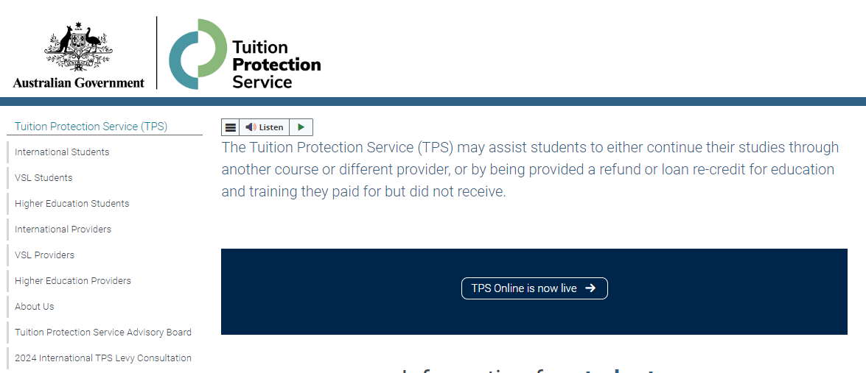
Further Information
Information and resources relating to international sector consultation are available on the TPS website: www.education.gov.au/tps/2024-international-tps-levy-consultation
www.tps.gov.au
Notes:
From the TPS homepage, click on the area highlighted pink to access the consultation webpage

Slide 32
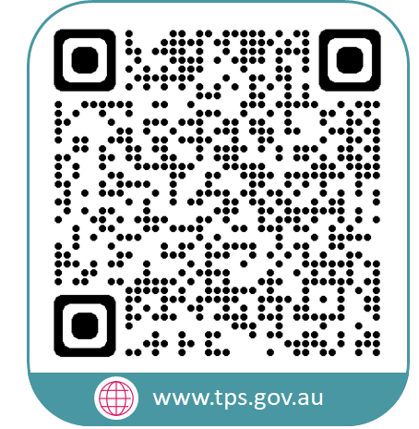
www.tps.gov.au
operations@tps.gov.au
Notes:
Thank you for participating in our consultation sessions. We value your feedback and the insight you can provide into the state of the international education and training sector.
Questions/feedback can be emailed to the TPS via operations@tps.gov.au

