Slide 1
Draft 2024 International TPS Levy
August/September 2023
Melinda Hatton
Tuition Protection Service Director
www.tps.gov.au
Notes:
Acknowledgement of Country
'I begin by acknowledging the Traditional Custodians of the land on which we meet today and pay my respects to their Elders past and present. I extend that respect to Aboriginal and Torres Strait Islander peoples here today.’
Canberra: lands of the Ngunnawal people
Sydney: lands of the Gadigal people of the Eora nation
Melbourne: lands of the Wurundjeri (wuh-run-jeh-ree) people of the Kulin (Kooh-lin) nation
Brisbane: lands of the Jagera (Yug-er-rah) and Turrbal (Tur-a-bul) peoples
Adelaide: lands of the Kaurna (Gar-nah) people
Perth: lands of the Whadjuk (Wod-juk) Noongar (noong-uh) people
Darwin: lands of the Larrakia (La-ruh-kee-ah) people
Hobart: lands of the Muwinina (Moo-we-nin-ah) people

Slide 2
Outline
Purpose and function of the Tuition Protection Service
TPS Director, Operations team and Advisory Board
International TPS Levy – guiding principles, framework and legislative authority
International TPS Levy collection overview
Draft 2024 International TPS Levy settings
2024 International Levy timeline and key takeaways
www.tps.gov.au

Slide 3
Purpose and function of the Tuition Protection Service
www.tps.gov.au

Slide 4
Purpose of the Tuition Protection Service (TPS)
Australian Government initiative supported by federal Department of Education
Student tuition protection scheme that safeguards Australia’s reputation as an education destination
Developed for international student tuition fee protection and expanded to specified domestic student cohorts
Manages levy collections from registered education providers
Supports registered education providers to understand and meet obligations to students
Supports students with refunds and Government loan re-credits, and facilitates alternative course placements
www.tps.gov.au

Slide 5
TPS Director, Operations Team and Advisory Board
www.tps.gov.au

Slide 6
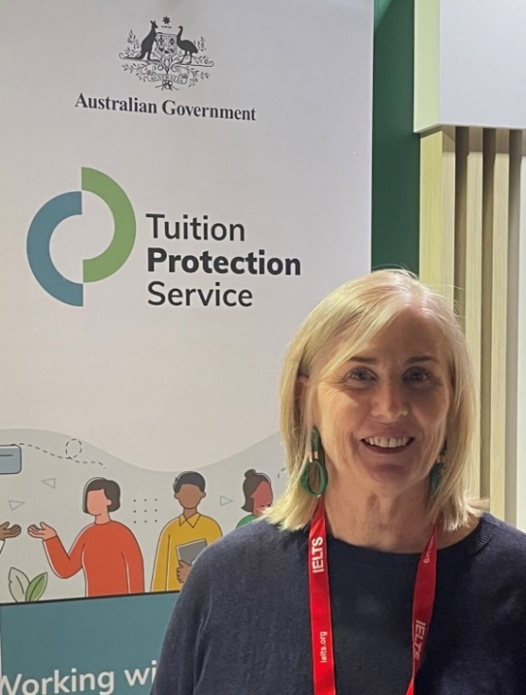
Tuition Protection Service Director
Melinda Hatton, TPS Director
Statutory office holder appointed by the federal Minister for Education
Operational oversight over the daily activities of the TPS
Responsible for the annual collection of tuition protection levies from CRICOS and eligible domestic education providers
Responsible under law for managing the levy funds
www.tps.gov.au

Slide 7
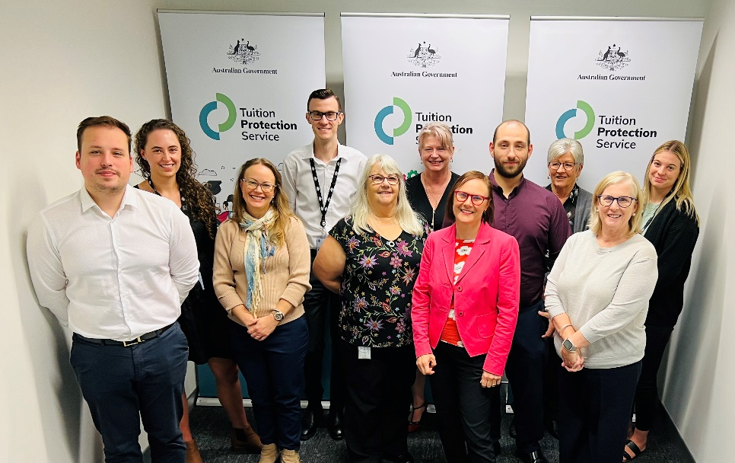
TPS Operations Team
Led by TPS Director
Small team of around 16
Located in Canberra
www.tps.gov.au

Slide 8
TPS Advisory Board
View Board member profiles at
www.tps.gov.au
Ms Helen Zimmerman (Chair)
Dr Kevin Donnelly AM (Deputy Chair)
Ms Jenny Lambert
The Hon Phil Honeywood
Ms Sharon Robertson
Ms Karen Sandercock, Australian Government Department of Education
Mr Matthew Hardy, Australian Government Department of Employment and Workplace Relations
Mr Guy Thorburn, Australian Government Actuary
Ms Gloria Yu, Australian Prudential Regulation Authority
Mr Daniel Frewer, Australian Government Department of Finance
Ms Alison Garrod, Australian Government Department of Home Affairs (acting)
www.tps.gov.au
Notes:
Names in italics are members’ whose terms have recently expired. Their reappointment is currently being considered. If they are not reappointed, new independent members will be appointed to replace them.

Slide 9
International TPS Levy Guiding principles, framework and legislative authority
www.tps.gov.au

Slide 10
International TPS Levy
An annual tuition protection levy collected from international education providers
Funds the student placement and refund activities of the TPS following an international education provider closure as well as TPS operational costs
Levy calculation based on an education provider’s size and risk of closure
Paid into the Overseas Students Tuition Fund (OSTF) – a quarantined account managed by the TPS Director
2022 International levy waived as a COVID-19 pandemic relief measure
TPS Advisory Board provides advice and makes recommendations to the TPS Director on the levy settings
www.tps.gov.au
Notes:
TPS Advisory Board provided its draft advice on the levy settings to the TPS Director at its August meeting
The Board will provide its final advice on the levy settings to the TPS Director at its October meeting - following this period of sector consultation and provision of consultation feedback to the Board

Slide 11
TPS Advisory Board’s Levy Setting Advice
When formulating its advice, the Board considers a range of factors including:
The strategic risk environment
Advice from the Australian Government Actuary (AGA)
Views of the sector regulators and industry peak bodies
Continuing impacts of the COVID-19 pandemic
The balance of the OSTF and the quantum of funds required for its long-term sustainability
www.tps.gov.au

Slide 12
Guiding Principles for Levy Settings
Advice should reflect the overall risk environment and ensure that revenue sustains the relevant fund, while also being sustainable for the industry
The model for each levy should reflect gradual change and assist the industry with business planning by providing a stable regulatory environment
The model should be as simple and transparent as possible, preferably based on a small number of risk factors
Risk premiums should provide incentives for education providers to adopt positive behaviours
Additional imposts on industry, such as data collection, should be minimised as far as possible, consistent with the ability to set sound risk-based levies
www.tps.gov.au
Notes:
The TPS Advisory Board’s levy setting advice is guided by these principles.

Slide 13
TPS Levy Framework
Developed by the Australian Government Actuary (AGA)
AGA provides advice on levy settings to ensure the arrangements are financially sound
Annual international levy settings are set through two legislative instruments:
one for the Administrative Fee component and Base Fee component (made by the Minister for Education)
one for the Risk Rated Premium component and Special Tuition Protection component (made by the TPS Director)
www.tps.gov.au
Notes:
AGA’s advice
Data-based
Focussed on the risk rated premium component – particularly the risk factors and justification for their application
Considers environmental factors for the sector (e.g. COVID-19)
Recommends a target range for the Fund’s balance
4 TPS levies
TPS collects 4 sector-based tuition protection levies each year
Providers operating across multiple education sectors pay separate levies for each sector
Collected at different times during the year

Slide 14
Legislative Authority
Education Services for Overseas Students Act 2000 https://www.legislation.gov.au/Series/C2004A00757
www.tps.gov.au

Slide 15
International TPS Levy Collection Overview
www.tps.gov.au

Slide 16
Overseas Students Tuition Fund (OSTF)
International TPS Levy paid into the OSTF
Australian Government Actuary (AGA) recommends a target Fund range
Target range: $35-60 million
OSTF Mid-point: $47.5 million
Balance as at 30 June 2023: $45.8 million
www.tps.gov.au
Notes:
TPS Director is responsible for managing the Fund
Target range is recommended by the AGA and endorsed by the TPS Advisory Board. It guides the TPS Director in managing the Fund.
Ensures sufficient funds are available in the event of a large provider closure, or multiple provider closures
Current balance is below mid-point of target range
Balance as at 31 March 2023: $43.3 million (below mid-point)
Balance as at 30 June 2023 (after 2023 levy collection): $45.8 million (still below mid-point)

Slide 17
International Levy – Comparison of Components 2013-2023
www.tps.gov.au
Notes:
2022 international levy waived as a Commonwealth Government COVID-19 relief measure
Base and Administrative Fee Component figures have reduced over time, except for the years when the figures were indexed
RRPC specified percentage has been either maintained or reduced each year
We will talk about this again later

Slide 18
International Levy – Average Payment per Provider 2013-2023
www.tps.gov.au
Notes:
2022 international levy waived by Australian Government as a COVID-19 relief measure
Data shows a decreasing trend in providers’ average international levy payment (blue line = total levy amount)

Slide 19
Draft 2024 International TPS Levy Settings
www.tps.gov.au

Slide 20
International TPS Levy Components
Component | Key elements | Purpose and authority
Administrative fee | Sum of a ‘per provider’ and ‘per student’ charge | Covers ongoing administrative costs Set by Minister for Education
Base fee | Sum of a ‘per provider’ and ‘per student’ charge | Maintains the Fund at a sustainable level Set by Minister for Education
Risk rated premium | Considers 5 risk factors and overseas student tuition fees for previous year | Reflects risk of provider closure Set by TPS Director with Board advice
Special tuition protection | Percentage multiplied by overseas student tuition fees for previous year | Charged when the Fund is below its target size Set by TPS Director with Board advice
www.tps.gov.au
Notes:
Administrative and Base Fee components
If the Minister does not make an Instrument for the administrative and base fee components, a CPI indexation will apply (see Section 8 of ESOS (TPS Levies) Act 2012)
Risk rated premium component
Determined annually by TPS Director in collaboration with the TPS Advisory Board, AGA and feedback from stakeholders
Risk factors designed to reflect the risk of a provider closure
Therefore, they are not equivalent to the risk assessments conducted by the regulators
Special tuition protection component
Charged in the initial years when the levy Fund is below its target size

Slide 21
Risk Rated Premium Component: Risk Factors
Risk Factor 1 – Base risk factor
Base risk factor of 1 applied for all providers
Risk Factor 2 – Length of operation
Providers with a shorter length of operation present a higher risk of closure
Risk Factor 3 – Volatility in overseas student enrolments
Providers with extreme volatility in overseas student enrolments present a higher risk of closure
Risk Factor 4 – Maximum overseas source country concentration
Providers with diversified source countries of overseas students present a lesser risk of closure
Risk Factor 5 – Non-compliance and registration renewal
Penalises providers for late payment of the levy, having sanctions imposed for non-compliance, and having registration renewed for a period less than the maximum allowable
www.tps.gov.au
Notes:
All risk factors were recommended by the AGA and endorsed by the Board
Data indicates a correlation between the risk factors and likelihood of provider closure

Slide 22
Draft 2024 International Levy Settings
Administrative fee* | Base fee* | Risk rated premium | Special tuition protection
$99.00 per provider + $0.51 per 2023 international student enrolment | $199.00 per provider + $1.26 per 2023 international student enrolment | [0.05% x increase factor for each risk factor] x total 2023 overseas student tuition fees | 0% x total 2023 overseas student tuition fees
*Administrative and Base fee figures quoted were applied for the 2023 levy and will be indexed to CPI for the 2024 levy if the Minister decides not to make a legislative instrument
www.tps.gov.au
Notes:
2024 levy calculated using 2023 international student enrolment numbers and overseas student tuition fee income received
Administrative and Base fee components
Figures quoted were applied for the 2023 levy
If the Minister for Education decides not to make a legislative instrument with new amounts, these figures will be indexed to CPI for the 2024 levy
Risk rated premium component
5 risk factors make up this component
‘Increase factors’ apply to providers for each risk factor
Increase factors are decimal amounts determined by where a provider sits in a given data set
The legislative instrument details each risk factor and their increase factors
The increase factors for each risk factor are added together to calculate a provider’s risk rated premium component

Slide 23
Risk Rated Premium Component
The following formula is calculated for each of the risk factors, then added together to form the risk rated premium component
$$\left({Specified percentage \atop for the year} × \begin{matrix}Increase factor for the \\ risk factor for the year\end{matrix}\right) × \begin{matrix}Provider^{′}s overseas student tuition \\ fees for the previous year\end{matrix}$$
Specified percentage for 2024: 0.05%
‘Increase factors’ are decimal amounts determined by where a provider sits in a given data set for each risk factor
www.tps.gov.au
Notes:
‘Increase factors’ apply to providers for each risk factor
Increase factors are decimal amounts determined by where a provider sits in a given data set
The legislative instrument details each risk factor and their increase factors
The increase factors for each risk factor are added together to calculate a provider’s risk rated premium component

Slide 24
Risk Rated Premium Component Specified Percentage
Year | Specified Percentage | Year | Specified Percentage
2013 | 0.155% | 2019 | 0.07%
2014 | 0.155% | 2020 | 0.07%
2015 | 0.155% | 2021 | 0.04%
2016 | 0.10% | 2022 | 0% (waived)
2017 | 0.08% | 2023 | 0.04%
2018 | 0.07% | 2024 | 0.05%
www.tps.gov.au
Notes:
First year specified percentage has increased

Slide 25
Risk Rated Premium Component: Key Points
Specified percentage increased from 0.04% to 0.05%
Maintaining the positive volatility increase factor waiver for the volatility in overseas student enrolments risk factor
First applied for 2023 levy
Recognition of the continued return of international students post-COVID-19
The Board will decide whether to reinstate the positive volatility increase factor for the 2025 levy
www.tps.gov.au
Notes:
Specified percentage increased to 0.05%
Maintaining specified percentage at 0.04% would have resulted in a deficit (based on expected 2024 levy collection amount and returning to pre-COVID claims levels)
Increase necessary to create a more robust Fund
Risk forecast
Missed levy collection in 2022
Increased closure costs
Maintaining positive volatility waiver
Waived for 2023 levy to avoid penalising providers with a high rate of growth in international student numbers post-COVID-19
Post-COVID-19 return of international students does not present the same risk as high rates of growth in a more normal environment
Maintaining waiver recognises the continued disruption to the market
The Board will decide whether to reinstate the increase factor for positive volatility for the 2025 levy
(Note: Negative volatility increase factors were waived for 2021 levy as a concession to the impact of COVID-19 on international student numbers)

Slide 26
Risk Rated Premium Component: Key Points
Considering new filter for providers whose ratio of international students constitute less than 20% of its total student population
To be applied to the volatility in overseas student enrolments and maximum overseas source country concentration risk factors
Eligible providers’ increase factors will be set to 0% for these risk factors
Already have filters for these risk factors, which only apply to providers that had either or both of the following apply in the previous year:
Had at least 20 overseas student enrolments
Received $400,000 or more in overseas student tuition fees
Providers with small proportions of international students are at less risk of closure and requiring support from TPS
www.tps.gov.au
Notes:
Consideration of new filter
For providers whose ratio of international students constitute less than 20% of its total student population
Increase factors will be set to 0% for these providers for the volatility in overseas student enrolments and maximum overseas source country concentration risk factors
Already have filters for these risk factors
Only apply to providers with at least 20 overseas student enrolments and/or $400,000 in overseas student tuition fees for the previous year
Volatility in overseas student enrolments risk factor also only applicable to providers with a length of operation of at least 2 years
Why has this filter been proposed?
Due to findings from research, the TPS Advisory Board has recommended further refinements for these risk factors
There are many leviable providers that cater for international and domestic students
The filter recognises that providers with a low proportion of international students to domestic students are at less risk of closure than providers who are reliant on international students
How will it work?
Where we have data on providers’ international and domestic student numbers, we will use it
We may need to send an RFI to providers to declare international and domestic student numbers

Slide 27
Special Tuition Protection Component
Charged when the Fund is below its target size
Calculated as follows:
$$\left.{Specified percentage \atop for the year} \right.× \begin{matrix}Provider^{′}s overseas student tuition \\ fees for the previous year\end{matrix}$$
Specified percentage for 2024: 0%
www.tps.gov.au

Slide 28
Legislative Instruments
See the legislative instruments for the 2023 international levy for further information on levy components and calculations:
Education Services for Overseas Students (TPS Levies) (Risk Rated Premium and Special Tuition Protection Components) Instrument 2022 https://www.legislation.gov.au/Details/F2022L01724
Education Services for Overseas Students (TPS Levies) (Administrative and Base Fees) Determination 2022 https://www.legislation.gov.au/Details/F2022L01674
Instruments must be made by 1 January each year
Instruments published on the Federal Register of Legislation
www.tps.gov.au

Slide 29
2024 International Levy Timeline and Key Takeaways
www.tps.gov.au

Slide 30
2024 International Levy Timeline
August 2023
September 2023
October 2023
November 2023
December 2023
Feb – May 2024
4 August
Draft advice on 2024 international levy confirmed at TPS Advisory Board meeting
Mid-August
Draft advice letter published on TPS website
Meetings with peak bodies
Online information session for all providers
Late August
Information sessions in Melbourne
Meetings with providers and other stakeholders in TAS
September
Information sessions in Perth, Brisbane, Sydney and Adelaide
Meetings with stakeholders in each state around information sessions
Mid-September
Meetings with providers and other stakeholders in NT
Early October
Online feedback session for all providers
18 October
Final advice on 2024 international levy confirmed at TPS Advisory Board meeting
Early November
Final advice letter published on TPS website
Mid-November
Legislative instrument drafted and sent to Treasurer with a noting brief sent to Minister for Education
Department of Education briefing for Administrative and Base Fee Components sent to Minister for Education
31 December
Legislative instrument must be signed off by Treasurer
February
Non-exempt providers receive a Request for Information to declare their 2023 overseas students tuition fee income
March
International providers receive levy estimate
April
International levy invoices sent to providers
May
International levy collected
www.tps.gov.au
Notes:
TPS conducts sector consultation on the draft levy settings
Sector feedback on the draft settings will be presented to Board before its October meeting, when its final advice will be provided to the TPS Director

Slide 31
Key Takeaways
Please ensure all contacts and student enrolment data are up to date in PRISMS
Timeline estimates levy will be collected in May 2024
Key features of the Board’s draft advice on 2024 levy settings:
Specified percentage of the risk rated premium component increased to 0.05%
Temporary waiver of the positive volatility increase factor maintained for the volatility in overseas student enrolments risk factor
Consideration of new filter applied to the volatility in overseas student enrolments and maximum overseas source country concentration risk factors for providers whose international students constitute less than 20% of its total student population
Feedback on draft 2024 levy settings will be presented to the Board
www.tps.gov.au

Slide 32
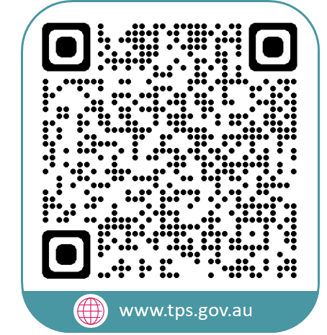
www.tps.gov.au
operations@tps.gov.au
Notes:
Questions/feedback can be emailed to the TPS via operations@tps.gov.au

