Slide 1
Pacific Training Group Closure
Education Agents Information Session
July 2023
Mirah Lambert
Director, Program Management
www.tps.gov.au

Slide 2
Outline
Tuition Protection Service (TPS)
Visa matters (Home Affairs)
Student records (ASQA)
Study Queensland, Study Gold Coast and Study New South Wales
How to use TPS Online
www.tps.gov.au

Slide 3
Purpose of this meeting
Inform education agents of how the Tuition Protection Service can assist students
Present information on visa matters
Present information on getting a copy of a student’s study records
Identify other assistance available
www.tps.gov.au

Slide 4
Pacific Training Group (OHS Media Services Pty Ltd)
Pacific Training Group ceased delivering courses to students on Wednesday 19 July 2023
Pacific Training Group did not meet its obligations to students and the Tuition Protection Service (TPS) activated on Friday 21 July 2023
We will be working to arrange for students to continue their studies with an alternative provider, or provide students with a refund of their unspent tuition fees
www.tps.gov.au

Slide 5
What is the Tuition Protection Service (TPS)?
www.tps.gov.au

Slide 6
Tuition Protection Service (TPS)
Australian Government initiative within the Department of Education
Student tuition fee protection scheme
Supports students following an education provider closure by:
arranging for students to continue their studies with an alternative provider; or
providing students with a refund of unspent tuition fees
www.tps.gov.au

Slide 7
TPS Operations Team
Led by TPS Director
Small team of around 16
Located in Canberra
www.tps.gov.au

Slide 8
TPS Online system
TPS Online is the system used to request and receive TPS assistance
Students, or agents on students’ behalf, can request a place with an alternative provider or request a refund in TPS Online
We will show you how to use TPS Online later in this presentation
TPS Online step-by-step instructions are on the TPS website
If a student would like their agent to act on their behalf in TPS Online, the student must request and return an Authority to Act form by emailing support@tps.gov.au
www.tps.gov.au
Notes:
Access TPS Online from the TPS website home page

Slide 9
Continuing studies with an alternative provider
Our priority: to help students find a new education and training provider so they can continue their studies
TPS Online contains a list of alternative courses at different providers nearby
Students will need to contact the new provider to enrol with them. The provider will upload an offer in TPS Online that students will need to accept. The TPS will pay what is owed to the student by Pacific Training Group directly to the new provider
If a student has already enrolled at a new education provider, the TPS can pay their unspent tuition fees through TPS Online
www.tps.gov.au

Slide 10
Unspent tuition fees
Unspent tuition fees are the fees that were paid to Pacific Training Group for education or training that a student did not receive:
For example, if 10 weeks of tuition were paid and a student only attended classes for 7 weeks, the remaining 3 weeks are their unspent tuition fees.
The TPS can provide students with a refund of any unspent tuition fees that were paid to Pacific Training Group for their tuition
www.tps.gov.au

Slide 11
Unspent tuition fees
A student’s refund can be deposited to:
their personal bank account
another nominated bank account (for example: a family member)
their new education provider (if they have secured a placement in an alternative course)
their education agent.
If a student would like their agent to receive their refund on their behalf, the student must request and return an Authority to Act form by emailing support@tps.gov.au
www.tps.gov.au

Slide 12
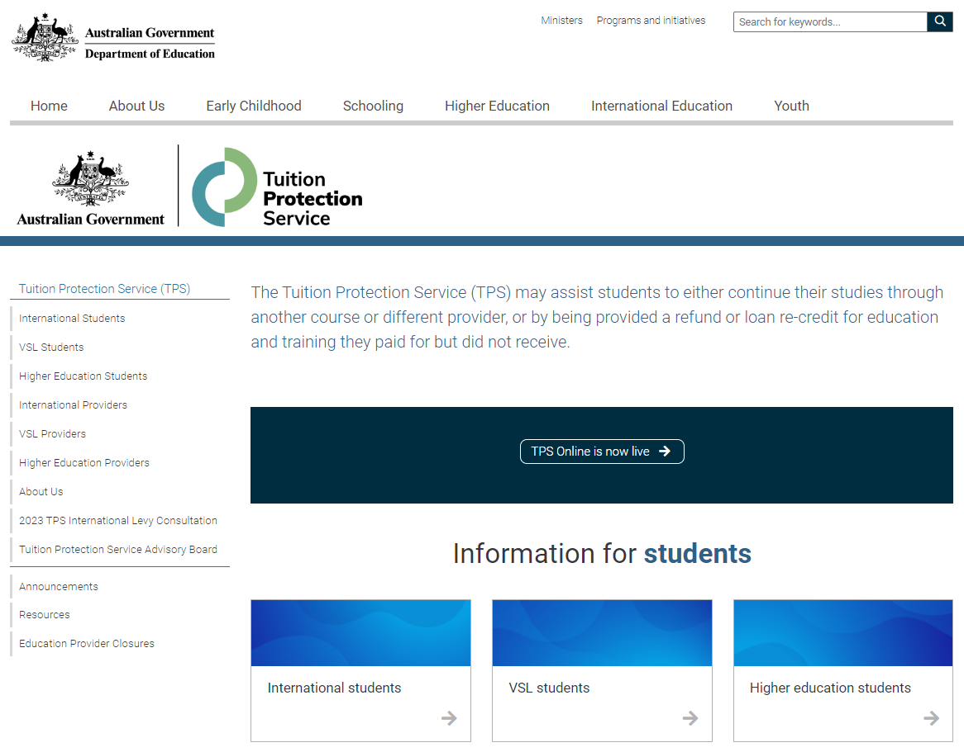
TPS website home page
For TPS Online, click on TPS Online is now live
For information about the Pacific Training Group closure, click on Education Provider Closures
www.tps.gov.au

Slide 13
Visa Matters
Applications and visa status
Visa Application Charge exemptions
Contacts and further information

Slide 14
Information session on education provider closures
Department of Home Affairs

Slide 15
What will we cover?
Applications and visa status
VAC exemption
Welfare for students under 18
Work conditions
Travelling home
Contacts and further information

Slide 16
What is my status?
International student visa holders need to maintain enrolment in a course that is registered on the Commonwealth Register of Institutions and Courses for Overseas Students (CRICOS) at all times while in Australia.
You can continue staying in Australia on your valid student visa if you enrol with another provider to study a course at the same level.
Students affected by provider default are afforded an extended period of three months in which to finalise a new enrolment.
If you have a student visa application that has not yet been decided and your provider has closed, the Department of Home Affairs will contact you to request a new CoE from another provider. Your application will be assessed based on the new course you have chosen to study and you will be afforded additional time to provide a new CoE.
Notes:
International student visa holders need to maintain enrolment in a course that is registered on the Commonwealth Register of Institutions and Courses for Overseas Students (CRICOS) at all times while in Australia.
You can travel outside Australia while waiting to be placed with a new provider as long as you return while your visa is valid.
You can continue staying in Australia on your valid student visa if you enrol with another provider to study a course at the same level.
Where a student is no longer enrolled in a registered course, the Department of Home Affairs would normally allow 28 days in which time a student could enrol with another education provider before the Department would consider visa cancellation.
Students affected by provider default are afforded an extended period of three months in which to finalise a new enrolment.
This is in acknowledgement that consumer protection processes may take longer than 28 days and that the situation is beyond the control of affected students.
Where the consumer protection mechanisms take more than three months, Department of Home Affairs may further extend its special arrangements on a case by case basis.
If you have a student visa application that has not yet been decided and your provider has closed, the Department of Home Affairs will contact you to request a new CoE from another provider. Your application will be assessed based on the new course you have chosen to study.
We will give you a chance to enrol in an alternative course if your education provider defaults after you have applied for a student visa but before we make a decision on your application.
Respond as quickly as you can to any request from your visa processing officer.
Send us information about your new enrolment as soon as possible.
Ensure you upload your information on your ImmiAccount as soon as it is available.

Slide 17
Do I need a new visa?
Please check the expiry date of your student visa. If you require more time to finish your new course, or you move to a new course that is at a lower AQF level than your previous course, you must apply for a further student visa.
There are arrangements in place to waive the Visa Application Charge (VAC) for students affected by an education provider closure if you apply within 12 months.
You must hold a student visa or your last substantive visa must have been a student visa.
When you apply let us know you have been affected by a provider default and attach evidence of your enrolment with the new education provider, such as your CoE.
Notes:
Please check the expiry date of your student visa. If you require further time to finish your new course, or you move to a new course that is at a lower AQF level than your previous course, you must apply for a further student visa before your current visa expires or before you commence your lower AQF level course.
If you change to a lower AQF level course, you must apply for a new visa. If you do not, you are in breach of your visa condition and your visa may be cancelled. For example if you are changing from a Diploma level course to a Certificate 4 course or if you change from a Bachelor Degree to an Advanced Diploma they are all lower AQF moves which will require you to apply for a new visa.
The only exception is If you are changing from an AQF level 10 course (doctoral degree) to an AQF level 9 course (masters degree), you will not need to apply for a new visa.
Student visa (subclass 570-575) holders must enrol in a course in the same sector or apply for a new Student visa (subclass 500).
There are arrangements in place to waive the Visa Application Charge or VAC for students affected by an education provider closure who need to extend their stay in Australia, if they apply within 12 months.
You must hold a student visa or your last substantive visa must have been a student visa.
Your family members will only be eligible for a VAC exemption if they are included in your application, not if they apply separately.
You might also be eligible for a VAC exemption if you apply for a Student Guardian visa (subclass 590) and the nominating student is affected by provider default.
You can check your visa expiry date by using the Department of Home Affairs’ Visa Entitlement Verification Online (VEVO) service which is available on the Department’s website (link provided)
If your new course will finish after the expiry date of your current visa, you will need to apply for a new Student visa (subclass 500) before your current visa expires.

Slide 18
Do I need a new visa?
You can check your visa expiry date by using the Department of Home Affairs’ Visa Entitlement Verification Online (VEVO) service at https://immi.homeaffairs.gov.au/visas/already-have-a-visa/check-visa-details-and-conditions/check-conditions-online/visa-holders

Slide 19
Students under 18
You must maintain welfare arrangements at all times as a condition of your student visa if you are under 18.
If your education provider issued a Confirmation of Appropriate Accommodation and Welfare (CAAW) to take responsibility for your welfare in Australia, you must seek alternative enrolment immediately and make alternative welfare arrangements.
If you will turn 18 soon, you will still need to ensure you have appropriate arrangements in place until you turn 18.
Notes:
You must maintain welfare arrangements at all times as a condition of your student visa if you are under 18.
If you do not have appropriate welfare arrangements, you will be in breach of your visa conditions and your visa may be cancelled.
If you will be turning 18 soon but are still a minor at the time of closure, you still need appropriate welfare arrangements in place until you turn 18
If your education provider issued a Confirmation of Appropriate Accommodation and Welfare (CAAW) to take responsibility for your welfare in Australia, seek alternative enrolment immediately and make alternative welfare arrangements.

Slide 20
Work arrangements
Condition 8105 – Work restriction
All student visa holders have this condition on their visa. Normally there are two main scenarios to consider:
Study has started – you can work 48 hours per fortnight
Study has not yet started – you cannot work if you have not commenced your course unless you held a visa when you applied for your student visa and your previous visa permitted you to work.
If you are on a Bridging visa (BV), you will need to refer to the conditions attached to your BV regarding work and other conditions

Slide 21
Travelling home and delays
You are able to travel home and return to Australia while you arrange your enrolment and commencement in another course. You must have a valid Student visa to enter Australia on your return.
If you have applied for a Student visa and area awaiting a decision, you must have a valid Bridging Visa B in order to travel.
Students affected by provider default have up to three months to finalise a new enrolment.
If it takes longer than three months to finalise your enrolment, the Department of Home Affairs may further extend its special arrangements on a case-by-case basis. You must provide relevant information for consideration.
Notes:
If you are planning to travel overseas within the three month grace period make sure all the necessary arrangement are in place re obtaining educational assessments and updating TPS and Home Affairs with their contact details etc and perhaps identify potential new providers to enrol with and seek enrolment before you travel.
You could do these activities whilst you are overseas but it could be that much harder. You will need to return to Australia before your current Student visa expires. And you need to provide a new COE within the 3 month period unless you can substantiate compelling circumstances, which would be assessed on a case by case basis

Slide 22
Further information and contacts
For further information about your Student visa, https://immi.homeaffairs.gov.au/visas/getting-a-visa/visa-listing/student-500
Queries or concerns about visa arrangements, http://www.homeaffairs.gov.au/
Specific information on education provider default https://immi.homeaffairs.gov.au/visas/getting-a-visa/visa-listing/student-500/education-provider-default
Service Centre: telephone 131 881 (in Australia).

Slide 23
Australian Skills Quality Authority
Getting a copy of a student’s study records

Slide 24
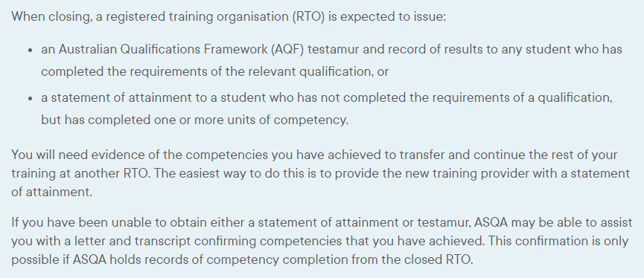
ASQA
www.asqa.gov.au/students/student-record

Slide 25
Contact details for ASQA
www.asqa.gov.au/students/how-asqa-can-help-students
www.asqa.gov.au/students/student-record
Phone from in Australia: 1300 701 801 between 9am to 7pm (AEDT) Monday to Friday
Phone from outside Australia: +61 3 8613 3910

Slide 26
Study Queensland and Study Gold Coast
Support for international students
Notes:
Study Queensland and Study Gold Coast have resources for international students on their websites. The following 2 slides show what those webpages look like.

Slide 27
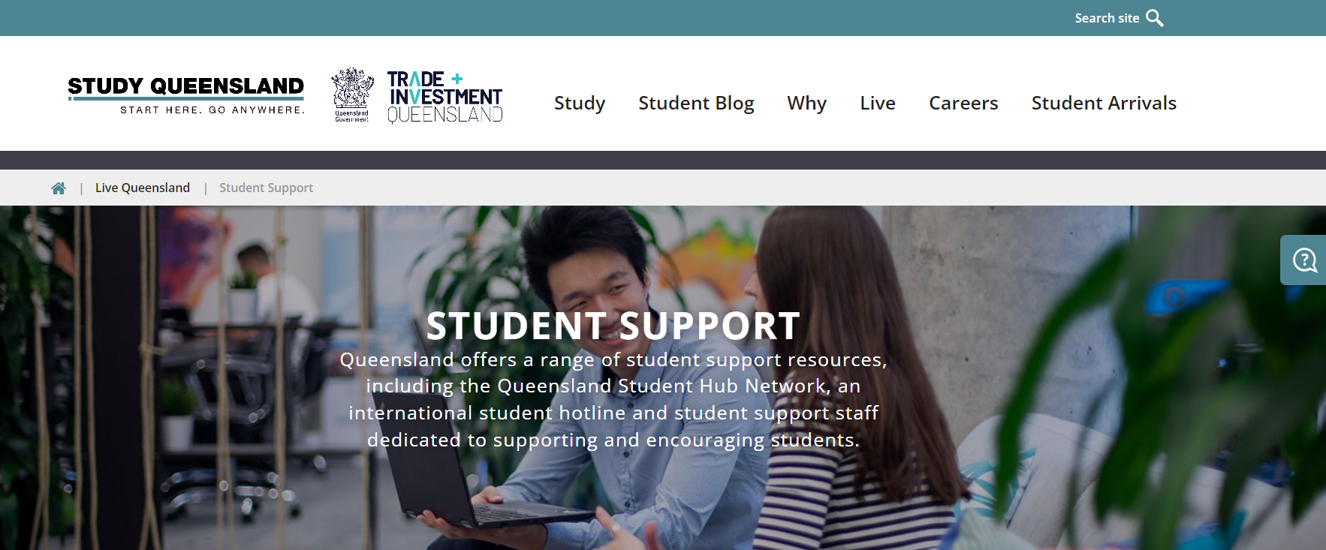
Study Queensland
https://www.studyqueensland.qld.gov.au/live-in-queensland/student-support
https://eqi.com.au/student-support/hotline

Slide 28
Gold Coast Student HUB
https://www.goldcoaststudenthub.com/
https://www.goldcoaststudenthub.com/support/

Slide 29
Study New South Wales
Support for international students
Notes:
Study NSW support services for international students are on the Study NSW website.

Slide 30
Study NSW
https://www.study.nsw.gov.au/live/support-services

Slide 31
How to use TPS Online
Accessing TPS Online
Using TPS Online to receive a refund of unspent tuition fees
Summary of tasks to complete in TPS Online
www.tps.gov.au

Slide 32
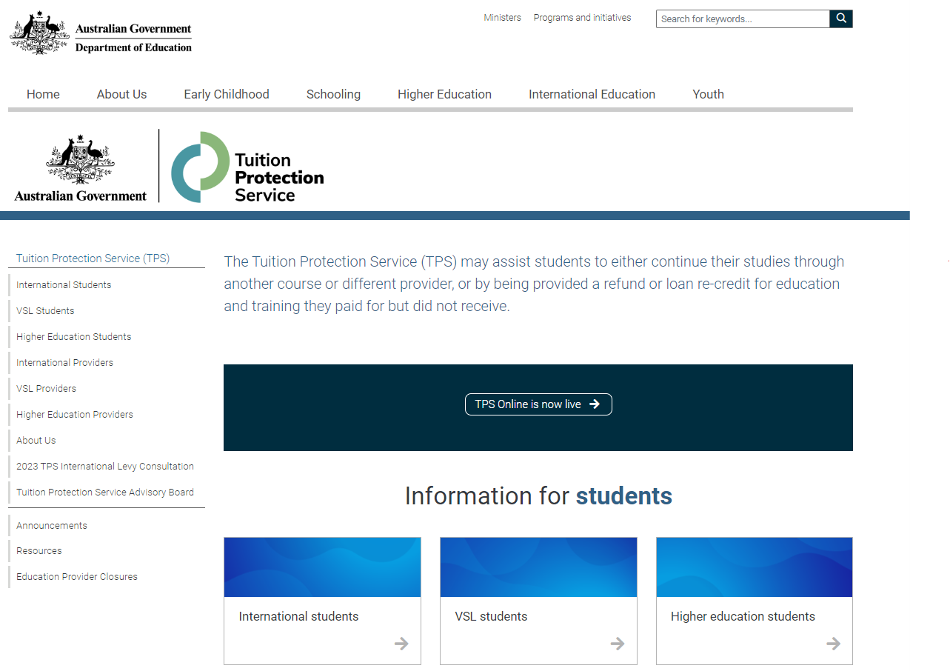
TPS Online
Visit www.tps.gov.au and click on TPS Online is now live to be redirected to the TPS Online system.
www.tps.gov.au

Slide 33
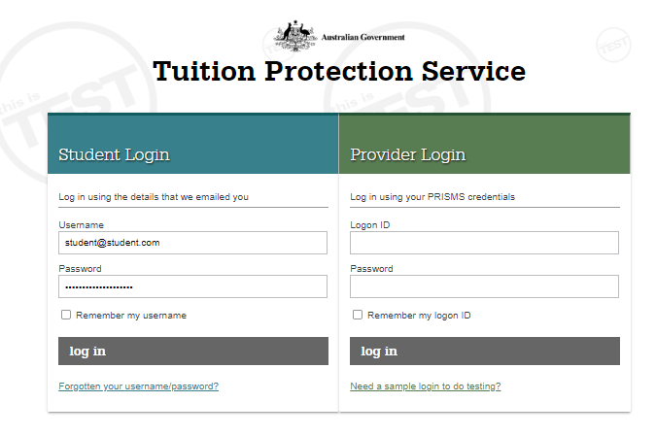
TPS Online: Log-in page
Log in using the username and password emailed to you from TPS Online.
If you have forgotten your log in details, click forgotten your username/password.
www.tps.gov.au

Slide 34
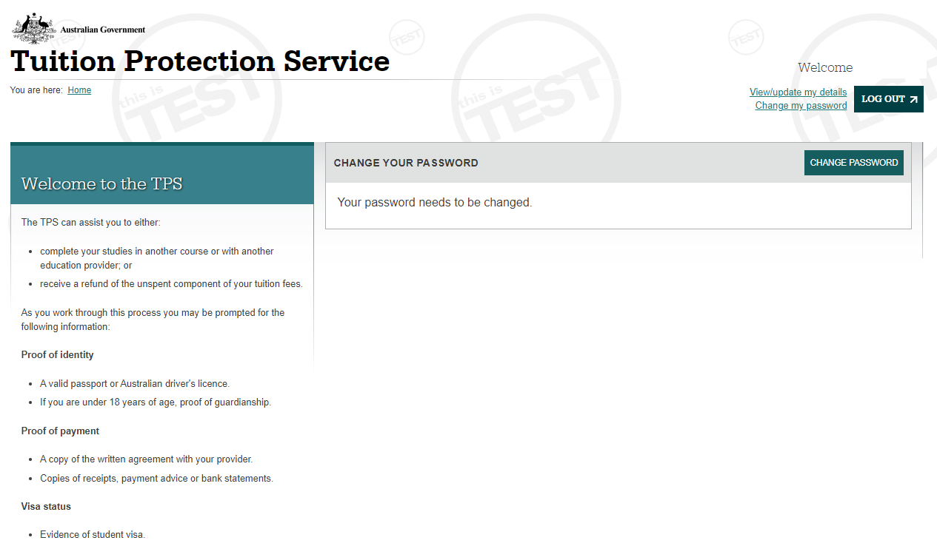
TPS Online: Change your password
You must change your password to continue.
www.tps.gov.au

Slide 35
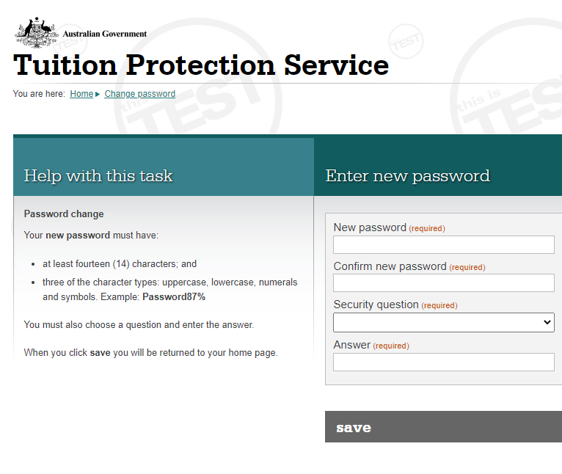
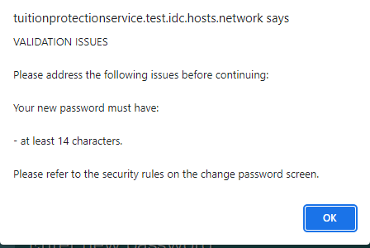
TPS Online: Change your password
Enter your new password twice
Choose a security question and answer
Click save.
Your new password must have fourteen (14) characters including uppercase and lowercase letters, numbers, and symbols (e.g. !, $ or #).
If your new password does not meet the criteria, you will see this message:
www.tps.gov.au

Slide 36
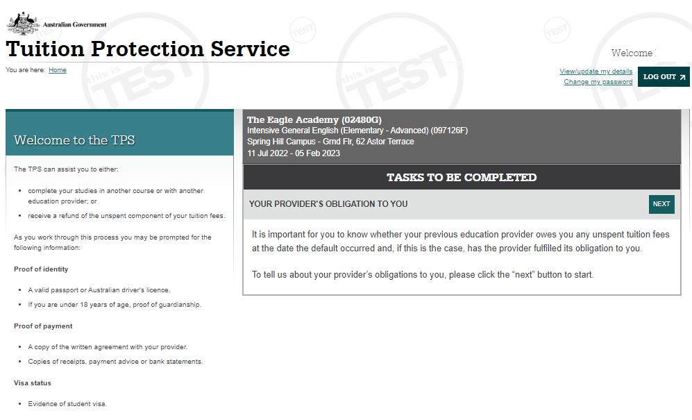
TPS Online: Home page
Your home page will list any tasks you need to complete to progress your claim with the TPS.
Check your home page regularly for tasks to complete!
www.tps.gov.au

Slide 37
TPS Online: Your provider’s obligation to you
It is important to know whether your provider owed you a refund of any unspent tuition fees at the date of the default and whether the provider fulfilled its obligations to you.
On your home page, click next on YOUR PROVIDER’S OBLIGATION TO YOU.
www.tps.gov.au

Slide 38
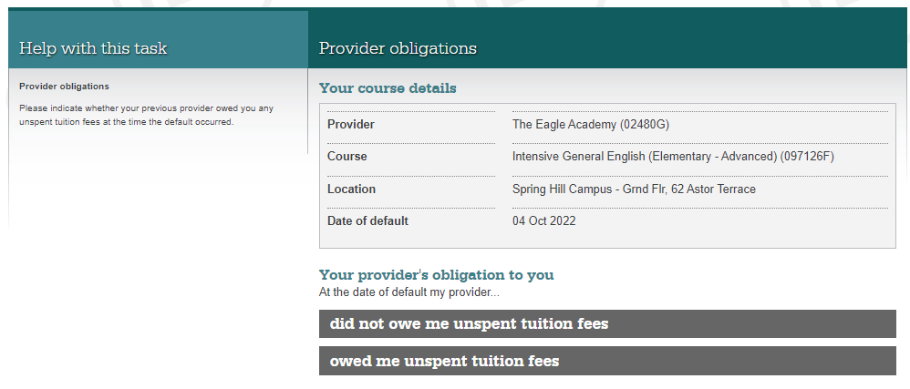
TPS Online: Your provider’s obligation to you
On the date of the default, did your provider owe you any unspent tuition fees?
If you select owed me unspent tuition fees, you will need to provide proof of payment documents.
If you select did not owe me unspent tuition fees, the financial assessment process will end. You will only be able to browse alternative courses.
www.tps.gov.au

Slide 39
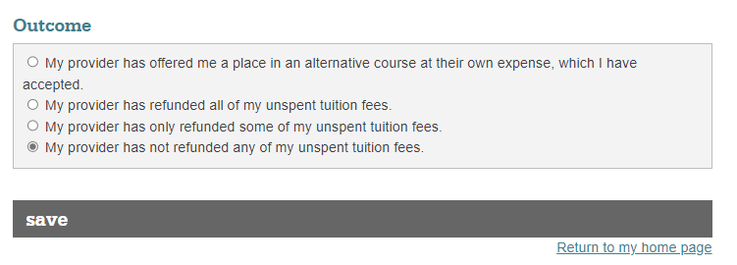
TPS Online: Your provider’s obligation to you
Select the option that applies to you.
Click save.
www.tps.gov.au

Slide 40
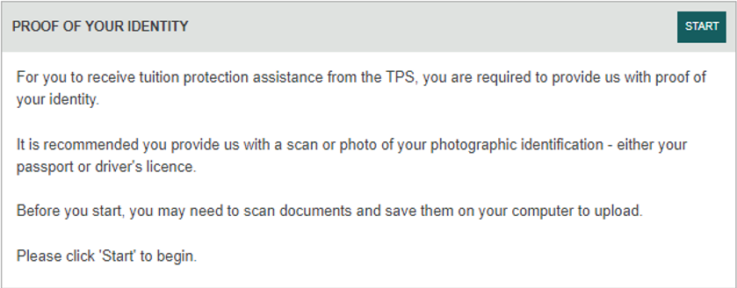
TPS Online: Proof of your identity
To receive any assistance from the TPS, you must provide proof of your identity.
On your home page, click start on PROOF OF YOUR IDENTITY.
www.tps.gov.au

Slide 41
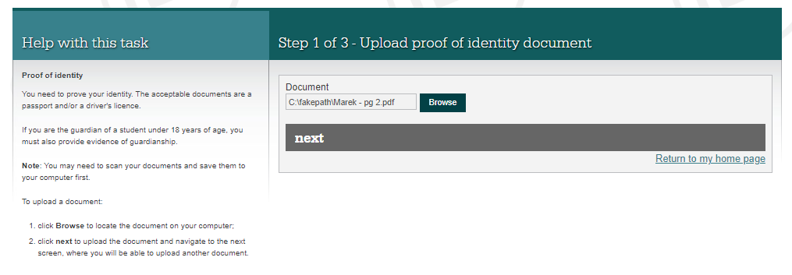
TPS Online: Upload your proof of identity document
C:\fakepath\passport.pdf
You will need to upload a photo of your passport (preferable) or driver’s licence from your device to prove your identity.
Click browse and select the file you wish to upload
Click ok and then next.
www.tps.gov.au

Slide 42
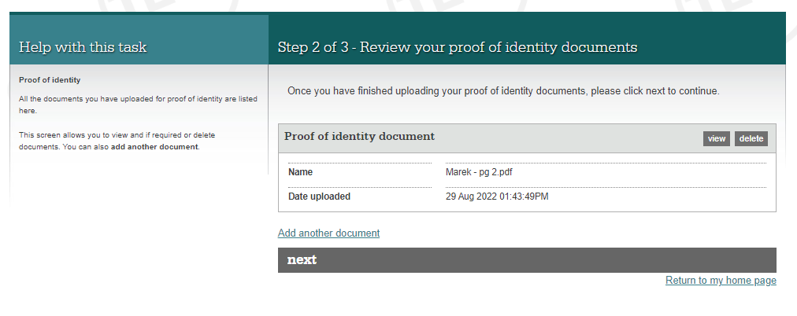
TPS Online: Review your proof of identity document
passport.pdf
30 Jan 2023 10:30:19AM
View the document you uploaded to make sure it is the right document.
If you have uploaded an incorrect document, click delete and then add another document.
If you are happy with the document, click next.
www.tps.gov.au

Slide 43
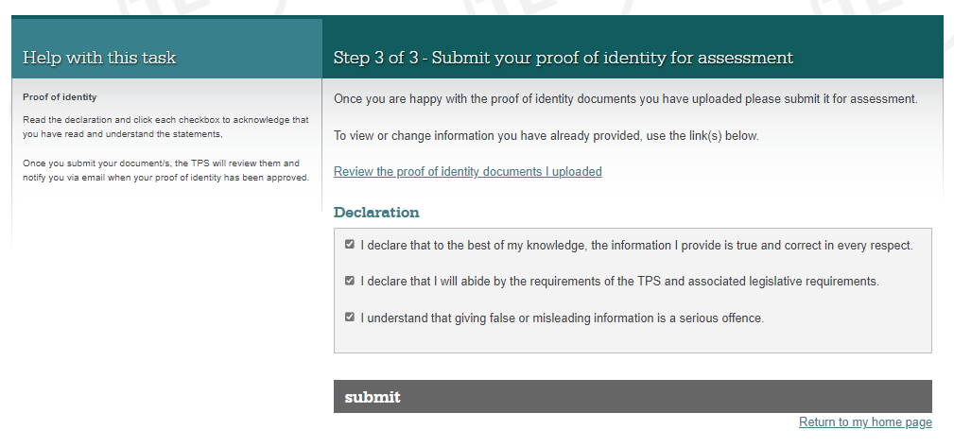
TPS Online: Submit your proof of identity document
Read the declaration.
If you are happy to proceed, tick all three boxes and click submit.
www.tps.gov.au

Slide 44
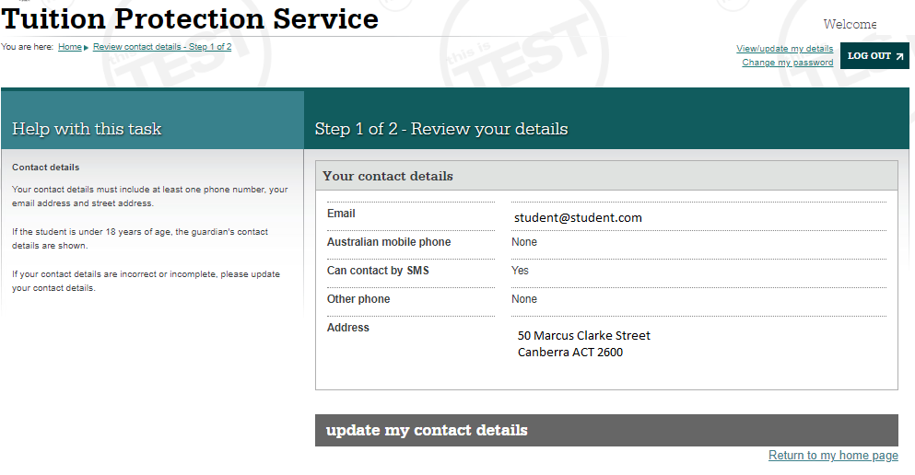
TPS Online: Review your contact details
The TPS will send you any notifications or requests using your contact details in TPS Online.
On your home page, click review on REVIEW YOUR CONTACT DETAILS to make sure your contact details are correct.
Click update my contact details.
www.tps.gov.au

Slide 45
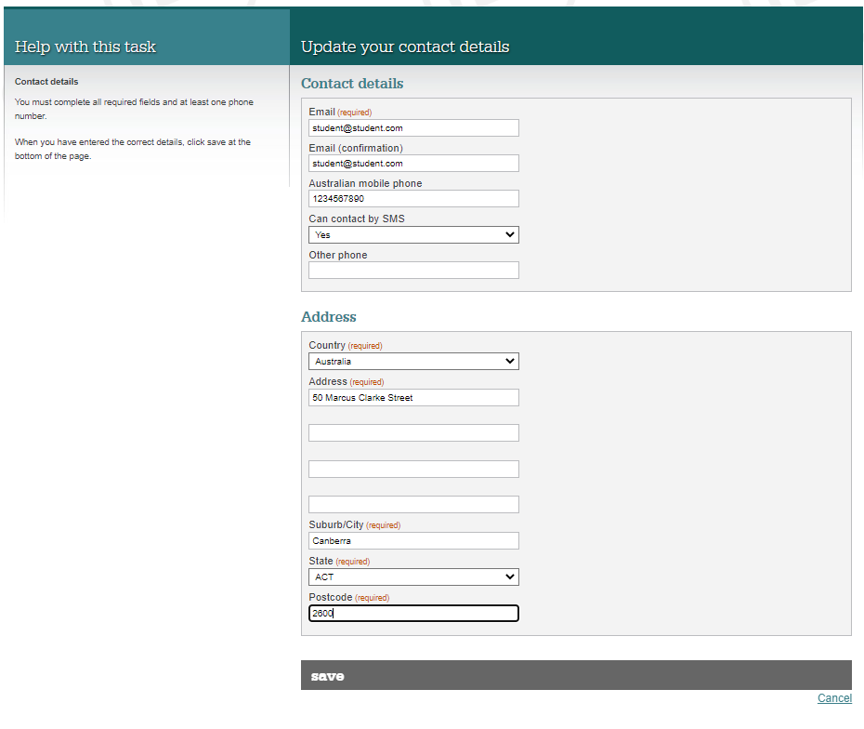
TPS Online: Update your contact details
Update your contact details and click save.
www.tps.gov.au

Slide 46
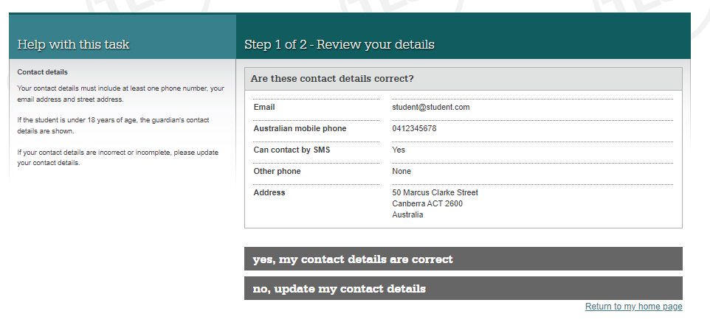
TPS Online: Review your contact details
After updating your contact details, you will be asked to confirm that they are correct.
www.tps.gov.au

Slide 47
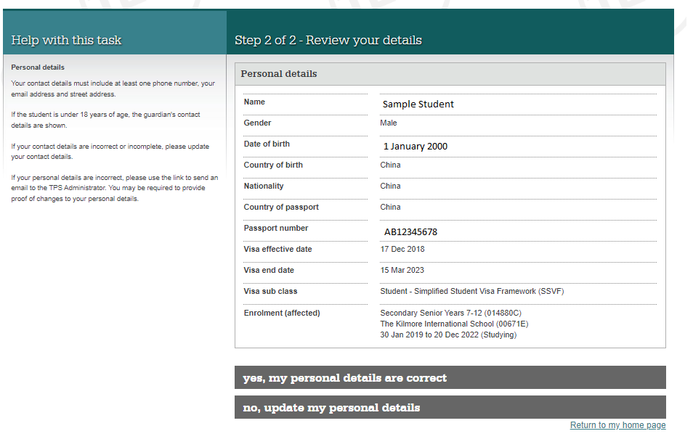
TPS Online: Review your contact details
If your details are correct, click yes, my personal details are correct.
If any of your details are incorrect, click on no, update my personal details. You will be advised to send an email to support@tps.gov.au.
www.tps.gov.au

Slide 48
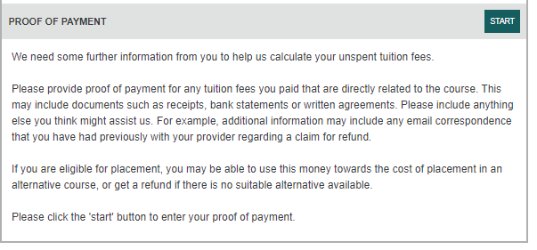
TPS Online: Proof of payment
If your provider owes you a refund of unspent tuition fees, you must submit proof of payment documents.
On your home page, click start on PROOF OF PAYMENT.
www.tps.gov.au

Slide 49
TPS Online: Proof of payment
Payments you made to your provider may have been recorded in our systems.
Click next to review our payment information.
www.tps.gov.au

Slide 50
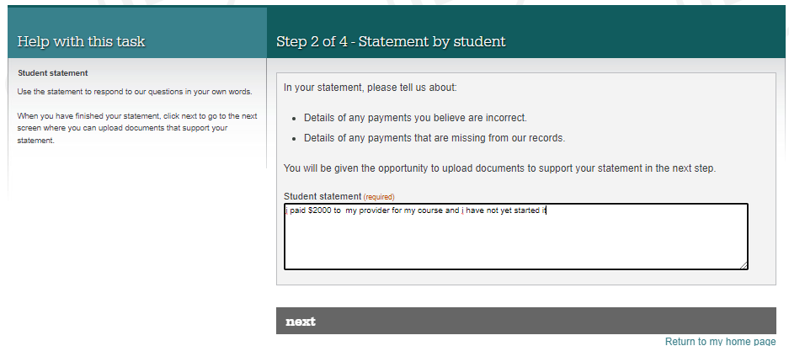
TPS Online: Proof of payment
I paid $2000 to my provider for my course on 28 November 2022 and I have not yet started it.
In the student statement box, please provide:
details about all payments made to your provider (and your agent, if applicable) for your course; and
a brief explanation of your individual circumstances.
Click next to begin uploading documents to support your statement.
www.tps.gov.au

Slide 51
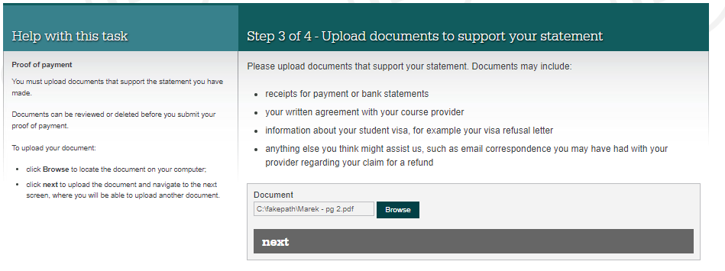
TPS Online: Proof of payment
C:\fakepath\document.pdf
Click browse to select documents to upload from your device.
Refer to the following checklist to ensure you upload all of the required documentation.
This task will be returned to you to upload additional documentation if necessary.
www.tps.gov.au

Slide 52
TPS Online: Proof of payment document checklist
You must upload the following documents for the TPS to calculate your unspent tuition fees:
Provider and bank receipts for all payments made to your provider for your course
Bank statements showing all payments made to your provider for your course. Bank statements must indicate who owns the bank account.
Letter of offer outlining all payments due to your provider for your course
Any other documentation (e.g. emails) that will assist us in assessing your financial claim.
Do you have an agent? If you have an agent, you must upload the following documentation:
Receipts or bank statements for all payments made to your agent
Receipts for all payments your agent made to your provider on your behalf. You may need to contact your agent to obtain these.
Agent commission statement or invoice. You may need to contact your agent to obtain these.
Did you defer your course? If you deferred your course, you must upload the following documentation:
Approval of deferment
Your deferment form
www.tps.gov.au

Slide 53
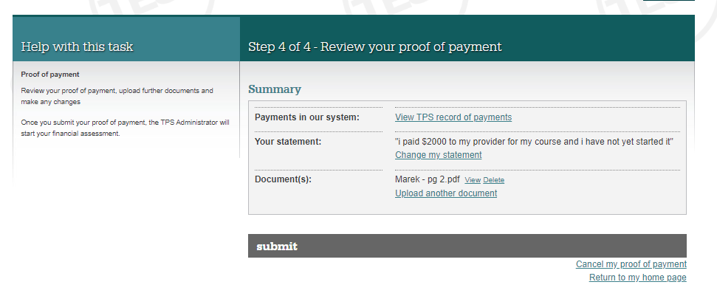
TPS Online: Proof of payment
Click next once you have uploaded all of the required documents.
C:\fakepath\document.pdf
Review your statement and your proof of payment documents.
To make any changes, click change my statement or upload another document.
Click submit to upload your statement and proof of payment documents.
“I paid $2000 to my provider for my course on 28 November 2022 and…”
document.pdf
www.tps.gov.au

Slide 54
TPS Online: Apply for a refund
If the TPS determines that you are eligible for a refund of unspent tuition fees, you will need to apply for a refund.
On your home page, click apply on APPLY FOR A REFUND.
www.tps.gov.au

Slide 55
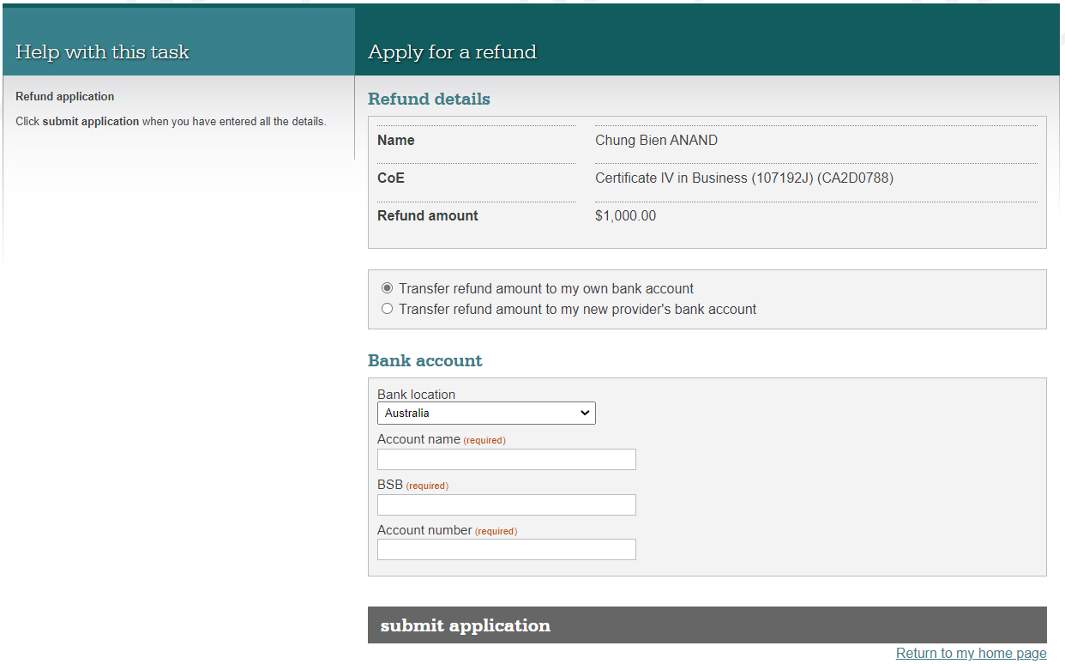
TPS Online: Apply for a refund
Select whether you would like the refund to be transferred to your own bank account or to your new provider (if applicable).
Student name
Course name
Refund amount
Provide the details of the bank account you would like your refund to be transferred to.
Check the information you have provided, then click submit application.
www.tps.gov.au

Slide 56
TPS Online: Browse alternative courses
Example Course 1
Example Course 2
Example Course 3
On your home page, click browse on BROWSE ALTERNATIVE COURSES to view a list of suitable alternative course options.
Click on the course links to see information about the course and the contact details for the alternative provider.
www.tps.gov.au

Slide 57
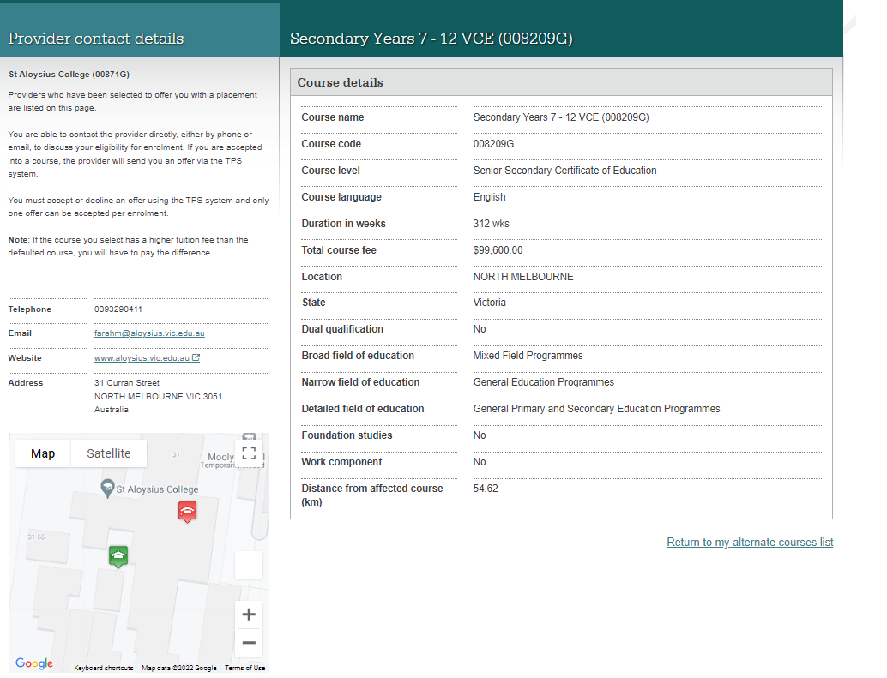
TPS Online: Alternative provider contact details
Example Course 1 (123456G)
ABC School of Learning (01010A)
Example Course 1 (123456G)
123456G
Contact the new provider to request enrolment using the contact details provided.
$20,000
0312345678
example@abclearning.vic.edu.au
www.abclearning.com.au
123 Sample Street
Your new provider will upload an offer in TPS Online. You must log into TPS Online and accept this offer.
The ABC School of Learning
www.tps.gov.au

Slide 58
TPS Online: Summary of tasks
Log in to TPS Online
Change your password
Indicate whether your provider owed you a refund of unspent tuition fees on the date of the closure
Provide proof of your identity
Update your contact details
If your provider owes you a refund of unspent tuition fees, upload your proof of payment documents
If you are eligible to receive a refund of unspent tuition fees, apply for a refund
Browse the alternative course list and contact alternative providers to request enrolment
View and accept your alternative course offer from your new provider
Check your emails and TPS Online regularly for notifications and tasks to complete. Be quick to respond to TPS requests!
www.tps.gov.au

Slide 59
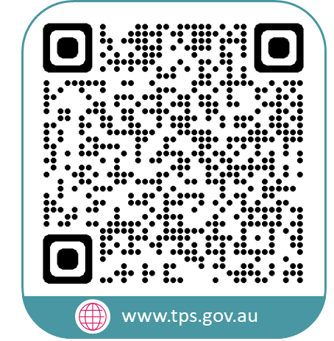
Contact the TPS
www.tps.gov.au
support@tps.gov.au
1300 131 798

