Slide 1
Draft 2023 VSL, HELP and Up-front Domestic TPS Levies
May 2023
Melinda Hatton
Tuition Protection Service Director
www.tps.gov.au
Notes:
Acknowledgement of country

Slide 2
Outline
Purpose and function of the Tuition Protection Service (TPS)
TPS Director, TPS Operations team and the TPS Advisory Board
TPS Domestic Levies – guiding principles and levy framework
Levy components and calculations
Levy development and collection timeline
www.tps.gov.au
Notes:
Session purpose:
To share the TPS Advisory Board’s draft advice on the 2023 Domestic levy settings, and gather feedback from you on the proposed settings
To explain the domestic levy components and calculations
To answer any questions you have about the domestic levies
The Board’s draft advice will be published on the TPS website. We invite you to provide feedback on the Board’s draft advice at this session, or by emailing the TPS at operations@tps.gov.au. The invitation for your feedback will close on (???). Feedback from sector consultation will be provided to the TPS Advisory Board ahead of its June meeting. The Board will consider feedback before the Board provides its final advice to the TPS Director on the 2023 domestic levies, and the settings are legislated.

Slide 3
Purpose of the Tuition Protection Service (TPS)
Australian Government initiative supported by federal Department of Education
Student tuition protection scheme that safeguards Australia’s reputation as an education destination
Developed for international student fee protection and expanded to specified domestic students
Manages levy collections from registered education providers
Supports registered education providers to understand and meet obligations to students
Supports students with refunds and Government loan re-credits, and facilitates alternative course placements
www.tps.gov.au
Notes:
The Tuition Protection Service (TPS) is an initiative of the Australian Government Department of Education, which functions as a consumer protection or insurance scheme for students.
The TPS was originally established to safeguard the reputation of Australia as an international education destination, but in recent years has been expanded to certain domestic education and training.
The TPS assists international and applicable domestic students whose education providers have not been able to deliver education and training in which students have enrolled, facilitating arrangements to enable a refund, loan recredit, or continuation in alternative education and training for students.
Education and training providers who contribute to the TPS by way of annual levies are themselves covered by the TPS scheme. The TPS Director, based on advice from the Australian Government Actuary and the TPS Advisory Board, determines the risk-rated premium and special tuition protection components of the levies, and relevant federal Ministers determine the administrative components. The levies are used to facilitate alternative arrangements for students affected by a provider’s default.
There is no need for providers to register with the TPS – the TPS will engage with relevant education and training organisations, keeping you informed about annual levy estimates and timings. The TPS will also support you in the case of a default – or possible default situation – alongside sector regulators and other relevant agencies.
For domestic VSL students, the TPS will help eligible students to find another VSL provider that offers a similar course so they can continue their studies. If a suitable replacement course is unavailable, we will arrange for a loan re-credit for commenced but not completed units.
For domestic HECS-HELP, FEE-HELP and up-front higher education fee paying students, the TPS will provide eligible students with the option to either transfer to a suitable replacement course, or receive a refund of tuition fees or loan re-credit for commenced but not completed.

Slide 4
Legislative Authority
VET Student Loans (VSL Tuition Protection Levy) Act 2020 https://www.legislation.gov.au/Series/C2020A00005
Higher Education Support (HELP Tuition Protection Levy) Act 2020 https://www.legislation.gov.au/Series/C2020A00004
Higher Education (Up-front Payments Tuition Protection Levy) Act 2020 https://www.legislation.gov.au/Series/C2020A00102
www.tps.gov.au

Slide 5
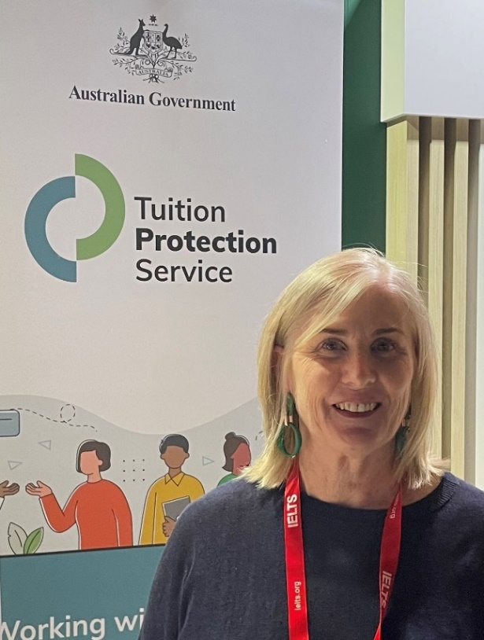
Tuition Protection Service Director
Melinda Hatton, TPS Director
Statutory office holder appointed by the federal Minister for Education
Operational oversight over the daily activities of the TPS
Responsible for the annual collection of TPS levies from CRICOS and eligible domestic education providers
Responsible under law for managing the levy funds
www.tps.gov.au

Slide 6
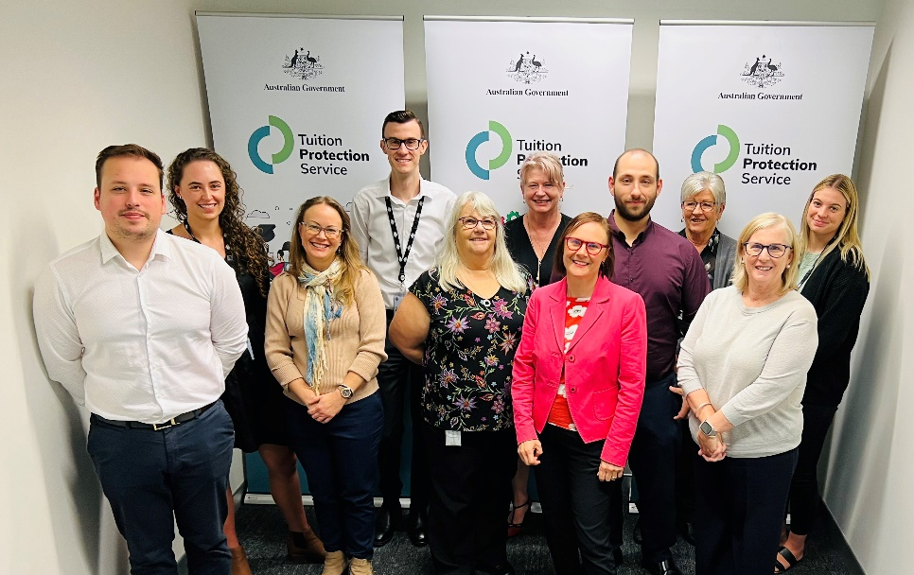
TPS Operations Team
Led by TPS Director
Small team of around 16
Located in Canberra
www.tps.gov.au

Slide 7
TPS Advisory Board
View Board member profiles at
www.tps.gov.au
Ms Helen Zimmerman (Chair)
Dr Kevin Donnelly AM (Deputy Chair)
Ms Jenny Lambert
The Hon Phil Honeywood
Ms Karen Sandercock, Australian Government Department of Education
Mr Matthew Hardy, Australian Government Department of Employment and Workplace Relations (DEWR)
Mr Guy Thorburn, Australian Government Actuary
Mr Peter Kohlhagen, Australian Prudential Regulation Authority
Mr Daniel Frewer, Australian Government Department of Finance (acting)
Ms Alison Garrod, Australian Government Department of Home Affairs (acting)
www.tps.gov.au

Slide 8
TPS Domestic Levies
Three annual sector-based tuition protection levies collected from domestic education providers
Levies fund the student placement and refund activities of the TPS following an education provider closure as well as TPS operational costs
Levy calculation based on an education provider’s size and risk of closure
Domestic levies paid into two quarantined accounts managed by the TPS Director:
VSL Levy → VSL Tuition Protection Fund
HELP Levy → Higher Education Tuition Protection Fund
Up-front Payments Levy → Higher Education Tuition Protection Fund
All TPS domestic levies were waived in 2020 and 2021 as part of the Commonwealth Government COVID-19 pandemic relief package
www.tps.gov.au
Notes:
TPS developed for international student fee protection and expanded to domestic VSL and HELP students in 2020, and HE up-front fee paying students in 2021
Separate levy for international students
Providers operating in multiple sectors pay separate levies for each sector
All domestic levies waived in 2020 and 2021 as a COVID-19 relief measure

Slide 9
Guiding Principles for levy settings
The TPS Advisory Board’s levy setting advice is guided by the following principles:
Advice should reflect the overall risk environment and ensure that revenue sustains the relevant fund, while also being sustainable for the industry
The model for each levy should reflect gradual change and assist the industry with business planning by providing a stable regulatory environment
The model should be as simple and transparent as possible, preferably based on a small number of risk factors
Risk premiums should provide incentives for education providers to adopt positive behaviours
Additional imposts on industry, such as data collection, should be minimised as far as possible, consistent with the ability to set sound risk-based levies
www.tps.gov.au

Slide 10
TPS Levy Framework
TPS Levy Framework developed by the Australian Government Actuary (AGA)
AGA provides advice on the levies to ensure the arrangements are financially sound
Annual domestic TPS levies are set through two legislative instruments:
one for the Administrative Fee component (set by the relevant Minister), and
one for the Risk Rated Premium component and Special Tuition Protection component (set by the TPS Director)
Education providers operating across multiple education sectors pay separate levies for each sector, which may be collected at different times during the year
www.tps.gov.au
Notes:
Levy Framework developed by AGA
The AGA has provided, and will continue to provide, advice on the levies to ensure the arrangements are financially sound.
The levies for each year are set through legislative instruments for both the administrative component (set by the relevant Minister), and the risk-rated premium and special tuition protection components (set by TPS Director).
Providers operating across the Higher Education, VET and international education sectors pay separate levies for each sector.
Independent levy amounts are calculated based on data for each sector, and levies may be collected at different times during the year
The levies collected under the arrangements are held in sector-specific quarantined accounts and will be used to fund ongoing tuition protections for students and providers of each specific sector only. This means there will be no cross-subsidisation across the existing tuition protection arrangements for international students, FEE-HELP / HECS-HELP or up-front fee paying higher education students, or VSL students.
The levies are used to pay for:
tuition protection activation costs, including incentive/transfer payments and any loan re-crediting costs
third party TPS administrator that will assist students
insurance, as required, while the fund builds up to a sufficient amount
yearly actuarial services to advise the levy settings
the TPS Director and Advisory Board remuneration
There is no longer an obligation on an approved provider to publish a VSL Statement of Tuition Assurance. Information for both providers and students regarding the Tuition Protection Service can be found on our website at www.tps.gov.au.

Slide 11
Domestic TPS Levy Components
Component | Key elements | Purpose and authority
Administrative fee | Sum of a ‘per provider’ and ‘per student’ charge | Designed to cover administrative costs Set by relevant Minister
Risk-rated premium | Considers 3 risk factors: Financial strength Completion rate Non-compliance history and registration renewal | Intended to reflect risk of provider default Financial reward for positive provider behaviour and risk management practices Set by the TPS Director
Special tuition protection | Percentage multiplied by total loan amounts or up-front payments received | Intended to assist building the funds when below target range or to repay seed funding Set by the TPS Director
www.tps.gov.au
Notes:
3 components: administrative fee, risk-rated premium, and special tuition protection components
Administrative fee component
Sum of a ‘per provider’ specified amount, and a ‘per student’ charge to adjust for provider scale
Designed to cover administrative costs (TPS Director, Advisory Board, administrator)

Slide 12
Administrative Fee Component
Sector contribution to the ongoing costs of the TPS
Sum of a specified ‘per provider’ amount and a ‘per student’ amount
Determined by the responsible Minister
If the responsible Minister decides not to determine the administrative fee component amounts, a CPI indexation will apply (see Section 10 of the VSL, HELP and Up-front Payments Levy Acts)
If a provider is a new provider for a year, the provider’s administrative fee component will be the ‘per provider’ amount only
www.tps.gov.au
Notes:
If the responsible Minister decides not to determine the administrative fee component amounts, a CPI indexation will apply
Responsible Ministers made legislative instruments in the first year determining the administrative fee amounts (per provider and per student)
For VSL and HELP, these instruments were made in 2020
For Up-front Payments, the instrument was made in 2021
Section 10 of the VSL, HELP and Up-front Payments Levy Acts provides for the indexation of the administrative fee amounts
On 1 August of each year, if no legislative instrument is made, the amounts determined are replaced by the amount worked out using the formula:
Amount for previous year X Indexation factor for that 1 August
The indexation factor for a 1 August is the number worked out using the formula:
Index number for the reference quarter / Index number for the base quarter
Index number: All Groups Consumer Price Index number for the original series published by the Australian Statistician for that quarter
Reference quarter: the September quarter in the year before the current year
Base quarter: the last September quarter before the reference quarter

Slide 13
Risk Rated Premium Component
Determined annually by TPS Director in collaboration with the TPS Advisory Board, AGA and feedback from stakeholders
Considers a provider’s student enrolment numbers, income (loan amounts or up-front payments) and risk factor values
Risk factor value based on an individual provider’s risk score against three risk factors
TPS risk factor calculations designed to reflect the risk of a provider default
Not equivalent to the risk assessments conducted by the regulators
www.tps.gov.au
Notes:
Risk factors intended to reflect risk of provider default / risk of calling on the levy funds
Risk factors supported by AGA analysis showing correlation between provider defaults and:
High financial risk scores
Low completion rates
Registration renewal for less than the maximum permissible
Note: No late payment data yet as levies were waived, but penalising late TPS levy payment encourages positive provider behaviour
TPS risk assessments are different from the regulators’ risk assessments
TPS maintains regular contact with the education and training sector regulators to discuss relevant issues (e.g. education providers at risk of compliance action)
TPS Advisory Board also invites the regulators to its Board meeting on an annual basis to share views on the domestic and international education sectors, which helps inform the risk factor settings of the respective TPS levies each year
As the risk factor calculations for the respective TPS levies are designed to reflect the risk of provider default, they are not equivalent to the risk assessments conducted by the regulators and are calculated using different data

Slide 14
Risk Factors
Risk Factor 1: Financial Strength
Based on analysis of an education provider’s most recent financial data
Assessed on the net profit ratio, return on assets, and debt to equity
Risk Factor 2: Completion Rate
Based on students’ course/unit of study completion rates
Risk Factor 3: Non-Compliance History and Registration Renewal
Late payment history of annual registration provider charges and TPS levies, and provider registration renewals for a shorter period than the maximum allowed
www.tps.gov.au
Notes:
See fact sheet handout for risk factor calculations and weightings
Note: The completion rate risk factor weightings is the only proposed change from the 2022 domestic levy settings (see following slide)
Financial strength
All providers must provide their 2022 financial reporting year financial statements through the HELP IT System (HITS).
Providers that have not provided the statements will attract the highest risk value of 2.5.
Note: Providers that only provide parent entity statements and not financial statements for the approved entities will also attract the 2.5 risk value.
Completion rate
AGA analysis has identified where the completion rate deteriorates, there is an increased likelihood of TPS support
Completion rate percentage formula:
$$\left[\frac{Passed EFTSL }{(Passed EFTSL + Failed EFTSL + Withdrawn EFTSL + Ongoing EFTSL + Data missing EFTSL)}\right]×100$$
Late payment history
Late payment history relates to VSL and HELP provider annual charges and TPS levies. For 2022, only the VSL provider annual charge late payment history will be relevant for the VSL levy. This is due to the 2020 and 2021 domestic levies and HELP provider annual charges being waived as COVID-19 pandemic relief measures.

Slide 15
Completion Rate
Domestic levies waived in 2020 and 2021 as a COVID-19 relief measure
2022 completion rate loadings reduced as COVID-19 support measure
Proposal to increase loadings in 2023, but still lower than 2020 level
Completion rate percentage | 2020 loadings | 2022 loadings | Proposed 2023 loadings
85% or higher | 0 | 0 | 0
60% to <85% | 0 | 0 | 1
35% to <60% | 3.5 | 1.7 | 2.5
0% to <35% | 5.5 | 2.7 | 3.5
Passed EFTSL x 100
____________________________________________________________________________
Passed + Failed + Withdrawn + Ongoing + Data Missing EFTSL
Completion rate percentage formula =
www.tps.gov.au
Notes:
Note: Up-front levy did not exist in 2020
Increased loadings for 2023
AGA: Increased loading from 0 to 1 for 60% to <85% category “better aligns overall risk loadings to relative rates of failure and better reflects the experience to date”
New loading increases the expected levy collection
The marginal impact of increasing the loading from 0 to 1 is moderated by maintaining the Special Tuition Protection Component at 0.10% (0.05% below the maximum permissible amount)
Increased loadings for lower completion rates to unwind the temporary reductions during COVID-19
Temporary reductions were based on perceived impact of COVID-19 on ability of students to complete courses

Slide 16
Risk Rated Premium Component
Risk rated premium component formula differs slightly across the levies
If a provider is a new provider for a year, the risk rated premium component for the year will be 0
$$=\left\{\left(\begin{aligned}\text{total} \text{students} \\ \text{for} \text{the} \text{year} \\ × \\ \text{amount} \text{determined} \\ \text{by} \text{the} \text{TPS} \text{Director}\end{aligned}\right)+\left(\begin{aligned}\text{total} \text{loan} \text{amounts}\text{ /} \\ \text{up}\text{−}\text{front} \text{payments} \\ \text{for} previous year \\ × \\ \text{percentage} \text{determined} \\ \text{by} \text{the} \text{TPS} \text{Director}\end{aligned}\right)\right\} ×\left\{\left(sum of risk factor values\right)+ 1\right\}$$
www.tps.gov.au
Notes:
Formula in fact sheet handout

Slide 17
Special Tuition Protection Component
Determined annually by the TPS Director with AGA and TPS Advisory Board guidance
To be charged in the initial years when the funds are below their target size to build fund reserves and meet Commonwealth seed capital repayments
Calculated as a percentage of a provider’s income (loan amounts or up-front payments)
Proposed special tuition protection component percentage for 2023:
VSL: 0.10%
HELP: 0.10%
Up-front: 0.10%
If a provider is a new provider for a year, the special tuition protection component for the year will be 0
www.tps.gov.au
Notes:
Ultimately ensures the funds are capable of meeting the demand of a provider default
Domestic funds have Commonwealth seed funding that will need to be repaid
Proposed percentages unchanged from 2022

Slide 18
Draft 2023 domestic TPS levy settings
Levy | Administrative fee* | Risk rated premium | Special tuition protection
VSL | $111 per provider + $9.33 per VSL student | $6 per VSL student + 0.17% x total 2022 loan amounts | 0.10% x total 2022 VSL loan amounts
HELP | $111 per provider + $9.33 per HELP student | $6 per HELP student + 0.06% x total 2022 loan amounts | 0.10% x total 2022 HELP loan amounts
Up-front Payments | $111 per provider + $9.33 per up-front student | $2 per up-front fee-paying student + 0.04% x total 2022 up-front payments | 0.10% x total 2022 up-front payments
*Administrative fee figures quoted are for 2022 and will be indexed to CPI for 2023
N.B. All student figures are based on 2022 enrolments
www.tps.gov.au
Notes:
Note: Administrative fee figures quoted are for 2022. If the responsible Minister does not determine an administrative fee component amount, these figures will be indexed to CPI for 2023
Calculated using 2022 student enrolment numbers

Slide 19
Key Takeaways
Domestic levies collected annually in October
Levy Notices will be sent to contacts provided in the HELP IT System (HITS)
Please ensure contacts identified as CEO/VC, CFO, SAO, PCH or PVH are up to date in HITS
One proposed change from 2022 domestic levy settings: Increased completion rate risk factor loadings
Feedback on 2023 draft levy settings from this session will be provided to the TPS Advisory Board at its June meeting
www.tps.gov.au
Notes:
Increased completion rate loadings are the only proposed change from 2022 domestic levies
Note: Administrative fee component will be indexed to 2023, which will also change providers’ levy amounts

Slide 20
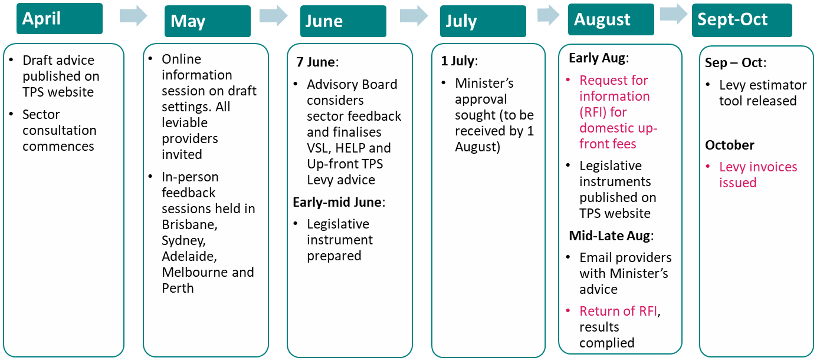
2023 Domestic TPS Levies Timeline
www.tps.gov.au
Notes:
TPS conducts annual sector consultation on proposed levy settings before settings are finalised and legislated
Sector feedback collected by TPS is presented to TPS Advisory Board ahead of providing their final advice on levy settings
TPS would like to know current challenges facing the sector

Slide 21
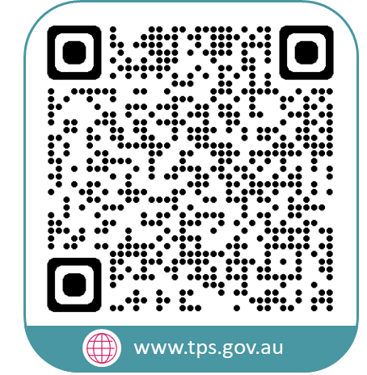
www.tps.gov.au
operations@tps.gov.au
Notes:
Questions from audience?
Attendees can send questions/feedback to Operations email on screen

