Slide 1

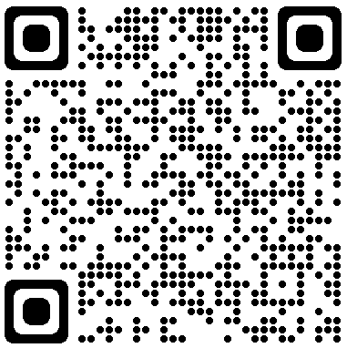

The Eagle Academy Closure
Agent Information Session
13 February 2023
Melinda Hatton
Tuition Protection Service Director
www.tps.gov.au

Slide 2
Welcome, acknowledgement of Country and purpose of meeting
Tuition Protection Service (TPS)
Australian Government Department of Education
Visa conditions for international students
Australian Government Department of Home Affairs
Student records
Australian Skills Quality Authority (ASQA)
Study Australia
Agenda
www.tps.gov.au

Slide 3

Purpose of this meeting
Provide agents with information and advice on what international students can do next
Understand the role of the TPS during a provider default
Present information on visa conditions for international students
Present information on how international students can get
a copy of their study records
www.tps.gov.au

Slide 4
The Eagle Academy (Xamerg Pty Ltd)
The Eagle Academy ceased delivering courses on 4 October 2022.
The TPS has been working closely with Eagle Academy to provide refunds to students to the Eagle Academy timeline of 31 January 2023.
The Eagle Academy did not meet this timeline and the TPS activated on 10 February 2023.
We will be working to provide students with a refund of their unspent tuition fees as quickly as possible.
www.tps.gov.au

Slide 5
Student consumer protection
Student placement support
Unspent tuition fee refunds
Tuition Protection Service
www.tps.gov.au

Slide 6
What is the Tuition Protection Service (TPS)?
Australian Government initiative supported by Department of Education
Student tuition fee protection scheme
Supports registered education providers to understand and meet their obligations to students
Supports students (and their nominated agents) whose education or training providers close, a ‘provider default’, and do not:
  arrange for students to continue their studies with an alternative provider; or
  provide students with a refund.
  Provides refunds when a student defaults if their visa is refused or where they have withdrawn from the course prior to the closure of the education provider and not received the refund they were due.
www.tps.gov.au

Slide 7


The TPS team
a small team of about 16 employees
based in Canberra
Most are camera-shy but all are ready to assist students!
www.tps.gov.au

Slide 8

Tuition Protection Service: TPS Online
The TPS will be able to support students when they register a financial claim with us in TPS Online
An agent can act on behalf of a student in TPS Online. To do so, the student must email the TPS at support@tps.gov.au to request an Authority to Act form. The form must be completed by the student and returned to the TPS.
TPS Online step-by-step instructions are available on the
TPS website
www.tps.gov.au

Slide 9
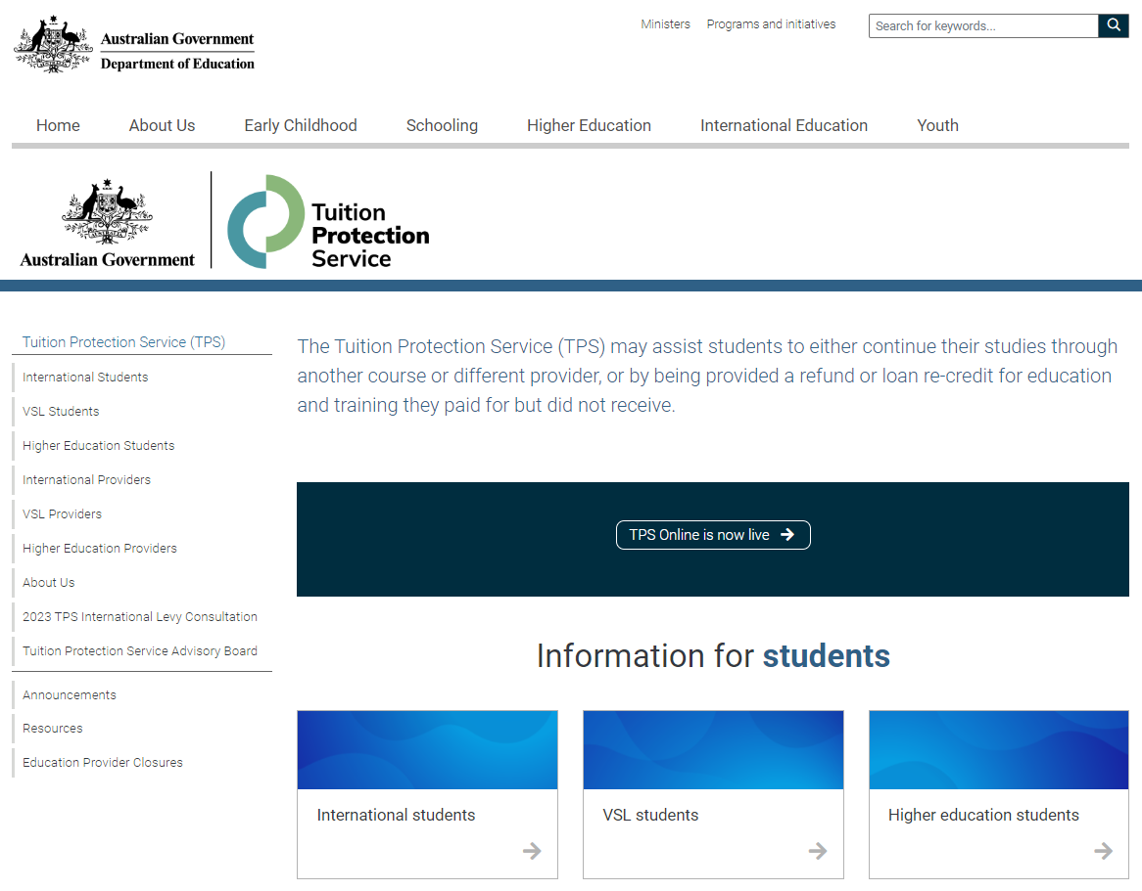
TPS website home page
For TPS Online Instructions, click on Resources and find TPS Online Step-By-Step Instructions – Eagle Academy
For TPS Online, click on TPS Online is now live
For information about The Eagle Academy closure, click on Education Provider Closures
www.tps.gov.au

Slide 10

Unspent tuition fees
Unspent tuition fees are the fees that were paid to The Eagle Academy for education or training that the student did not receive:
  If 10 weeks of tuition fees were paid and the student only attended classes for 7 weeks, the remaining 3 weeks are the unspent tuition fees.
The TPS will provide students with a refund of any unspent tuition fees that were paid to The Eagle Academy
www.tps.gov.au

Slide 11
Unspent tuition fees
A student’s refund can be deposited in:
  student’s personal bank account
  another nominated bank account (for example: a family member)
  new education provider (if student has secured a placement in an
  alternative course)
  their education agent.
If students would like their agent to receive their refund
on their behalf, students can request and return an
Authority to Act form from support@tps.gov.au.
www.tps.gov.au
Notes:
Here is where we explain the calculation of unspent tuition fees.

Slide 12
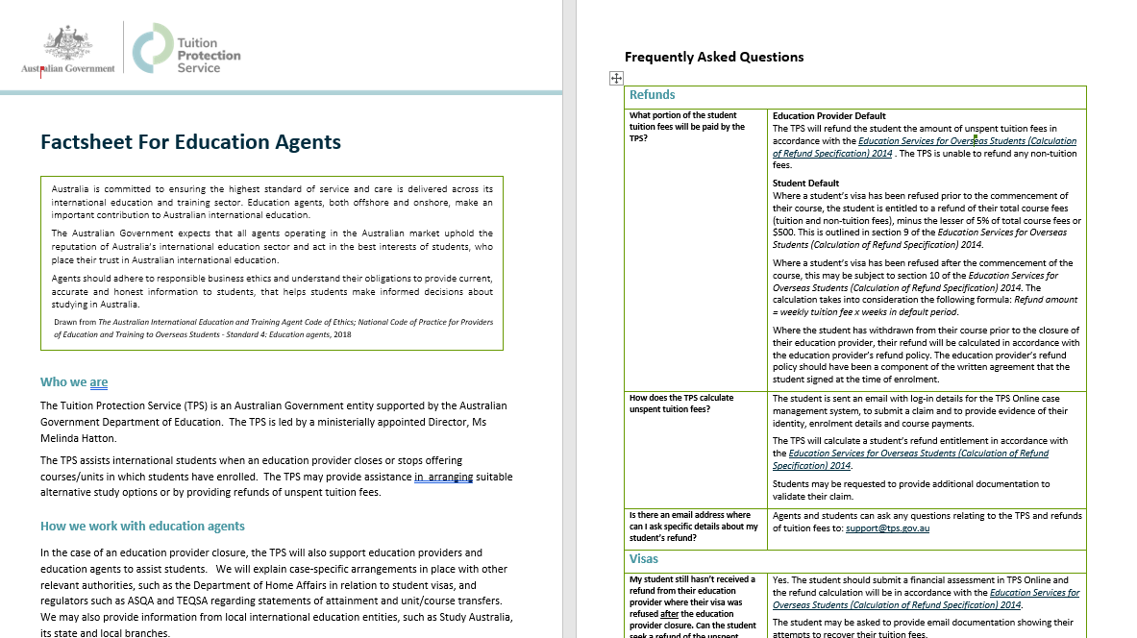
Agent Fact Sheet

Slide 13
Standard 4: National Code of Practice
Agents should adhere to responsible business ethics and understand their obligations to provide current, accurate and honest information to students, that helps students make informed decisions about studying in Australia
For more information, see:
  Australian International Education and Training Agent Code of Ethics
  Standard 4: Education agents
  National Code of Practice for Providers of Education and Training to Overseas Students 2018
www.tps.gov.au

Slide 14

Visa implications for students when their provider defaults
Visa Matters

Slide 15

Student visa requirements and provider defaults
International student visa holders must maintain enrolment in a course that is on the Commonwealth Register of Institutions and Courses for Overseas Students (CRICOS) at all times while in Australia
Students can stay in Australia on a valid student visa if they enrol with another provider to study a course at the same level
Students affected by a provider default are afforded an extended
period of three (3) months in which to finalise a new enrolment
and recommence their studies. This period does not include
genuine course breaks such as between the Christmas and
new year period.
www.tps.gov.au

Slide 16
Student visa requirements and education provider defaults
The Department of Home Affairs is aware of the Eagle Academy provider default and will be extending students’ visas on a case by case basis
If a student was enrolled at The Eagle Academy but had not yet commenced studying when the default occurred on 4 October 2022, the Department of Home Affairs will contact them to request a new CoE from another provider. Students’ applications will be assessed based on the new course they
have chosen to study.
If the student needs to apply for a further student visa, they are
able to do so without paying the Visa Application Charge (VAC)
if they apply for the visa within 12 months of the date of the
default.
www.tps.gov.au

Slide 17
Contact details for Home Affairs
For further information about student visas:
https://immi.homeaffairs.gov.au/visas/getting-a-visa/visa-listing/student-500
Queries or concerns about visa arrangements:
http://www.homeaffairs.gov.au/
Specific information on education provider defaults:
https://immi.homeaffairs.gov.au/visas/getting-a-visa/visa-listing/student-500/education-provider-default
Service Centre: telephone 131 881 (in Australia).
www.tps.gov.au

Slide 18

Australian Skills Quality Authority
Obtaining student records

Slide 19

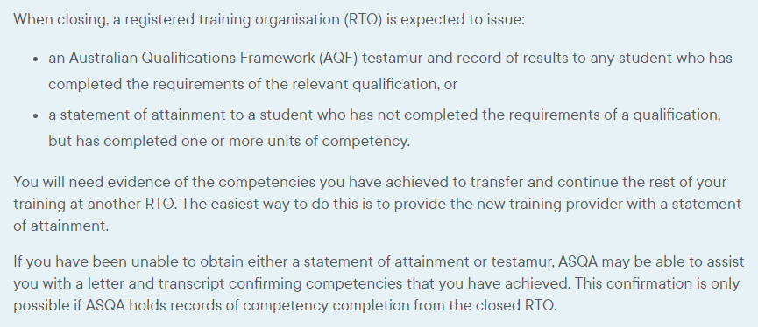
Unique Student Identifier website: www.usi.gov.au
www.asqa.gov.au/students/student-record

Slide 20
Contact details for ASQA
www.asqa.gov.au/students/how-asqa-can-help-students
www.asqa.gov.au/students/student-record
Phone from in Australia: 1300 701 801 between 9am to 7pm (AEDT) Monday to Friday
Phone from outside Australia: +61 3 8613 3910
Unique Student Identifier website: www.usi.gov.au

Slide 21


National promotion for Australian international education
State and local support network for students
Study Australia

Slide 22

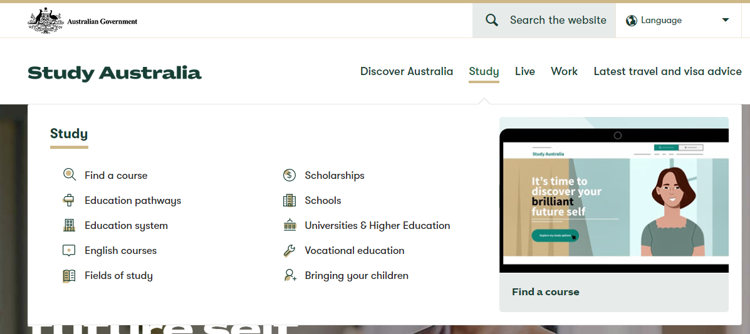

Slide 23
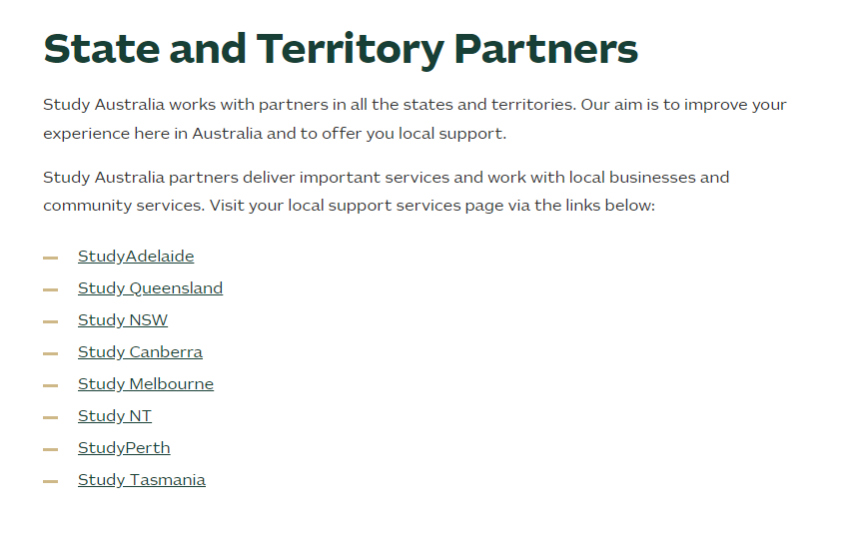
www.studyaustralia.gov.au/english/live/student-support/support-services

Slide 24



www.tps.gov.au
Contact the TPS if you have any questions or need further assistance.
support@tps.gov.au
1300 131 798
www.tps.gov.au

