Slide 1
TMG College (The Malka Group)
International Student Information Session
30 and 31 August 2022
Mirah Lambert, TPS and guests

Slide 2
Welcome and purpose of meeting
Tuition Protection Service (TPS) – Australian Government Department of Education
Visa matters – Australian Government Department of Home Affairs
Student records – Australian Skills Quality Authority (ASQA)
Study Melbourne
Questions and Answers
Workshop - Registering with the TPS Online placement system
Agenda

Slide 3

Introductions
Tuition Protection Service (TPS) team
Department of Home Affairs
Australian Skills Quality Authority (ASQA)
Study Melbourne
Notes:
Ask those present to stand up and wave as they are introduced?

Slide 4
Purpose of this meeting
Provide international students with information advice on what to do next
Inform students on how the Tuition Protection Service can assist
Present information on Visa Matters
Present information on getting a copy of your study records
Identify other assistance available

Slide 5
TMG Training and Consulting / TMG College Australia (The Malka Group Pty Ltd)
8 August 2022: TMG ceased delivering education and training
McGrath Nicol was appointed voluntary administrator
TMG then had 14 days to meet its obligations under ESOS Act, to find students replacement course or refund their unspent tuition fees
Administrator has advised TPS obligations will not be met, so TPS support is required.

Slide 6

Student consumer protection
Suitable alternative courses
Unspent tuition fees
Tuition Protection Service
Australian Government
Notes:
Mel - This is he HA PPT that we wrote, they checked and maintain and deliver.
Hopefully the HA rep will send us an updated version before Tuesday.

Slide 7
Who is the Tuition Protection Service (TPS)?
Australian Government initiative supported within the Department of Education
Student tuition fee protection scheme
Developed for international student fee protection and expanded to specified domestic students
Safeguards Australia’s reputation as education destination
Supports registered education providers to understand, meet student obligations
Supports students to transfer to alternative courses or provides refunds of unspent tuition fees
Notes:
Need to explain that once they log into the TPS online system (which we will go through later) they will see a list of providers who have courses suitable for you to continue your studies.
Each student sees a list specific to their needs.
Here is where we split the students into those who have already placed themselves = straight to refund, those who place themselves at our alternatives and have any money owing to them calculated and paid the the new provider and those who are unable to be placed for any reason (e.g. when we cease the placement period or they put a case to us why they should just be refunded)

Slide 8
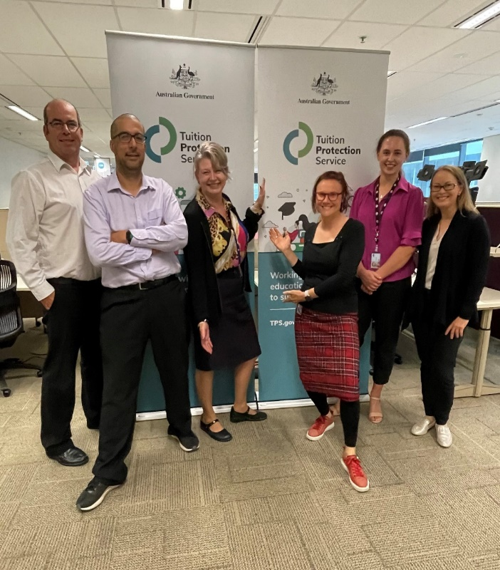
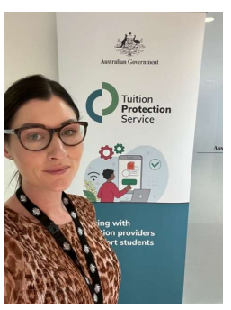
The TPS
a small team of about 14 Department of Education employees
based in Canberra
most are camera-shy, but all are ready to assist students!
Notes:
Need to explain that once they log into the TPS online system (which we will go through later) they will see a list of providers who have courses suitable for you to continue your studies.
Each student sees a list specific to their needs.
Here is where we split the students into those who have already placed themselves = straight to refund, those who place themselves at our alternatives and have any money owing to them calculated and paid the the new provider and those who are unable to be placed for any reason (e.g. when we cease the placement period or they put a case to us why they should just be refunded)

Slide 9


Tuition Protection Service - TPS ONLINE Registration
The Tuition Protection Service will be able to support you when you register a claim with us
You need to register in TPS ONLINE
We will be doing a workshop later in this meeting to step you through this process
We have a TPS ONLINE handout for you to take with you

Slide 10
Finding you a course with an alternative provider
Our priority: to help you find a new education and training provider so you can continue your studies with minimal disruption
If TPS assists you to find an alternative course, we will pay what is owed to you by TMG directly to your new provider
TPS Online contains list of suitable alternative courses at different providers nearby – many within 5-10km of TMG
You will need to contact the new provider and enrol with them. The provider will upload an offer in TPS Online that you will need to accept
Already enrolled at a new provider? TPS can pay your unspent tuition fees from TMG through TPS Online
Notes:
Point 4 - It may be worth mentioning that it all happens on paper outside the TPS Online system (letter of offer is signed and accepted by the student)

Slide 11


Unspent Tuition Fees
The Tuition Protection Service will be able to give you back your unspent tuition fees that you paid to TMG.
You may have paid tuition fees in advance to TMG…….
Paid for 10 weeks of tuition and only attended classes for 7 weeks
    …………remaining 3 weeks are your unspent tuition fees.
Notes:
Here is where we explain the calculation of unspent tuition fees.

Slide 12
Replacement course with an alternative education provider
You can continue your studies with another education provider – TPS will pay your unspent tuition fees to your new provider.
TPS ONLINE will provide you with a list of replacement courses at alternative education providers in the same location.
You will need to contact the new education provider and be enrolled with them in the TPS ONLINE.
If you have already enrolled at a new education provider, TPS can pay your unspent tuition fees with TMG through TPS ONLINE.
That
zzzzzzzzzzzzzzzzS to pay your replacement provider your unspent tuition fees. Your refund is able to be paid to either or the new provider.
If you are unable to place yourself you may still be entitled to a refund. You need to explain your situation to TPS s part of the financial assessment steps.

Slide 13

What is a “suitable alternative course”?
→ one that is the same or similar in:
type
location
cost
duration

Slide 14
Refunding your unspent tuition fees
If you do not require the TPS to find you an alternative course placement or a placement is not available, the TPS will give you a refund of your unspent tuition fees that you had paid to TMG.
Unspent tuition fees are those that you paid to TMG but TMG has not provided
    e.g. if you paid for 10 weeks of your course and only attended classes for 7 weeks, the remaining 3 weeks are your unspent tuition fees.
Notes:
Here is where we explain the calculation of unspent tuition fees.

Slide 15
Tuition Protection Service - Key steps
Sign into TPS Online to identify yourself for TPS support and to commence your claim
Notes:
Here is where you can ask if anyone has not received an email from TPS with details of a Login to the TPS online system. Anyone who has not should see one of the TPS team members up the back to check their email address in or system before they leave today.
Next we will hear from xxx from Home affairs who will tell you about what happens with your student visas.

Slide 16
Tuition Protection Service - Key steps
Make sure your correct email and mobile details are in your account in TPS Online
…we will send you important information on this email
Notes:
Here is where you can ask if anyone has not received an email from TPS with details of a Login to the TPS online system. Anyone who has not should see one of the TPS team members up the back to check their email address in or system before they leave today.
Next we will hear from xxx from Home affairs who will tell you about what happens with your student visas.

Slide 17
Tuition Protection Service - Key steps
Upload into TPS Online
Your proof of identity
Your payment documents showing your enrolment and payment of tuition fees
Notes:
Here is where you can ask if anyone has not received an email from TPS with details of a Login to the TPS online system. Anyone who has not should see one of the TPS team members up the back to check their email address in or system before they leave today.
Next we will hear from xxx from Home affairs who will tell you about what happens with your student visas.

Slide 18
Tuition Protection Service – Key steps
Find TPS website www.tps.gov.au
We will post important information for you on these pages
Notes:
Here is where you can ask if anyone has not received an email from TPS with details of a Login to the TPS online system. Anyone who has not should see one of the TPS team members up the back to check their email address in or system before they leave today.
Next we will hear from xxx from Home affairs who will tell you about what happens with your student visas.

Slide 19

Tuition Protection Service – Key steps
Contact us at support@tps.gov.au or on 1300 131 798 during business hours if you have any TPS questions
Notes:
Here is where you can ask if anyone has not received an email from TPS with details of a Login to the TPS online system. Anyone who has not should see one of the TPS team members up the back to check their email address in or system before they leave today.
Next we will hear from xxx from Home affairs who will tell you about what happens with your student visas.

Slide 20
Tuition Protection Service - key steps
Register with TPS Online to identify yourself for TPS support and to commence your claim
Make sure your correct email and mobile details are in your account in TPS Online – we will send you important information on this email
Upload into TPS Online your proof of identity and evidence documents showing your enrolment and your payment of tuition fees
Find TPS website www.tps.gov.au and the page on TMG closure – we will post important information for you on these pages
Contact us at support@tps.gov.au or on 1300 131 798 (during business hours) if you have any TPS questions
Notes:
Here is where you can ask if anyone has not received an email from TPS with details of a Login to the TPS online system. Anyone who has not should see one of the TPS team members up the back to check their email address in or system before they leave today.
Next we will hear from xxx from Home affairs who will tell you about what happens with your student visas.

Slide 21
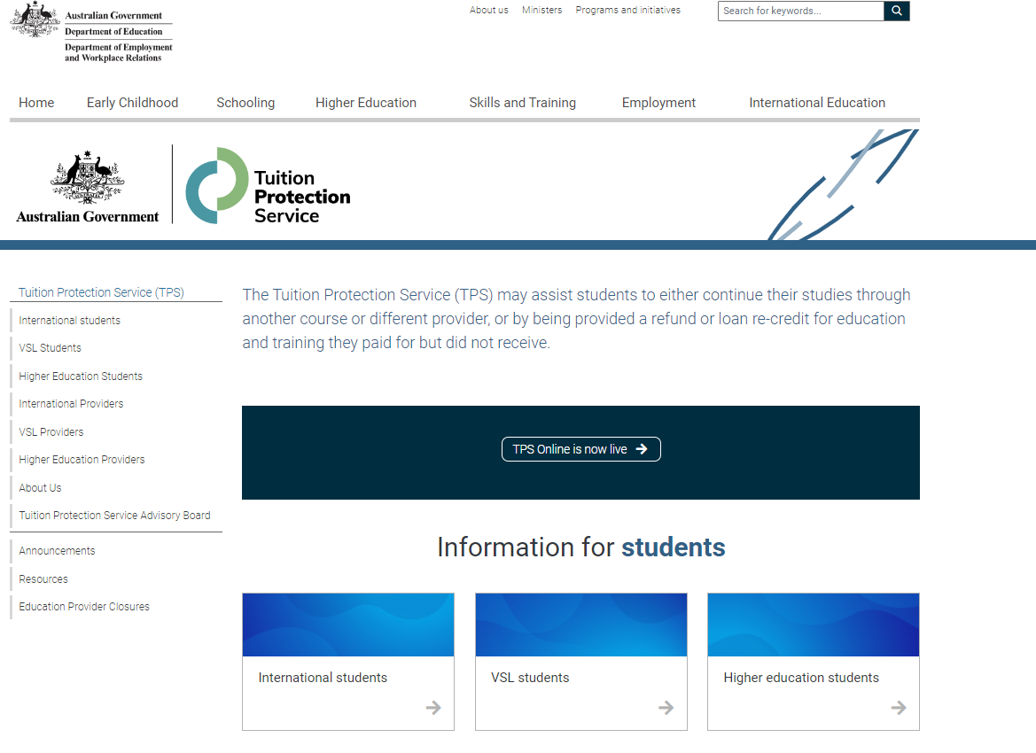

TPS Website Home Page
For information via TPS Online,
click on TPS Online is
now live
For information
about TMG closure,
click on Education
Provider Closures

Slide 22
Applications and visa status
Visa Application Charge exemptions
Contacts and further information
Visa Matters
Department of Home Affairs
Madeleine Aikenhead Assistant Director | Student and Graduate Visas section
Notes:
Mel - This is he HA PPT that we wrote, they checked and maintain and deliver.
Hopefully the HA rep will send us an updated version before Tuesday.

Slide 23
Information session on education provider closure
Department of Home Affairs

Slide 24
What will we cover?
Applications and visa status
VAC exemption
Welfare for students under 18
Contacts and further information

Slide 25
What is my status?
International student visa holders need to maintain enrolment in a course that is registered on the Commonwealth Register of Institutions and Courses for Overseas Students (CRICOS) at all times while in Australia.
You can continue staying in Australia on your valid student visa if you enrol with another provider to study a course at the same level.
Students affected by provider default are afforded an extended period of three months in which to finalise a new enrolment.
If you have a student visa application that has not yet been decided and your provider has closed, the Department of Home Affairs will contact you to request a new CoE from another provider. Your application will be assessed based on the new course you have chosen to study.
Notes:
International student visa holders need to maintain enrolment in a course that is registered on the Commonwealth Register of Institutions and Courses for Overseas Students (CRICOS) at all times while in Australia.
You can travel outside Australia while waiting to be placed with a new provider as long as you return while your visa is valid.
You can continue staying in Australia on your valid student visa if you enrol with another provider to study a course at the same level.
Where a student is no longer enrolled in a registered course, the Department of Home Affairs would normally allow 28 days in which time a student could enrol with another education provider before the Department would consider visa cancellation.
Students affected by provider default are afforded an extended period of three months in which to finalise a new enrolment.
This is in acknowledgement that consumer protection processes may take longer than 28 days and that the situation is beyond the control of affected students.
Where the consumer protection mechanisms take more than three months, Department of Home Affairs may further extend its special arrangements on a case by case basis.
If you have a student visa application that has not yet been decided and your provider has closed, the Department of Home Affairs will contact you to request a new CoE from another provider. Your application will be assessed based on the new course you have chosen to study.
We will give you a chance to enrol in an alternative course if your education provider defaults after you have applied for a student visa but before we make a decision on your application.
Respond as quickly as you can to any request from your visa processing officer.
Send us information about your new enrolment as soon as possible.
Ensure you upload your information on your ImmiAccount as soon as it is available.

Slide 26
Do I need a new visa?
Please check the expiry date of your student visa. If you require more time to finish your new course, or you move to a new course that is at a lower AQF level than your previous course, you must apply for a further student visa.
There are arrangements in place to waive the Visa Application Charge (VAC) for students affected by an education provider closure if you apply within 12 months.
  You must hold a student visa or your last substantive visa must have been a student visa.
  When you apply let us know you have been affected by a provider default and attach evidence of your enrolment with the new education provider, such as your CoE.
Notes:
Please check the expiry date of your student visa. If you require further time to finish your new course, or you move to a new course that is at a lower AQF level than your previous course, you must apply for a further student visa before your current visa expires or before you commence your lower AQF level course.
If you change to a lower AQF level course, you must apply for a new visa. If you do not, you are in breach of your visa condition and your visa may be cancelled. For example if you are changing from a Diploma level course to a Certificate 4 course or if you change from a Bachelor Degree to an Advanced Diploma they are all lower AQF moves which will require you to apply for a new visa.
The only exception is If you are changing from an AQF level 10 course (doctoral degree) to an AQF level 9 course (masters degree), you will not need to apply for a new visa.
Student visa (subclass 570-575) holders must enrol in a course in the same sector or apply for a new Student visa (subclass 500).
There are arrangements in place to waive the Visa Application Charge or VAC for students affected by an education provider closure who need to extend their stay in Australia, if they apply within 12 months.
You must hold a student visa or your last substantive visa must have been a student visa.
Your family members will only be eligible for a VAC exemption if they are included in your application, not if they apply separately.
You might also be eligible for a VAC exemption if you apply for a Student Guardian visa (subclass 590) and the nominating student is affected by provider default.
You can check your visa expiry date by using the Department of Home Affairs’ Visa Entitlement Verification Online (VEVO) service which is available on the Department’s website (link provided)
If your new course will finish after the expiry date of your current visa, you will need to apply for a new Student visa (subclass 500) before your current visa expires.

Slide 27
Do I need a new visa?
You can check your visa expiry date by using the Department of Home Affairs’ Visa Entitlement Verification Online (VEVO) service at https://immi.homeaffairs.gov.au/visas/already-have-a-visa/check-visa-details-and-conditions/check-conditions-online/visa-holders

Slide 28
Students under 18
You must maintain welfare arrangements at all times as a condition of your student visa if you are under 18.
If your education provider issued a Confirmation of Appropriate Accommodation and Welfare (CAAW) to take responsibility for your welfare in Australia, you must seek alternative enrolment immediately and make alternative welfare arrangements.
If you will turn 18 soon, you will still need to ensure you have appropriate arrangements in place until you turn 18.
Notes:
You must maintain welfare arrangements at all times as a condition of your student visa if you are under 18.
If you do not have appropriate welfare arrangements, you will be in breach of your visa conditions and your visa may be cancelled.
If you will be turning 18 soon but are still a minor at the time of closure, you still need appropriate welfare arrangements in place until you turn 18
If your education provider issued a Confirmation of Appropriate Accommodation and Welfare (CAAW) to take responsibility for your welfare in Australia, seek alternative enrolment immediately and make alternative welfare arrangements.

Slide 29
Work arrangements
Two main scenarios to consider:
  Study has started and,
  Study has not yet started.
If you were studying when the provider stopped teaching, you are currently able to work unlimited hours. This is a COVID concession and will be revisited in 2023. You should check the website regularly.
If you have not started your course as it is your first course on your Student visa, you are not allowed to work until you start studying.
If you are on a Bridging visa (BV), you will need to refer to the conditions attached to your BV regarding work and other conditions.

Slide 30
Travelling home and delays
You are able to travel home and return to Australia while you arrange your enrolment and commencement in another course. You must have a valid Student visa to enter Australia on your return.
Students affected by provider default have up to three months to finalise a new enrolment.
If it takes longer than three months to finalise your enrolment, the Department of Home Affairs may further extend its special arrangements on a case-by-case basis. You must provide relevant information for consideration.
Notes:
If you are planning to travel overseas within the three month grace period make sure all the necessary arrangement are in place re obtaining educational assessments and updating TPS and Home Affairs with their contact details etc and perhaps identify potential new providers to enrol with and seek enrolment before you travel.
You could do these activities whilst you are overseas but it could be that much harder. You will need to return to Australia before your current Student visa expires. And you need to provide a new COE within the 3 month period unless you can substantiate compelling circumstances, which would be assessed on a case by case basis

Slide 31
Further information and contacts
For further information about your Student visa, https://immi.homeaffairs.gov.au/visas/getting-a-visa/visa-listing/student-500
Queries or concerns about visa arrangements, http://www.homeaffairs.gov.au/
Specific information on education provider default https://immi.homeaffairs.gov.au/visas/getting-a-visa/visa-listing/student-500/education-provider-default
Service Centre: telephone 131 881 (in Australia).

Slide 32
Australian Skills Quality Authority
(ASQA)
Angus Boag
Kylie Stafford
Unique Student Identifier website: www.usi.gov.au

Slide 33

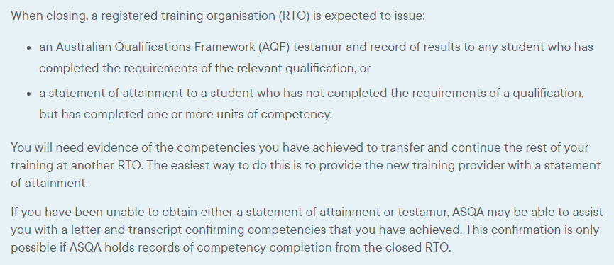
Unique Student Identifier website: www.usi.gov.au
www.asqa.gov.au/students/student-record
Notes:
Mel – ASQA will likely not have a PPT but should have good news about the Administrator issuing Statements of Attainment and how students will ne able to come to ASQA down the track for their SOAs from TMG.

Slide 34
Study
Melbourne
Andrea Brooks
Manager | Study Melbourne Student Centre
Support for international students

Slide 35
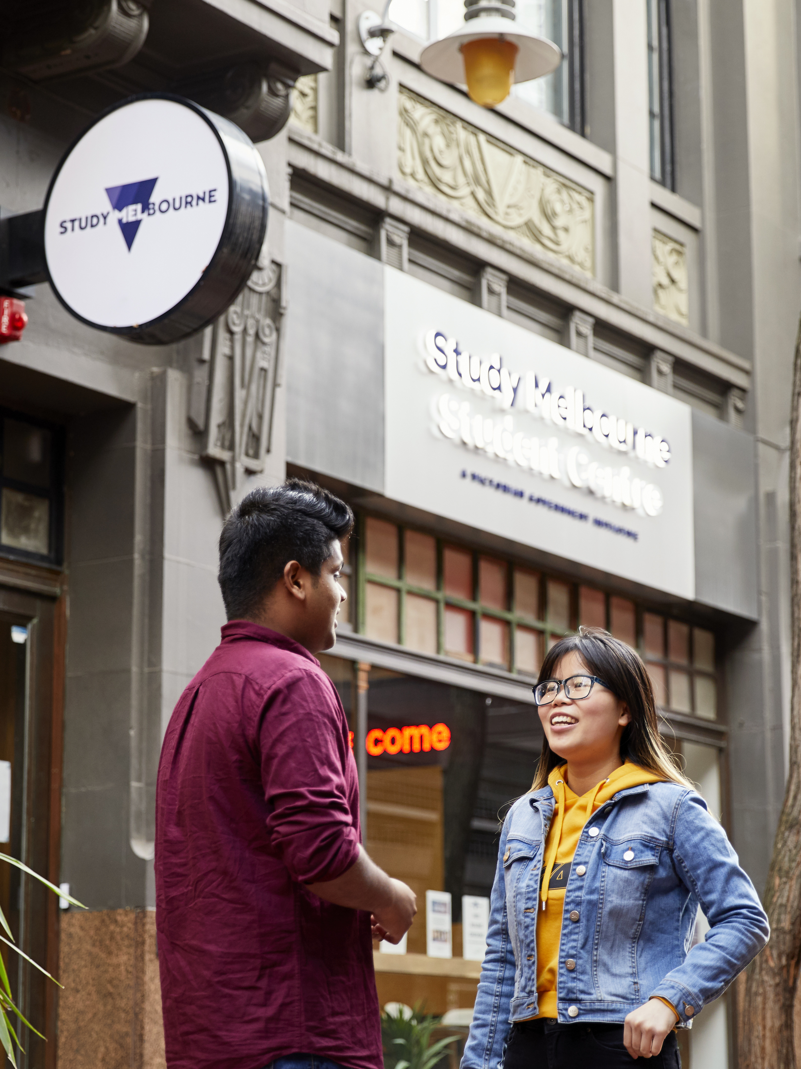
Study Melbourne Student Centre
The Study Melbourne Student Centre provides free help and support for all international students in Victoria
We support students with a range of enquiries including;
Financial Hardship
Accommodation Advice
Employment Programs
Employment and Accommodation Legal Service
Education Provider Problems
Wellbeing & Mental Health
Notes:
Study Melbourne Student Centre, located in the heart of Melbourne’s iconic laneways at 17 Hardware Lane. Currently closed but online/over the phone
Our friendly, multi-lingual staff can answer your questions about health, accommodation, student safety, work rights and managing your finances.
Note that our telephone service (1800 056 449) operates 24 hours,

Slide 36
Contact the Study Melbourne Student Centre
Contact the Study Melbourne Student Centre to speak with a caseworker.
All services are confidential.
Support is available online, by phone, and in person
Phone: 1800 049 556
Email: info@studymelbourne.vic.gov.au
Visit: 17 Hardware Lane, Melbourne
Please note: the Study Melbourne Student Centre will be offering in-person appointments from 1st September
Notes:
Study Melbourne is reopening their city location from 1 September.

Slide 37


Slide 38

HOW TO:
upload your proof of ID and payment documents
submit your claim with TPS Online
TPS Online
Workshop

Slide 39
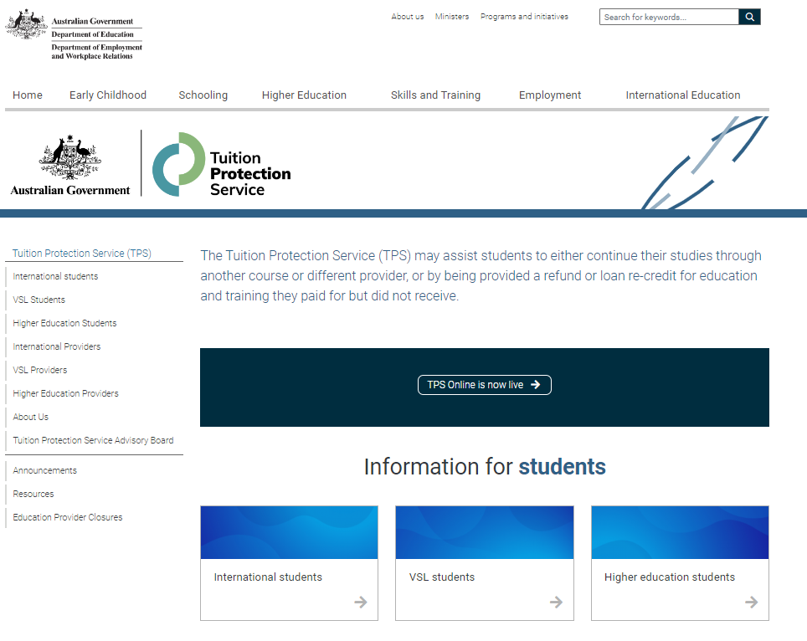
TPS website
Using the link www.tps.gov.au
will automatically direct you to
the Department of Education/ TPS website.
Click on TPS Online is now
Live to be redirected to our
TPS Online system.

Slide 40
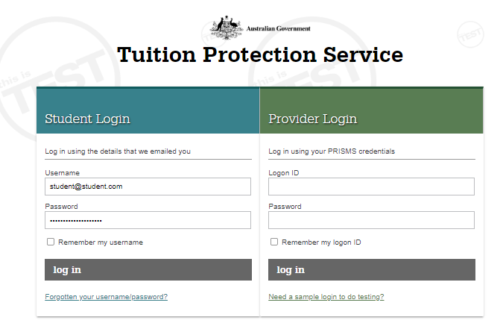
Log-in page for TPS Online
Username and password as sent to you via email from TPS Online

Slide 41
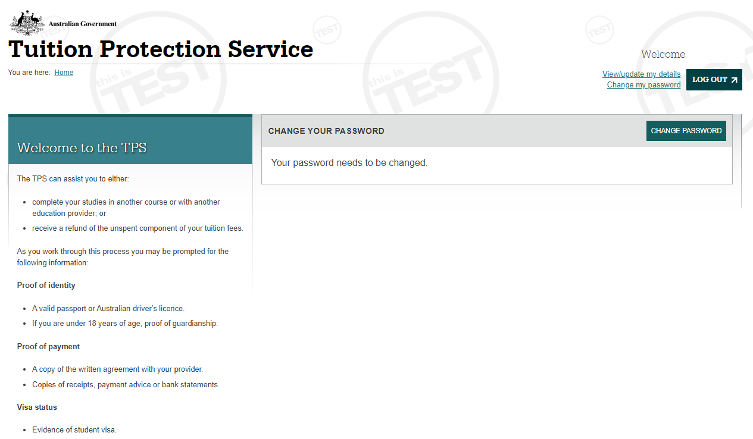
Change your password first!

Slide 42
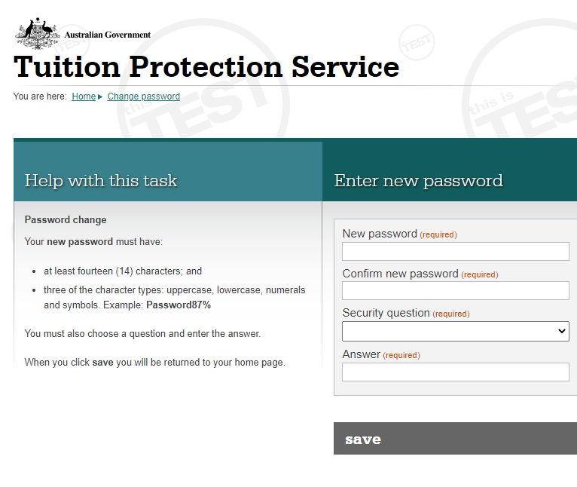
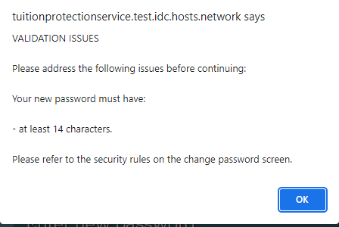
Changing your password:
Enter your new password twice
Choose a security question and answer
Save
Note: new password must have 14
characters, numbers, upper and lower case letters,
special characters e.g. !, $ or #
If your new password doesn’t meet the criteria,
you will see this message

Slide 43
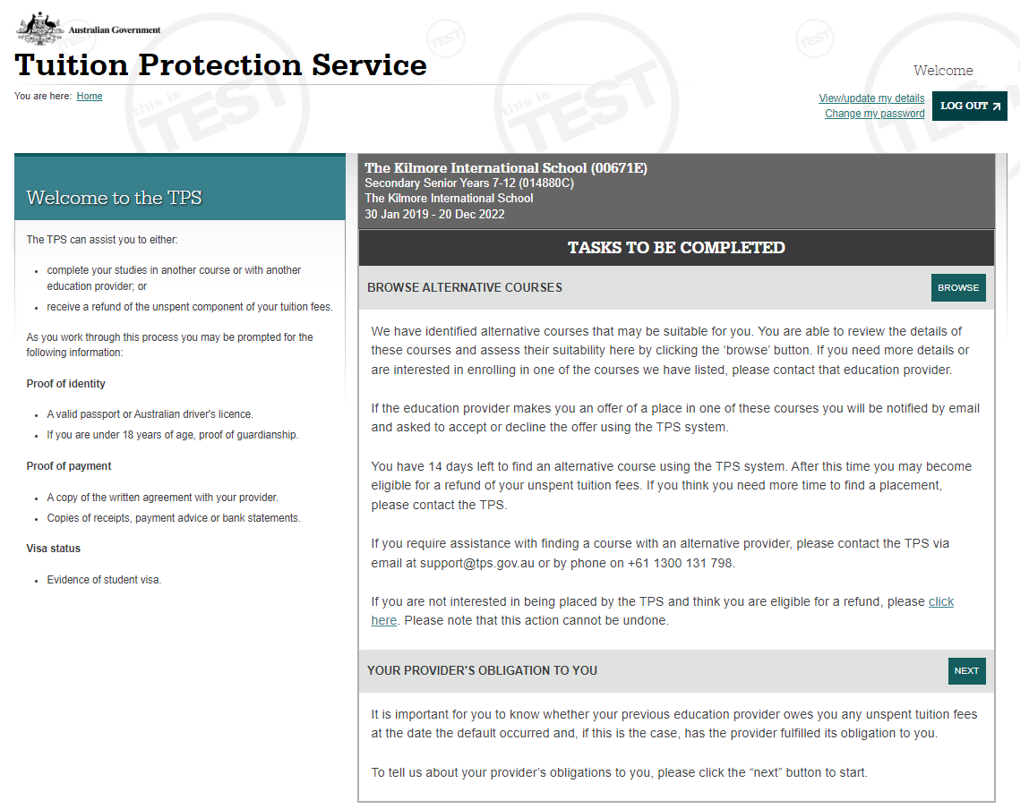
Student home page
Here you can:
browse alternative courses
start the process of recording whether TMG owed you tuition fees or not

Slide 44
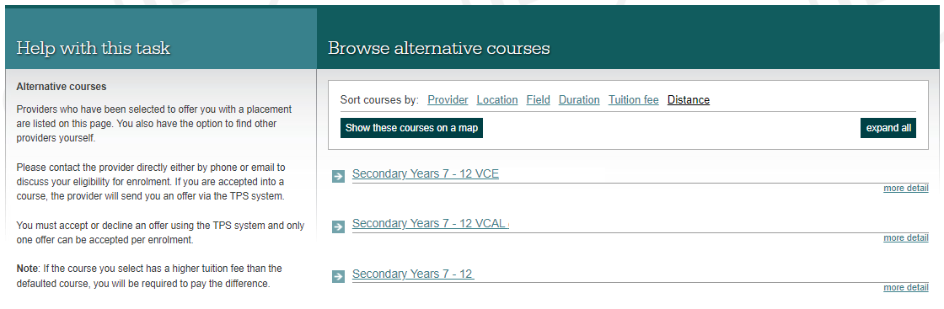
Browsing alternative courses
By clicking Browse alternative courses, a list of courses will appear for you to view

Slide 45
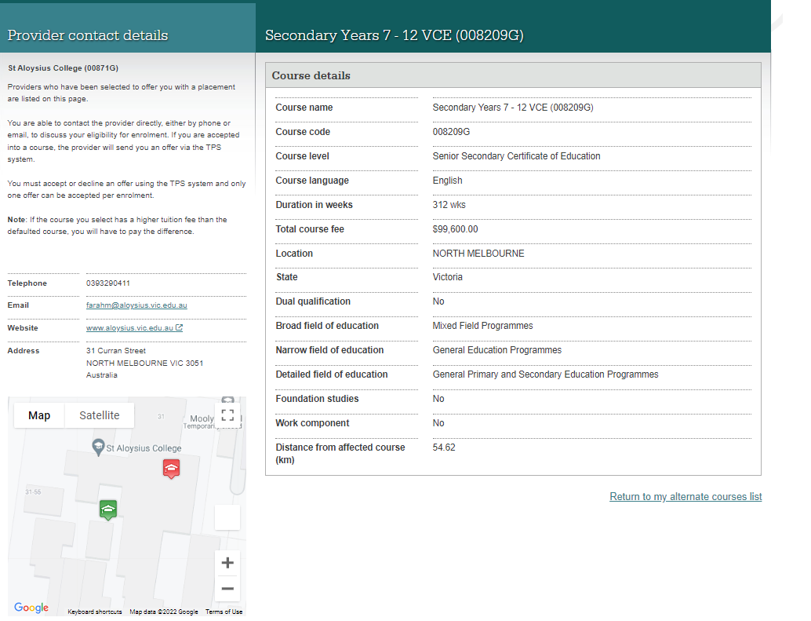
Alternative provider contact details
Click on course links to see contact information for providers in order to find out more about their courses

Slide 46
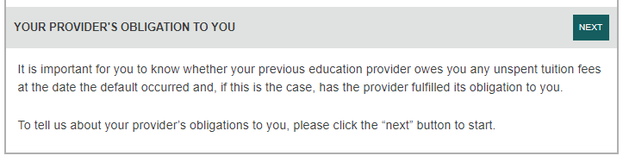
Commencing the financial assessment process
While browsing alternative courses, you can submit a financial claim.
To commence this step, click the NEXT button in YOUR PROVIDER’S OBLIGATION TO YOU
At this step, you will need to advise us if you think TMG owes you any tuition fees.

Slide 47
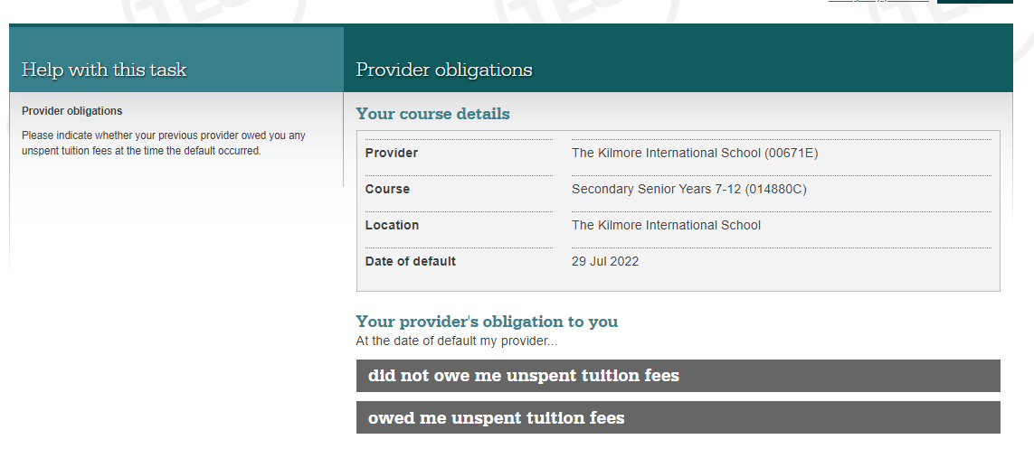
Does TMG owe you any unspent tuition fees?
On the day TMG closed, did you have any unspent tuition fees?
If you select owed me unspent tuition fees, you will progress in the financial assessment process.
If you select did not owe me unspent tuition fees, the financial assessment process will end and you can only browse alternative courses.

Slide 48
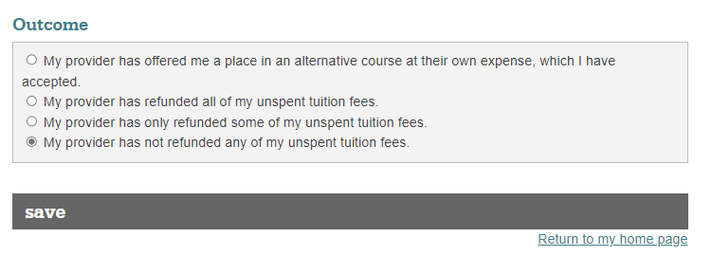
Recording the outcome of the provider obligation
In most cases you would select My provider has not refunded any of my unspent tuition.
Once you make your selection, click on the save button.

Slide 49
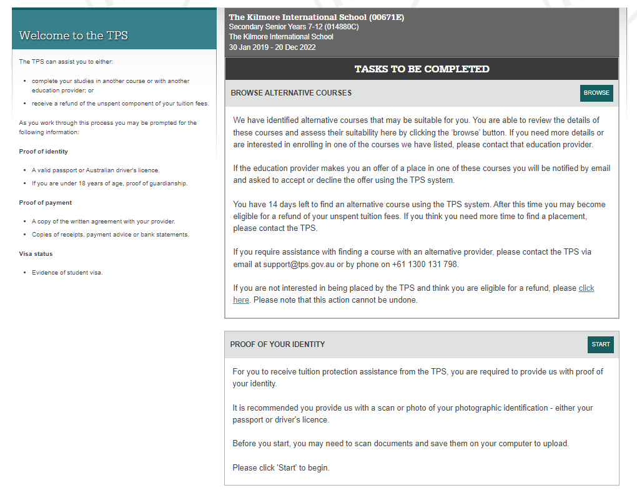
Home screen updated – Proof of Identity
Once you have indicated whether TMG met its obligations to you or not, you will then need to submit Proof of ID.
Click start to commence this process.

Slide 50
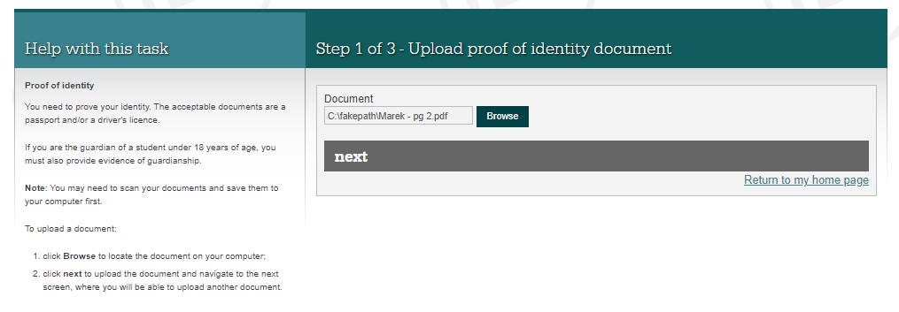
Uploading your proof of ID document
You will need to upload a photo of your passport (preferable) or driver’s licence.
You will also need to find that photo on your device by clicking browse.
Once you have found it, click ok and then next.

Slide 51
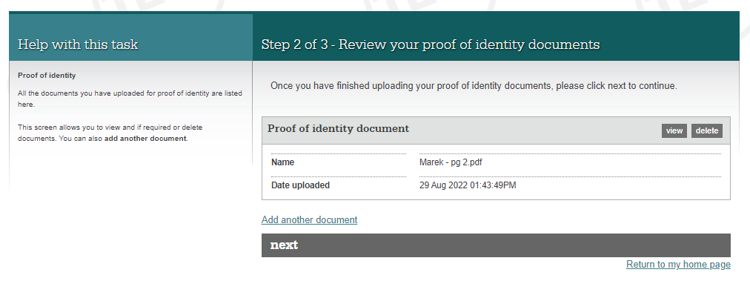
Review your proof of identity document
You can view the document you uploaded to make sure it’s the right document.
If you have uploaded an incorrect document, select delete and then add another document
If you are happy with the document, select next.

Slide 52
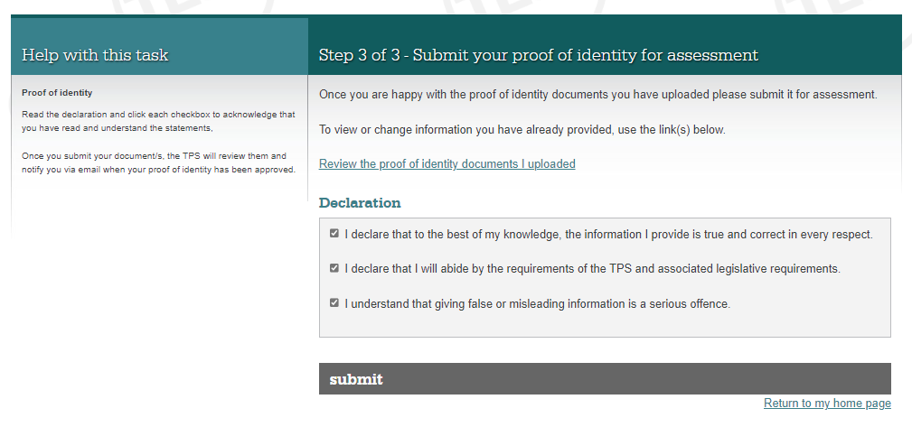
Submit your proof of identity document
Please read the Declaration and if happy to proceed, tick all three boxes and click submit.

Slide 53
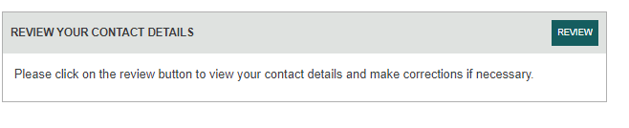
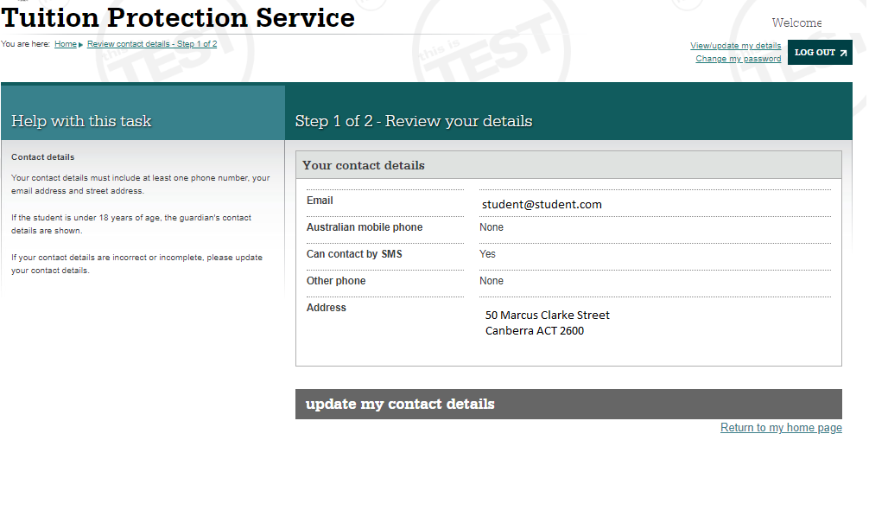
Review your contact details
Your next task will be to review your contact details in TPS Online
TPS Online will show you the details that we have in the system for you to update.

Slide 54
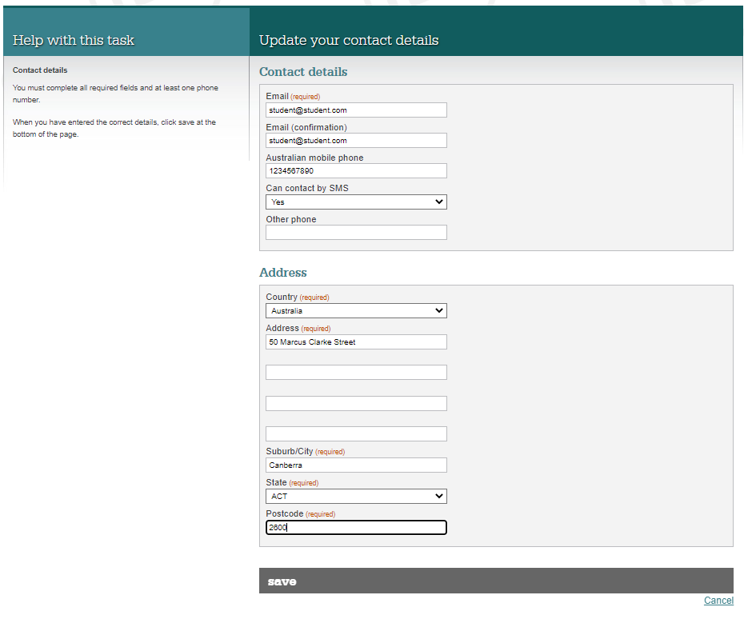
Review your contact details
update your contact details and then click save.

Slide 55
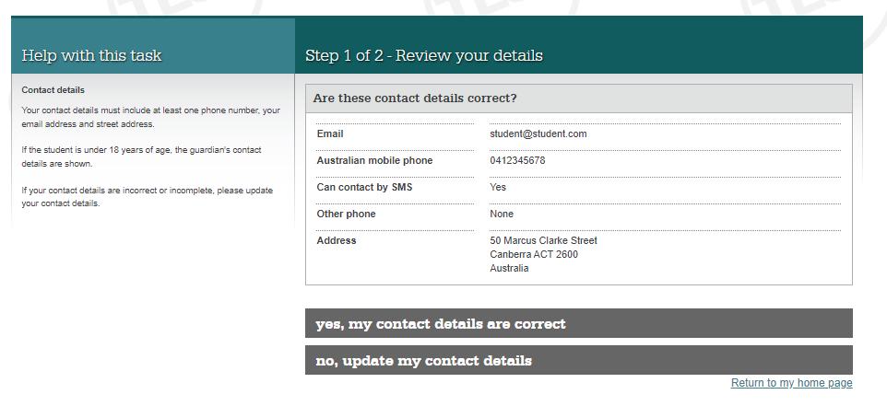
Review your contact details
Once updated, you will be asked to confirm that the contact details are correct.

Slide 56
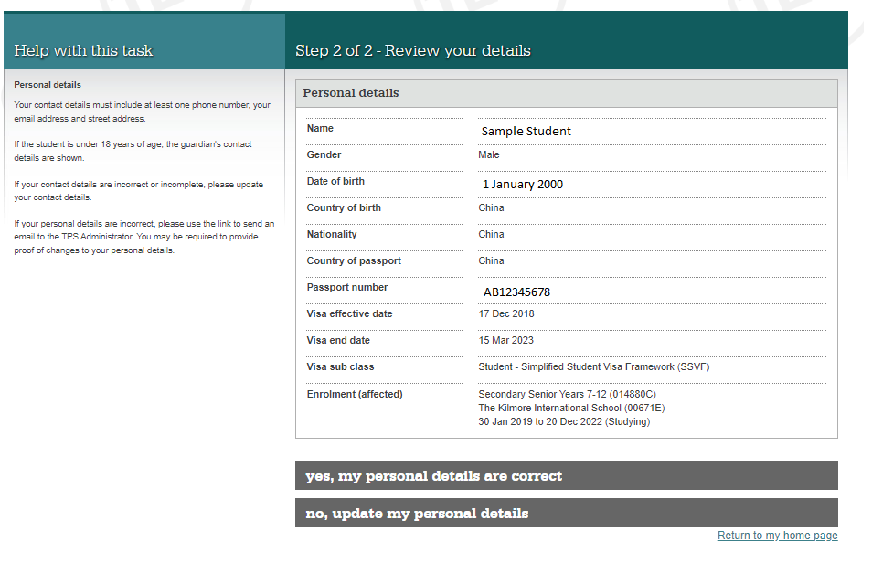
Review your contact details
If these details are correct, select yes, my personal details are correct.
If the details on this screen are incorrect, for example – passport number, click on no, update my personal details and you will be advised to send an email to support@tps.gov.au

Slide 57
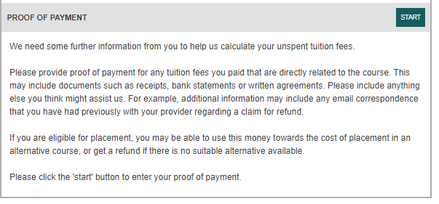
Uploading Proof of Payment
The last task we will discuss today is uploading proof of payment documentation.
Click start to commence the process.

Slide 58
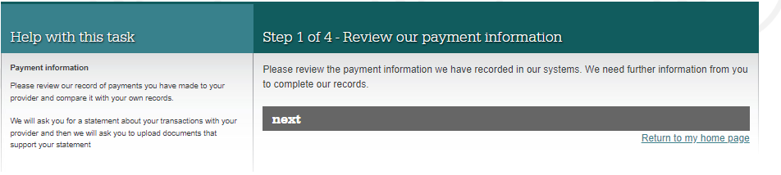
Uploading Proof of Payment
If any of your payments had been recorded in our systems, these would appear here for you to review.

Slide 59
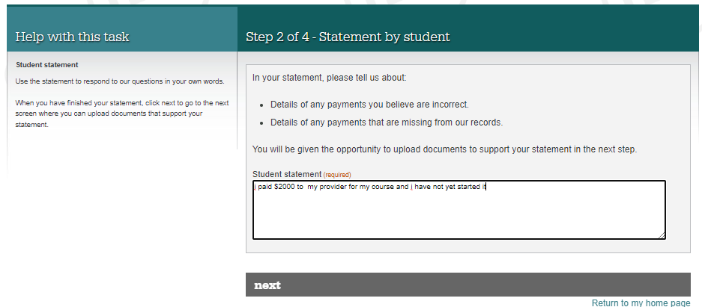
Uploading Proof of Payment
Please provide a short statement outlining all the payments you have made to TMG and a brief explanation of your individual circumstances.

Slide 60
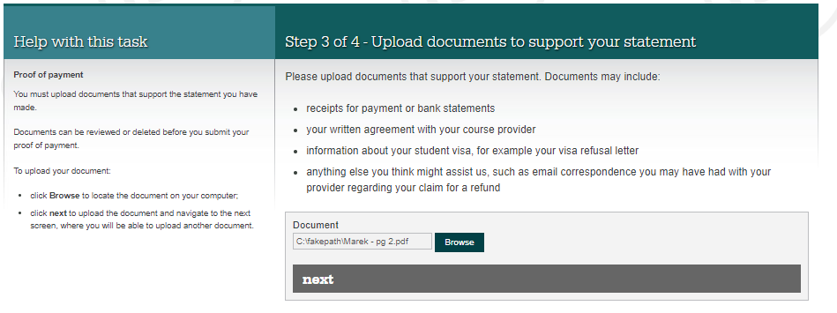
Uploading Proof of Payment
Documents to upload:
Receipts/bank statements showing payments
Written agreement
Any other documentation e.g. emails which will assist us to assess your financial claim.
Click next once you have uploaded all your documents
Notes:
Placeholder here for replacement provider screen shot and process to update with new provider details……

Slide 61
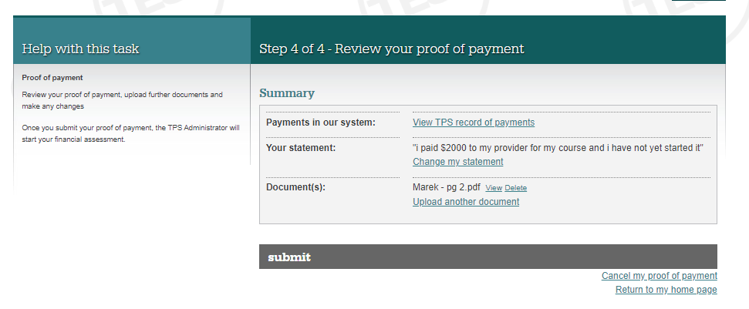
Uploading Proof of Payment
Review your items included in the proof of payment, i.e. your statement and associated documents.
Once you are happy to submit, click the submit button.
Notes:
Placeholder here for replacement provider screen shot and process to update with new provider details……

Slide 62

You need to:
Log into TPS Online
Provide proof of ID in TPS Online
Keep your email address and mobile phone details current in TPS Online
Review alternative providers list, contact them to ask for enrolment
View and accept your offer from your new provider in TPS Online
If you paid more than is showing in TPS Online, upload your proof of payment documents to support your financial assessment
Check your emails for further TPS notifications and instructions
Be quick to respond to TPS requests

Slide 63

If you have questions or need further assistance:
Stay and chat with our team members
Visit www.tps.gov.au
Contact TPS via
Email: support@tps.gov.au
    Phone: 1300 131 798
Further information

Slide 64
TMG College (The Malka Group)
International Student Information Session
30 and 31 August 2022
Mirah Lambert, TPS and guests

